Slide 1
‘Outwith guidelines’ care planning and care delivery outside an obstetric unit: outcomes and experience
Women’s Health Academic Centre
Jennifer Hattan, Julie Frohlich,
Professor Jane Sandall

Slide 2
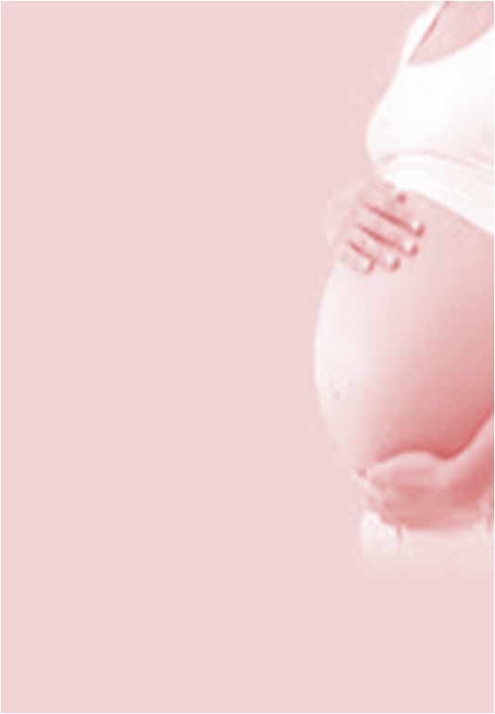
Introduction: informed choice
In the past two decades there has been high level commitment to extend informed choice to those who use UK maternity services starting in 1993 with Changing Childbirth
In 2004 the National Service Framework for Children, Young People and Maternity Services (DoH, 2004) stated:
“Every woman should be able to choose the most appropriate place and professional to attend her during childbirth based on her wishes and cultural preferences and any medical and obstetric needs she and her baby may have” (p.27)
Maternity Matters (DoH, 2007) continued this policy direction with four ‘choice guarantees’ which sought to ensure:
“Women and their partners are given the opportunity to make informed choices with an individual and flexible care plan drawn up in partnership with her midwife or obstetrician.”

Slide 3
Introduction: individualised care
In 2012 NICE published: Patient experience in adult NHS services: improving the experience of care for people using adult NHS services with 14 quality statements including:
Patients have opportunities to discuss their health beliefs, concerns and preferences to inform their individualised care.
Patients are supported by healthcare professionals to understand relevant treatment options, including benefits, risks and potential consequences.
Patients are actively involved in shared decision making and supported by healthcare professionals to make fully informed choices about investigations, treatment and care that reflect what is important to them.
In 2013, the Francis Report stated: “People must always come before numbers. Individual patients and their treatment are what really matters.”
Notes:
So women’s informed choices and individualised care are seen as important.
The question is, are we facilitating these priorities?? Are we there yet?!

Slide 4
National Maternity Review: Better Births (2016)
Every woman should develop a personalised care plan with her midwife and other health professionals
Unbiased information should be made available to all women to help them make their decisions and develop their care plan
Women should be able to make decisions about the support they need during birth and where they would prefer to give birth, whether this at home, in a midwifery unit or in an obstetric unit, after full discussion of the benefits and risks associated with each option

Slide 5
Introduction: summary
Clear that women’s informed choice, individualised care and shared decision making are key principles of high quality care
Anecdotally it is clear that some women are able to exercise choice
However, despite policy makers’ aspirations, there is still inequity of care provision regarding labour and birth care setting
There also appears to be inequity of support for shared decision making

Slide 6
Introduction: complex pregnancy
Arguably, women with a more complex pregnancy – the so called ‘high risk’ women – may have even more limited choices in our increasingly risk-averse NHS, with clinicians ‘struggling’ to reconcile women’s informed choices with their own perceptions of safety and, instead of facilitating meaningful discussions, ‘guiding’ (coercing) women to make a perceived ‘right choice

Slide 7

What did we know about place of birth?
Page 6
    Nationally
    Place of birth research suggests that for ‘low risk’ women, giving birth in MLUs is safe (Birthplace 2011)
    A number of women giving birth outside an obstetric unit were classified as ‘higher risk’ (Birthplace 2011)
    Locally
    A growing number of women sought to give birth outside the obstetric unit in the presence of known risk factors
    Little was known of the clinical processes, outcomes and motivations of these women. This study investigated the experiences of women with pregnancy risk factors who attended an ‘outwith guidelines’ care planning clinic
Notes:
Introduction and background to the clinic
Calls for identification of services associated with quality outcomes for women with higher social and medical risk
This clinic provided a source of participants for a study exploring the information needs, choices, beliefs outcomes and experiences of these women.
6

Slide 8
The ‘Outwith the guidelines’ clinic
Individualised care planning clinic run by a consultant midwife at a large central London teaching hospital with 6800 births per year
The clinic is held weekly and women are offered 45 minute appointments
The hospital has an obstetric unit (OU) for women with complex pregnancy or ‘low risk’ women who want epidural analgesia
There is a co-located MLU which has around 1400 births per year.
Home births account for around 3% of all births
Community midwifery services offer caseload or traditional care depending on area and there is also a dedicated home birth team and two ‘complex care’ midwifery teams

Slide 9
What happens during an ‘outwith guidelines’ appointment?
Women are supported to articulate and understand their priorities for care – their goals
Women’s individual risk factors are discussed and any possible associated implications are explained, including the possible associated risks of a requested intervention or care package
Women are asked about their own perception of risks and benefits in relation their individual circumstances
A labour and birth care plan is agreed and documented
The care plan is shared with other clinicians
The care plan is iterative

Slide 10
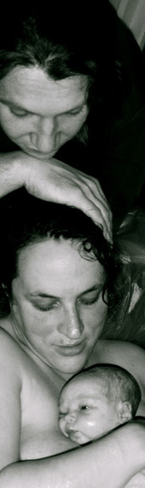
Study methodology
    Large urban maternity unit in England
    Mixed method study
    Quantitative retrospective cohort analysis of process and outcome data for all one hundred and fifty-six women
    Qualitative in-depth interviews were undertaken with a sub sample of twelve women and two of their partners and analysed using framework analysis (Ritchie and Spencer 1994).
Notes:
Descriptive statistics - SPSS

Slide 11
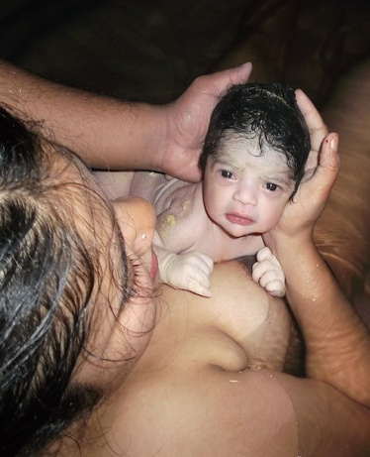
Study sample
 | Study group (range) n = 156 | Population (range) n = 13198
Age | 33.6 (21-45) | 31.6 (14-55)
Nulliparous | 39.1% | 56.3%
Ethnicity | Study group % (n = 153) | Population % (n = 13024)
White British | 43.6 | 27.6
White other | 20.5 | 23.9
Mixed | 5.8 | 3.8
Asian or Asian British | 4.5 | 4.2
Black or Black British | 19.9 | 32.2
Chinese | 1.3 | 2.3
Indian | 1.3 | 4.1
Other | 1.3 | 1.8
Notes:
Equity of access – the pushy white middle class?
Case load model
60% of the study population received case load care compared with 30% of the trust population
Is shared decision making already an element within the model of case load care?

Slide 12
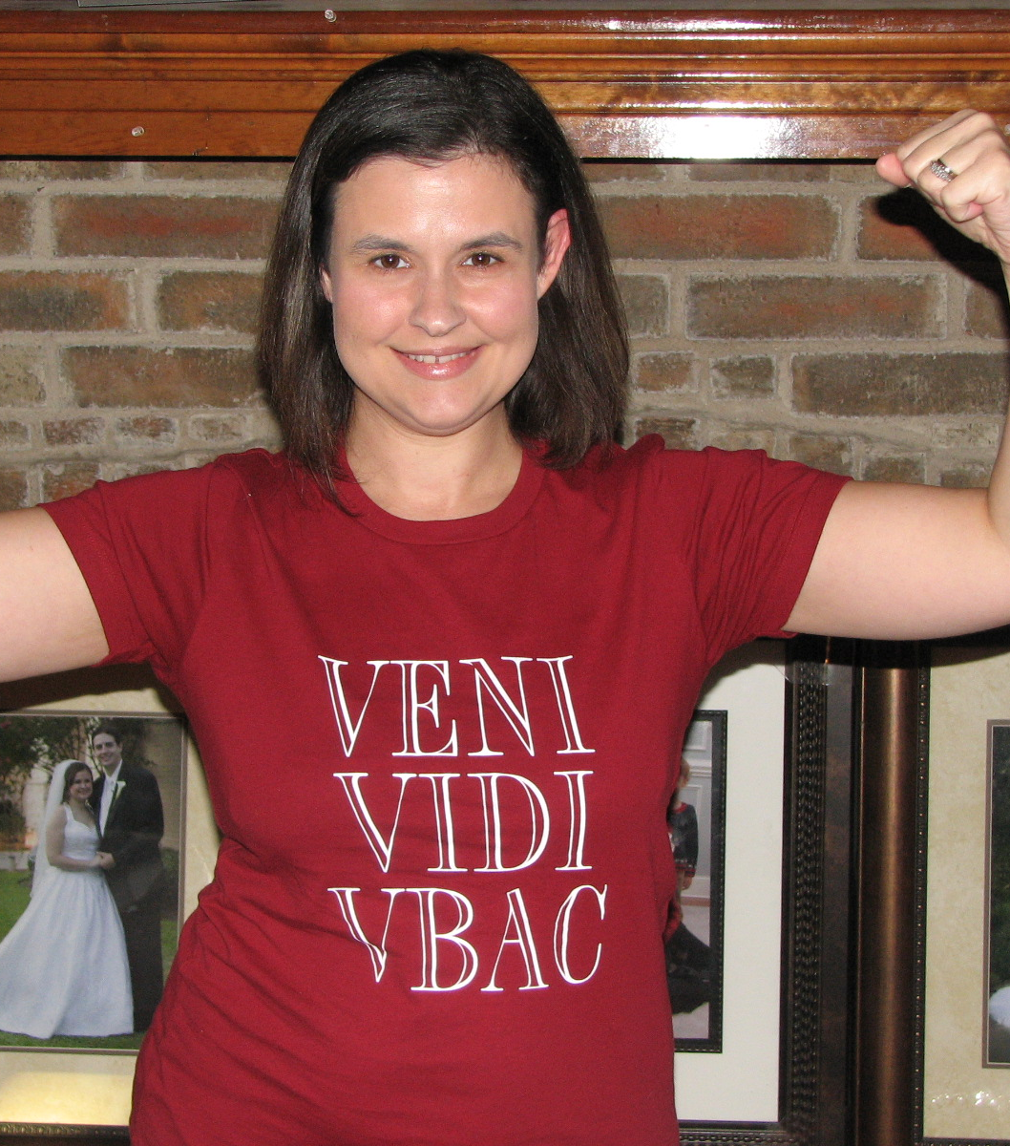
Findings
Majority of women had a single risk factor that was present at booking
Previous caesarean section was the most common risk factor.
Almost all the women were seeking to use the alongside midwifery led unit.
Just 7.7% requested a home birth.
89.5% had risk factors present at booking
10.5% were ‘low risk’ at booking but developed risk factors e.g. breech
Notes:
The majority of women had single risk factors that were present at booking, previous caesarean section (CS) being the most common. Almost all the women were seeking to use the alongside midwifery led unit (MLU). A small number were requesting a home birth.
89.5% of women had risk factors that were present at time of booking.
5.9% of these women developed further risk factors during pregnancy.
10.5% were low risk at booking but developed risk factors during pregnancy. Eg breech presentation or post dates

Slide 13
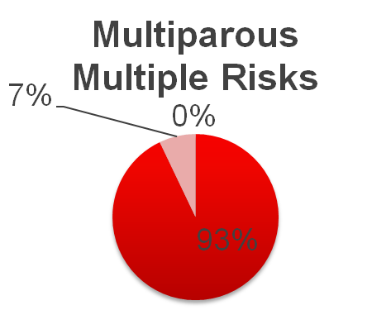
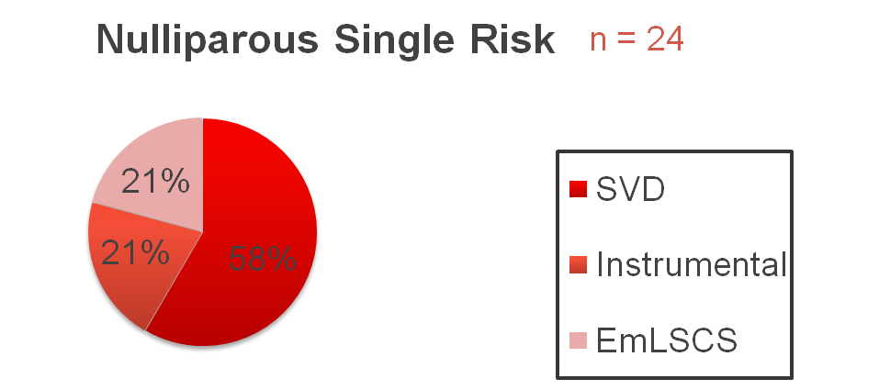
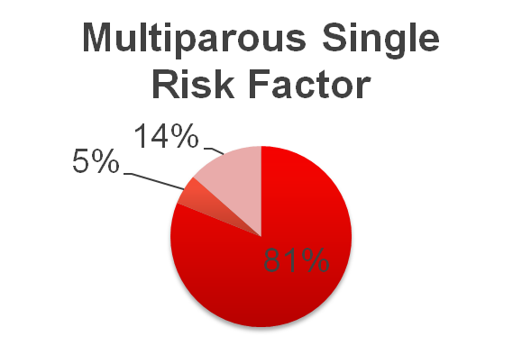
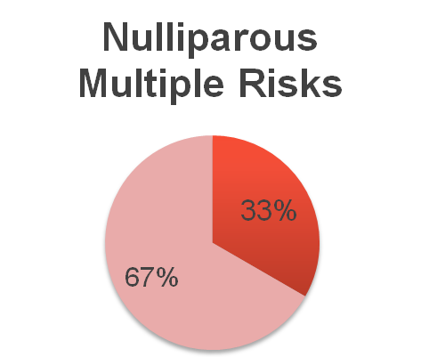
Birth Outcomes
n = 3
Transfer rate 54.2%
Transfer rate 100%
n = 37
n = 14
Transfer rate 27%
Transfer rate 35.7%
Notes:
Given the small sample size and lack of matched cases, it would be inappropriate to draw conclusions about effects of this model of individualised care planning on birth outcomes. However, there was a lower rate of CS, instrumental delivery and PPH in the study cohort.
25% of women Place of birth was changed - induction of labour the most common indication.
Women were admitted to their chosen place of birth in almost 50% of cases (n=76).
Explaining 25% of women were not admitted to agreed place of birth was beyond the scope of this study.
New risk factors? Appropriate to amend
?Operational issues or midwife confidence
However disrespectful to the woman if not
Women need to trust that we will keep our commitments
Engagement and subsequent choice of place of birth did not appear to adversely affect outcomes for themselves or their babies.
Slightly higher transfer rate in primip (single risk) compared with birth place findings
Multip single risk factor had higher transfer rate but appropriate seeing that large majority were VBAC
Multip multiple – most likely to be admitted to chosen PoB? Most outspoken/motivated?

Slide 14
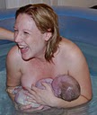
Towards a better birth and improved health for the future
Decision making of women in this study focused on their potential to ‘gain’ from giving birth in a midwifery led environment rather than any potential risks of being outside of the OU.
‘I wasn’t looking for an epidural or anything, you know, just wanted to kind of be as natural as possible and that was compatible with the [midwifery-led unit].’
(OG0010, thromboembolic disorders)
‘[Birth is] an empowering experience and it should be a positive experience. I think the more intervention that you have the more likely it is to become a really awful experience.’
(OG0007, thrombocytopenia)
Notes:
Women’s decisions focused upon the salutogenic impact of their choices.
They considered planned labour and birth on the OU did not reduce the risks associated with their conditions.
However
OU appropriate place to manage any complications should they occur.
The choices driven by the desire to protect themselves and their babies from unnecessary intervention and potential harm.
OU package of care exposed them to additional risks they wished to avoid.
The potential harm resulting from medical intervention and loss of control during pregnancy and birth was specifically mentioned by three women.
felt more involved in their pregnancy and choices around their birth plan.
Sense of control and confidence that they carried into the labour and birth.
Whilst they acknowledge risks, greater emphasis is placed on ability to give birth and birth as a natural event.
Risk managed by choosing alongside MLU.

Slide 15
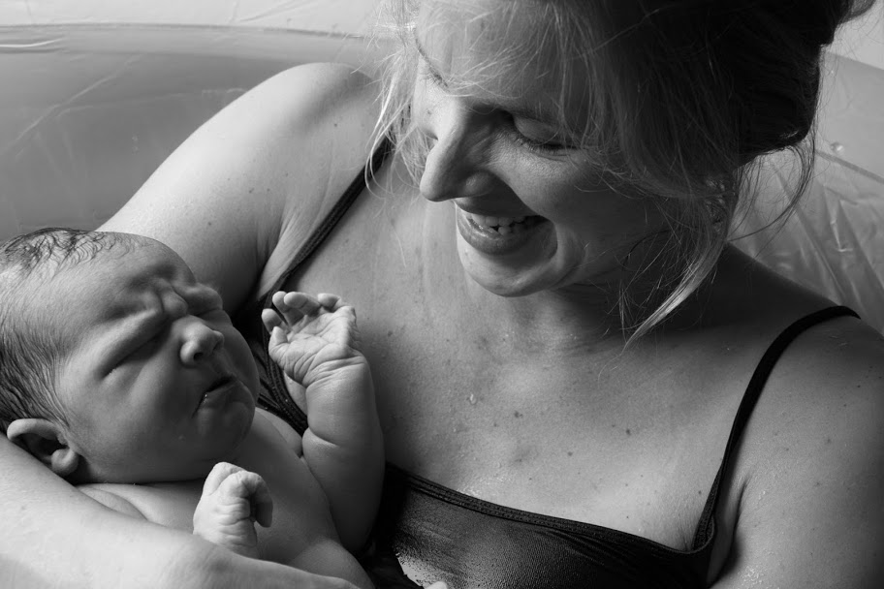
The birth environment
Women perceived the environment and culture of the OU as not conducive to a normal birth and sought to improve their experience and outcomes by labouring and giving birth outside of the OU.
‘[It] felt like we had lots of the positives from the home birth, but the safety and the kind of security that everyone deemed was necessary’
(OG0026, breech presentation)
‘It was the fact that not being able to move about if I’d had a fetal monitoring unit on me, that really concerned me.’
(OG0010, thromboembolic disorders)
Notes:
Women’s views that the environment could be enabling to a natural birth reflects a body of literature on this subject.
give themselves the best chance a natural birth.
They perceived natural birth was only possible outside of the obstetric unit (OU).
The environment, facilities and culture of the midwife led unit (MLU) appealed to the women.
There was a desire for less intervention: To avoid intervention, women felt they needed to avoid the OU.
freedom movement - limited mobility caused by CFM.
use water for labour and birth most frequently given indication for choosing the MLU.
co-located seen as mediating the risks.

Slide 16

Communicating risk
The prevalent approach to clinical decision making remains one where clinicians expect to make decisions ‘for’ rather than ‘with’ patients
‘He was likening having a [MLU] birth to crossing the M1 and taking my chances. I think I was close to tears. It just made me feel … irresponsible…they made me feel so stupid and little.’
(OG0015, multiple pregnancy)
‘When you speak to the consultants they speak to you on a kind of different level… just throwing the terms at you and not really trying to discuss it or help us understand.’
(OG0012, risk of haemorrhage)
Notes:
Findings demonstrate clinicians continue to struggle with communication of risk
Prevented women receiving the necessary information with which to make informed choices.
Women spoke of being talked at:
‘Well she wrote it down … it was almost in Latin. [Laughs] While she was scribbling away she was saying what they were going to do, it wasn’t … ‘How do you feel about this? Can we do this after this if you’re not comfortable with this?’ It was nothing like that, it was … writing, saying what was going to happen, writing, saying what’s happened … it felt like being on a conveyor belt: this comes then this comes then this comes, and I felt like, so what am I doing between all this happening to me?’ (OG0015, multiple pregnancy)
Made to feel little or silly if they had an opinion:
I think what really upset me before we saw [name of consultant midwife] was these people who looked like they’d just read a textbook, they weren’t willing to take into account that I was an educated person who had my own intuition, feelings, knowledge about the situation, there was this sort of totally anal response that if my platelet level was 100 then I was fine, if it was 99 I was about to die. They were just so rigid about it, I thought that was quite pathetic, I thought it should be left up to me to make the decision, being a responsible person.’ (OG0007, thrombocytopenia)
Some found they were given conflicting advice by different clinicians or between different pregnancies:
‘For my second pregnancy I had to go and see a consultant who told me if I had a home birth I’d bleed to death on the carpet! [Laughs] Which wasn’t particularly confidence-filling! [Laughs] … third time I went to see [name], who was really nice and explained everything … quite sensibly. He was fine for me to go to [MLU] and explained the risks … so I suppose I was far more informed the third time around.’ (OG0009, risk of haemorrhage)
An element of shroud waving was evident in several examples.
However, one woman spoke very highly of the consultant obstetrician and their first interaction:
‘He was brilliant, because he’d asked us what we were hoping for. He said, ‘OK, so your options are we could either book you in next week for elective Caesarean or I can go and see if [name of consultant midwife]’s available now to speak to. He was actually really pro-trying for a natural delivery if possible, thinking is starting to change, and yeah, telling us about the different studies about safety of breech deliveries versus electives and all that.’ (OG0026, breech presentation)
This was in contrast to an earlier conversation with a midwife sonographer:
‘She’d said the words, ‘It is your choice,’ but it didn’t feel like we really had a choice. Or it felt like if we made the choice to not have the elective caesarean it was the wrong choice. (OG0026, breech presentation)

Slide 17
Being ‘talked at’
‘Well she wrote it down … it was almost in Latin. [Laughs] While she was scribbling away she was saying what they were going to do, it wasn’t … ‘How do you feel about this? Can we do this after this if you’re not comfortable with this?’ It was nothing like that, it was … writing, saying what was going to happen, writing, saying what’s happened … it felt like being on a conveyor belt: this comes then this comes then this comes, and I felt like, so what am I doing between all this happening to me?’ (OG0015, multiple pregnancy)

Slide 18
Being made to feel ‘little’ or ‘silly’
I think what really upset me before we saw [name of consultant midwife] was these people who looked like they’d just read a textbook, they weren’t willing to take into account that I was an educated person who had my own intuition, feelings, knowledge about the situation, there was this sort of totally anal response that if my platelet level was 100 then I was fine, if it was 99 I was about to die. They were just so rigid about it, I thought that was quite pathetic, I thought it should be left up to me to make the decision, being a responsible person.’ (OG0007, thrombocytopenia)

Slide 19
Conflicting advice
‘For my second pregnancy I had to go and see a consultant who told me if I had a home birth I’d bleed to death on the carpet! [Laughs] Which wasn’t particularly confidence-filling! [Laughs] … third time I went to see [name of consultant obstetrician], who was really nice and explained everything … quite sensibly. He was fine for me to go to [MLU] and explained the risks … so I suppose I was far more informed the third time around.’ (OG0009, risk of haemorrhage)

Slide 20

No decision about me, without me
Women wanted to be part of the decision making process and sought information and advice to assist them in making informed choices.
‘She gave me all the information that I needed about risk, what she was happy for and what she wasn’t. I had a lot of confidence in her.’ (OG0009, risk of haemorrhage)
‘I thought she was just very honest and I liked that.’ (OG0004, fetal risk factors)
‘I had a lot of confidence in her straight away.’ (OG0009)
‘That was probably one of the best experiences I’ve ever had within the NHS.’
(Partner of OG0011)
Notes:
the clinic enabled women to access what they saw as unbiased, honest and fair advice,
they were equal partners
a sense of control
Women valued the use of evidence-based information,
individualised approach to the interpretation of their risks.
communication skills were commended important in gaining the women’s confidence and provided validity to the advice they received from her.
As a result of the clinic women felt able to make choices about their birth:
Women overwhelmingly positive regardless of unplanned events in labour and eventual mode of birth.
No woman/partner expressed regret about choices
Women who transferred did not see this as negative experience

Slide 21

Conclusions
The benefits of shared decision making were highly valued regardless of transfer, mode or actual place of birth.
Women perceived the culture of the OU as not conducive to normal birth and sought to improve their health, and that of their baby by labouring outside the OU
Women wanted to be part of the decision making process and to receive support and information to enable this. However, women frequently met with resistance if making the perceived ‘wrong’ choice
Success
Notes:
Future research needed to consider:
Can a model of SDM impact on quality and safety of care for women at higher risk in pregnancy

Slide 22
The range of ‘outwith guidelines’ conditions on the MLU
‘Typical’ cases:
Wanting VBAC on MLU or at home
Declining IOL at 41+5
BMI ≥35 at booking
Chronic medical condition such as: epilepsy, MS, Crohn's disease, Ehlers-Danlos, thrombocytopenia, cardiac arrhythmia, asthma, rheumatoid conditions, thyroid problems
Mental health problems
Previous or current obstetric condition such as: retained placenta/MROP, PPH requiring blood transfusion, fibroids

Slide 23
The range of ‘outwith guidelines’ conditions on the MLU
‘Atypical’ cases:
DCDA twins
Breech presentation
Benign brain tumour and blood clot on the brain
Aortic valve stenosis
IUGR (and h/o preterm birth) wanting homebirth

Slide 24
The ‘caveat’ for every labour and birth care plan
The plan is a plan and not a contract!
If circumstances change and new risk factors/concerns are identified at any stage, the plan will need to be revisited and any recommended modifications should be discussed, agreed and documented by the clinician

Slide 25
Legal aspects
http://www.birthrights.org.uk/
Human rights law gives pregnant women the right to receive maternity care; to make their own choices about their care; and to be given standards of care that respect their dignity as human beings
Women are free to make choices against medical advice and cannot be forced to accept treatment which is said to be in the unborn child’s interest

Slide 26
Further research
Further research is indicated regarding the potential impact of shared decision making around place of labour and birth on the normal birth rate and reduction of obstetric interventions for women with known risk factors.

Slide 27
Questions
How can we replicate this model of care planning in units where there is no consultant midwife?
How can we extend an individualised care planning service to all women regardless of ethnicity, socio-economic background, education, age and the presence of risk factors?
How can we support clinicians to support women to make informed and individual care choices that best meet their own unique needs?
How can we overcome a ‘guideline culture’ that views guidelines as policies?
How can we promote a more mature understanding of risk?

Slide 28
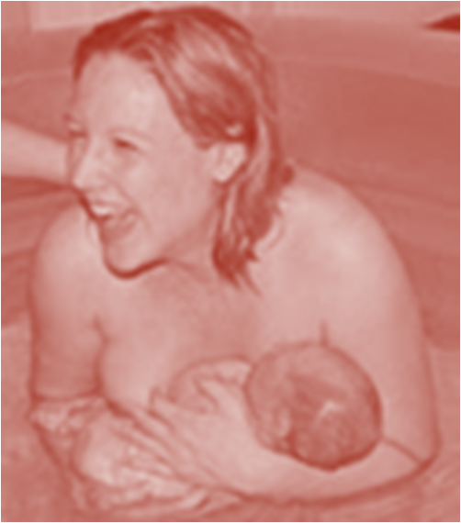
One final thought…
In the novel The unlikely pilgrimage of Harold Fry, the eponymous Mr Fry comes to the realisation that:
‘…everyone was the same, and also unique; and that this was the dilemma of being human’ (Joyce 2012:181).
This, in a nutshell, is what we as clinicians have similarly to understand if we are to have any chance at all of fulfilling women’s and policy makers’ aspirations for everyone to be able to exercise truly informed and individual care choices.

Slide 29
References
Department of Health [DH], 1993. Changing childbirth: report of the expert maternity group. London: HMSO.
Department of Health (2004) National Service Framework for Children, Young People and Maternity Services Department of Health, London.
Department of Health [DH], 2007. Maternity matters: choice, access and continuity of care in a safe service. London: The Stationery Office.
Department of Health. Equity and Excellence: Liberating the NHS https://www.gov.uk/government/uploads/system/uploads/attachment_data/file/213823/dh_117794.pdf
Joyce R (2012). The unlikely pilgrimage of Harold Fry. London: Doubleday: 181
National Maternity Review (2016) Better Births. Improving outcomes of maternity services in England. www.england.nhs.uk/futurenhs/mat-review
NICE 2012 https://www.nice.org.uk/guidance/CG138/chapter/Quality-statements
Nursing and Midwifery Council (NMC) (2006). Standards for the preparation and practice of supervisors of midwives. London: NMC. http://www.nmc-uk.org/Documents/NMC-Publications/NMC-Standards-for-preparation-and-practice-of-supervisors-of-midwives.pdf
Ritchie, J. & Spencer, L. (1994) Qualitative data analysis for applied policy research. In Analyzing qualitative data (Bryman, A. and Burgess, R. G. eds.) Routledge, London, pp. 173-194.

Slide 30
Thank you
We are deeply grateful to the women and partners who participated in the study for giving their time and sharing their experiences.
For further information please contact
julie.frohlich@gstt.nhs.uk
jennifer.hattan@nhs.net

