Slide 1
SurfON Study
Screening and Eligibility Bite size session
26th April 2023 Marie Hubbard Co-Investigator
SurfON SIV Training_ V0.1_18 April_2023

Slide 2
Study Design & Summary
Study Design
Multicentre, open-label, randomised controlled trial
Study Arms
Expectant management
Early surfactant therapy
Sample Size
1,522 infants across UK in NICUs and LNUs.
SCUs are also now included following Substantial Amendment 07 approval
Recruitment period
30 months of active recruitment was planned; Trial end date will be advised
Follow up
Remote FU with no direct contact with participants at one year of age, corrected for prematurity
Team
Study Coordinating centre – NPEU CTU, University of Oxford
Sponsor – University of Leicester
Funder – NIHR HTA Programme

Slide 3
Early, proactive management of respiratory disease will
reduce the progression to severe respiratory failure requiring mechanical ventilation
reduce length of hospital stay
reduce early hospital readmissions
reduce costs of neonatal care

Slide 4
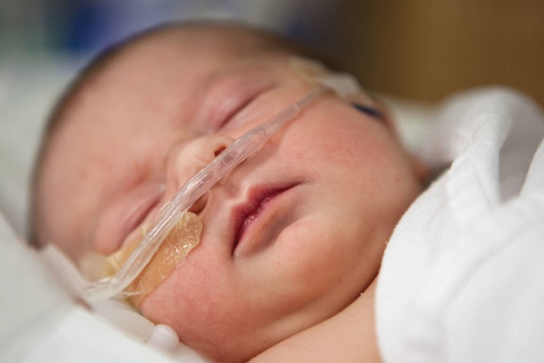
Current practice
Variable between and within neonatal units
Some clinicians treat early with surfactant to prevent deterioration
Some prefer to adopt a ‘watch and wait’ approach
No defined limits for intervention
No evidence for either approach
Both can be regarded as “standard care”
No RCTs in this group of babies
Notes:
Potential impacts of different approaches to management
Prolonged separation of mother and baby
Prolonged hospital stay
Decreased successful breastfeeding
Increased psychological stress for mother and family
Transfer for higher level of care
Higher costs of neonatal care
Long-term respiratory problems?

Slide 5
Screening and Eligibility Criteria

Slide 6
Eligibility Criteria
Inclusion criteria
Born at 34⁺⁰–38⁺⁶ weeks of gestation
≤ 24 hours old
Respiratory distress, defined as:
FiO₂ ≥ 0.3 and < 0.45 to maintain oxygen saturations SaO₂ ≥ 92%
or
Clinically significant work of breathing, regardless of FiO₂
Clinical decision to provide non-invasive respiratory support
Written parental informed consent
Exclusion criteria
Major structural or chromosomal abnormality
No realistic prospect of survival
Prior intubation and/or surfactant administration
Known or suspected hypoxic ischaemic encephalopathy
Congenital abnormality of the respiratory tract
Known or suspected neuromuscular disorder

Slide 7
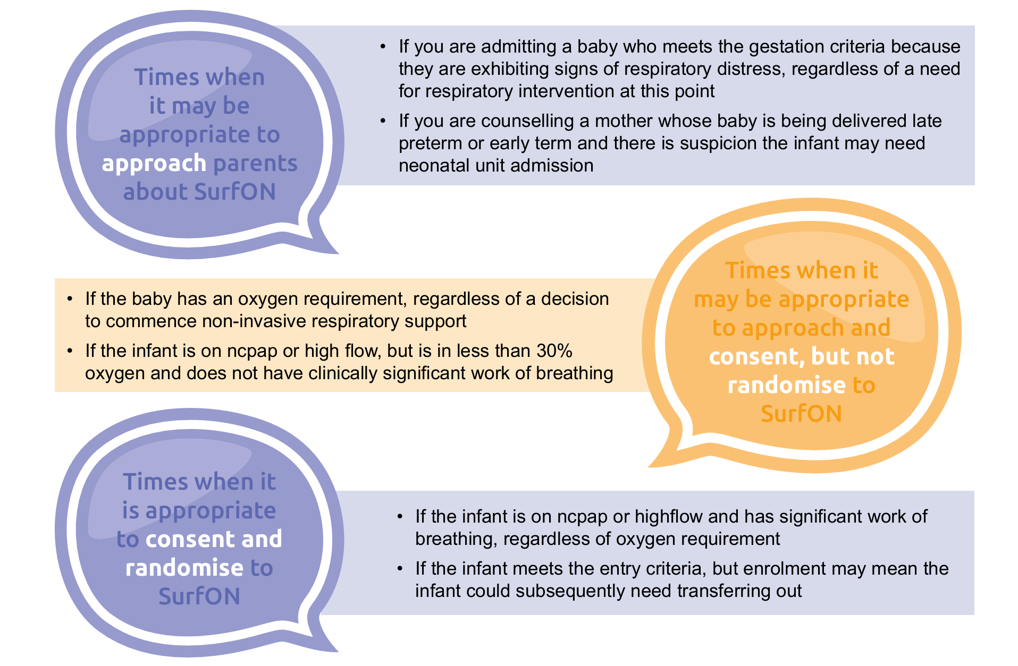
Early Approach is Key!

Slide 8
Parent-friendly Video
Please click the below link to be redirected to the video:
SurfON Introduction Podcast - YouTube

Slide 9
Screening
Please include all infants with admitted with an oxygen requirement that meet the gestation criteria on the Screening Log, even if they decline participation or don’t meet entry criteria.
Screening can be completed by any trained staff member
However, eligibility will be confirmed at the point of consent & randomisation by delegated medically trained doctor & ANNPs
Where parents do not have a good understanding of English, sites may use the translation and interpreting services, which they routinely use in clinical practice to communicate about the trial.

Slide 10
Screening and Logs
Once a month, upload summary data for those screened on the SurfON randomisation (https://rct.npeu.ox.ac.uk/surfon/login.php)
Screening log tips c/o Helen Harizaj from Medway NHS Foundation
‘We have looked at our screening logs and seen that we had 38 patients incorrectly documented as ineligible, all of these patients were on VT so all of them could have been approached and consented, whether or not they were eligible for randomisation would have depended on their level of WOB.’
Once a month, upload summary data for those screened on the SurfON randomisation website, by visiting (https://rct.npeu.ox.ac.uk/surfon/login.php), entering the site log in details and completing the screening tab

Slide 11
Early approach with parents
Please click the below link to be redirected to the video:
SurfON Early Approach - YouTube
Notes:
New slide

Slide 12
Delegation Logs
Sites who have more people on their delegation logs are achieving higher recruitment rate
Medway Maritime Hospital 24 delegates and 40 recruits
Royal Jubilee Maternity Hospital, 21 delegates and recruits 24 recruits

Slide 13
Site Success
Delegate team; strong delegate team with lots of enthusiastic trainees
Certificate and gift for the highest recruiter every month
Awareness raised at departmental monthly research meetings; opportunity for the PI to provide education, answer questions and encourage more participation
Research nurse and PI attend daily handovers and safety briefings to hear about potential participants so we approach as soon as possible.
Delegates and the neonatal team encouraged to approach early as soon as an eligible participant is admitted to offer the patient information leaflet and a delegate will return to have a chat and obtain informed consent.
PI always available on the phone to answer delegate questions and confirm eligibility of potential participants.
With thanks to Doris Iyamabo, Principal Investigator, Luton and Dunstable Hospital

Slide 14
Challenges
Attending Clinician interpretation on eligibility criteria
The PI and delegate use opportunities when there may be queries to discuss with the attending clinician and team.
Missed opportunities to recruit if no delegate available.

Slide 15
Case Study - Missed babies Marie Hubbard University Hospital Leicester

Slide 16
Case Study – Missed babies
37+0 weeks
3.7 kg
EMCS for maternal reasons
1 dose Dexamethasone prior to delivery
Pethidine, Dihydrocodeine, Oromorph and Buscopan prior to delivery for pain management
Well at birth then apnoeic at 5 mins of age
Admitted at 20 mins of age on CPAP and with respiratory distress – Intensive Care

Slide 17
Case Study - Presentation
CPAP from delivery suite
40% Oxygen weaned to 24% on admission
Sats High 90’s%
Grunting; Increased work of breathing
Other observations okay
Gases not improving (OA pH 7.12; CO2 10.2
NBM as no colostrum available

Slide 18
Case Study - Outcome
X-ray done at 2 hours showed TTN
Parents not approached as baby would be transferred out if remained on CPAP
Intubated around 9 hours of age for transfer
Surfactant not given
Intubated for 1 day and High Flow for 1 day
LOS 4 days

Slide 19
Site Experiences and any Questions?
Notes:
New slide

Slide 20
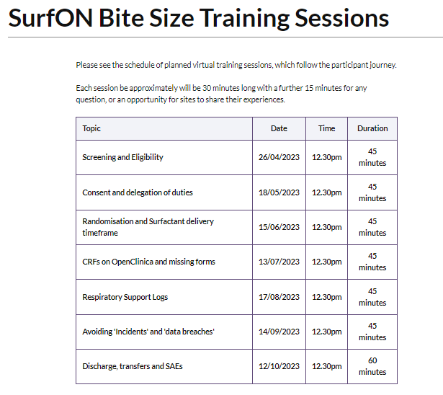

Slide 21
Thank you for listening
SurfON Study Team
NPEU Clinical Trials Unit
University of Oxford
Old Road Campus
Headington
Oxford OX3 7LF
P: 01865 289437/ 289738/ 617965
E: surfon@npeu.ox.ac.uk
ouh-tr.surfon@nhs.net
W: www.npeu.ox.ac.uk/surfon
@SurfONtrial https://twitter.com/SurfONtrial
#surfontrial
Training podcasts and further resources for use at internal training events, grand rounds etc:
https://www.npeu.ox.ac.uk/surfon/clinicians/podcasts
https://www.npeu.ox.ac.uk/surfon/clinicians/resources
https://www.npeu.ox.ac.uk/surfon/clinicians/training-materials
This study is funded by the National Institute for Health Research (NIHR) [Health Technology Assessment (HTA) (project reference 17/89/07)]. The views expressed are those of the author(s) and not necessarily those of the NIHR or the Department of Health and Social Care.

