Slide 1
SurfON Study
Delegation of Duties and Consent - Bite size session
18th May 2023 Sarah Turner Trial Manager
SurfON Bite Size Training_ V1.0_18 May_2023

Slide 2
Study Design & Summary
Study Design
Multicentre, open-label, randomised controlled trial
Study Arms
Expectant management
Early surfactant therapy
Sample Size
1,522 infants across UK in NICUs and LNUs.
SCUs are also now included following Substantial Amendment 07 approval
Recruitment period
30 months of active recruitment was planned; Trial end date will be advised
Follow up
Remote FU with no direct contact with participants at one year of age, corrected for prematurity
Team
Study Coordinating centre – NPEU CTU, University of Oxford
Sponsor – University of Leicester
Funder – NIHR HTA Programme

Slide 3
Early, proactive management of respiratory disease will
reduce the progression to severe respiratory failure requiring mechanical ventilation
reduce length of hospital stay
reduce early hospital readmissions
reduce costs of neonatal care

Slide 4
Delegation of Duties – Who?
All SurfON study staff and other clinical staff who routinely carry out study procedures or who have specific data collection/interpretation responsibilities must be included on the SurfON delegation log.
Health care professionals must be trained in their responsibilities before they are added to the delegation log. The training also needs to be recorded on the training log
Clinicians, ANNPs and nurses can obtain consent, however they must have GCP training, SurfON study training, and be delegated to take consent by the PI on the Delegation Log. This log is kept in the Investigator Site File (ISF).
The log must be completed with signed PI’s approval before an individual can start study-related responsibilities.
Notes:
Training recorded on training log

Slide 5
Delegated Staff
Figures show the more people you have on your delegation log, the more babies you recruit!
Leicester Royal Infirmary 37 people on the log and 51 recruits
Norfolk and Norwich University Hospital 17 people on the log and 36 recruits
Recent analysis of the screening logs has highlighted missed opportunities at various sites due to not having trained and delegated staff available to perform duties.

Slide 6
Delegation Logs
Store your signed, current V4.0 delegation log in your site file.
Changes in your team.
Add new SurfON staff to the delegation log and ensure is it signed by the staff member and PI before duties commence.
When staff leave, ensure their end date is recorded on the log.
Change of duties, add an end date to the previous duties, then create a new line listing current duties which needs to be signed off by the PI

Slide 7
Delegation Logs, What next?
Please send a copy of your entire delegation log (not just the amended pages) to NPEU SurfON team when you make changes.
Discuss delegation at your research meetings and use the opportunity to ensure your log is up to date.
Remember when you have staff rotation this is a key time to up date your log and share it with NPEU.
The NPEU SurfON team reference your delegation logs frequently to ensure that activity undertaken is performed by a trained and delegated individual.

Slide 8
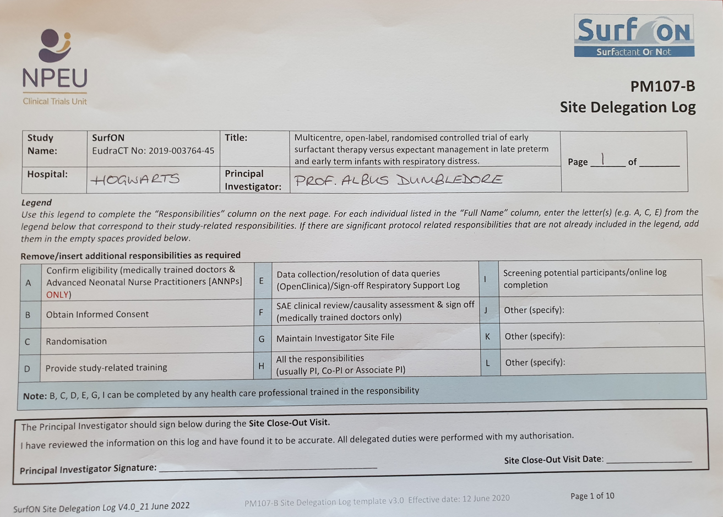
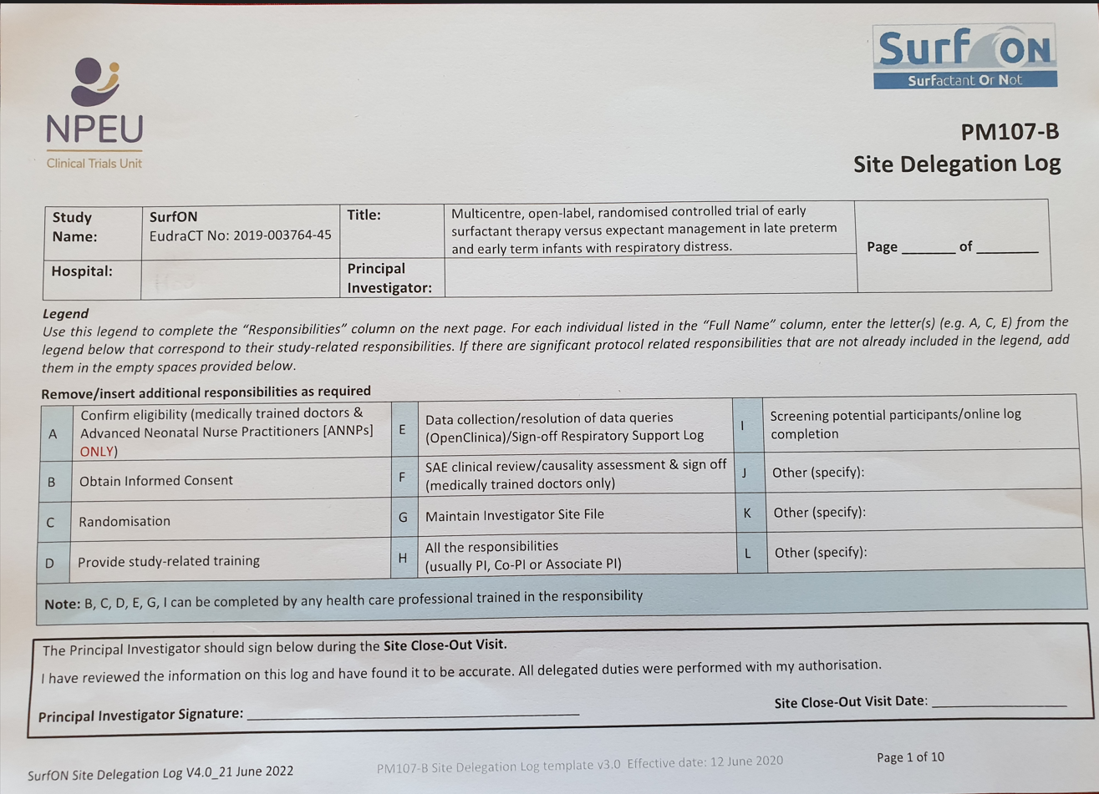
Common Delegation Log Errors?

Slide 9
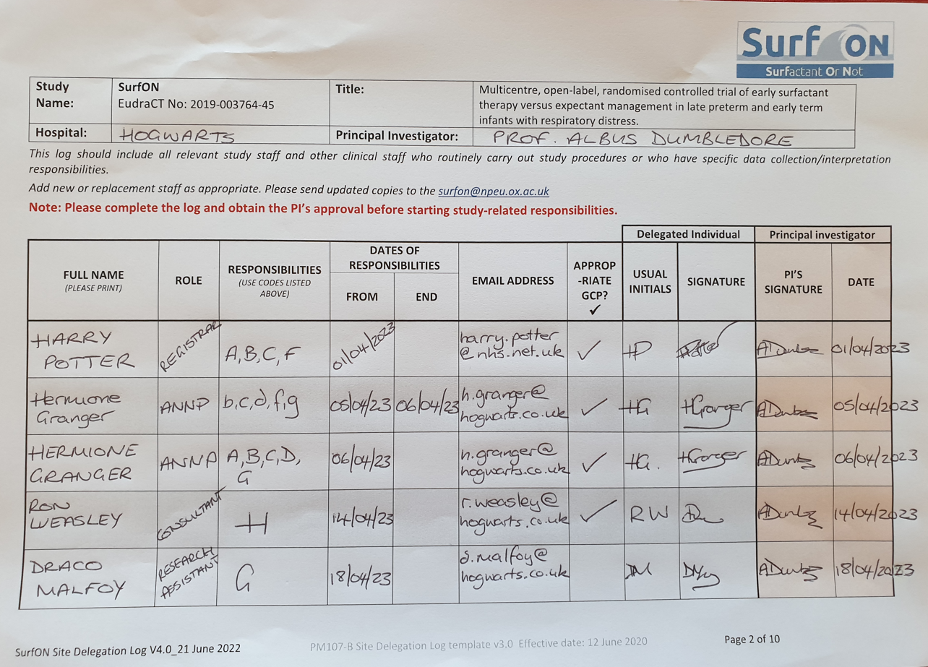
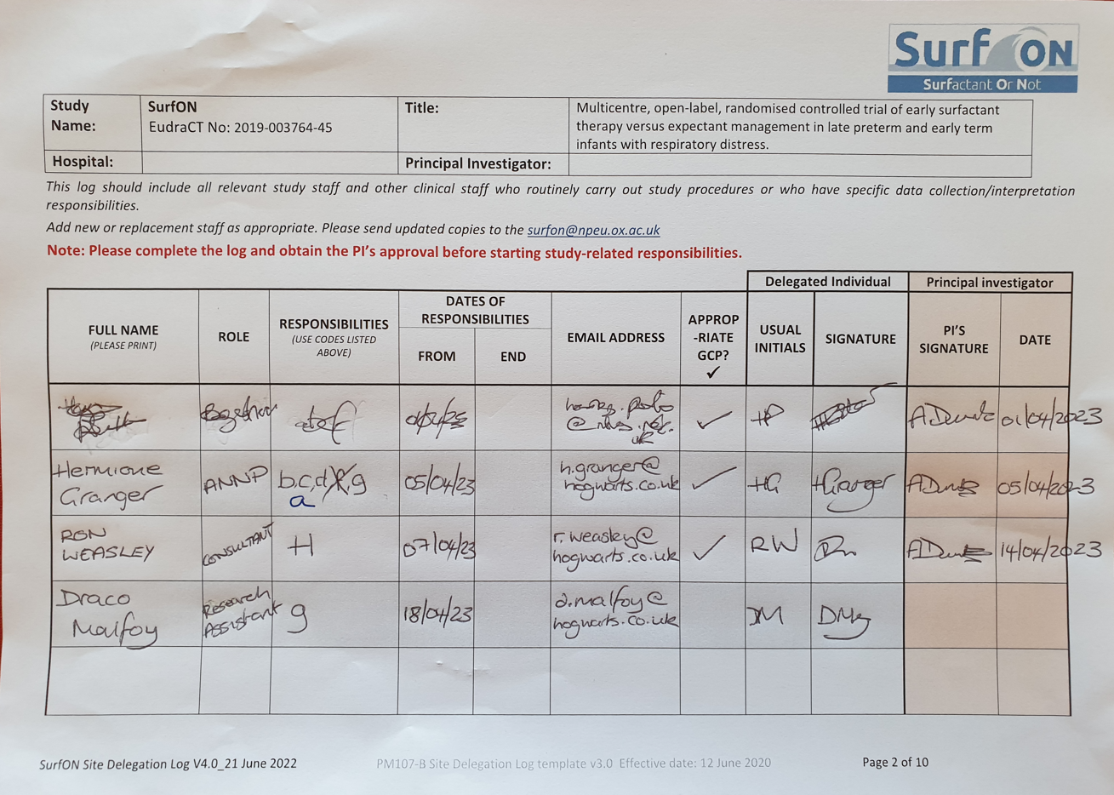
Common Delegation Log Errors?

Slide 10
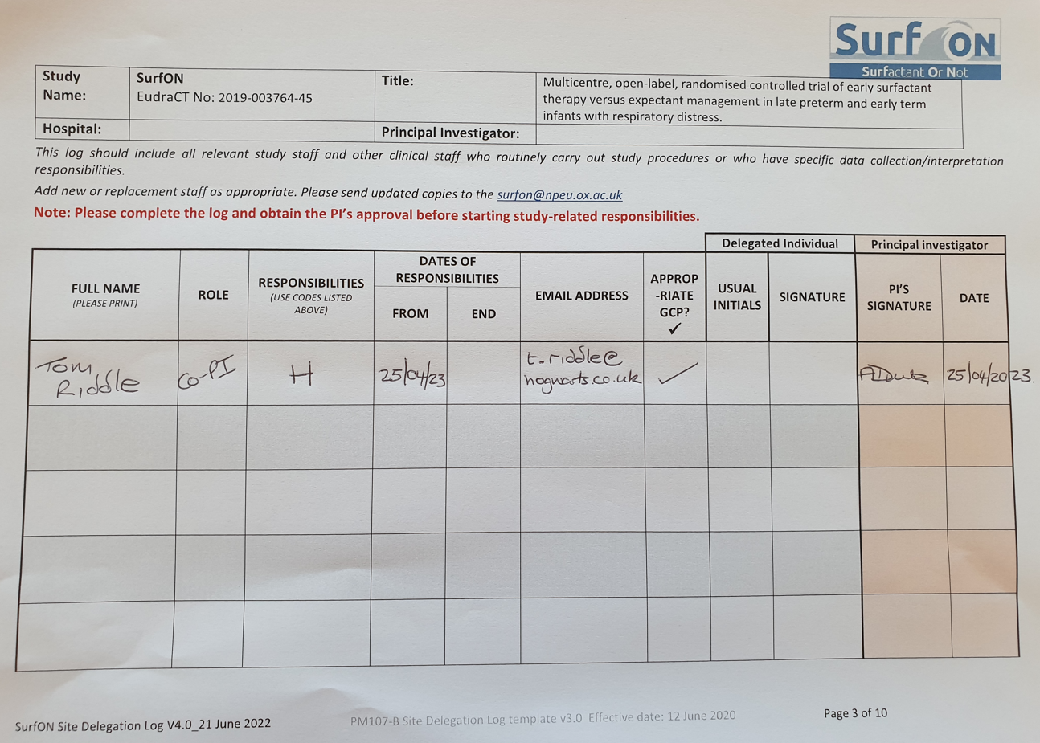
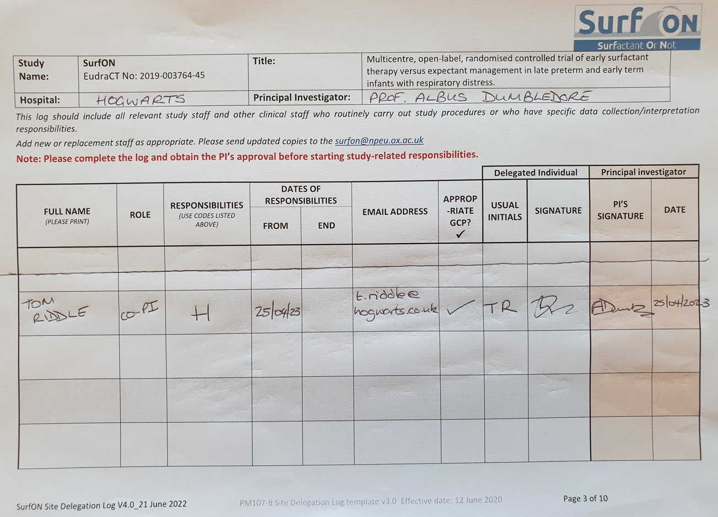
Common Delegation Log Errors?

Slide 11
Informed Consent
Consent and randomisation should be carried out ≤ 24 hours of birth.
Final assessment of eligibility of the infant for SurfON, must be confirmed by delegated clinician or ANNP at the point of randomisation.
Clinicians, ANNPs & nurses can obtain consent, but do check if this is in line with your trust policy. The staff member must be signed off by the local Principal Investigator (PI) on SurfON Site Delegation Log to perform this responsibility
Parents are made aware that participation is voluntary
Parent with legal parental responsibility for the infant must sign consent to the study. Where the mother is under 16 years of age, she may be approached for consent by the medical team, if she is determined to be competent according to the Fraser Guidelines.

Slide 12
Tips for Recruitment
Antenatal discussion
Very likely to deliver at 34-36 weeks
Not appropriate for 37-38 week deliveries routinely
Approach parents early
When baby is admitted with respiratory distress
May not necessarily meet eligibility criteria
Show the parent video
Discuss concept of study and that baby may get better quickly, but if not, may become eligible
Go back when baby meets eligibility criteria
NB. Give the baby some time to get better
Perhaps a couple of hours
But don’t wait until they have deteriorated or have been stable on CPAP for hours

Slide 13
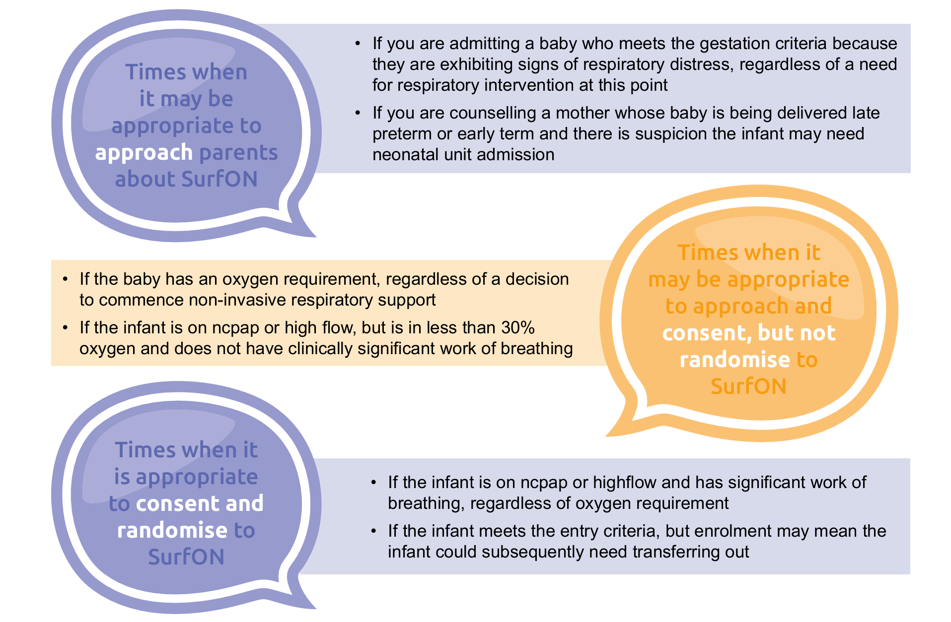
Informed Consent

Slide 14
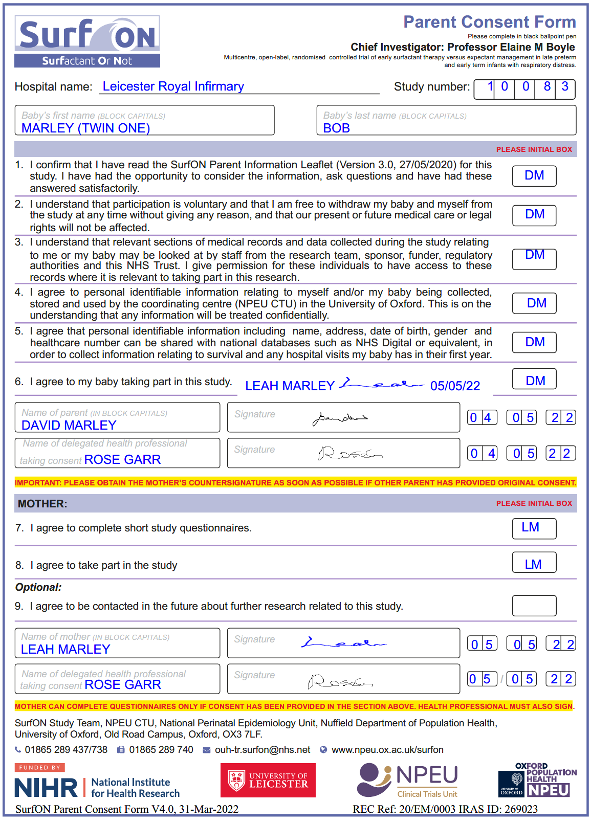
After consent, obtain a Study No from the Randomisation website and write Study No here
Differentiate between multiples (for example, infants can be named as TWIN ONE, TWIN TWO).
Where first name is not yet confirmed, write down as Baby.
V4.0 31st Mar 2022
Initial the box, not tick
Both the parent providing consent and the health professional taking consent must be on the same date.
Mother should counter-sign even if the other parent provides consent initially
Consent to complete questionnaire does not affect taking part in the main study
Optional consent and can be left blank if they do not wish to be contacted in the future
Original in the Investigator Site File (ISF); 1x copy to be given to the Parent and 1x copy to be stored in the infant’s medical notes.
Notes:
Complete the consent in block capital, in clear legible writing. The professional taking consent should through with the parent. Take advantage of translation services whether needed so as not to miss opportunities
Questionnaire completed for each infant.
If mother has completed consent please provide the trial entry questionnaire as soon as possible after consent is obtained.
Please also note the mother section can only be completed by the mother

Slide 15
After consent, obtain a Study No from the Randomisation website and write Study No here
Differentiate between multiples (for example, infants can be named as TWIN ONE, TWIN TWO).
Where first name is not yet confirmed, write down as Baby.
V4.0 31st Mar 2022
Initial the box, not tick
Both the parent providing consent and the health professional taking consent must be on the same date.
Mother should counter-sign even if the other parent provides consent initially
Consent to complete questionnaire does not affect taking part in the main study
Optional consent and can be left blank if they do not wish to be contacted in the future
Original in the Investigator Site File (ISF);
1x copy to be given to the Parent and 1x copy to be stored in the infant’s medical notes.
A clear scanned copy of the original (white copy) should be emailed
ONLY to ouh-tr.surfon@nhs.net
Please use your nhs.net or trust email id to ensure end-to-end encryption!

Slide 16
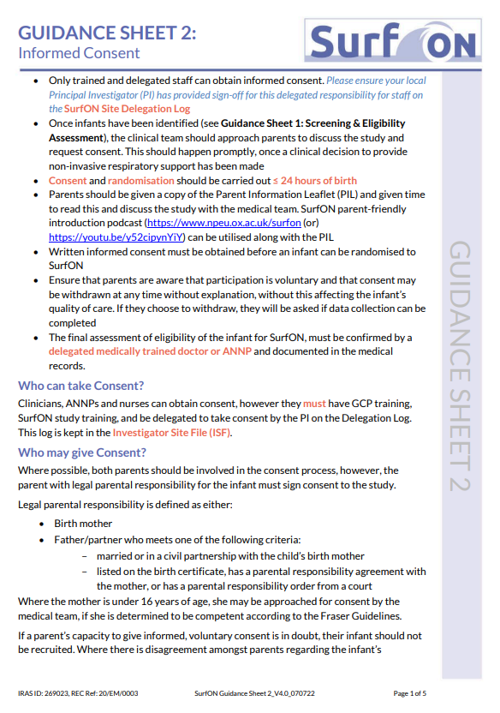
Remember guidance sheet 2 in your document box has detailed instruction, you can also access the document via the SurfON website

Slide 17
What goes wrong and why that matters
Incorrect version of consent form used (current formV4.0 31st March 2022)
The site will need to complete an incident form
Missing initials or ticks rather than initials in boxes from consenting parent
The site will need to complete an incident form
Missing consenting parent signature
The site will need to complete an incident form

Slide 18
What we get wrong and why that matters
Consenting parent and health care practitioner sign consent form on different dates
The site will need to complete an incident form
A healthcare professional has signed but is not listed on the delegation log
The site will need to complete an incident form
Sending a consent form to/from an unsecure email address
The site will need to complete an incident form and a data breach will be triggered

Slide 19
What we get wrong and why that matters
Fear not!
NPEU are working to make your life easier. We are currently trialling a new secure transfer system and look forward to launching for the SurfON trial soon.
More news to come…

Slide 20
Dr Santa Masila from Royal Preston Hospital
Recruitment success and how we work as a team
Recruitment in April and May 14 participants in four month!
Notes:
New slide

Slide 21
Any Questions?
Notes:
New slide

Slide 22
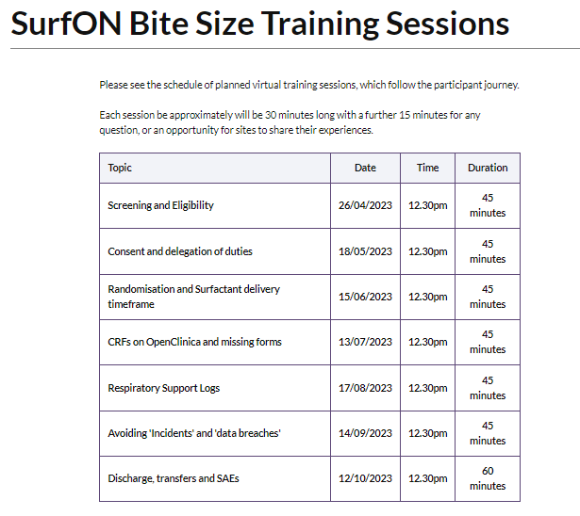

Slide 23
Thank you for listening
SurfON Study Team
NPEU Clinical Trials Unit
University of Oxford
Old Road Campus
Headington
Oxford OX3 7LF
P: 01865 289437/ 289738/ 617965
E: surfon@npeu.ox.ac.uk
ouh-tr.surfon@nhs.net
W: www.npeu.ox.ac.uk/surfon
@SurfONtrial https://twitter.com/SurfONtrial
#surfontrial
Training podcasts and further resources for use at internal training events, grand rounds etc:
https://www.npeu.ox.ac.uk/surfon/clinicians/podcasts
https://www.npeu.ox.ac.uk/surfon/clinicians/resources
https://www.npeu.ox.ac.uk/surfon/clinicians/training-materials
This study is funded by the National Institute for Health Research (NIHR) [Health Technology Assessment (HTA) (project reference 17/89/07)]. The views expressed are those of the author(s) and not necessarily those of the NIHR or the Department of Health and Social Care.

