Slide 1
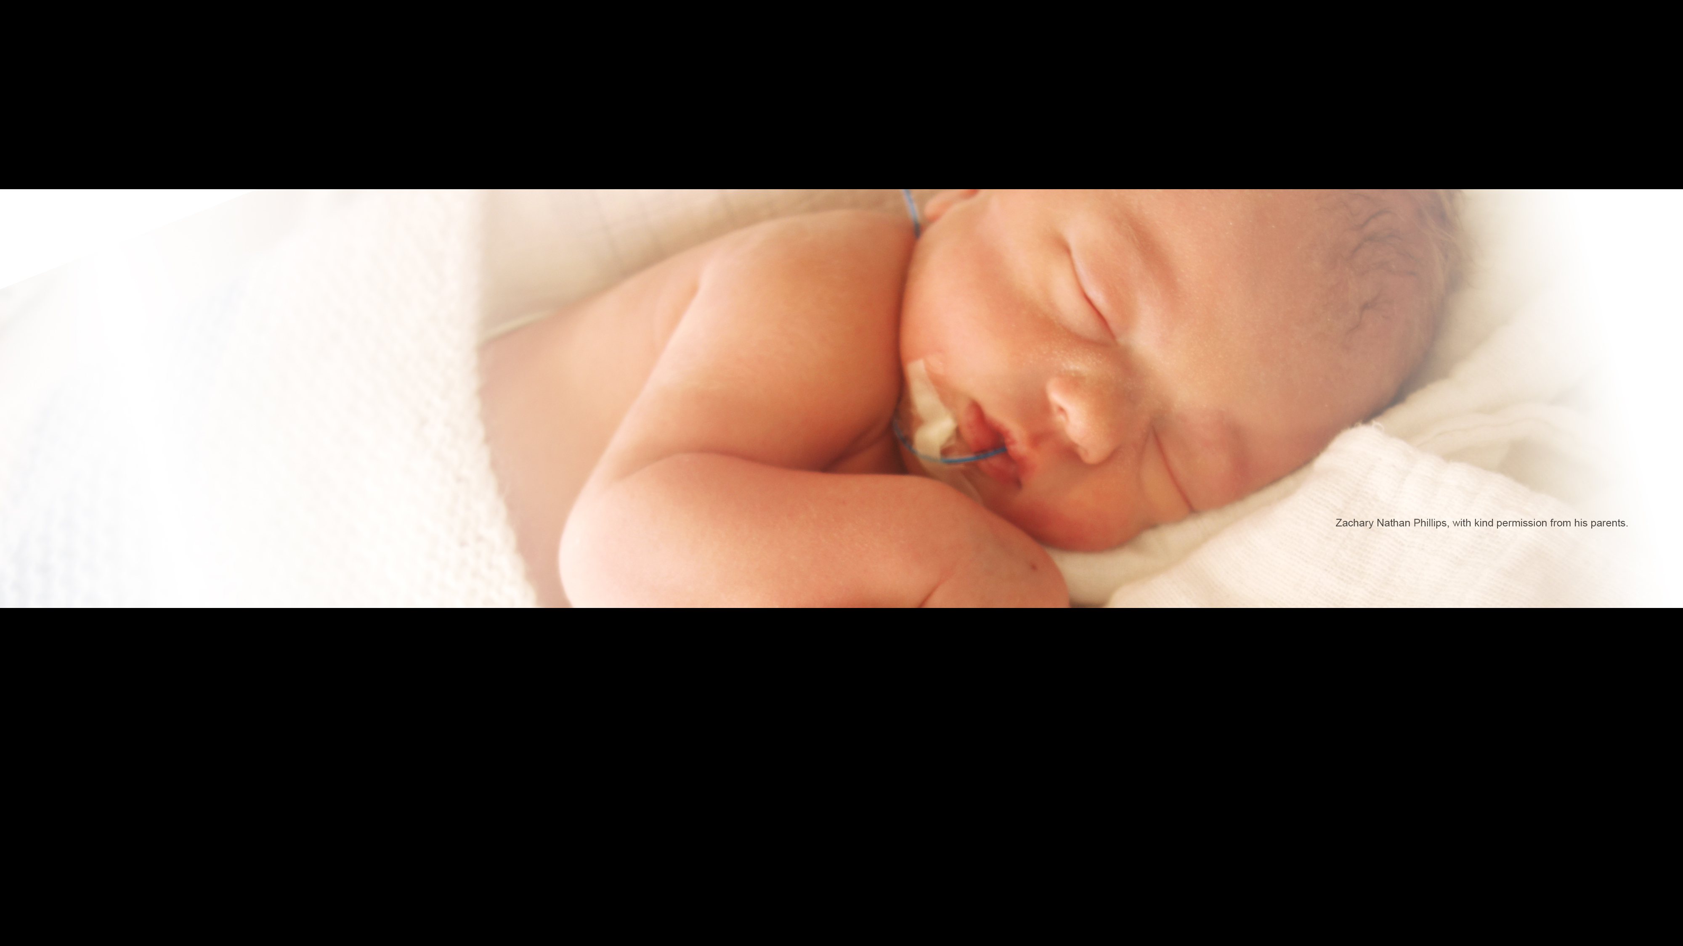


By Author Name
SurfON Collaborators Meeting 20/04/2021
Trial and Recruitment Update
Linda Mottram SurfON Trial Manager

Slide 2

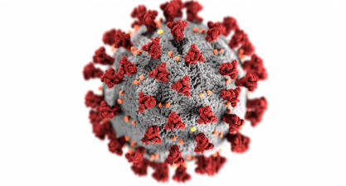
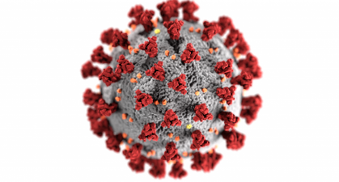

Running a study during a pandemic
The SurfON study was due to launch in March 2020
However, COVID-19 had a different agenda!
Despite this Leicester General Infirmary launched on 2nd September 2020
Recruited their 1st participant 3rd September!

Slide 3
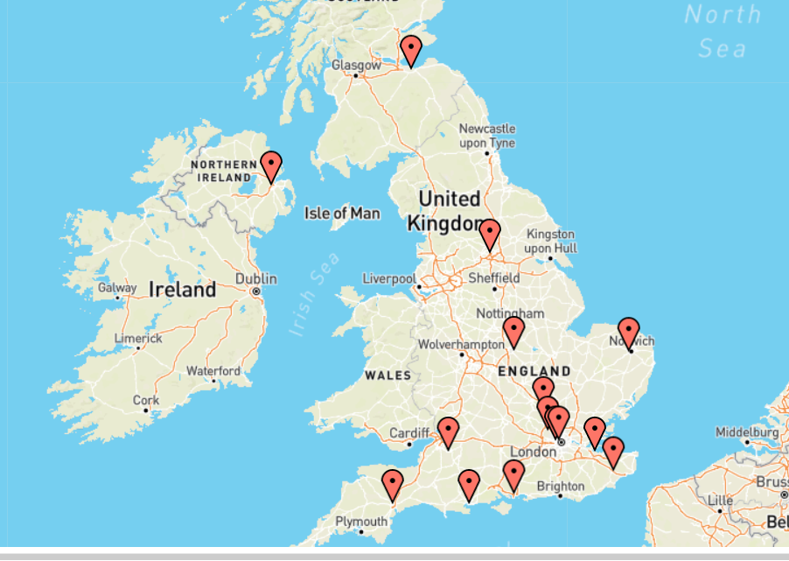
15 sites – Total 45 Recruits

Slide 4
15 sites now open to recruitment!
Leicester General Infirmary
William Harvey Hospital, Ashford
Royal Maternity Hospital, Belfast
Royal Infirmary of Edinburgh
Norfolk and Norwich University Hospital
Queen Alexandra Hospital, Portsmouth
Watford General Hospital
8) Poole Hospital
9) St Mary’s Hospital, London
10) Queen Charlotte’s & Chelsea Hospital, London
Medway Maritime Hospital
Leeds General Infirmary
13) Royal United Hospital, Bath
14) Luton & Dunstable University Hospital
15) Royal Devon & Exeter Hospital

Slide 5

Sites opening soon!
Heartlands Hospital, Birmingham
James Cook University Hospital
Royal Victoria Hospital, Newcastle
Kings College Hospital, London
Diana Princess of Wales, Grimsby
Ninewells Hospital and Medical School, Dundee

Slide 6
Site opening schedule
Our target was to open 3 sites per month until we reach our target of 35
Due to the second wave of COVID and many Trusts pausing opening to non-COVID trials we were unable to open any sites during January and February this year
Things seem to be improving now with 4 sites opening in March

Slide 7
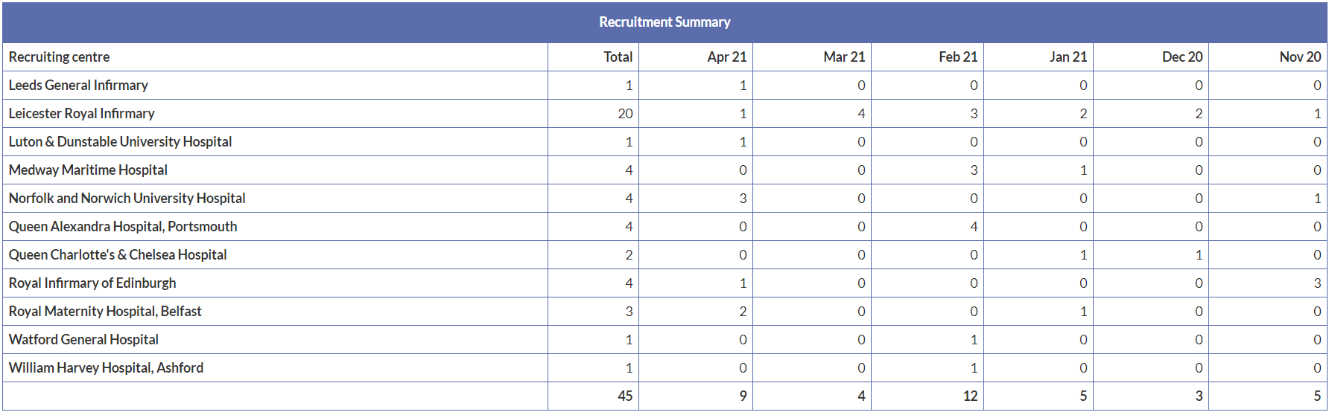
Recruitment by site
To add chart

Slide 8
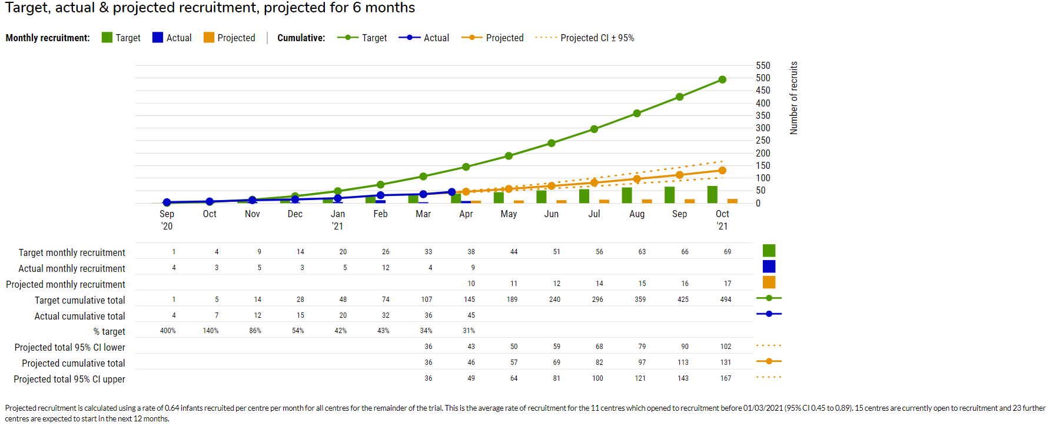
Target, actual & projected recruitment

Slide 9
Challenges
COVID-19 and the effects on staffing re-deployment, shielding and sickness.
Trusts delaying opening to non-COVID studies
Less eligible babies than expected in some areas
Some staff watching and waiting too long before approaching parents – staff focusing on 30% oxygen requirement
GCP training – online link for training?
Rotation of doctors – need to re-train with each rotation
Awareness of the study and keeping it at the forefront of clinicians minds

Slide 10

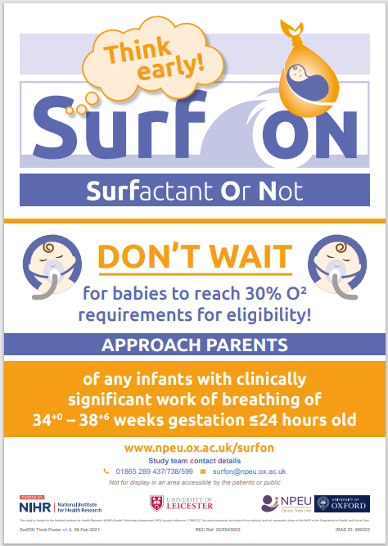
New Think SurfON Posters

Slide 11


Prize draws!
We ran a ‘Feel the love’ Valentine Prize draw in February
- the winner was Leicester General Infirmary!
We are running a ‘MarchON to Easter Prize Draw’ during April, every recruit is entered into a hat and the winner drawn at random

Slide 12
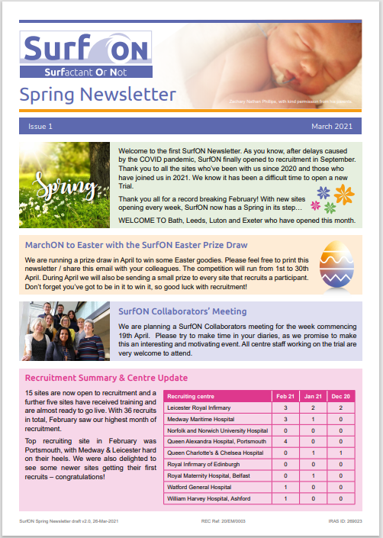
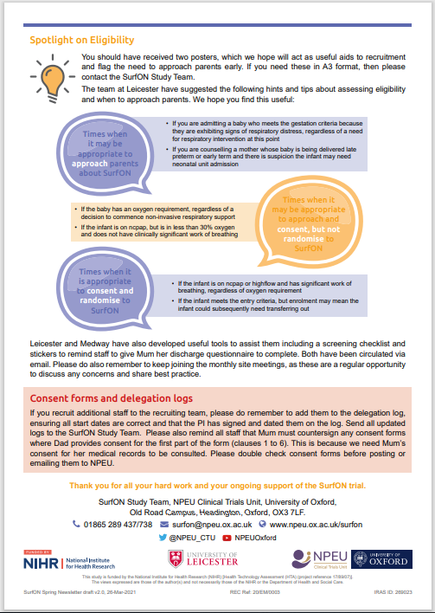
SurfON Newsletter

Slide 13
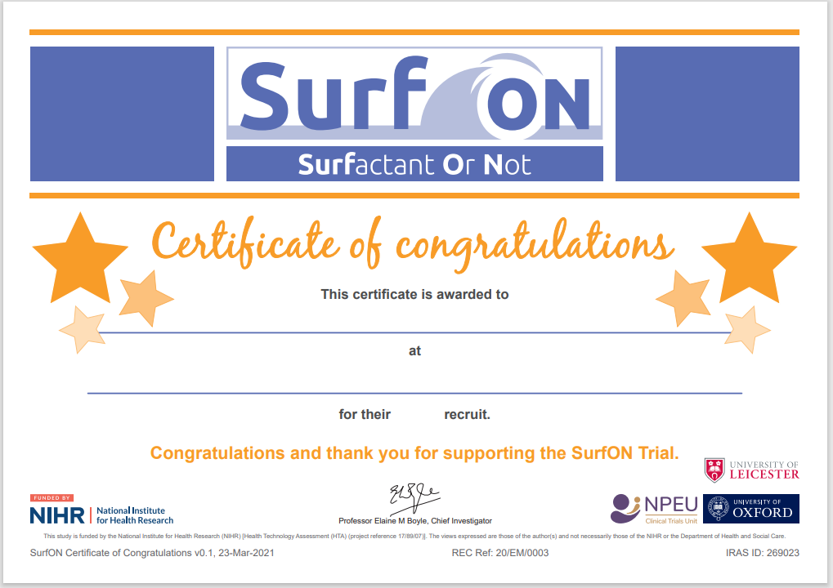
Certificates for staff

Slide 14
Monthly meetings/updates
We are now running monthly site meetings, please attend if at all possible
Useful hints, tips and updates from other sites
Chance to ask questions and meet other teams
We would love to see your smiling faces if at all possible so please turn on your cameras if you are able!

Slide 15

A big thank you!
We would like to say thank you for continuing to work through all of the many challenges that you have faced

Slide 16
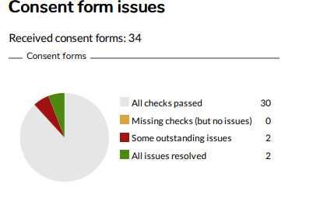
Data Collection - Consent Forms

Slide 17
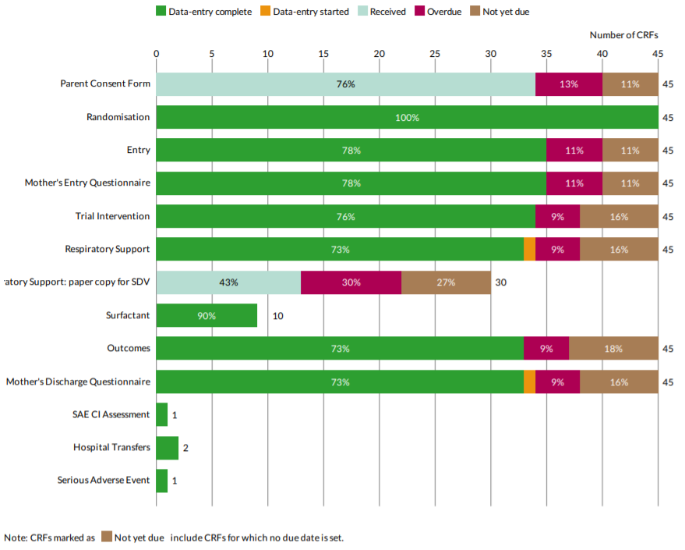
Completeness of data - CRFs

Slide 18
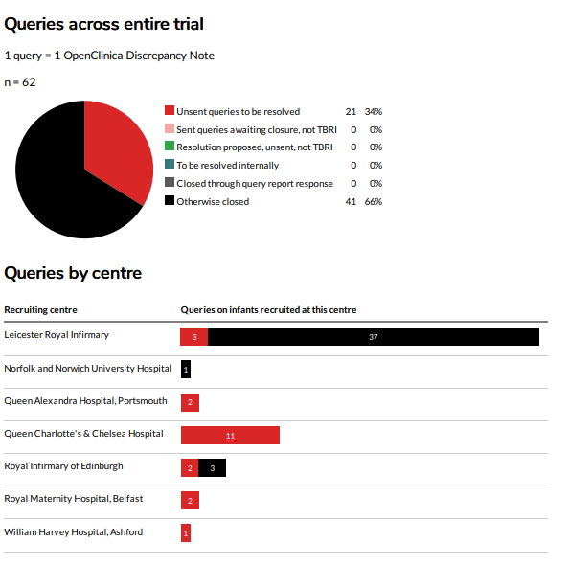
Queries across the entire trial

Slide 19
Delegation Logs
Please ensure you complete the Delegation logs correctly and send updated versions to us regularly
Most common errors:-
Member of staff carrying out study duties prior to sign off date by PI
Member of staff allocated to the incorrect duty
Dates of sign off omitting the year

Slide 20
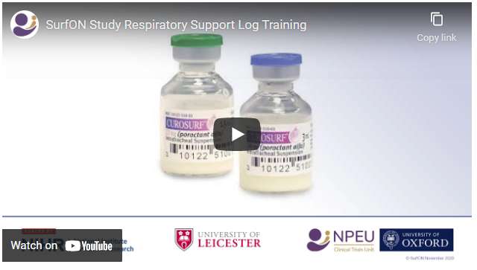
Respiratory Support Log Training https://npeu.ox.ac.uk/surfon

Slide 21

Anything else we can do to help?

Slide 22

Reasons to be cheerful!
The end of COVID-19 is in site with the successful roll out of vaccines
Trusts are re-opening to non-COVID studies
Spring is here with summer approaching!
You only need to recruit 1 or 2 babies per month
Thank you for all of your hard work to date – we need you to continue your fabulous efforts to push forward in order to reach our target of 1,522!

Slide 23

Any Questions?

