Slide 1


Slide 2
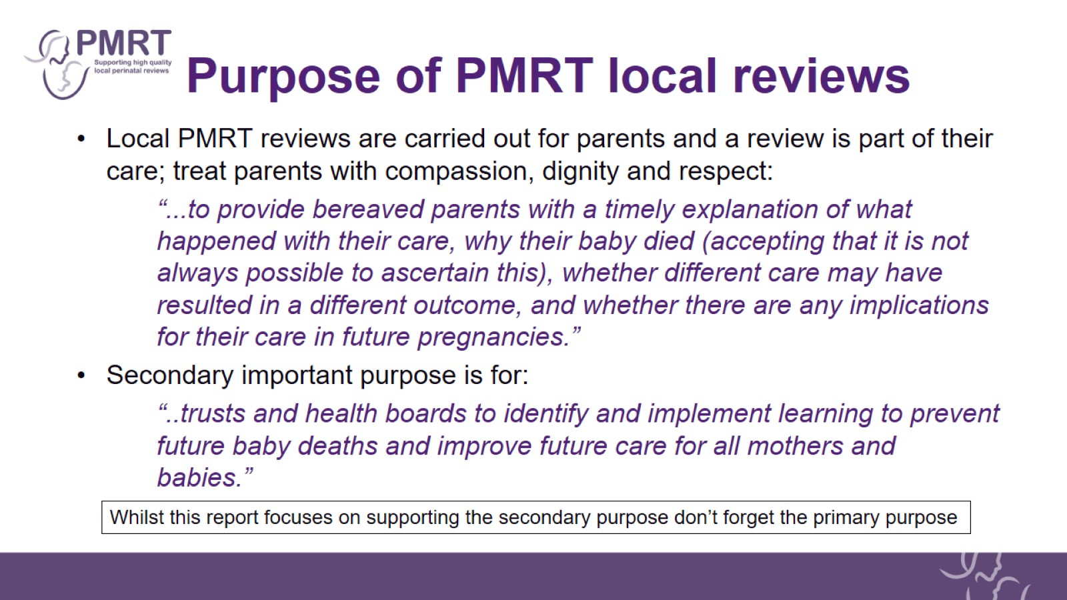
Purpose of PMRT local reviews

Slide 3
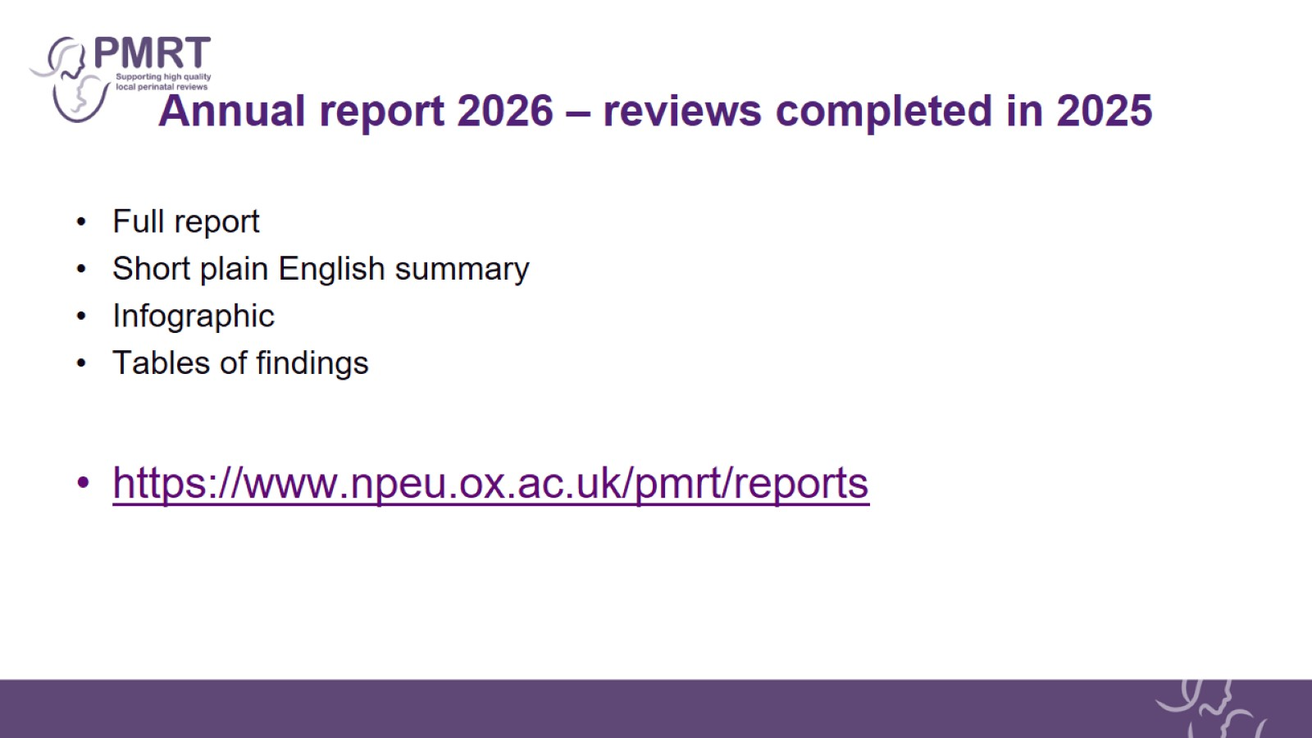
Annual report 2026 – reviews completed in 2025

Slide 4
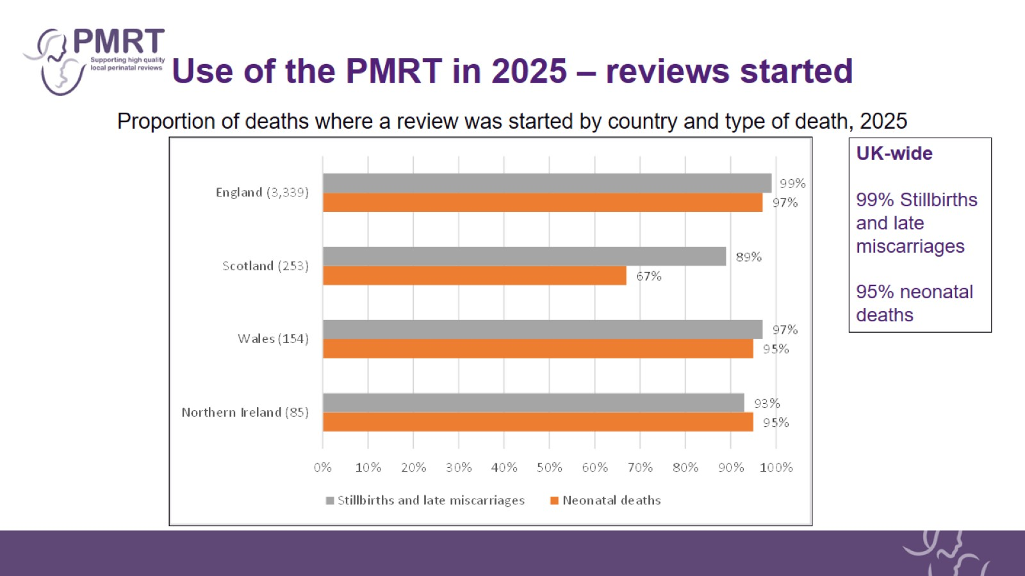
Use of the PMRT in 2025 – reviews started

Slide 5
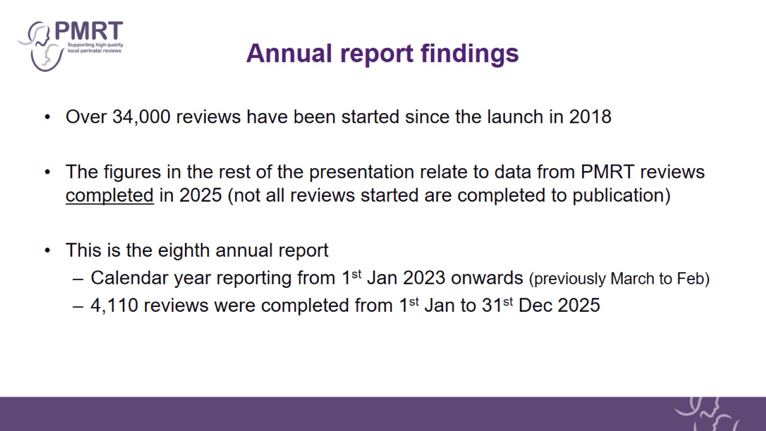
Annual report findings

Slide 6
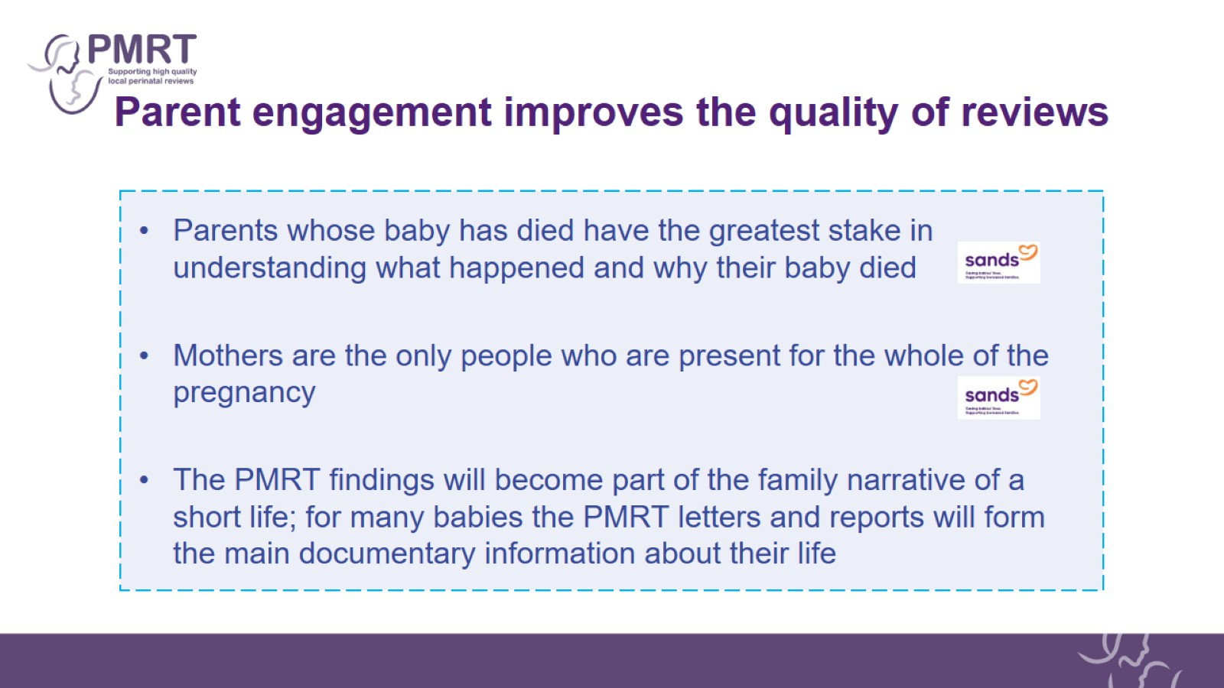
Parent engagement improves the quality of reviews

Slide 7
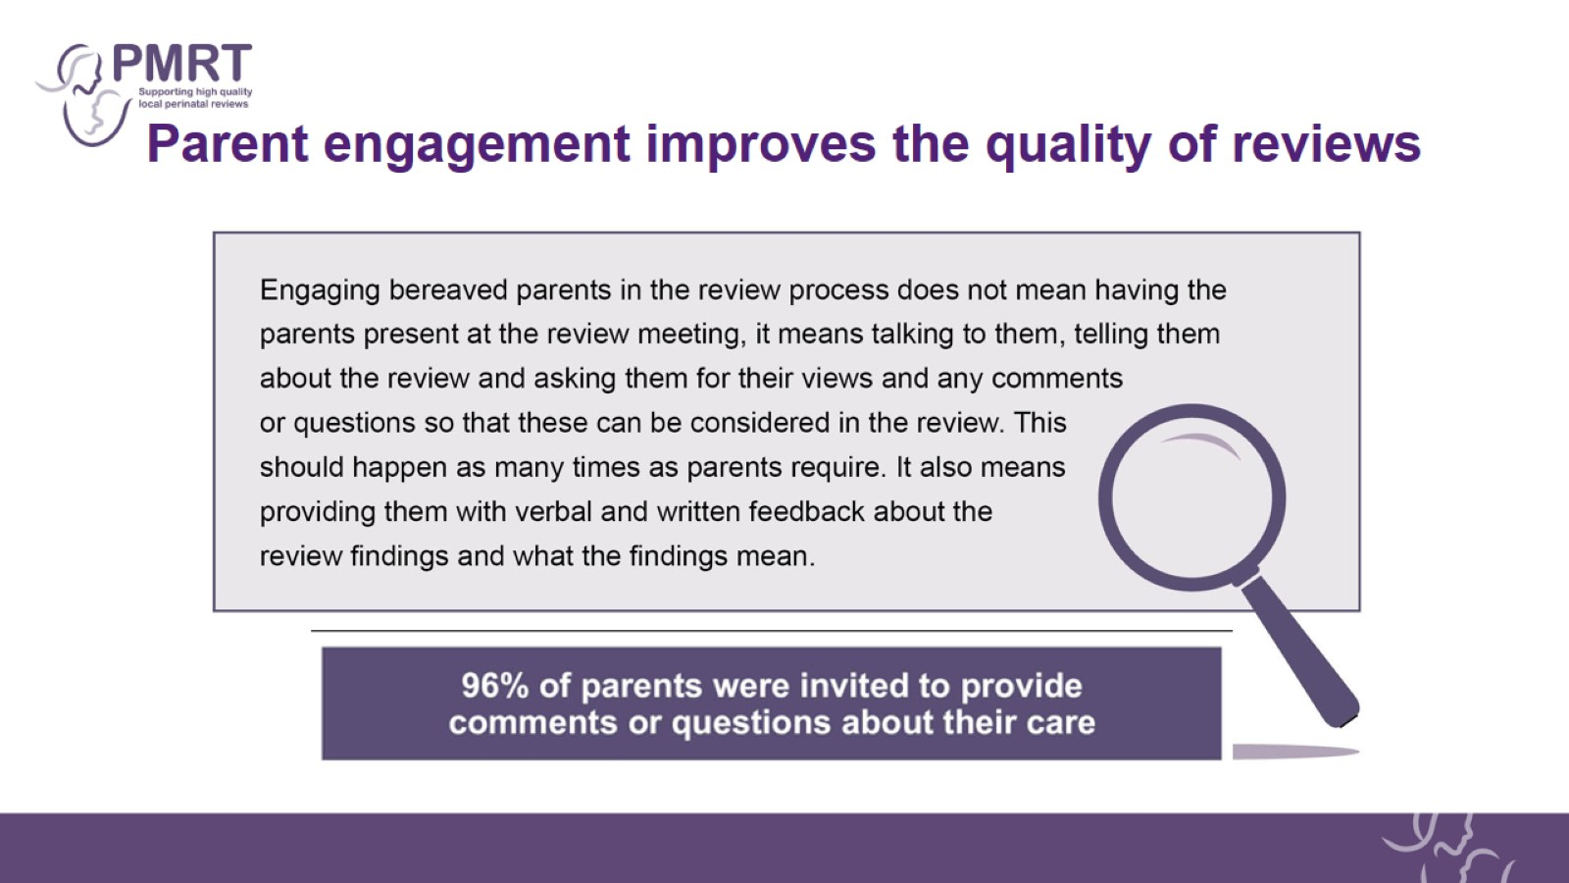
Parent engagement improves the quality of reviews

Slide 8
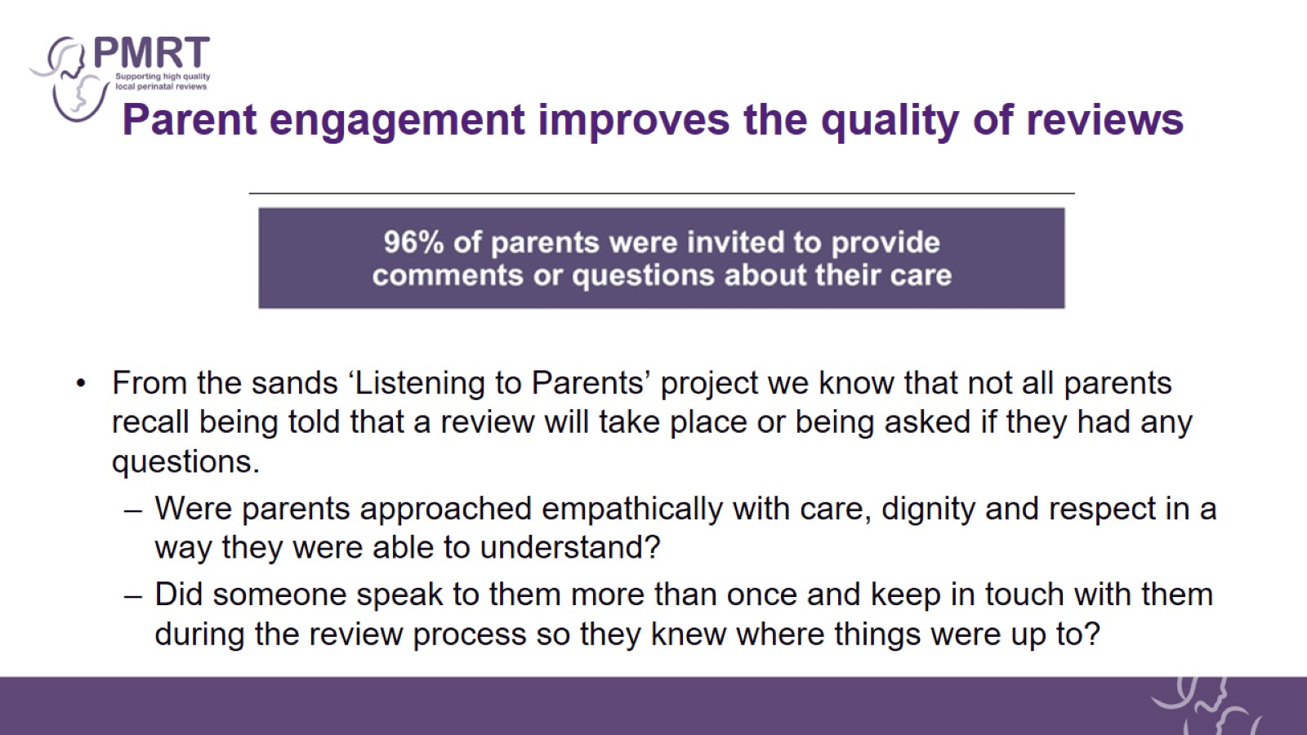
Parent engagement improves the quality of reviews

Slide 9

Parents’ comments and questions about their care

Slide 10
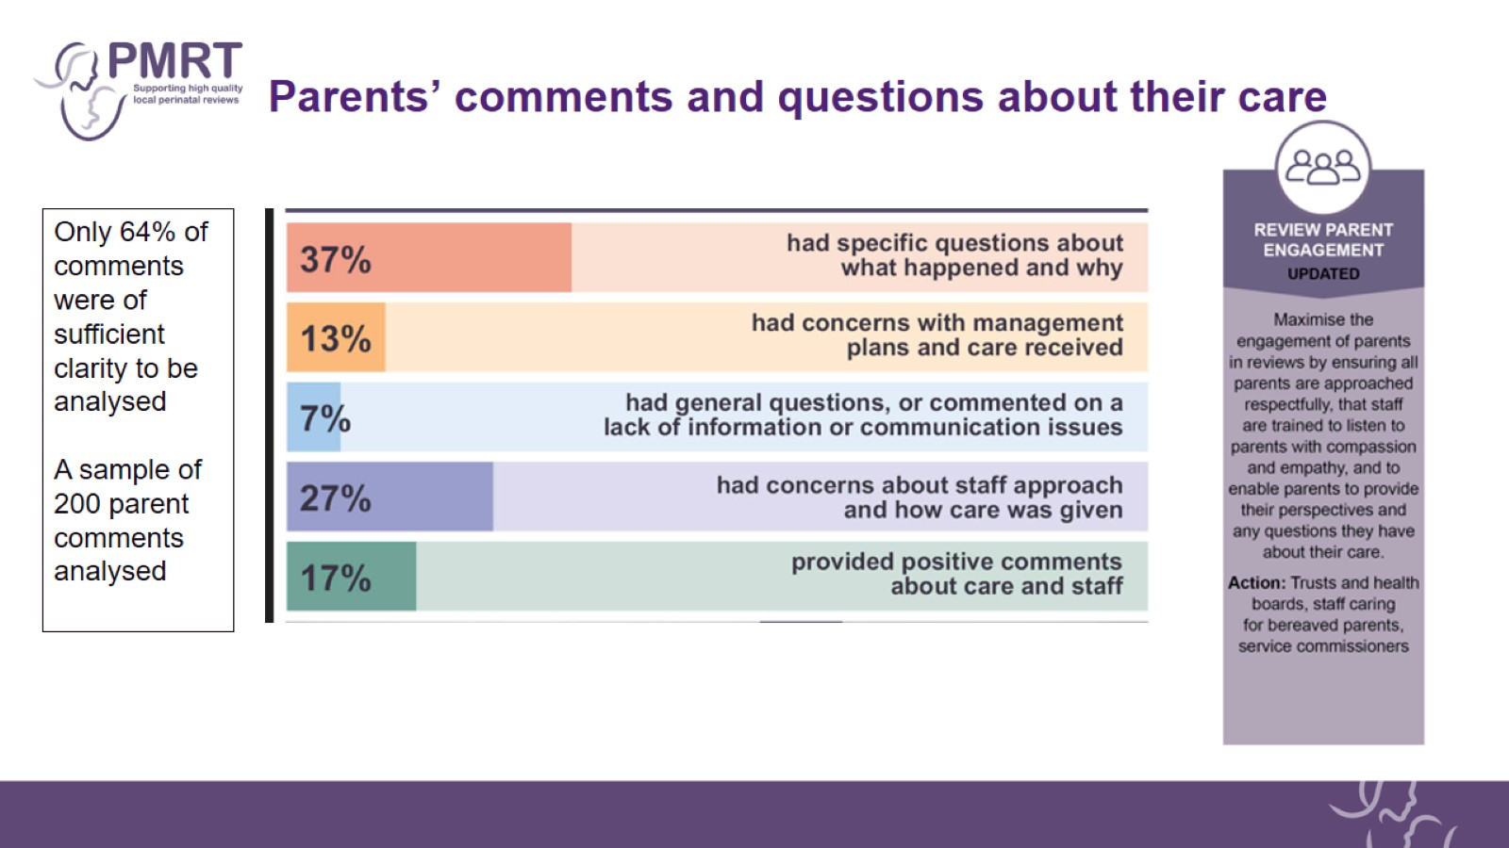
Parents’ comments and questions about their care

Slide 11
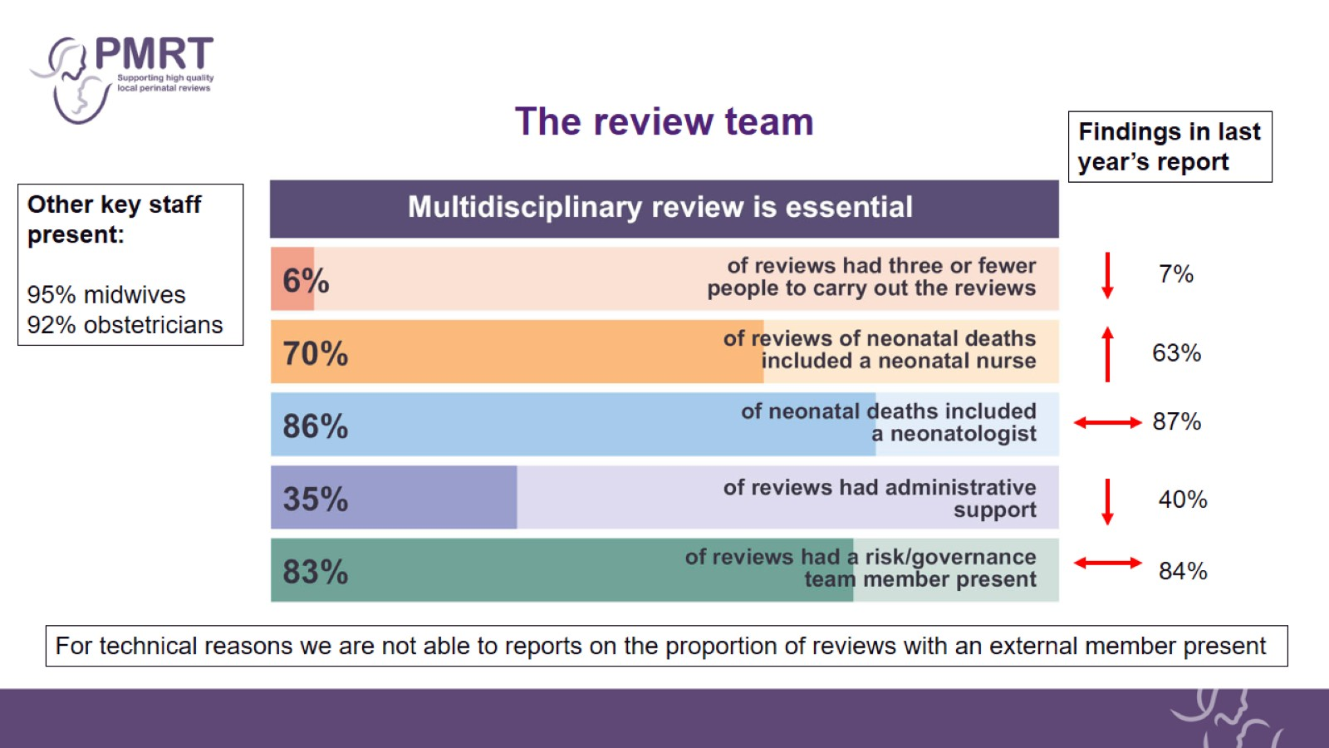
The review team

Slide 12
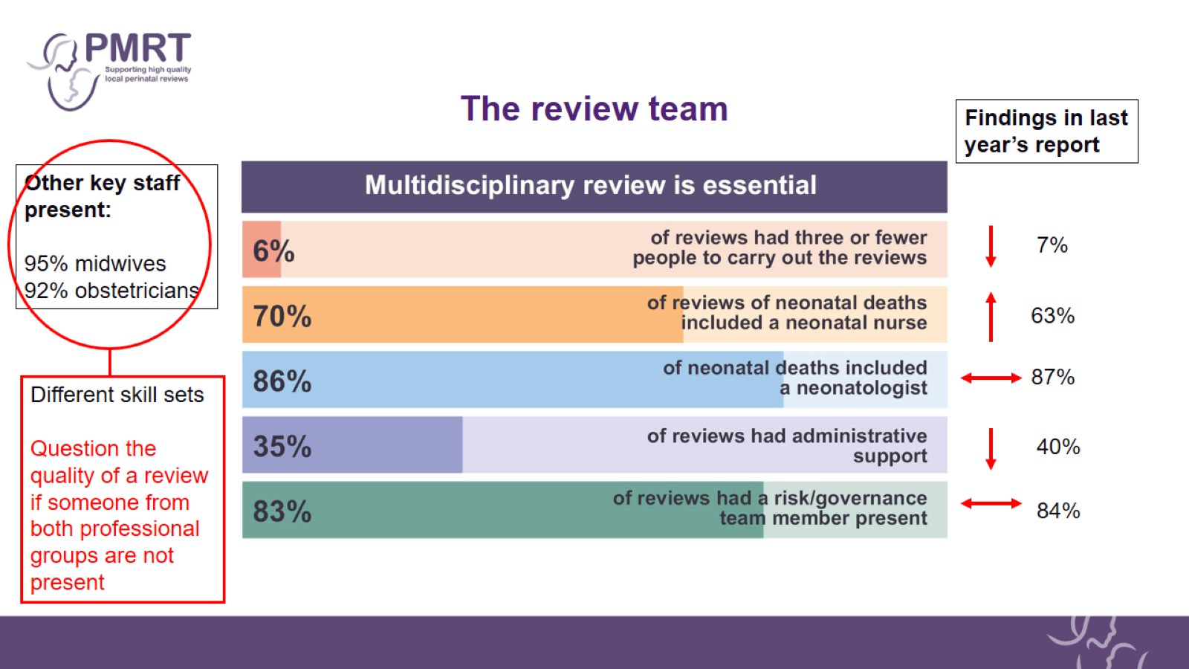
The review team

Slide 13
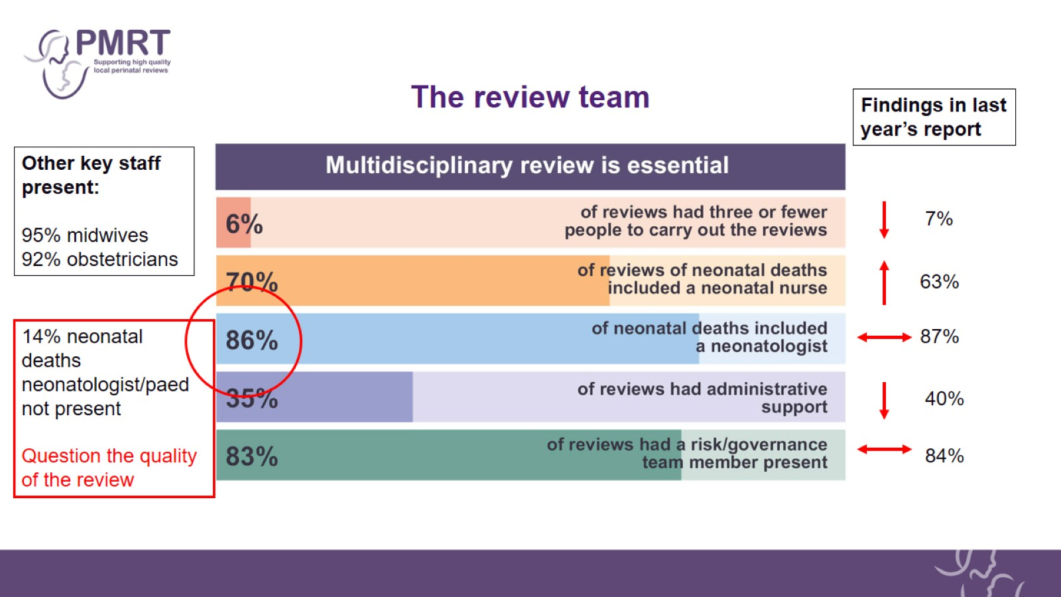
The review team

Slide 14
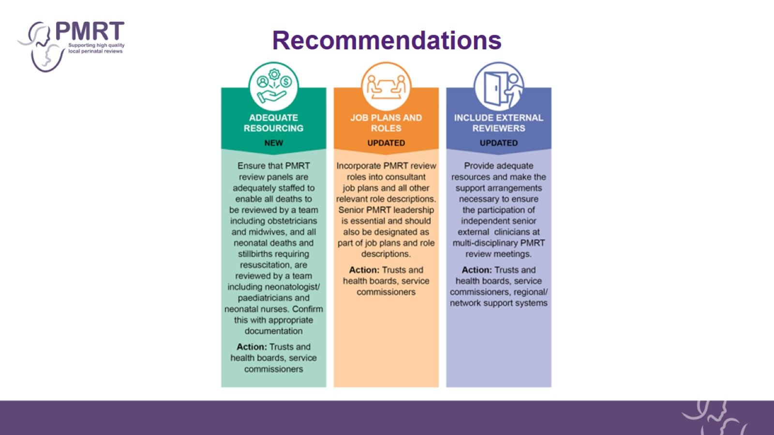
Recommendations

Slide 15
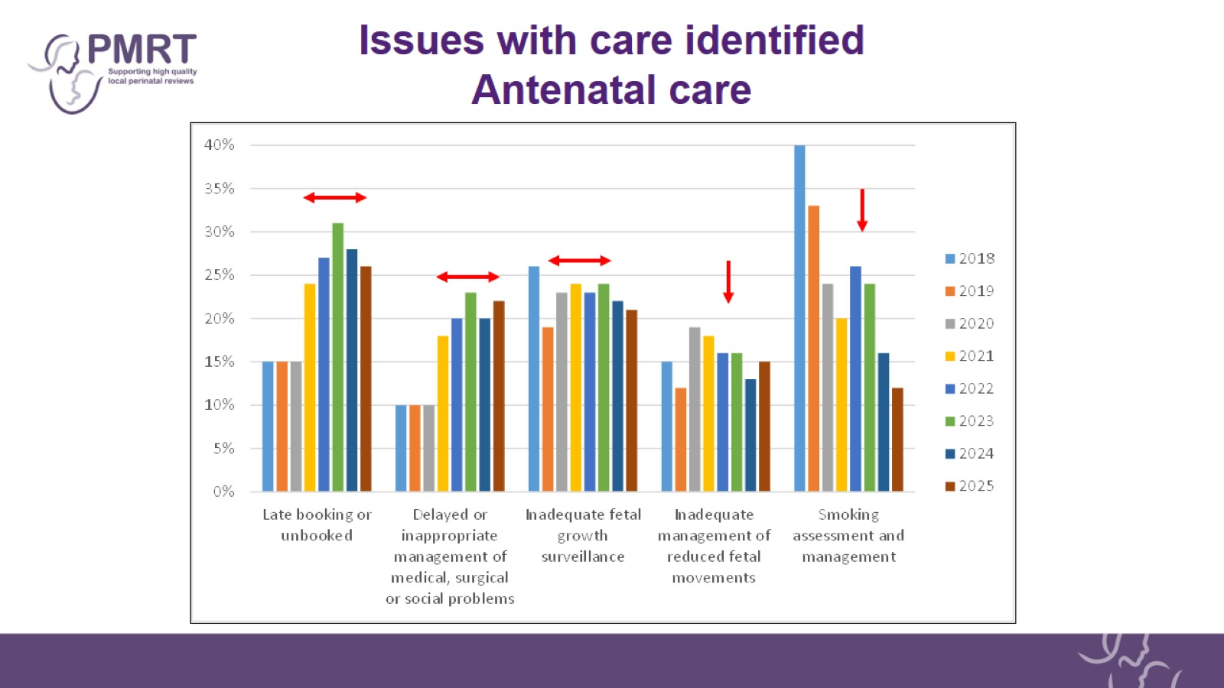
Issues with care identified
Antenatal care

Slide 16
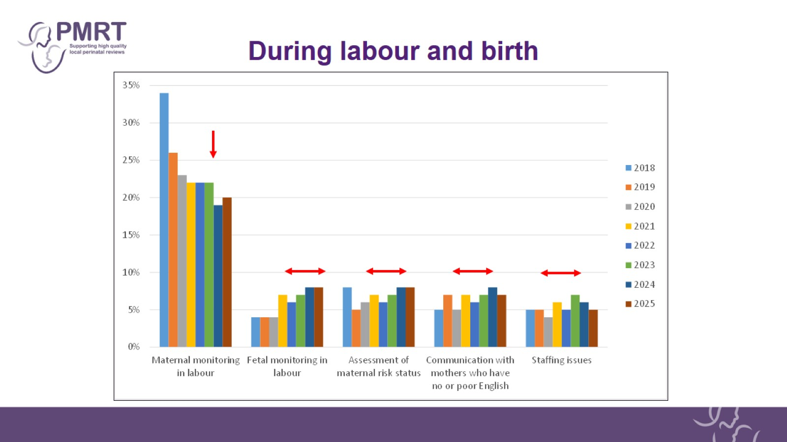
During labour and birth

Slide 17
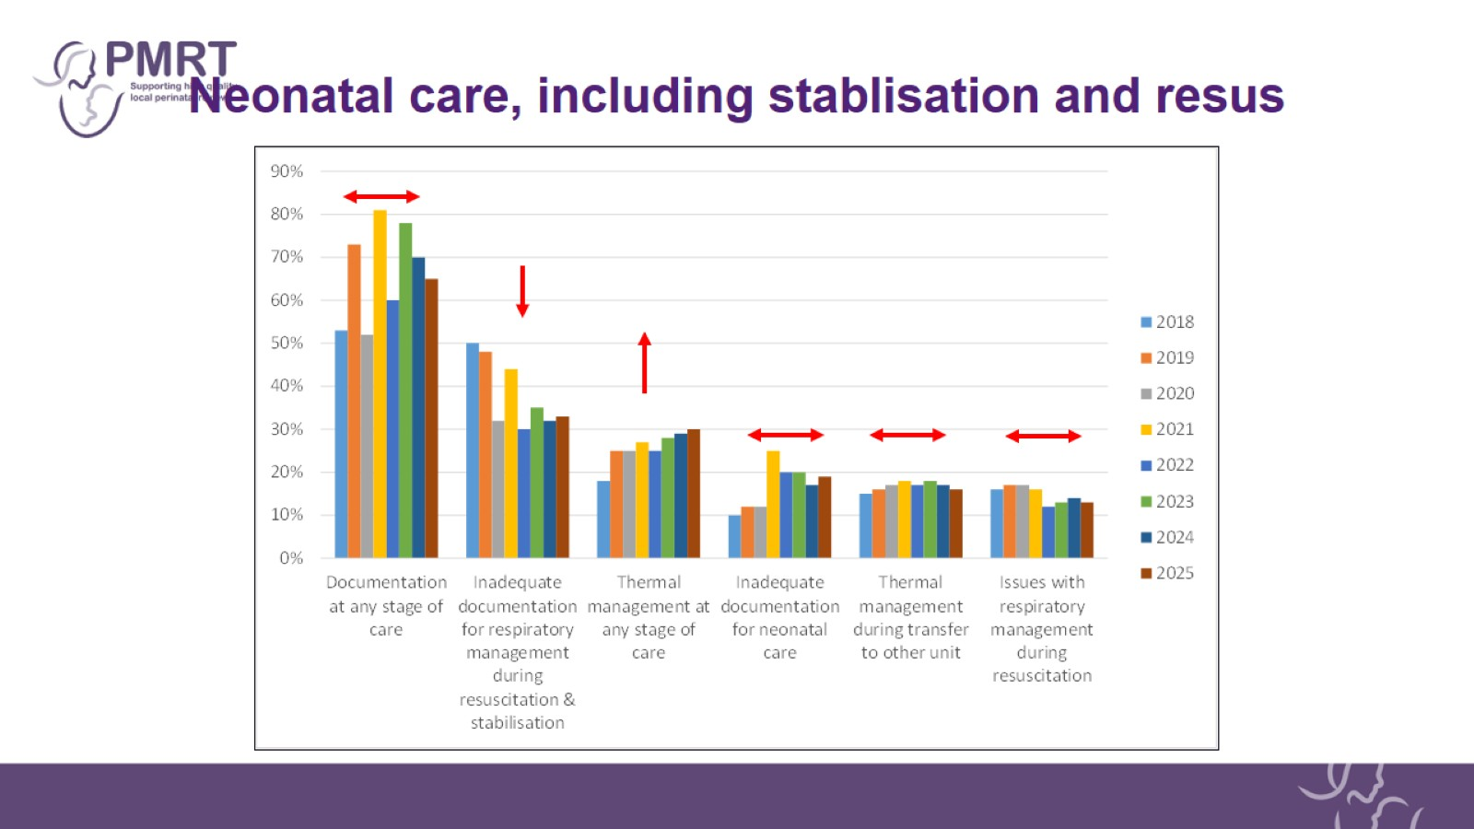
Neonatal care, including stablisation and resus

Slide 18
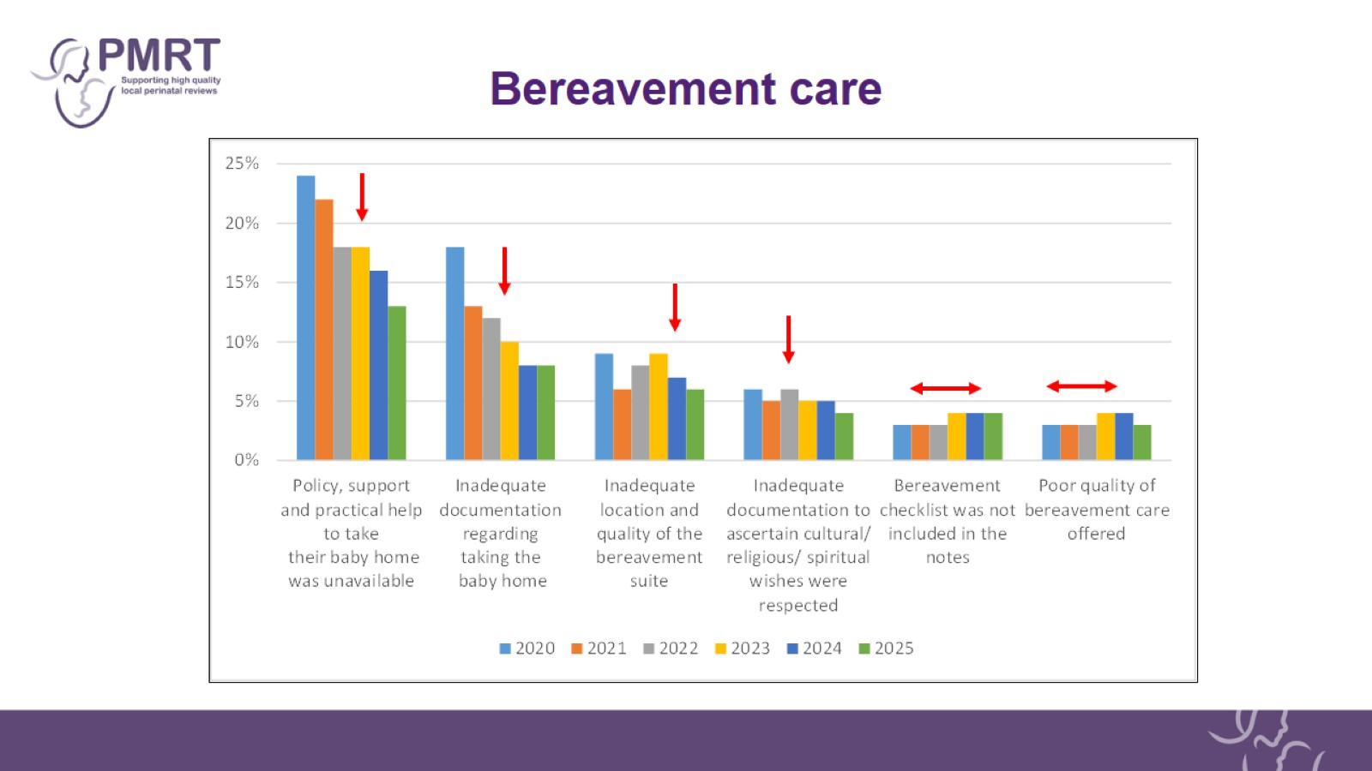
Bereavement care

Slide 19
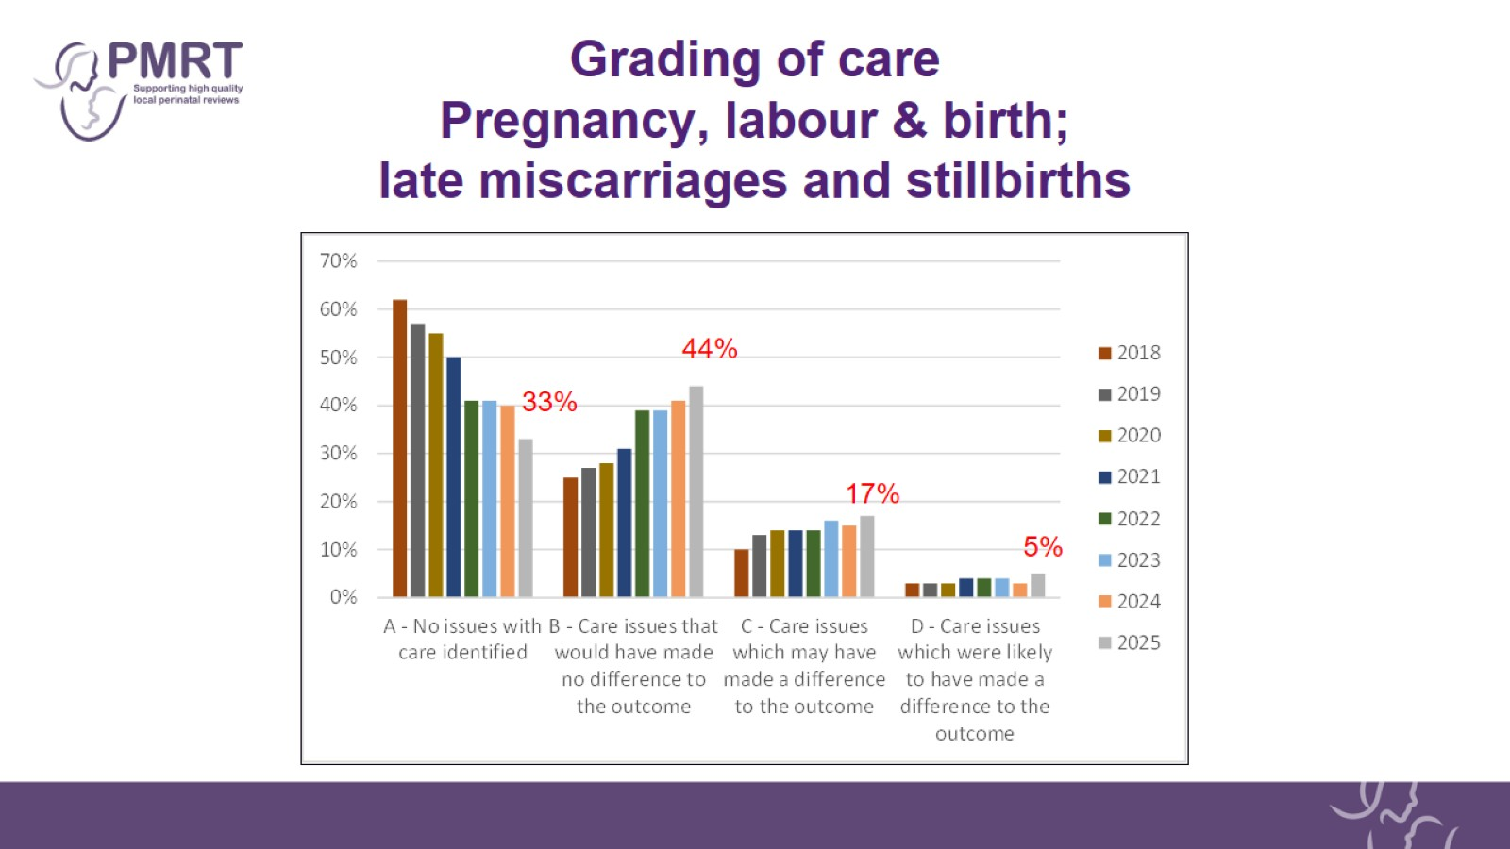
Grading of care
Pregnancy, labour & birth; late miscarriages and stillbirths

Slide 20
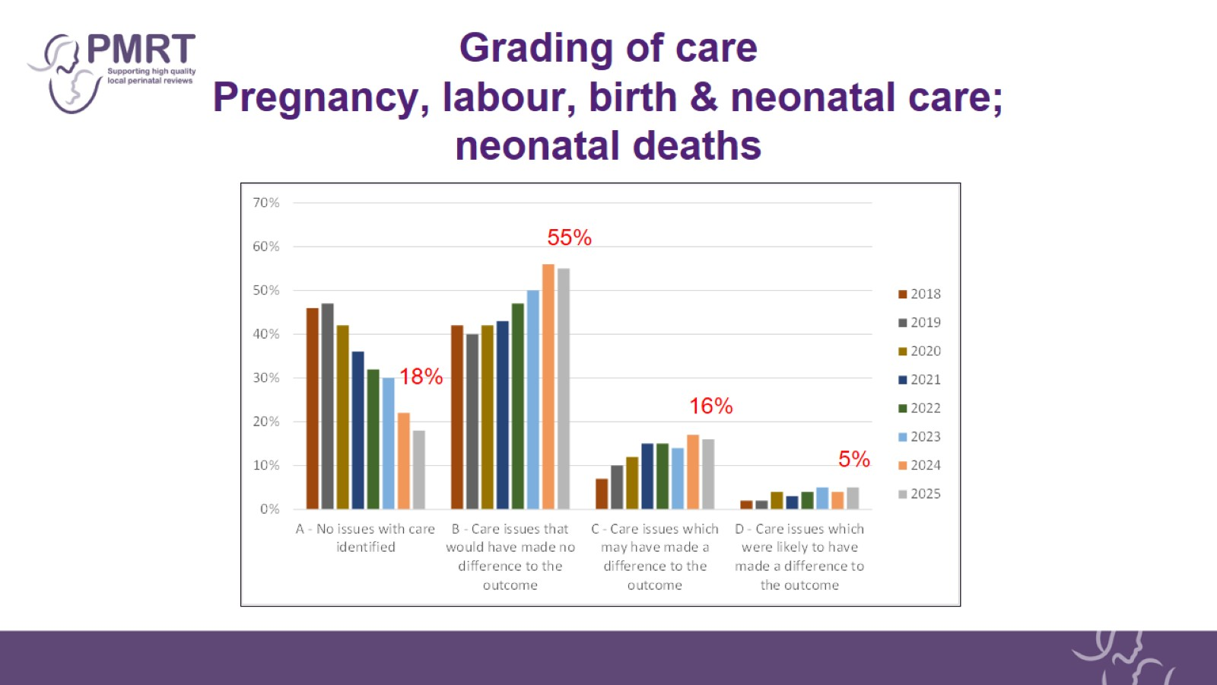
Grading of care
Pregnancy, labour, birth & neonatal care; neonatal deaths

Slide 21
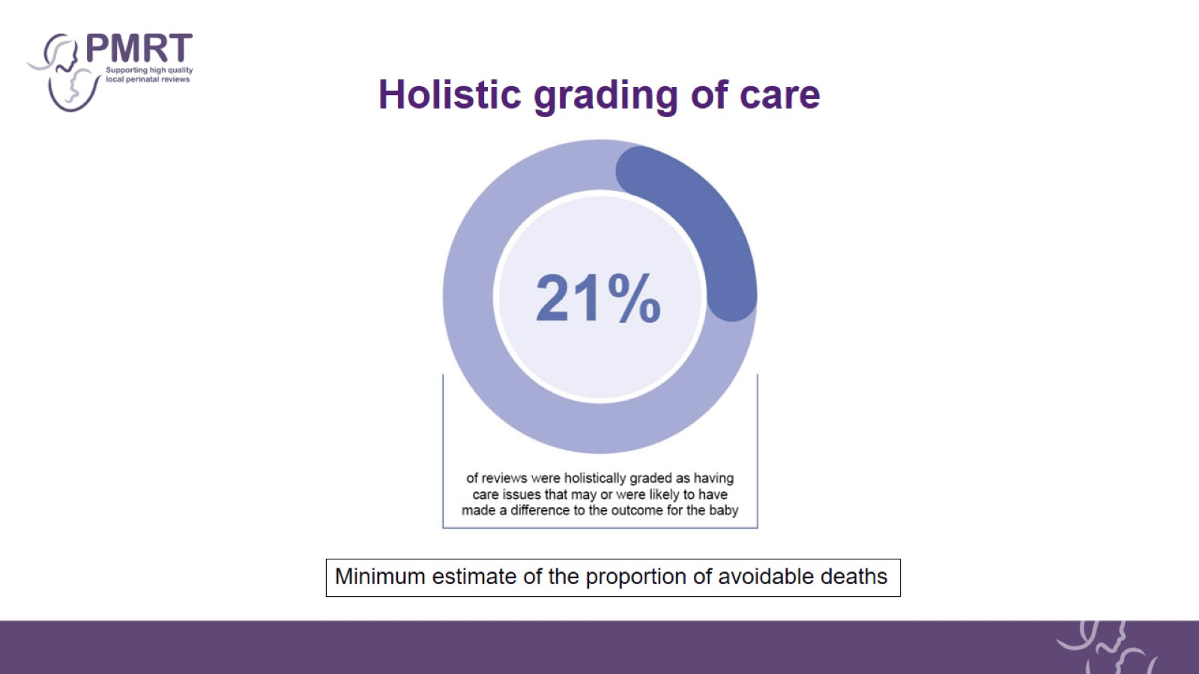
Holistic grading of care

Slide 22
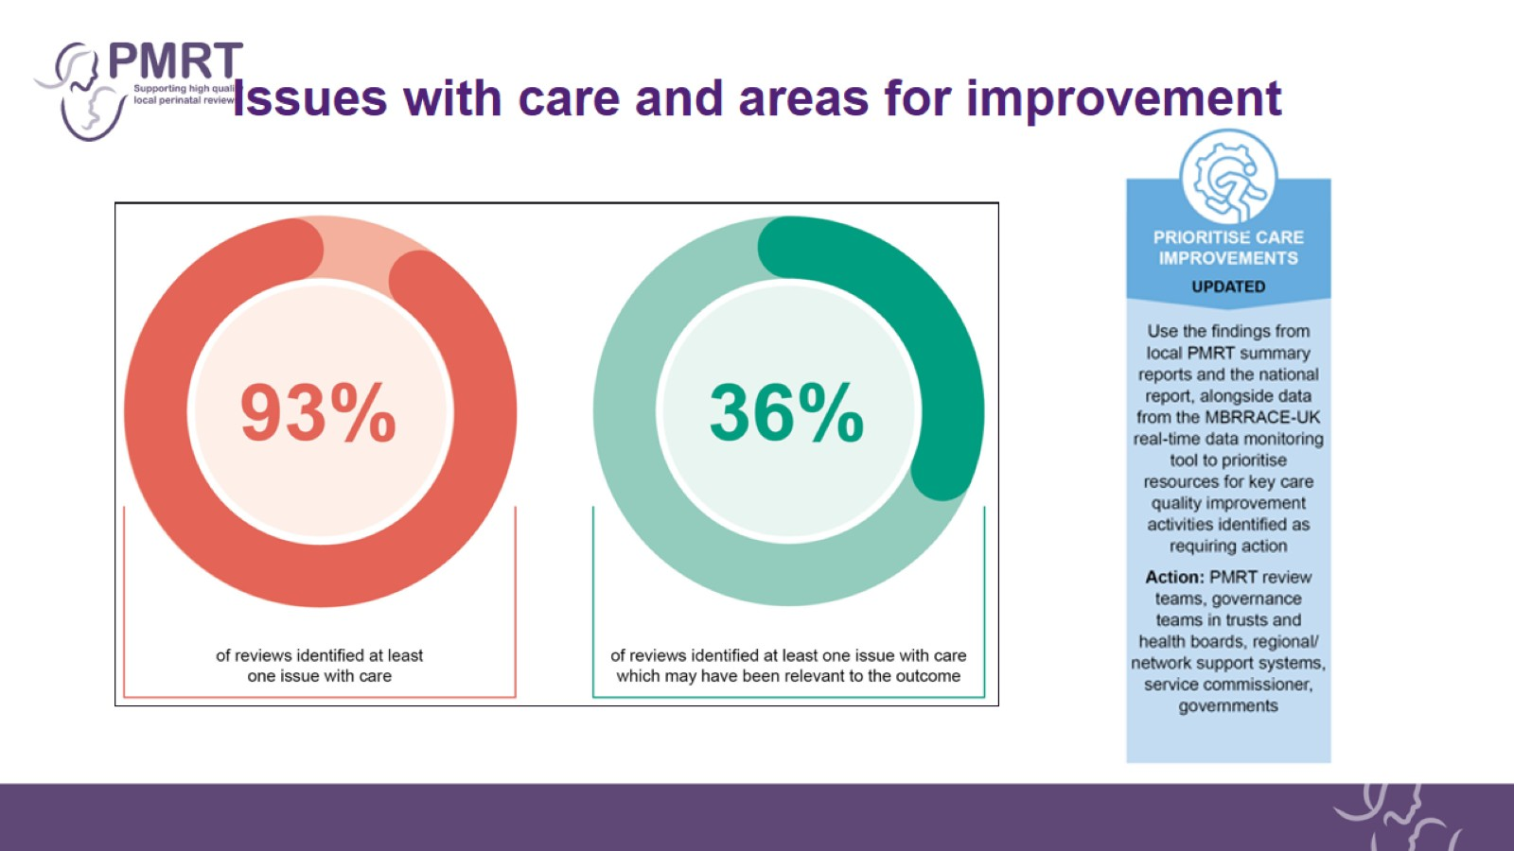
Issues with care and areas for improvement

Slide 23
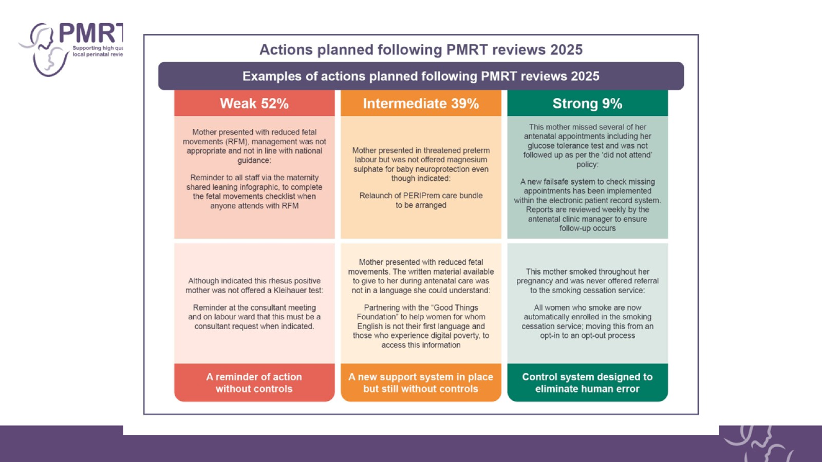
Action plan

Slide 24
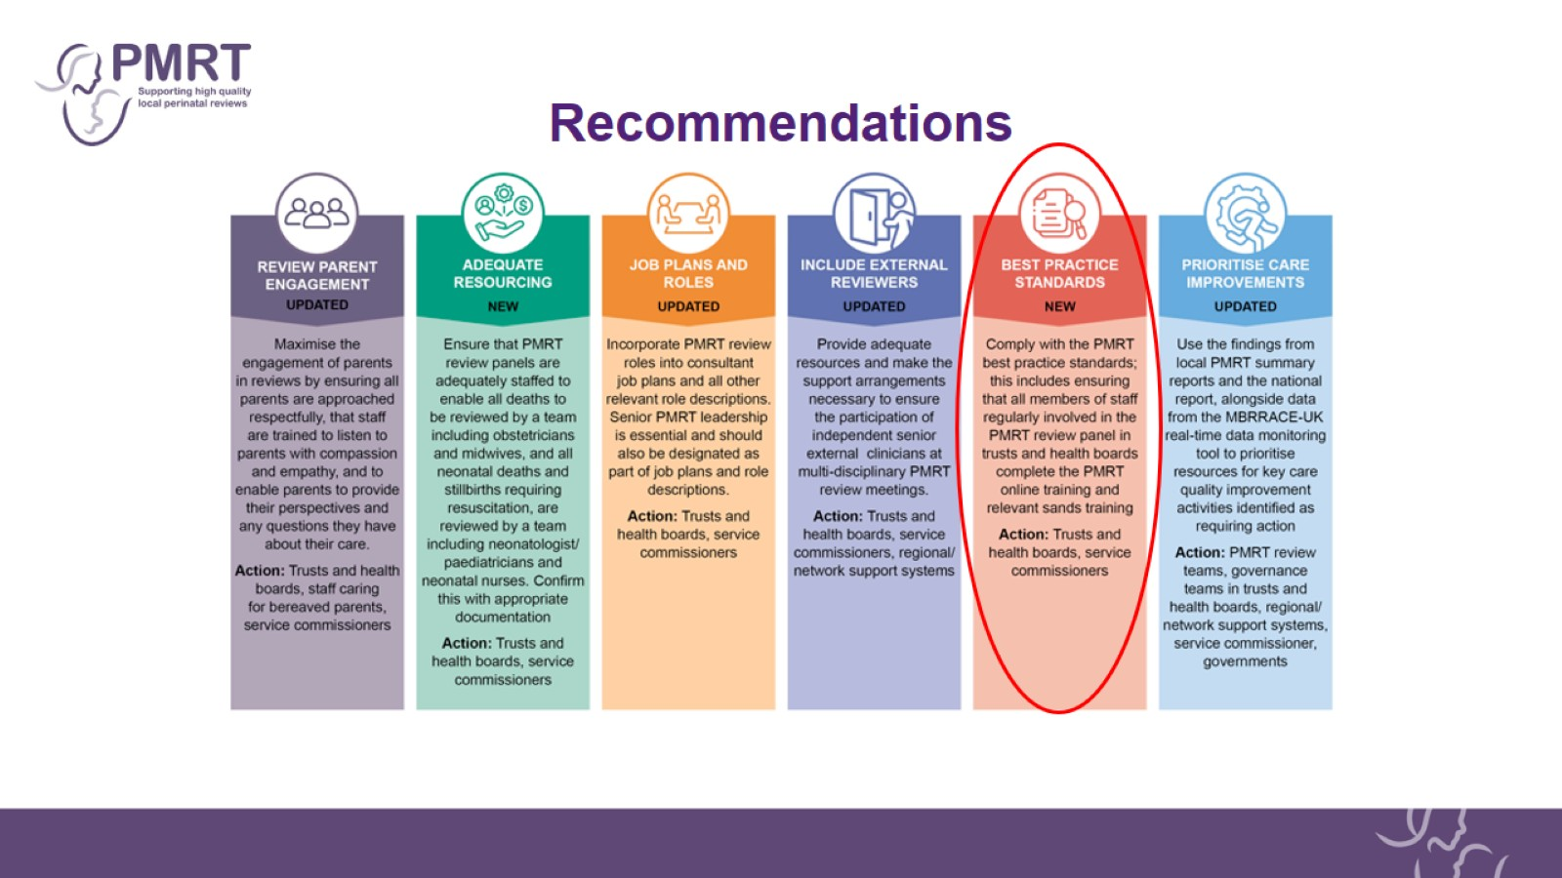
Recommendations

Slide 25
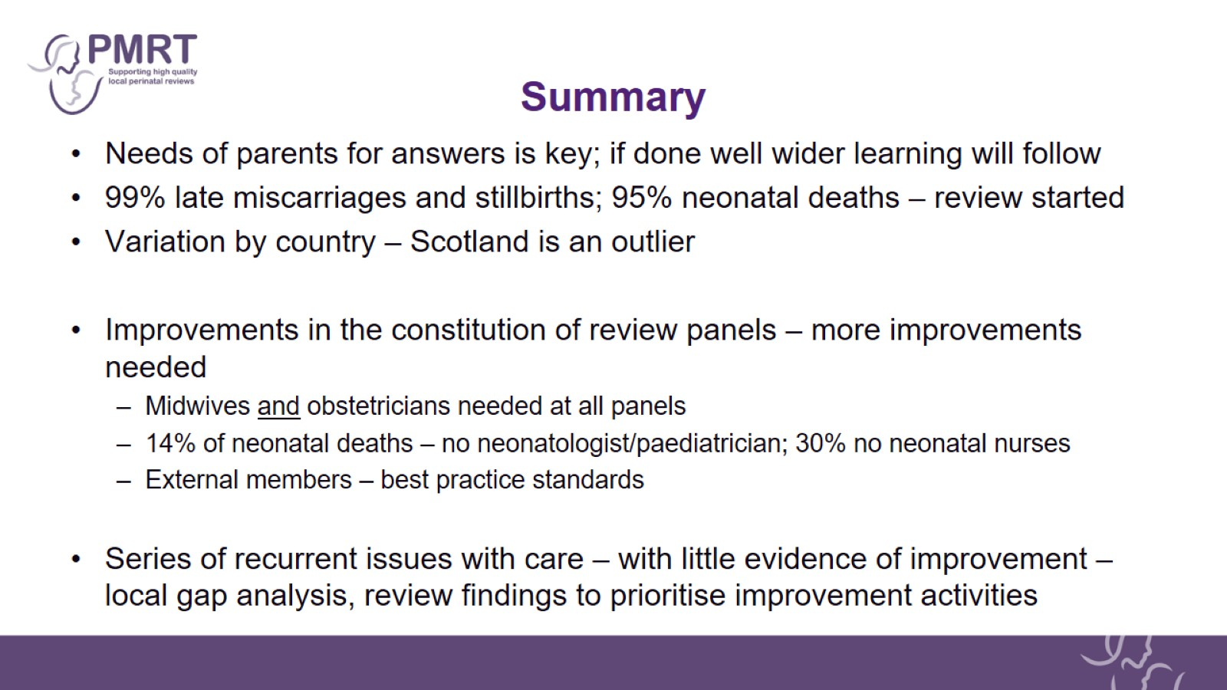
Summary

Slide 26
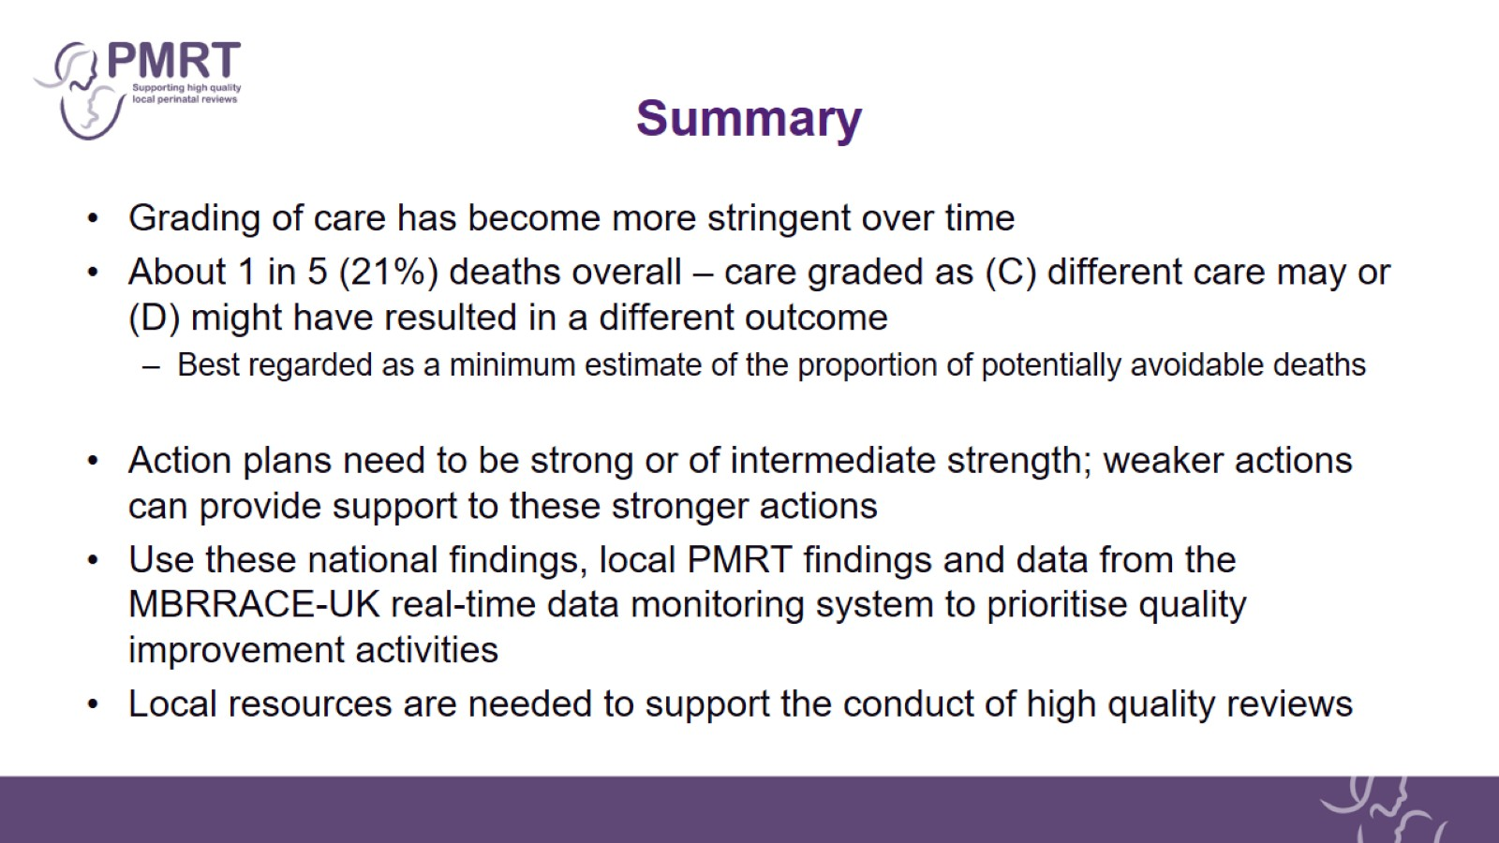
Summary

Slide 27

Acknowledgements

Slide 28

MBRRACE-UK/PMRT collaboration

Slide 29

PMRT original development group

