Slide 1
Background and development of the enquiry Pauline Hyman-Taylor

Slide 2
What is a confidential enquiry?

Slide 3
Choice of Confidential Enquiry topic

Slide 4
Background to this enquiry

Slide 5
Informal meeting with Prof. Gordon Smith and the MBRRACE-UK team to identify relevant questions to be addressed:

Slide 6
Specific aims of this enquiry

Slide 7
Current guidance and evaluable standards (1)

Slide 8
Current guidance and evaluable standards (2)

Slide 9
Current guidance and evaluable standards (3)

Slide 10
Current guidance and evaluable standards (4)

Slide 11
Topic Expert Group & Panel Membership

Slide 12
Developing the enquiry

Slide 13
Preparation for panel meetings

Slide 14
Panel meetings

Slide 15
Acquiring case notes

Slide 16
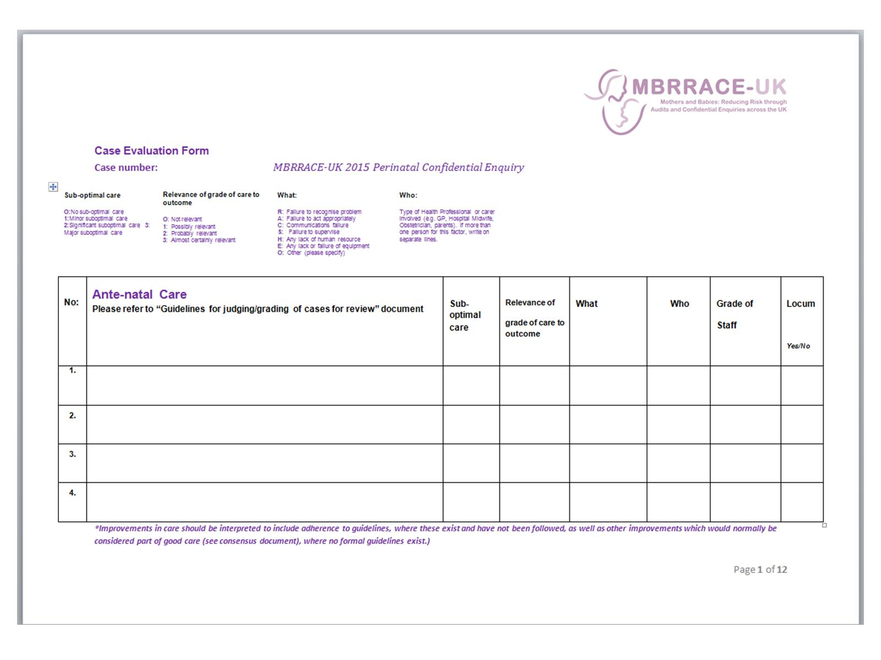

Slide 17
Case evaluation:

Slide 18
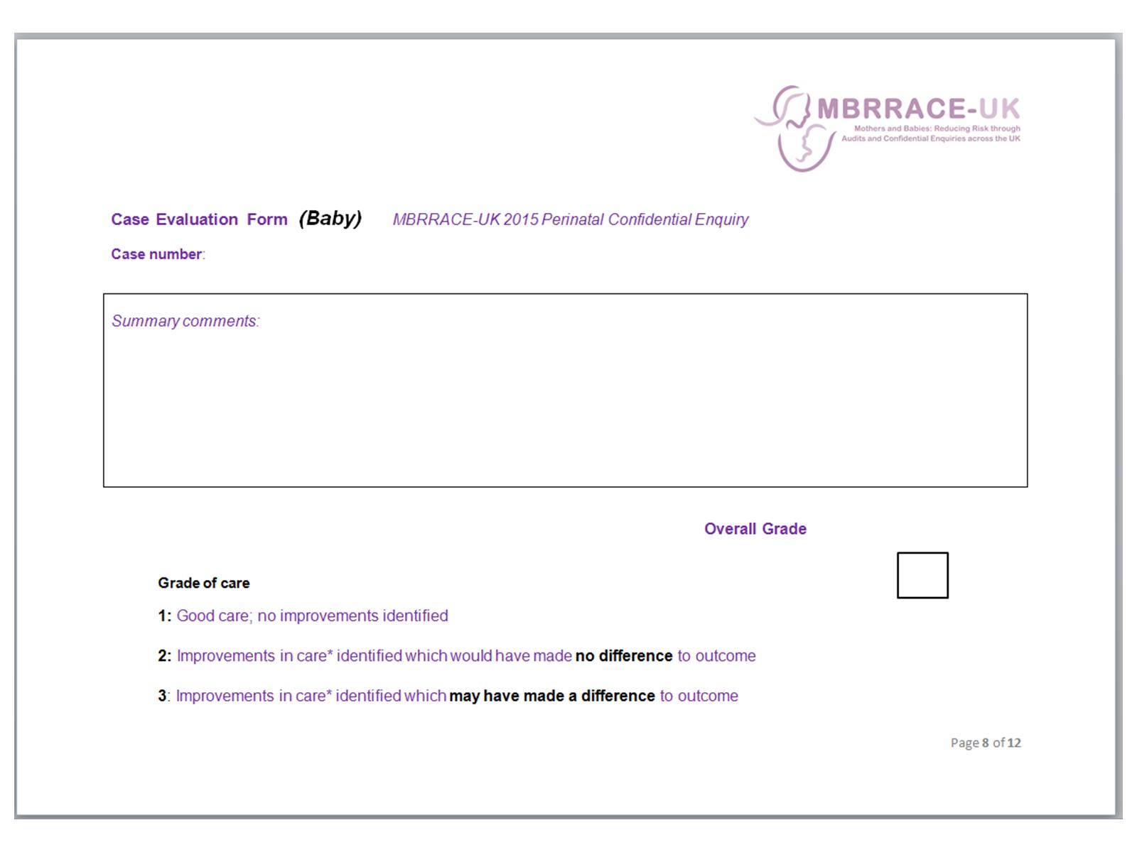

Slide 19
Overall grading of care:

Slide 20
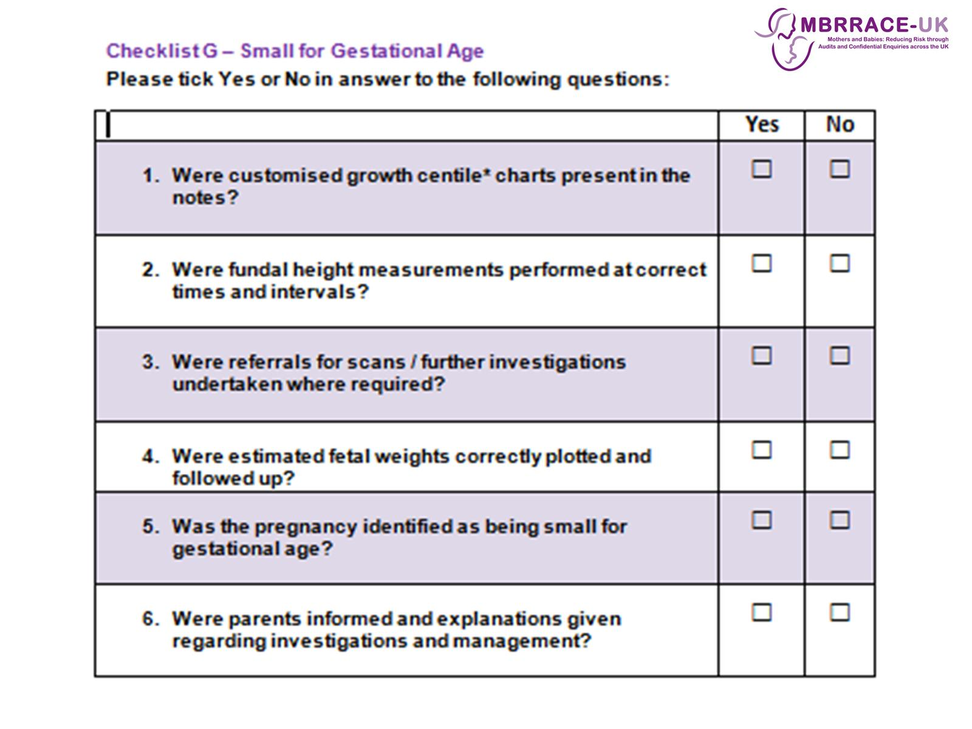

Slide 21
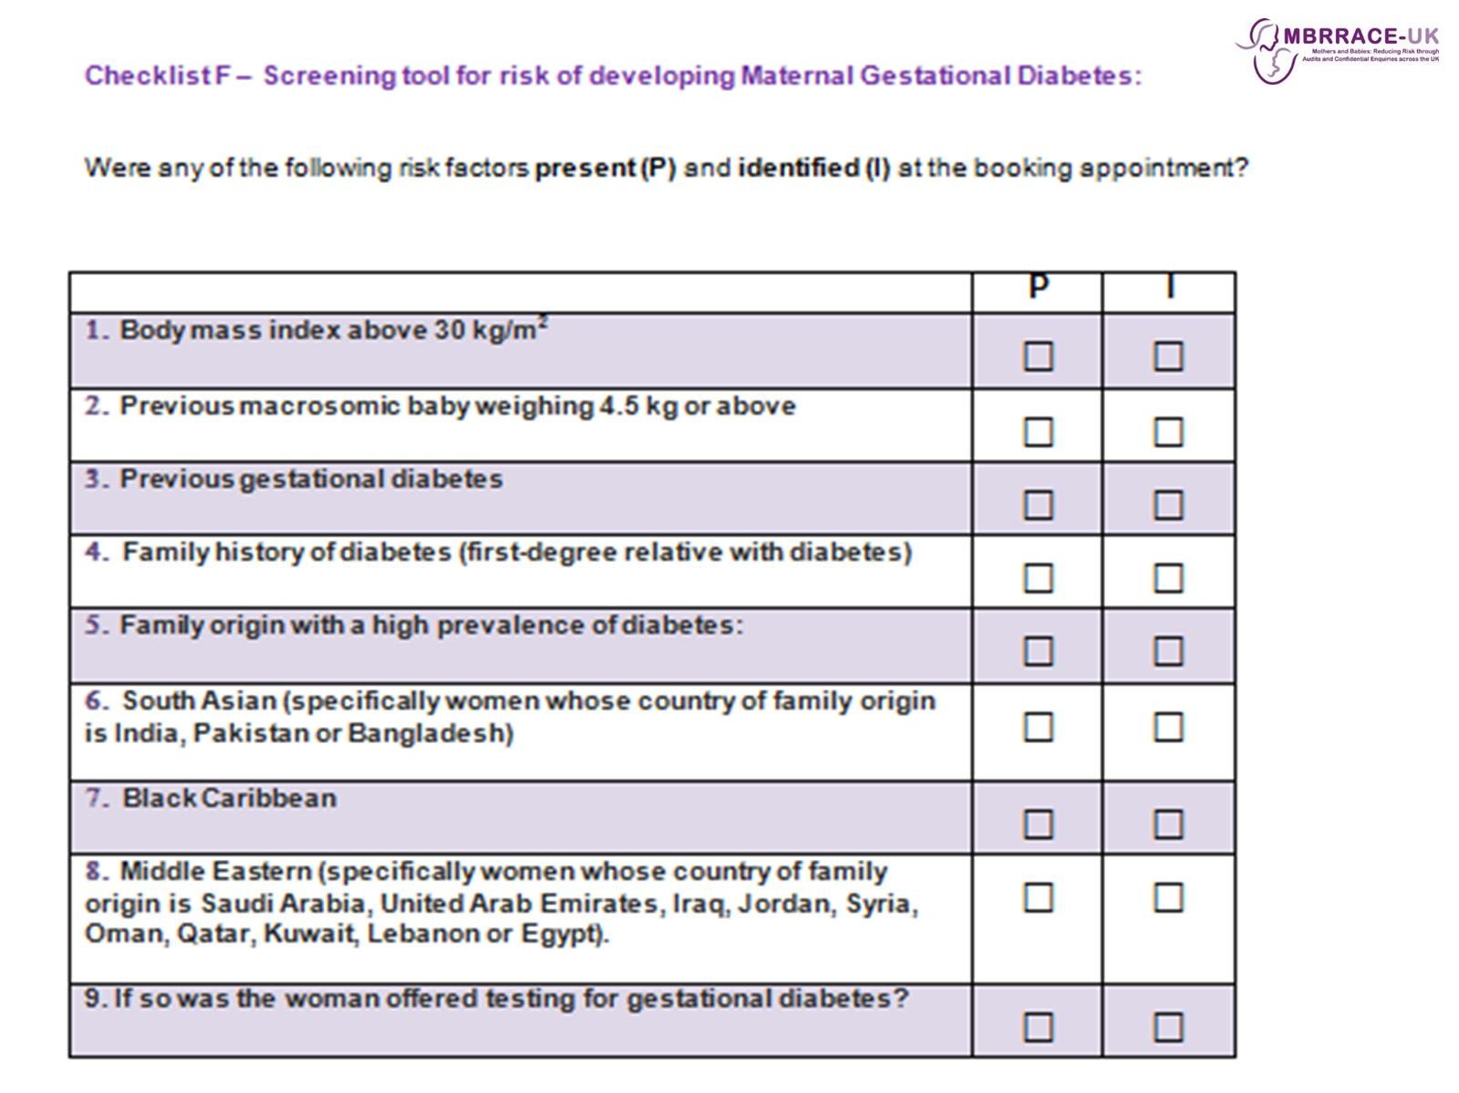

Slide 22
