Slide 1
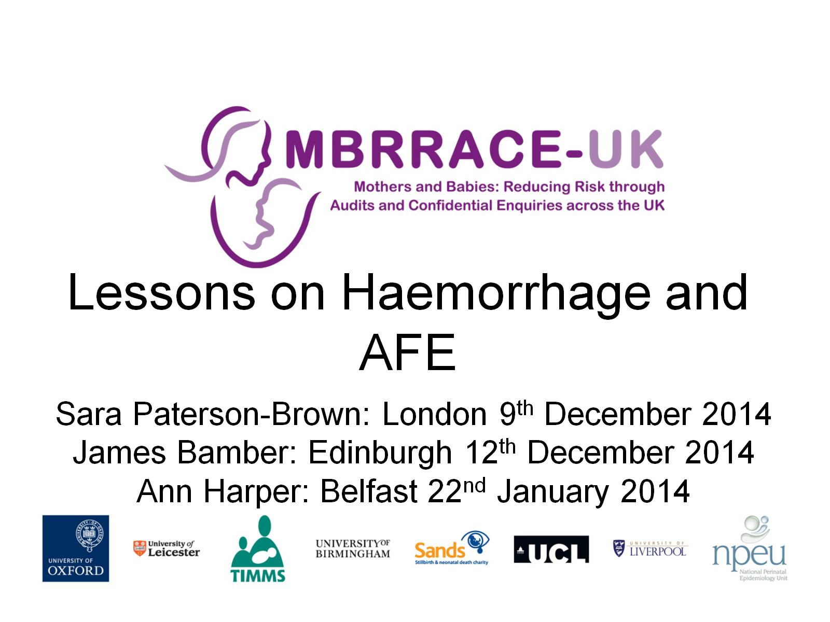
Lessons on Haemorrhage and AFE

Slide 2
Haemorrhage

Slide 3
Background

Slide 4
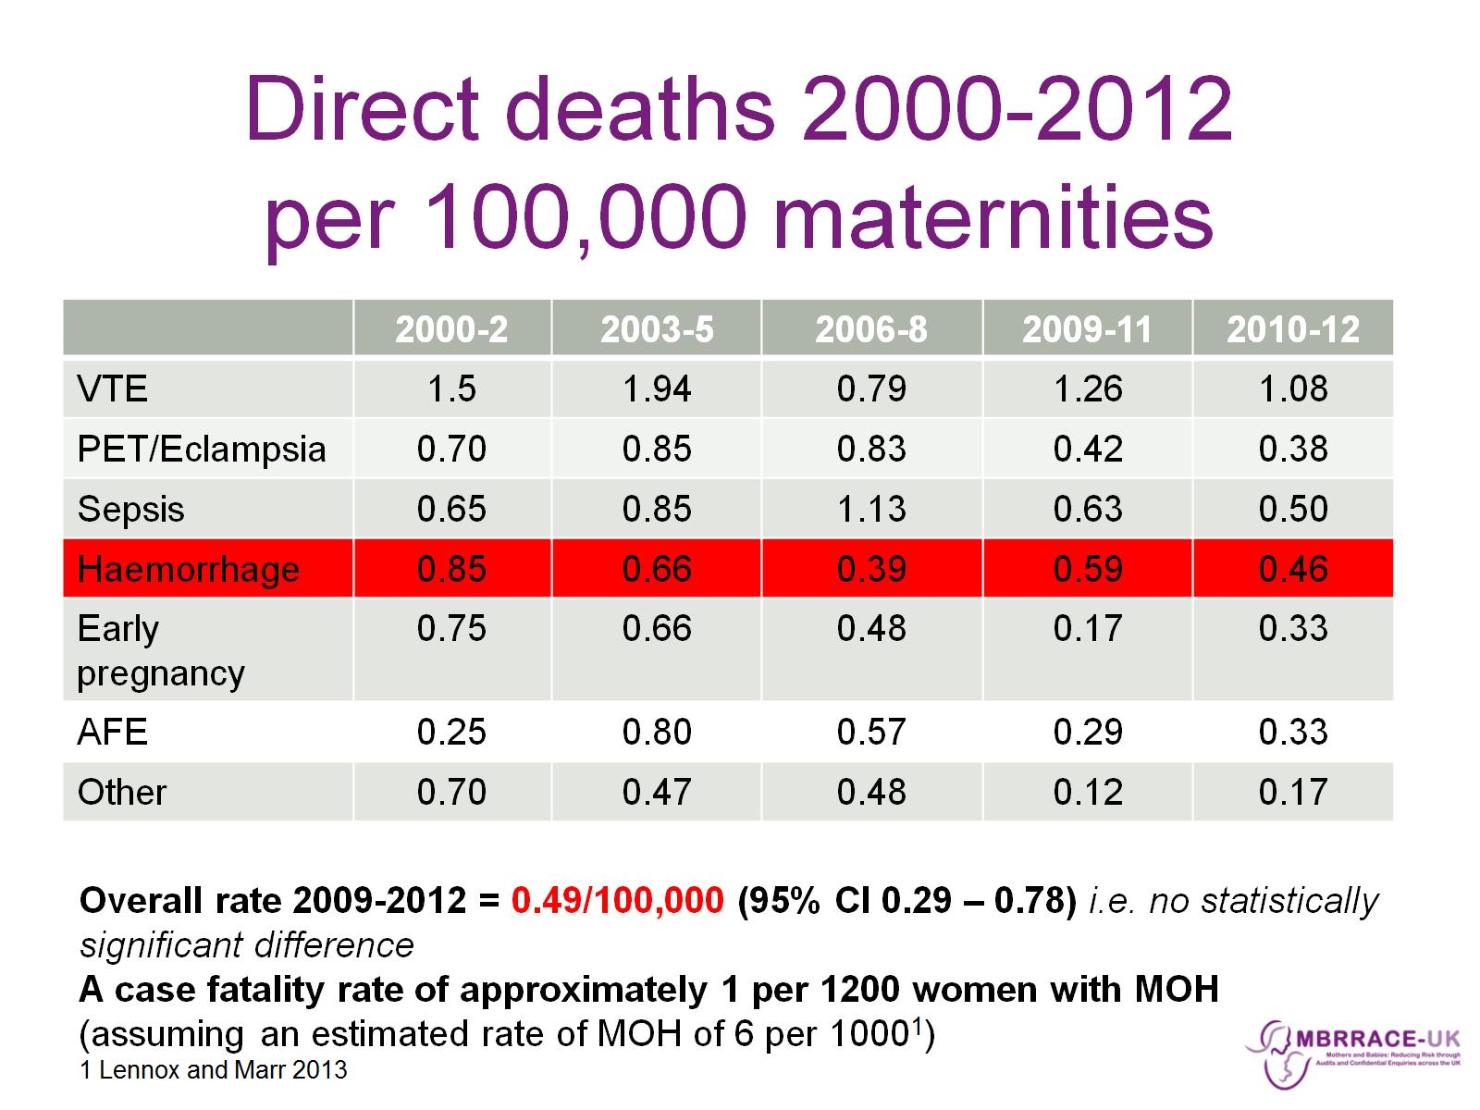
Direct deaths 2000-2012 per 100,000 maternities

Slide 5
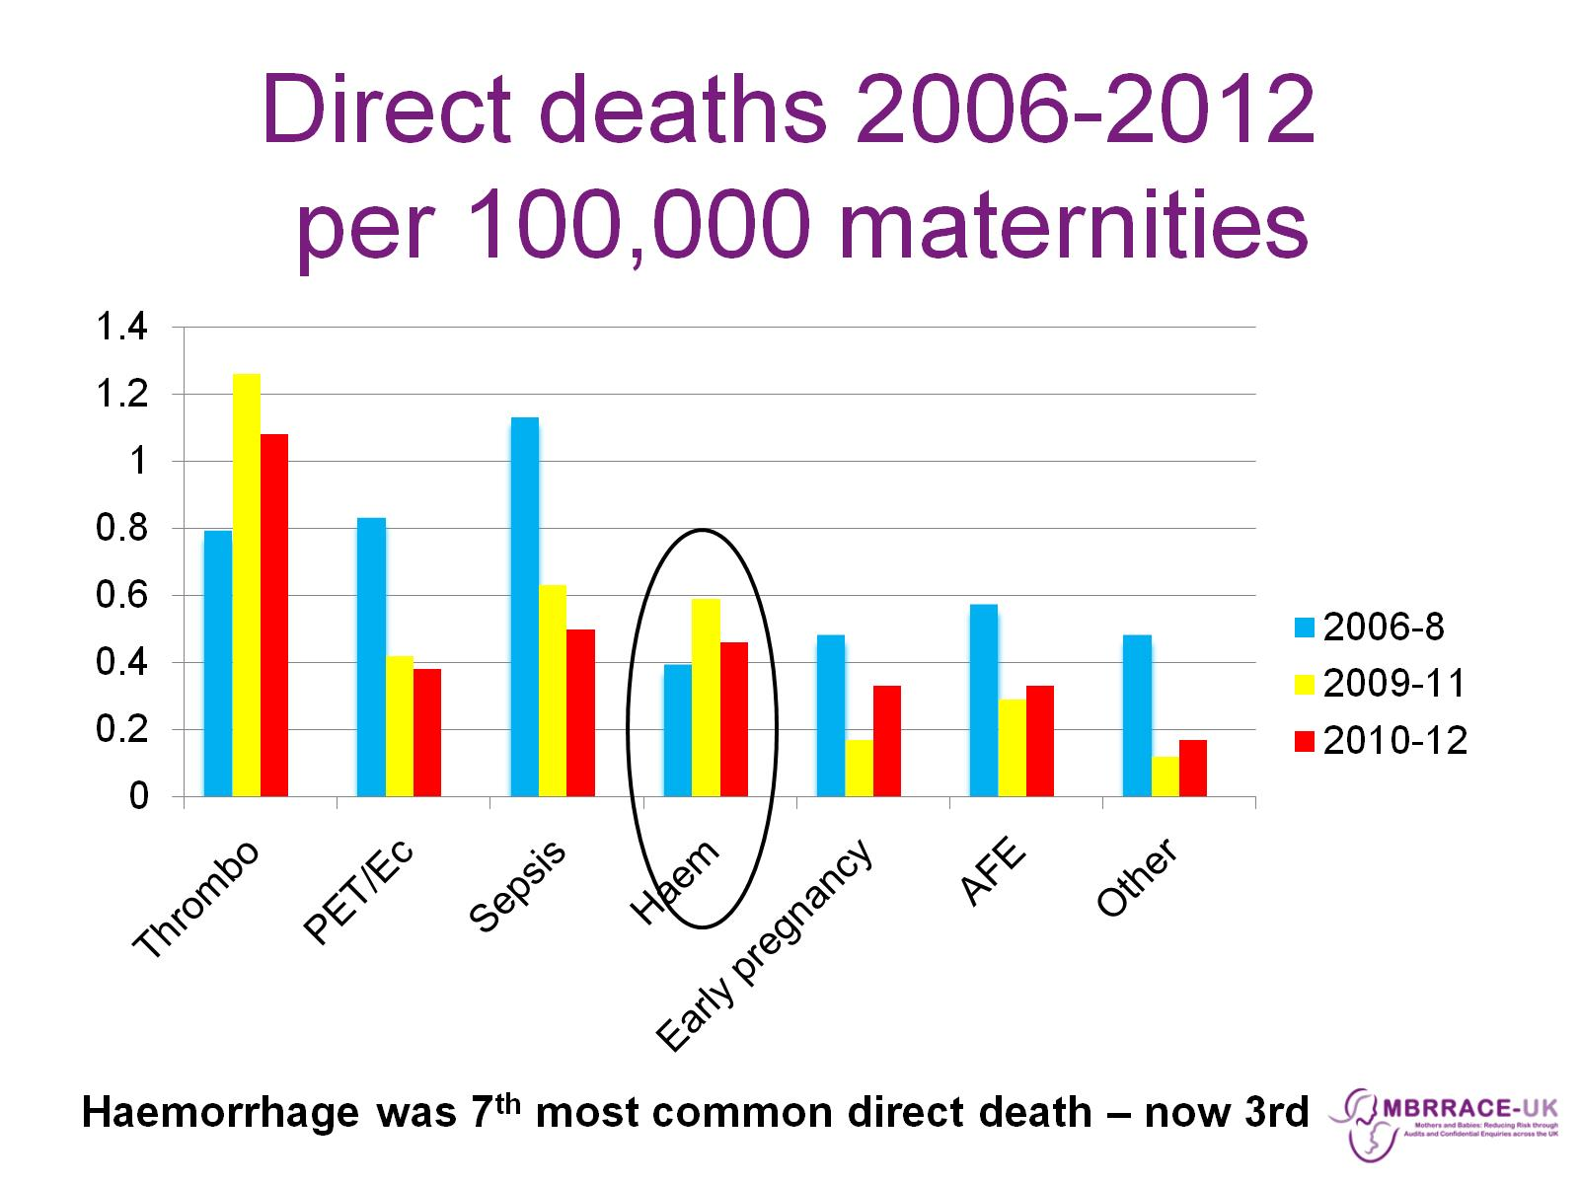
Direct deaths 2006-2012 per 100,000 maternities

Slide 6
Deaths from bleeding: 2009-2012

Slide 7
Who were these 17 women?

Slide 8
How did these 17 women deliver?

Slide 9
Causes of haemorrhage deaths

Slide 10
7 Deaths from Uterine Atony

Slide 11
7 Deaths from genital tract trauma

Slide 12
3 Women had Placental Pathology

Slide 13
Care could have been improved in all cases

Slide 14
Care could have been improved in all cases

Slide 15
Improving estimates of blood loss

Slide 16
Improving estimates of blood loss

Slide 17
Improving estimates of blood loss Small women have small blood volumes 9 women weighed less than 60kg

Slide 18
Improving communication of estimated blood loss

Slide 19
Improving communication of estimated blood loss

Slide 20
3. Improving Resuscitation

Slide 21
Improving Resuscitation

Slide 22
4. Improving Response: Control the bleeding

Slide 23
Turning off the tap

Slide 24
Turning off the Tap: Intra-uterine tamponade

Slide 25
Turning off the Tap: Hysterectomy

Slide 26
5. Improving human factor skills

Slide 27
Key Haemorrhage Messages

Slide 28
Amniotic Fluid Embolism

Slide 29
Direct deaths 2000-2012 per 100,000 maternities

Slide 30
AFE Diagnostic Criteria UK Obstetric Surveillance System (UKOSS) Knight, Tuffnell et al. 2010

Slide 31
11 Women Died from AFE

Slide 32
Clinical presentation of AFE:

Slide 33
Clinical course following collapse

Slide 34
Clinical outcome after AFE

Slide 35
Improving care

Slide 36
Key AFE Messages

Slide 37
Key AFE Messages

