Slide 1
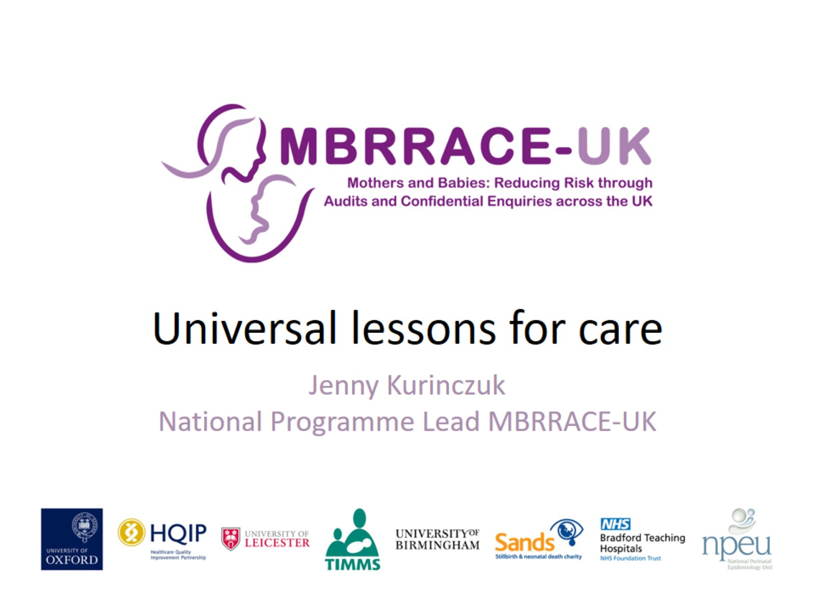
Universal lessons for care

Slide 2
Key messages

Slide 3
Maternal mortality UK 2003-14

Slide 4
Causes of maternal death 2012-14

Slide 5
Indirect Maternal Deaths 2012-14

Slide 6
Cardiac deaths are increasing

Slide 7
Direct Maternal Deaths 2012-14

Slide 8
Maternal deaths by suicide

Slide 9
Key messages for women and families

Slide 10
Key messages – early pregnancy care

Slide 11
Key messages – pre-eclampsia

Slide 12
Key messages – Critical care

Slide 13
Key Messages – cardiac disease

Slide 14
Key messages – chest pain

Slide 15
Key messages – cardiac care

Slide 16
Saving Lives, Improving Mothers’ Care

Slide 17
Funding

