Slide 2
Introduction

Slide 3
Context

Slide 5
The process

Slide 6
Development

Slide 7
Aims

Slide 8
Deaths reviewed

Slide 9
Deaths reviewed

Slide 10
Methods

Slide 11
Review panels

Slide 12
Quality of care assessed at each point of the care pathway

Slide 13
Grading along the pathway

Slide 14
Overall grading

Slide 15
Additional data

Slide 16
Limitations

Slide 20
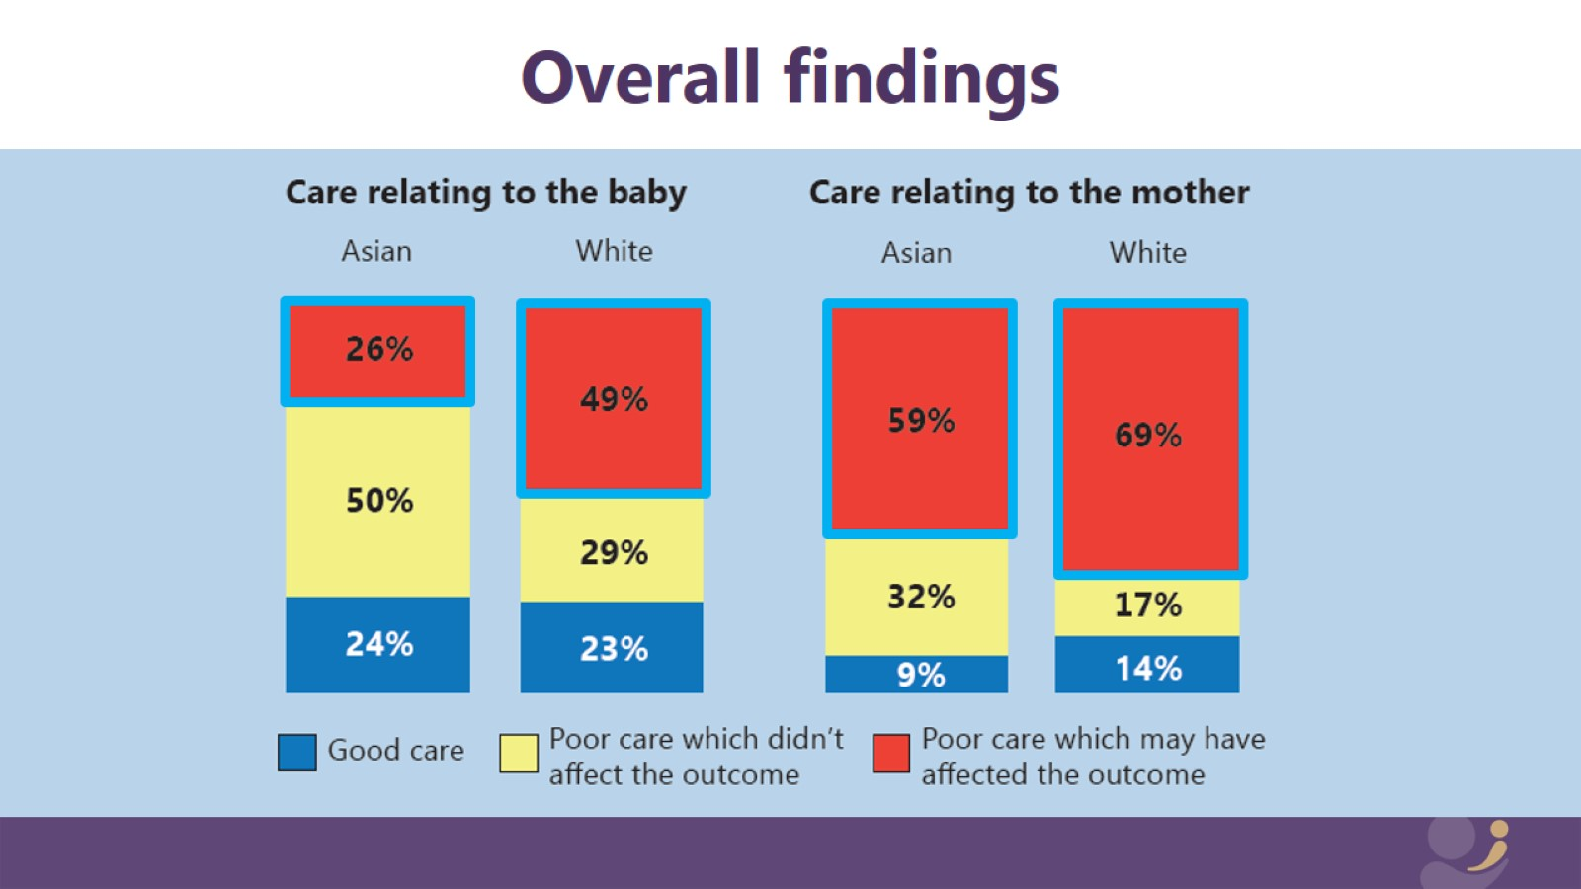
Overall findings

Slide 21
Overall findings

