Slide 1


Slide 2
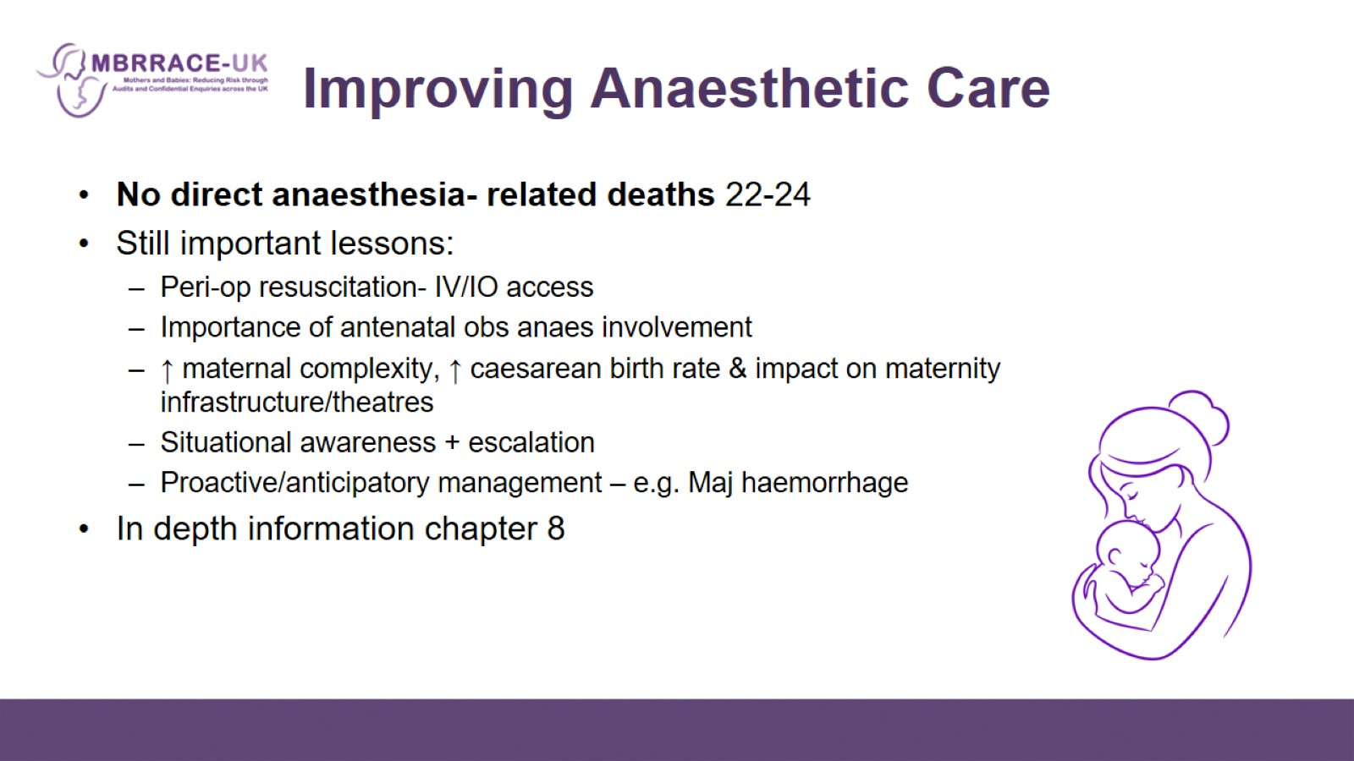
Improving Anaesthetic Care

Slide 3
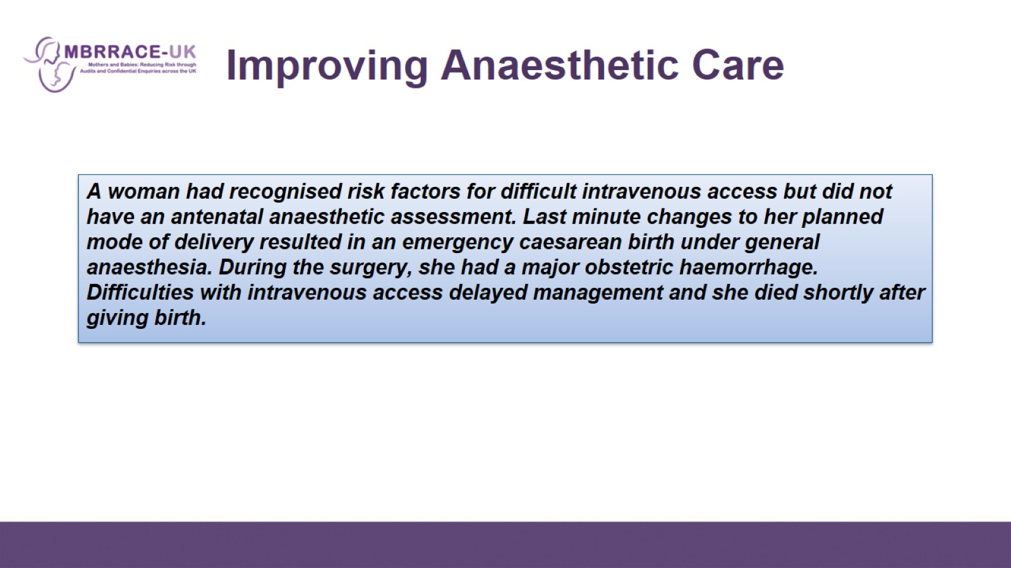

Slide 4
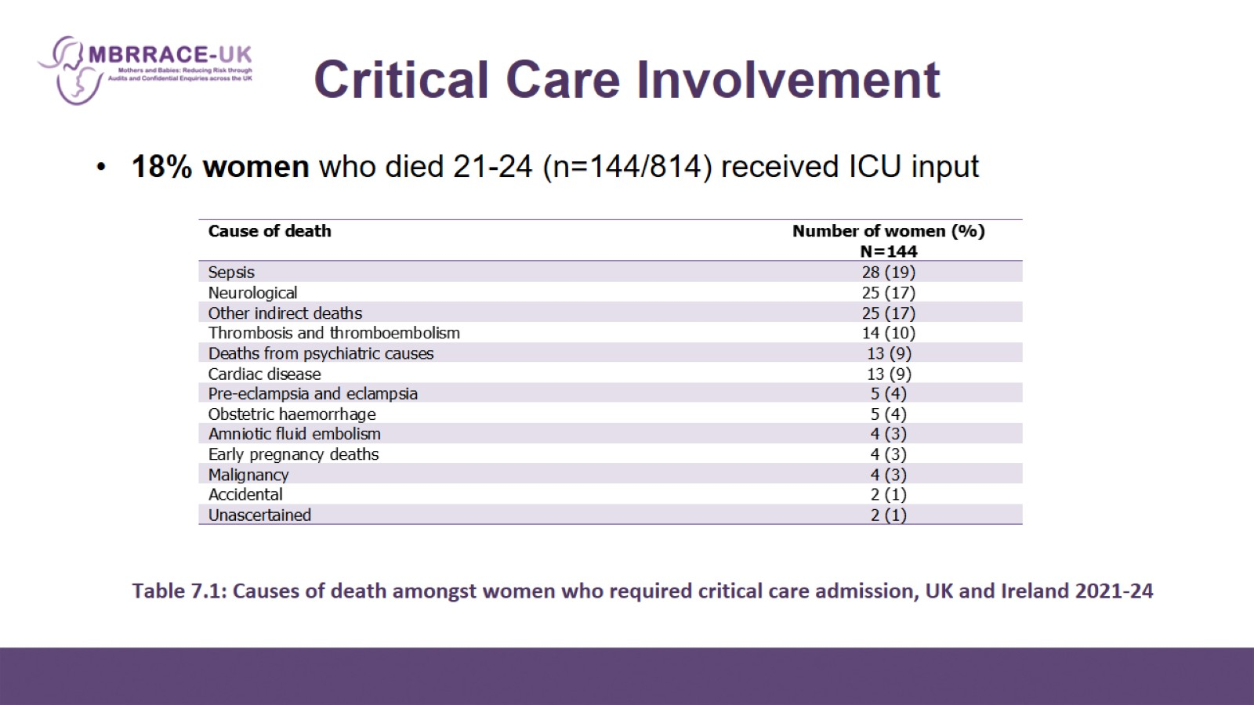
Table 7.1: Causes of death amongst women who required critical care admission, UK and Ireland 2021-24

Slide 5
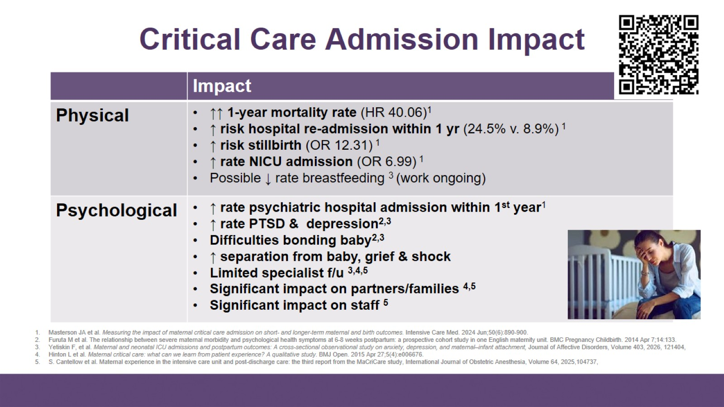
Critical Care Admission Impact

Slide 6
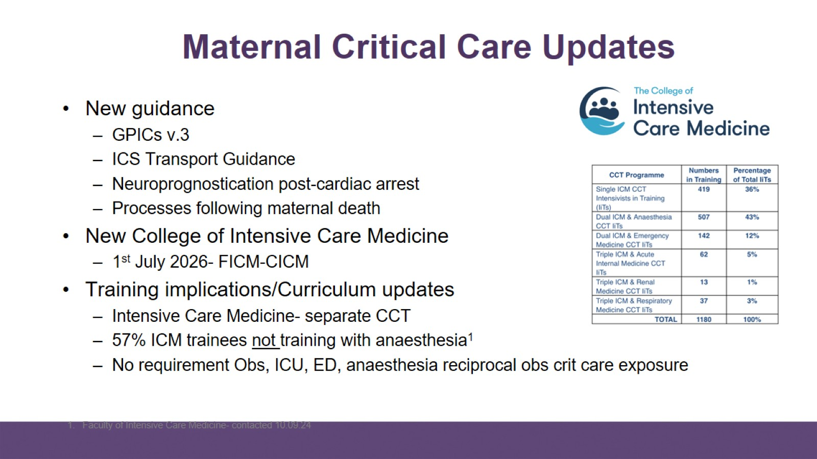
Maternal Critical Care Updates

Slide 7
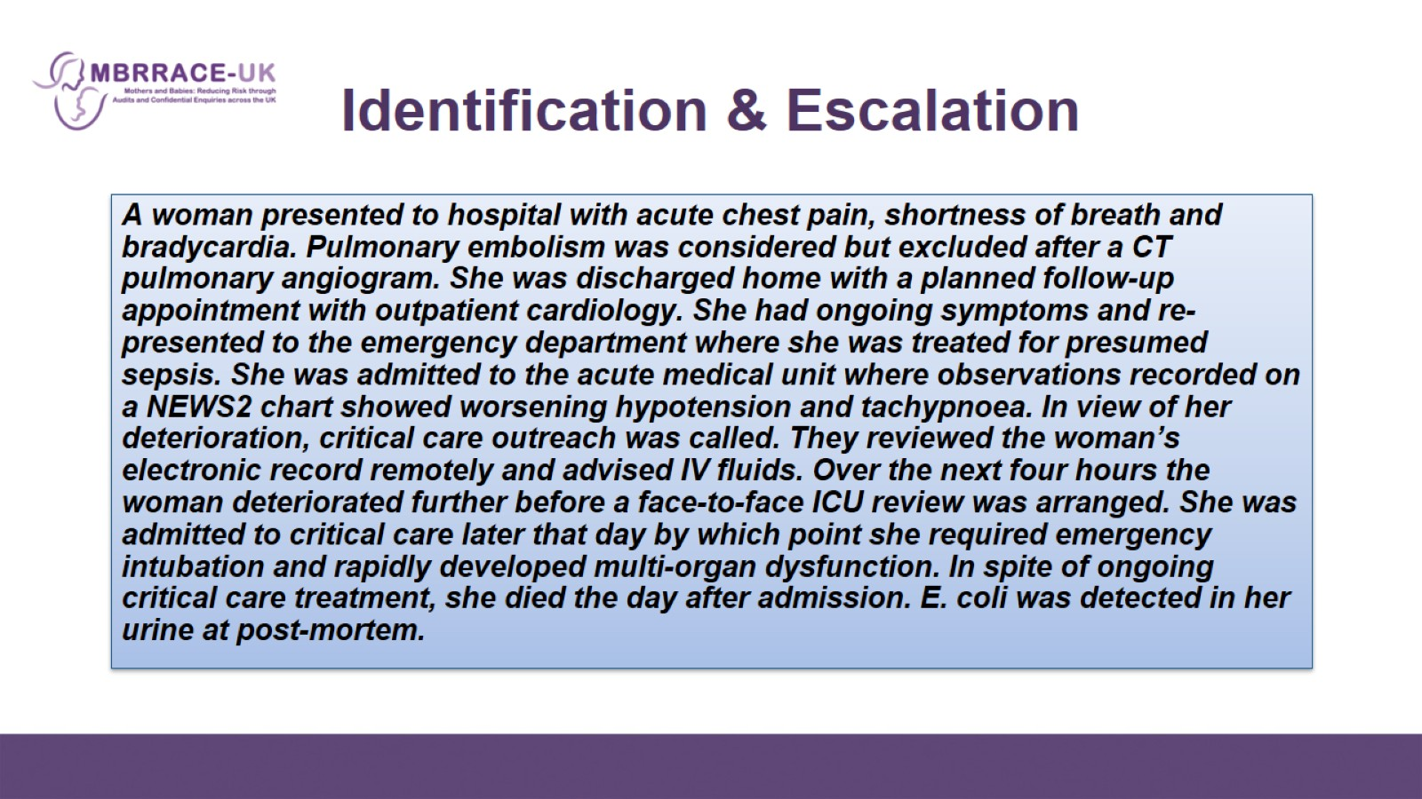
Identification & Escalation

Slide 8
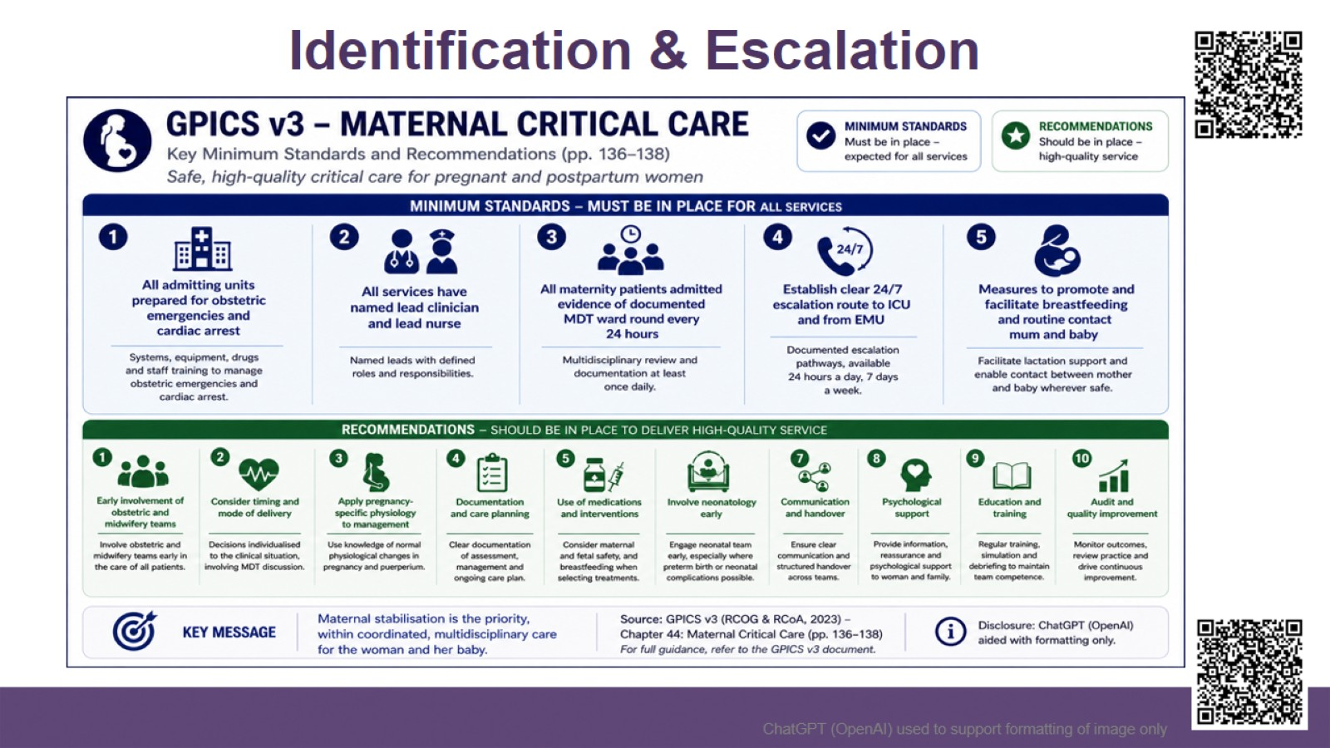
Identification & Escalation

Slide 9
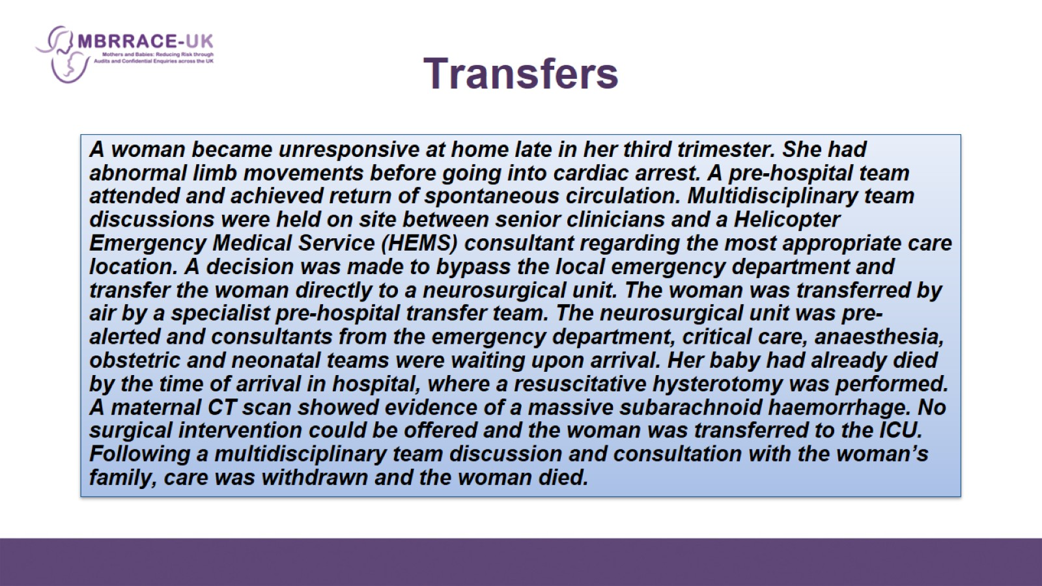
Transfers

Slide 10
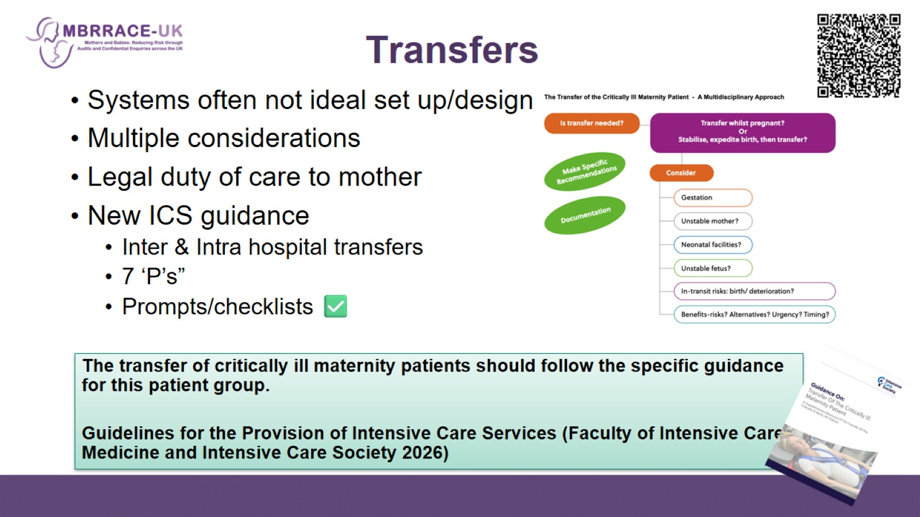
Transfers

Slide 11
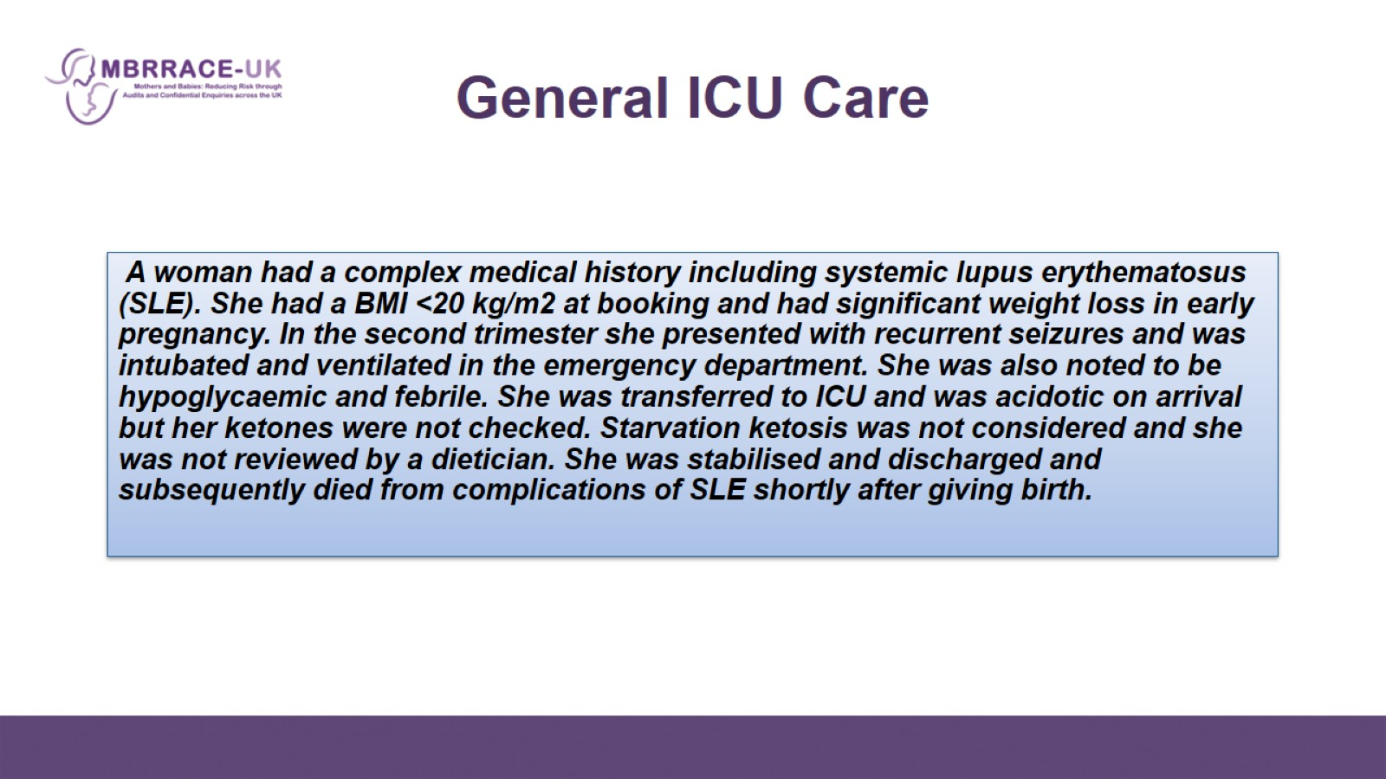
General ICU Care

Slide 12
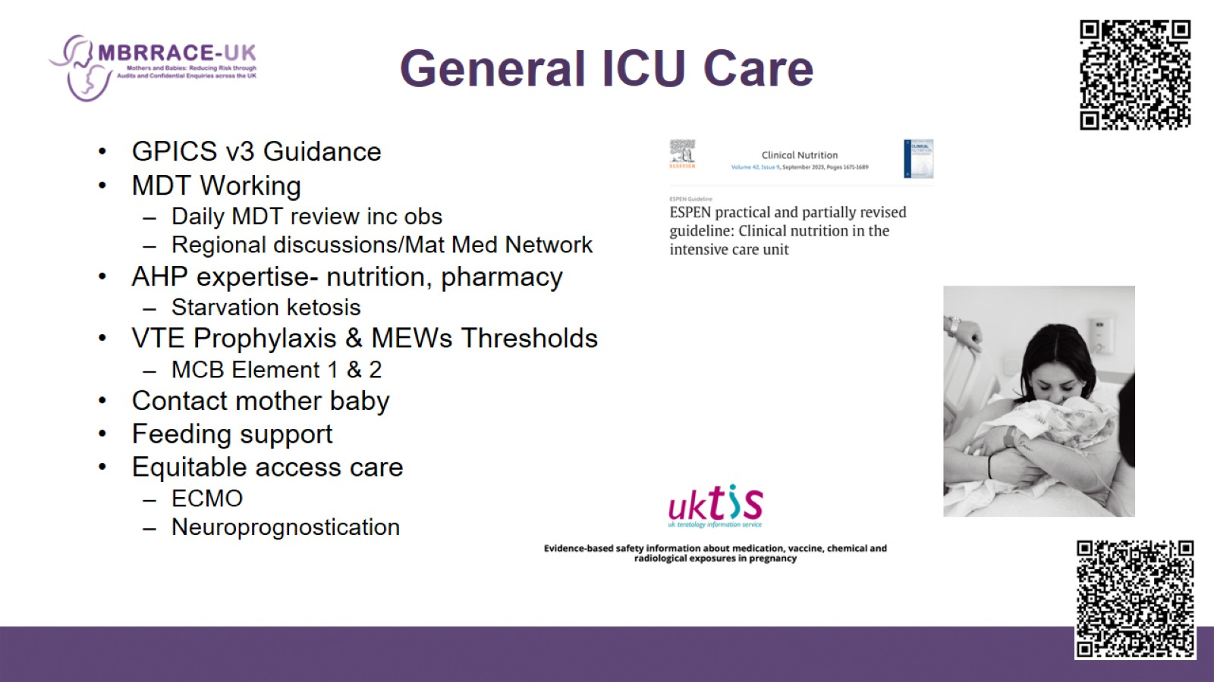
General ICU Care

Slide 13
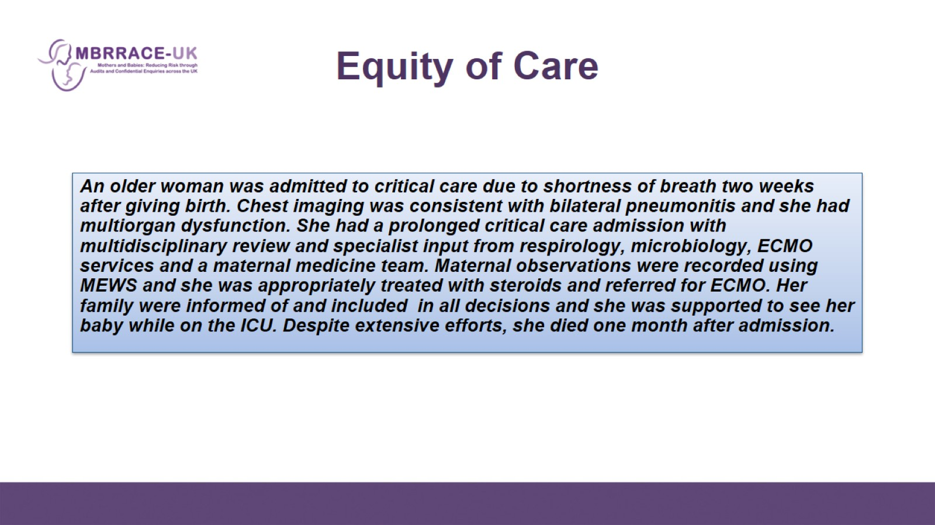
Equity of Care

Slide 14
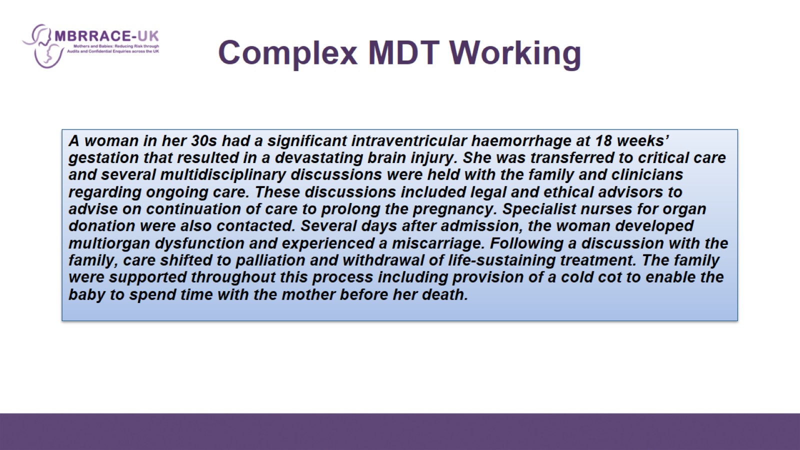
Complex MDT Working

Slide 15
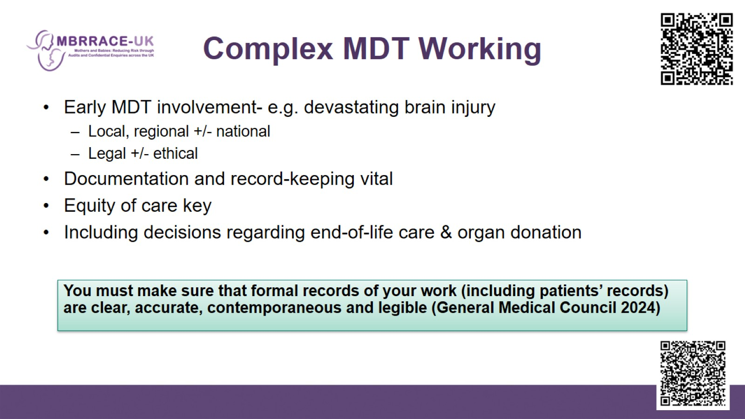
Complex MDT Working

Slide 16
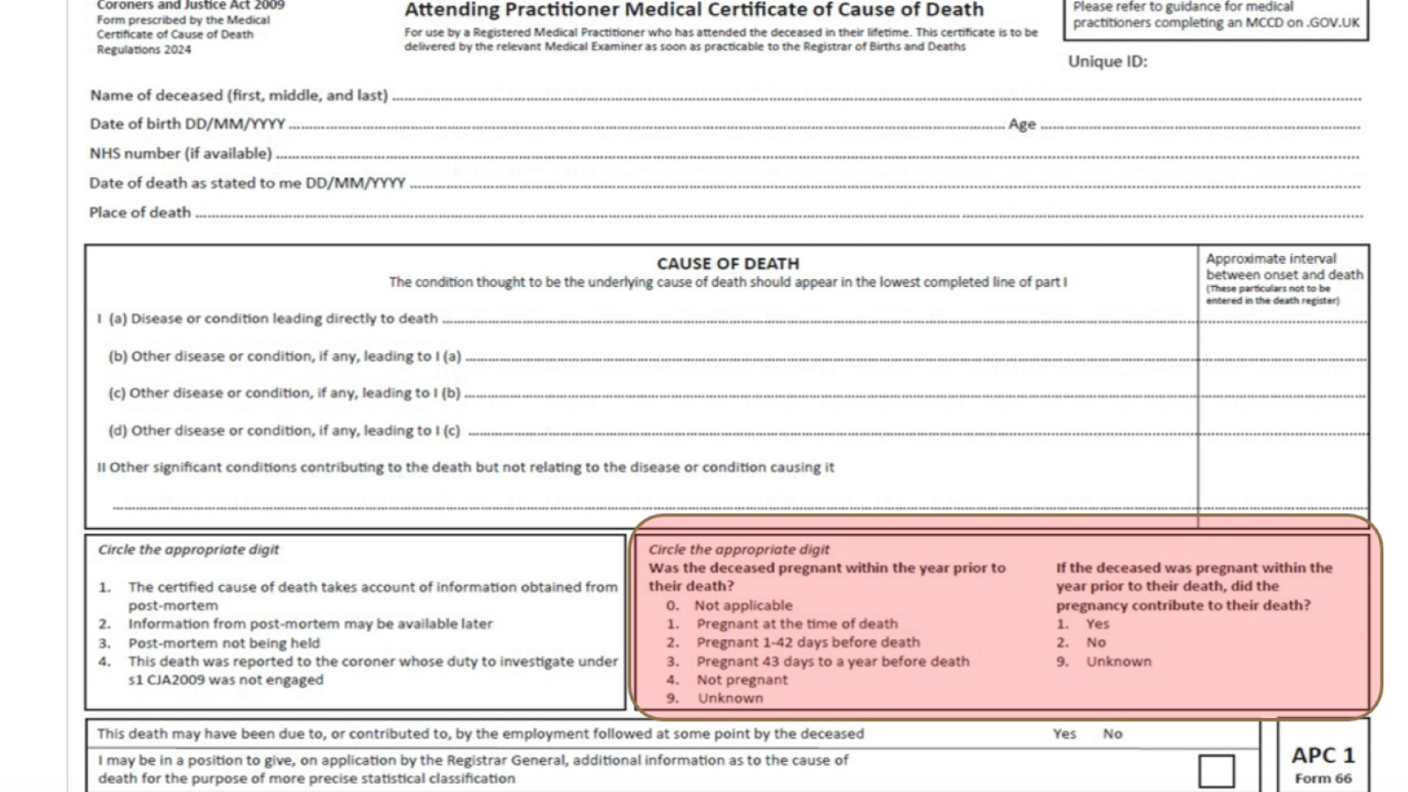
End of Life Care & After Death

Slide 17
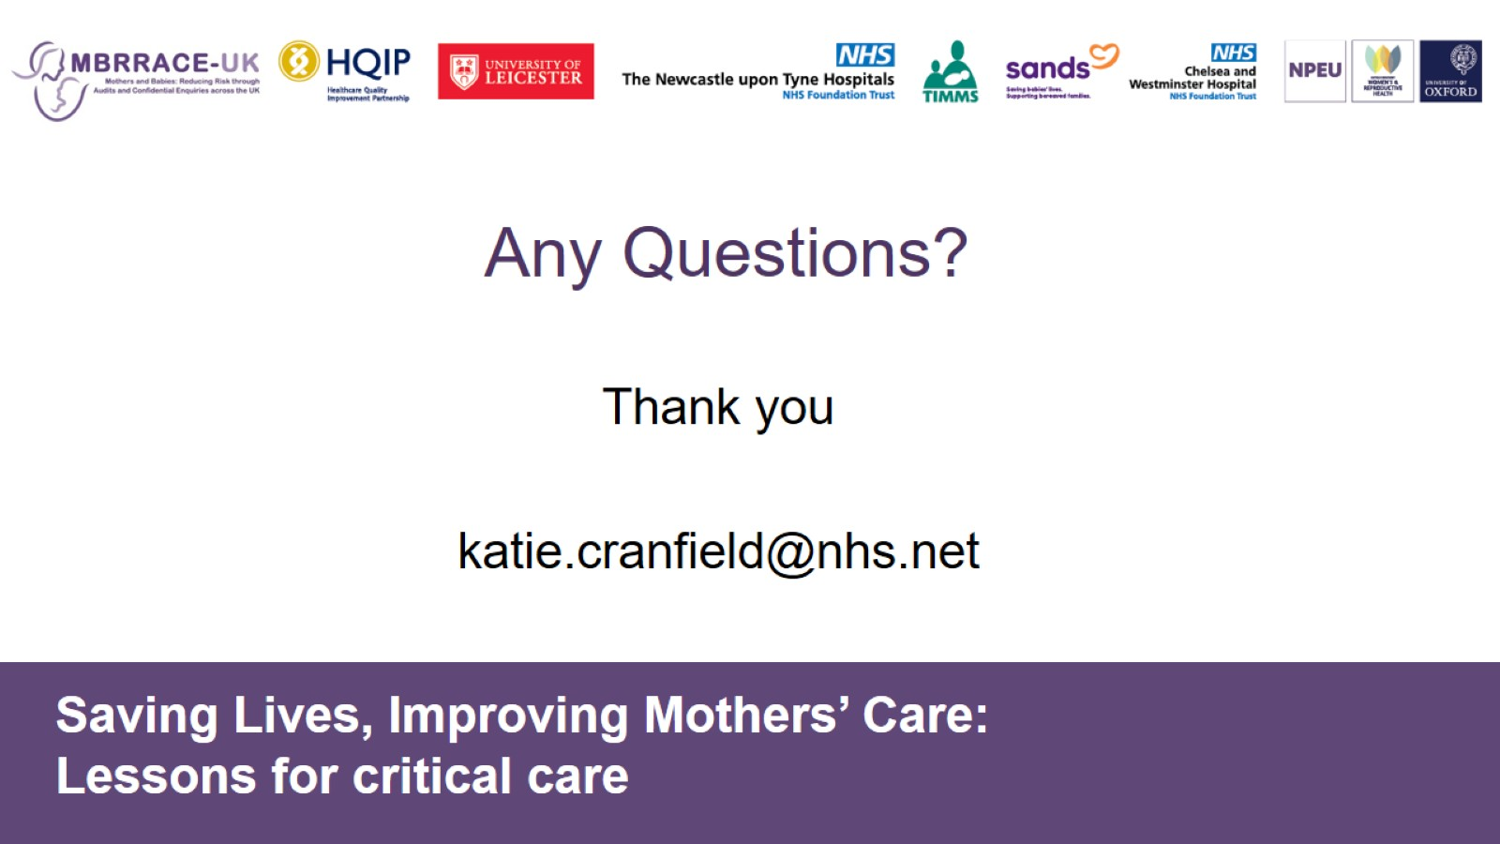
Any Questions?

