Slide 1
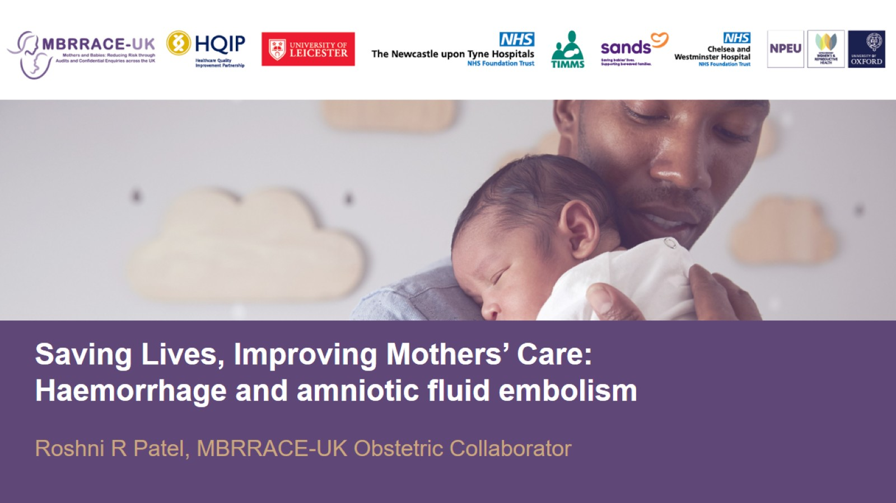

Slide 2
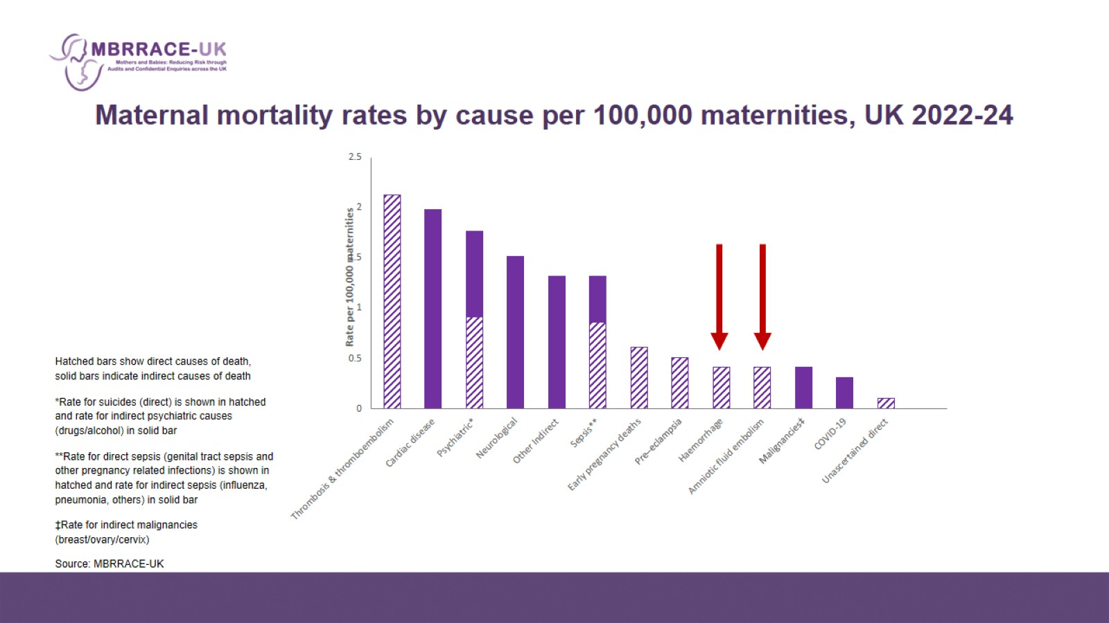
Maternal mortality rates by cause per 100,000 maternities, UK 2022-24

Slide 3
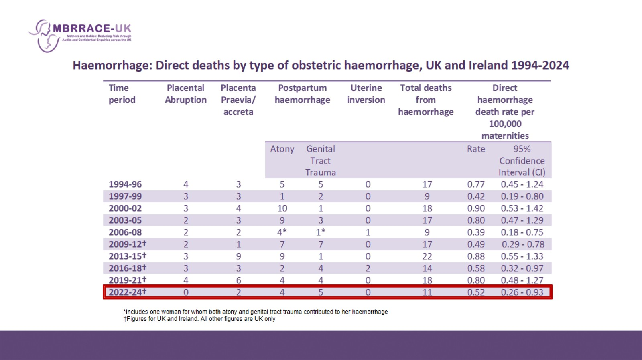
Haemorrhage: Direct deaths by type of obstetric haemorrhage, UK and Ireland 1994-2024

Slide 4
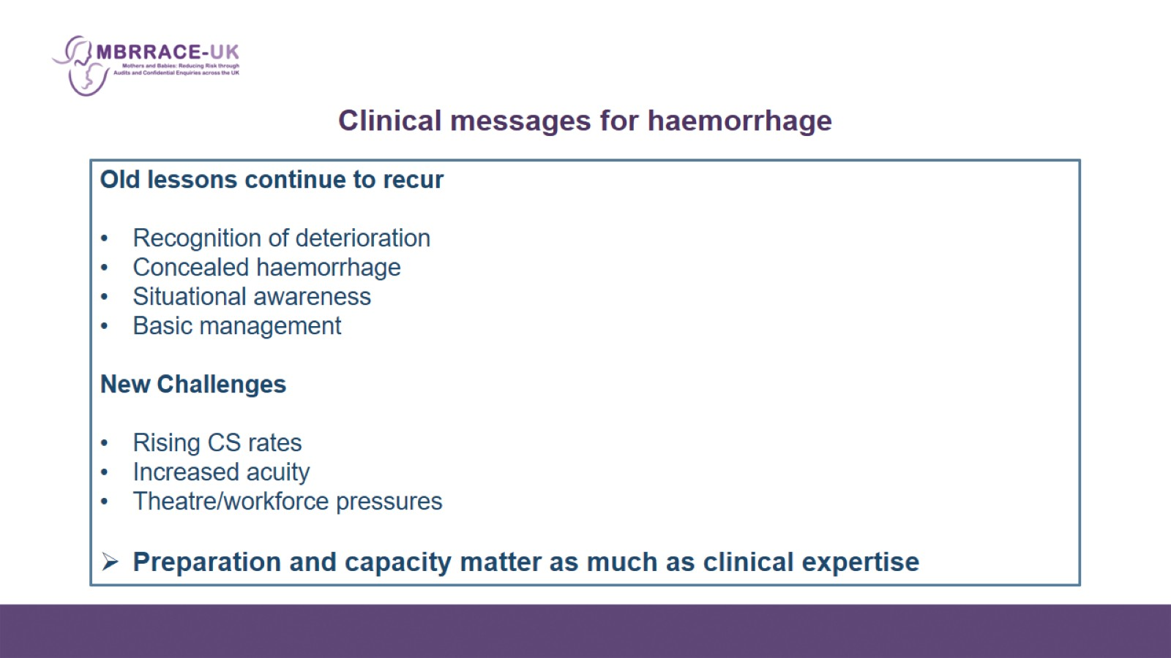
Clinical messages for haemorrhage

Slide 5
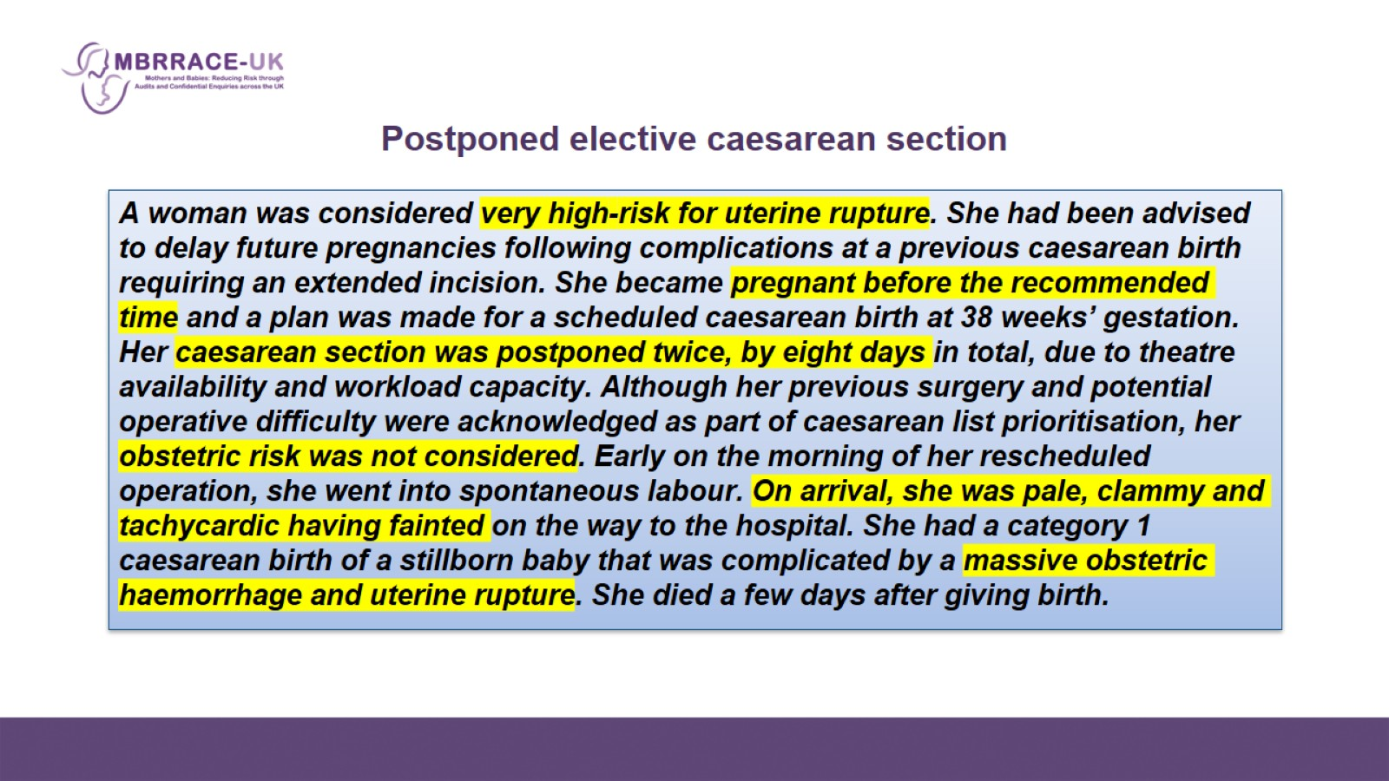
Postponed elective caesarean section

Slide 6
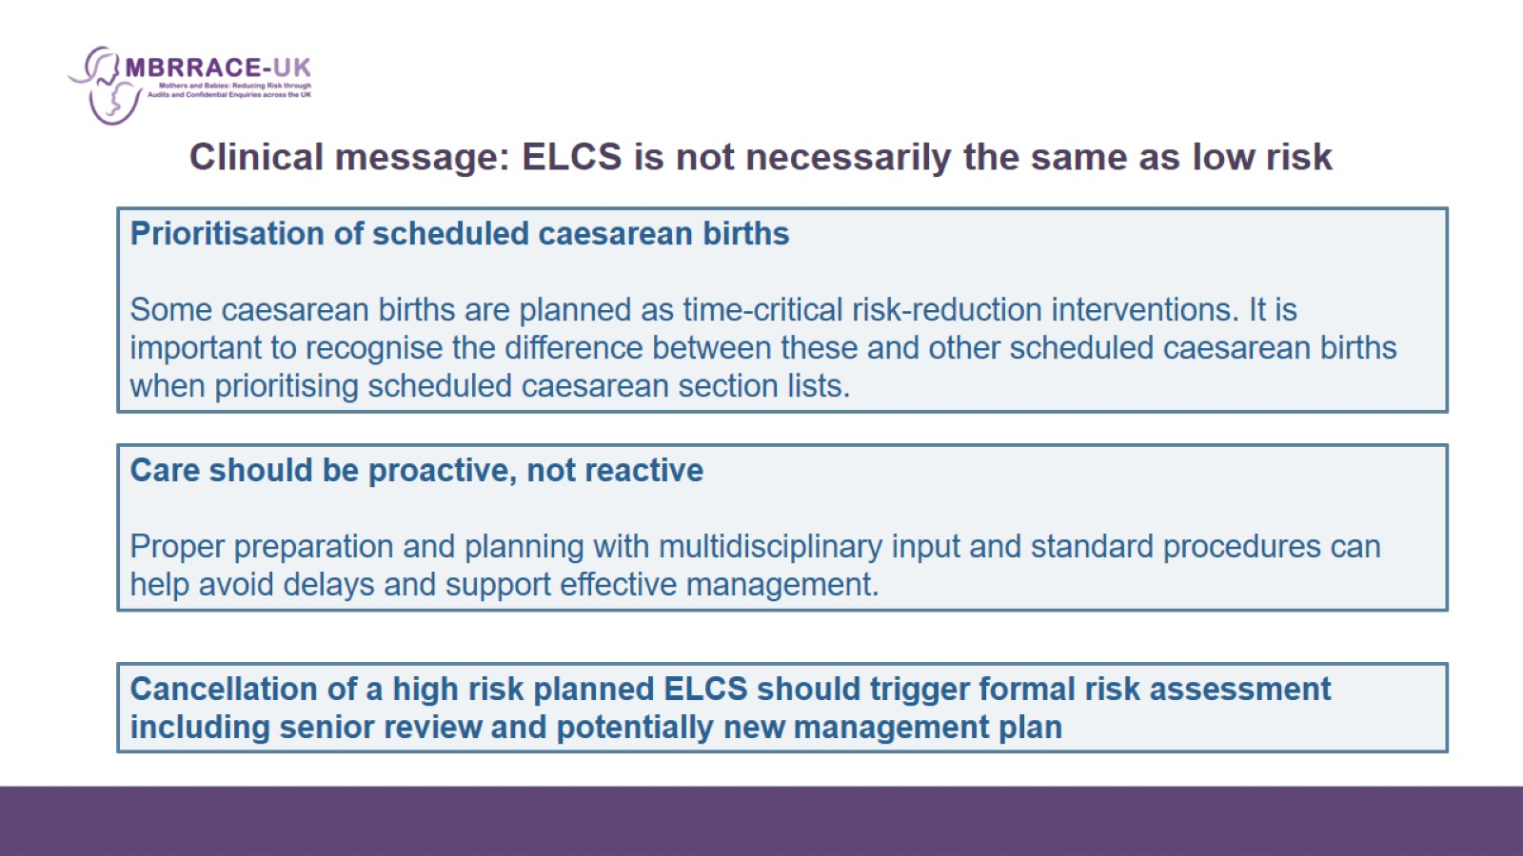
Clinical message: ELCS is not necessarily the same as low risk

Slide 7
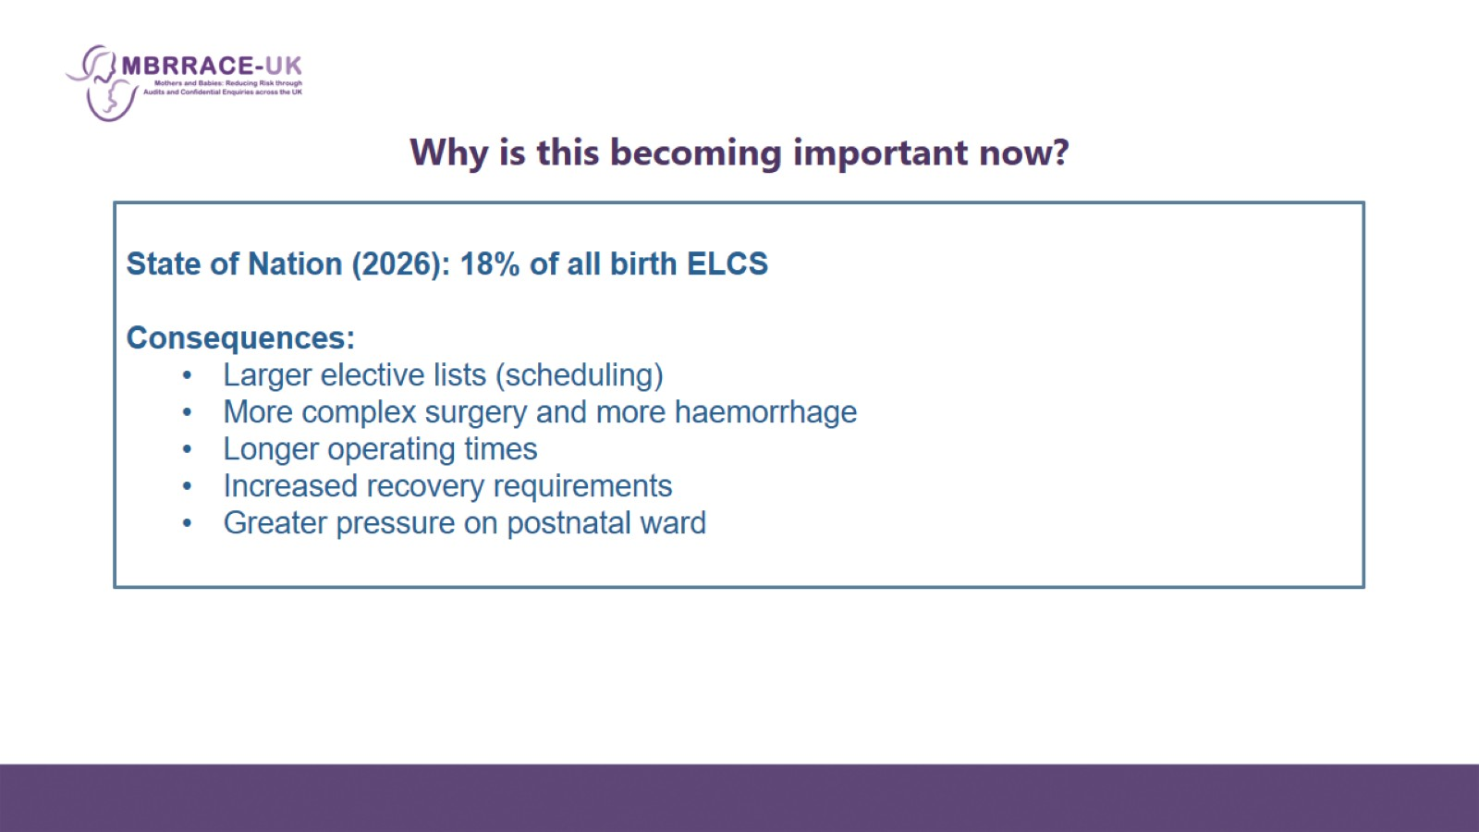
Why is this becoming important now?

Slide 8
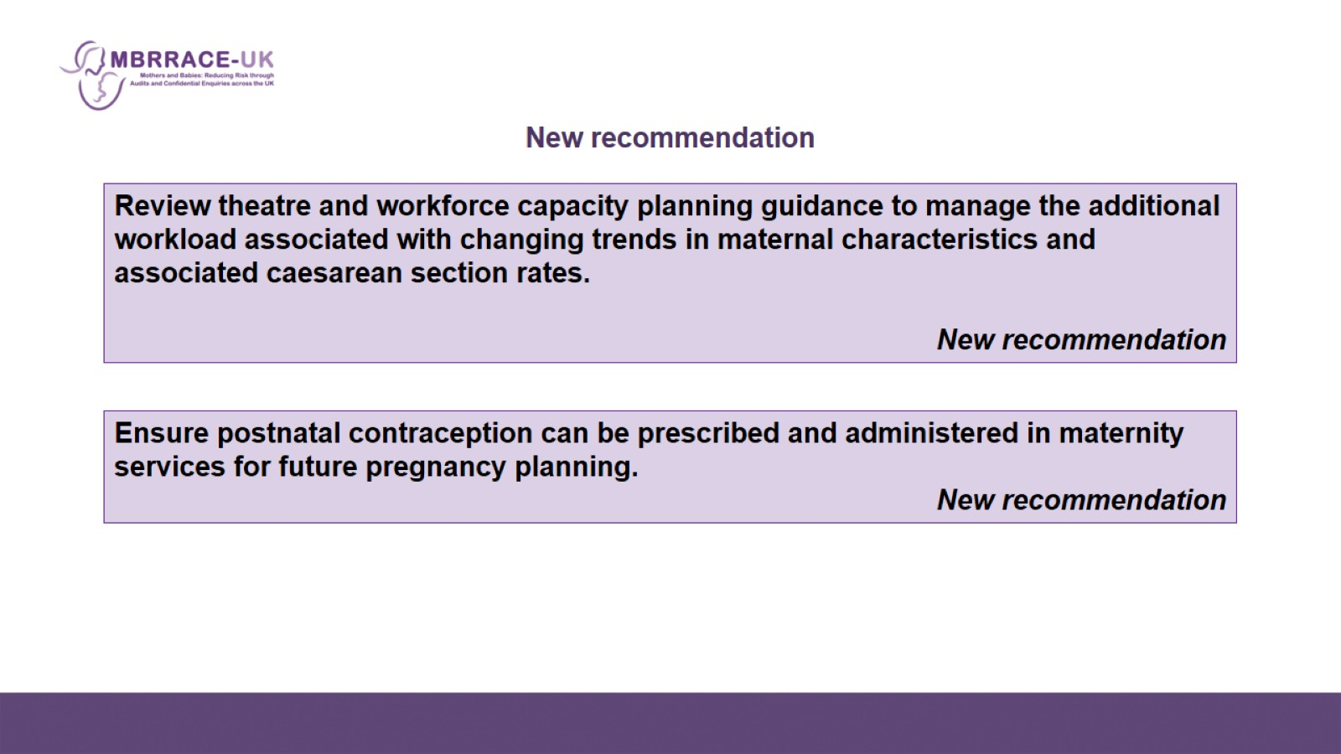
New recommendation

Slide 9
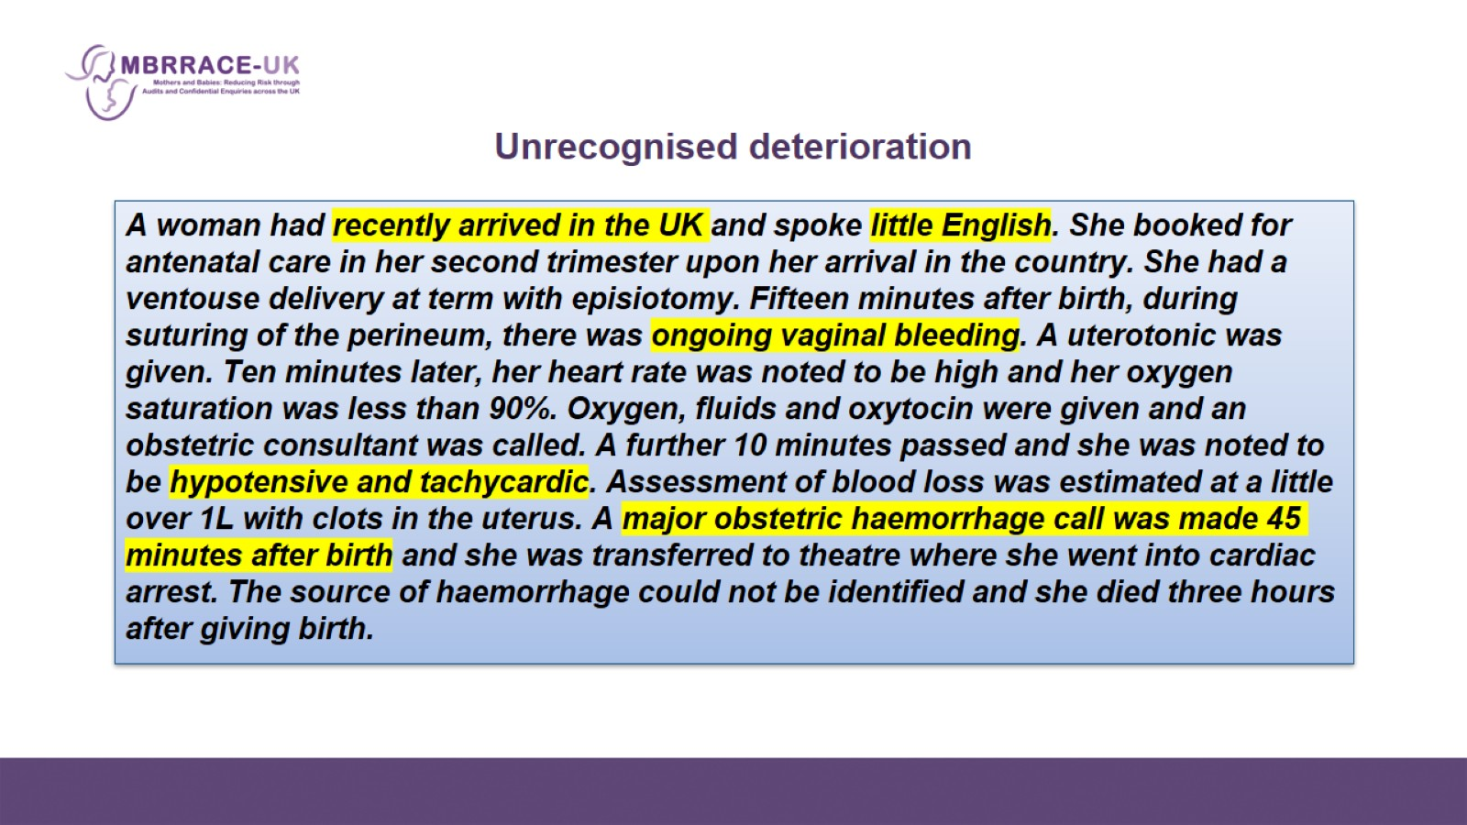
Unrecognised deterioration

Slide 10
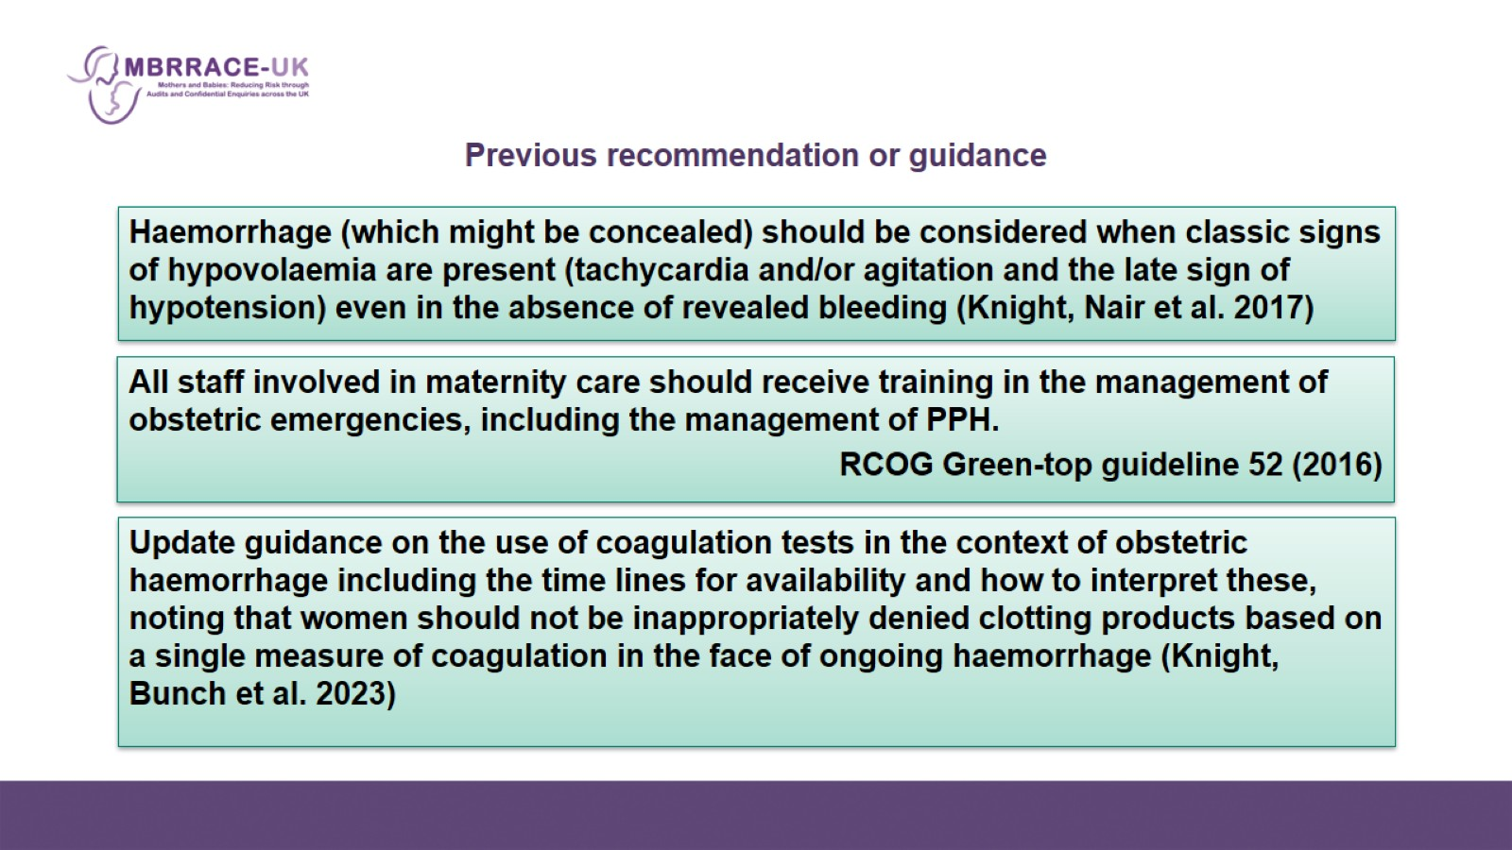
Previous recommendation or guidance

Slide 11
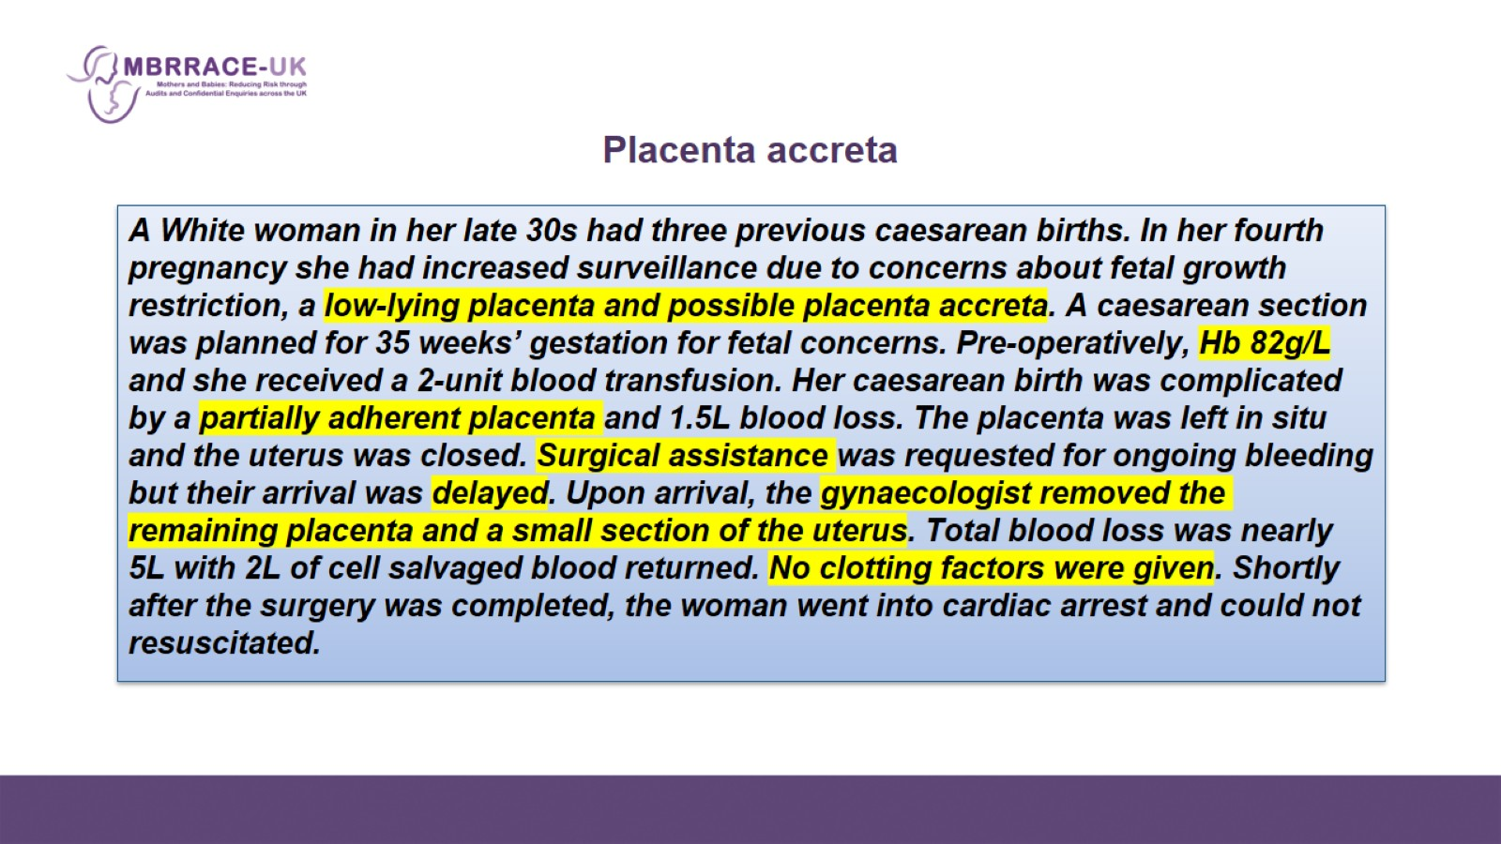
Placenta accreta

Slide 12
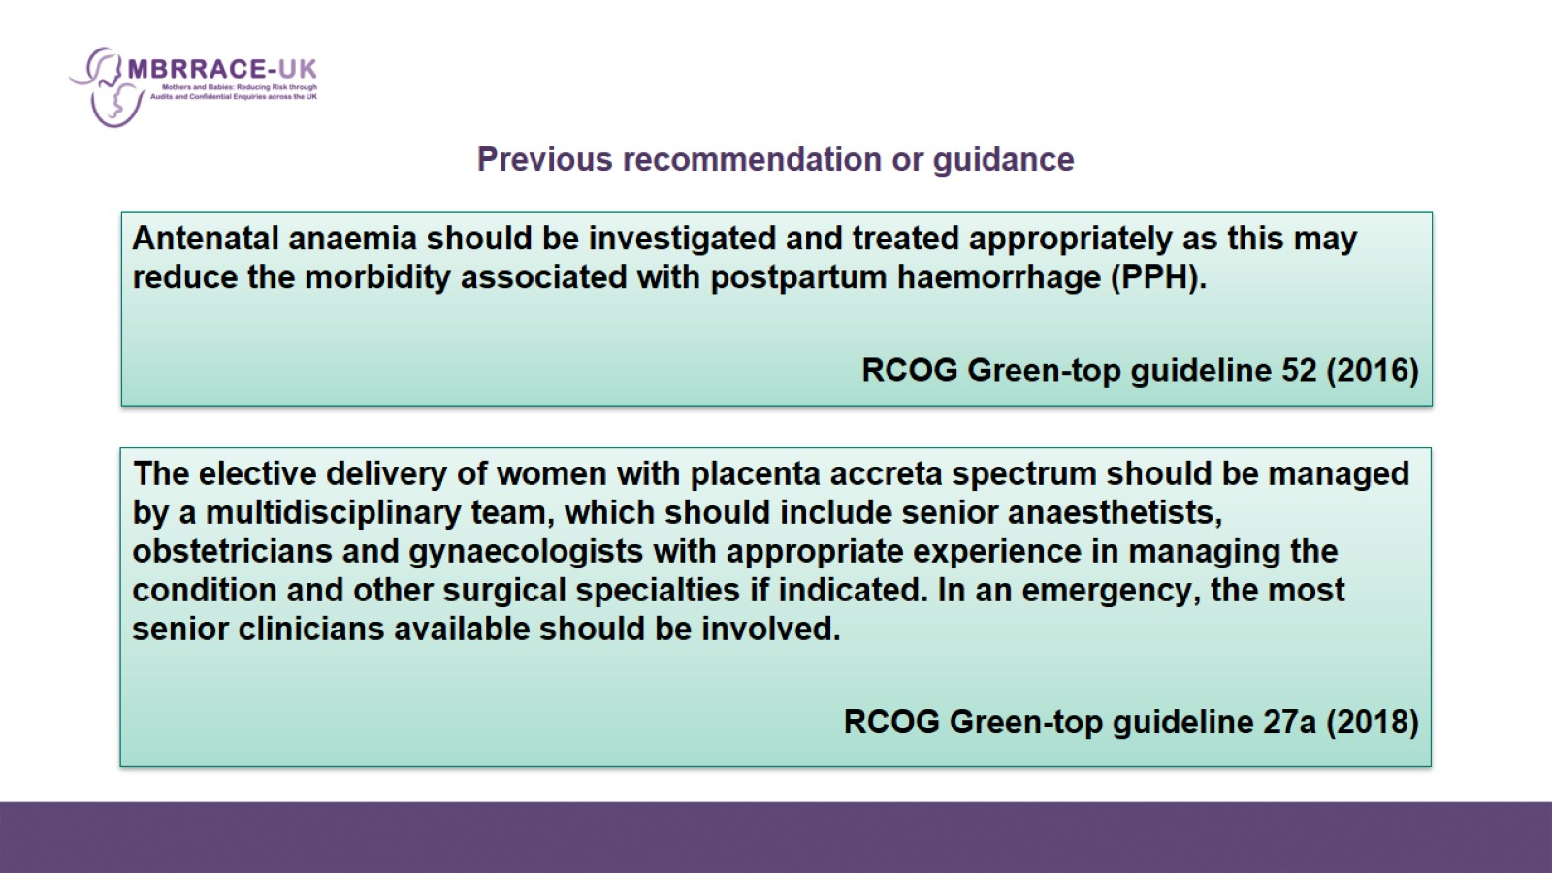
Previous recommendation or guidance

Slide 13
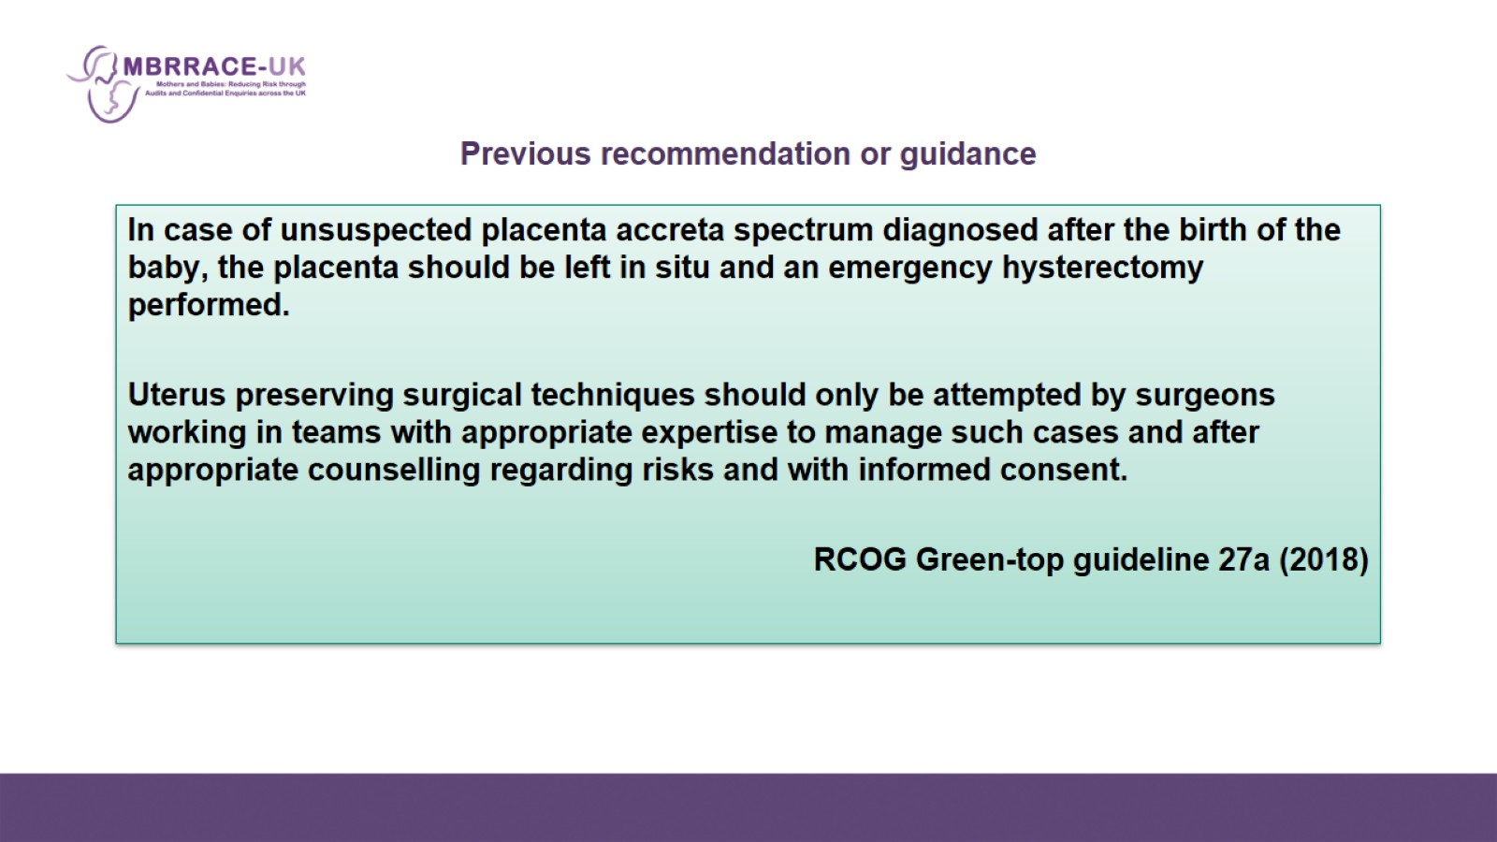
Previous recommendation or guidance

Slide 14
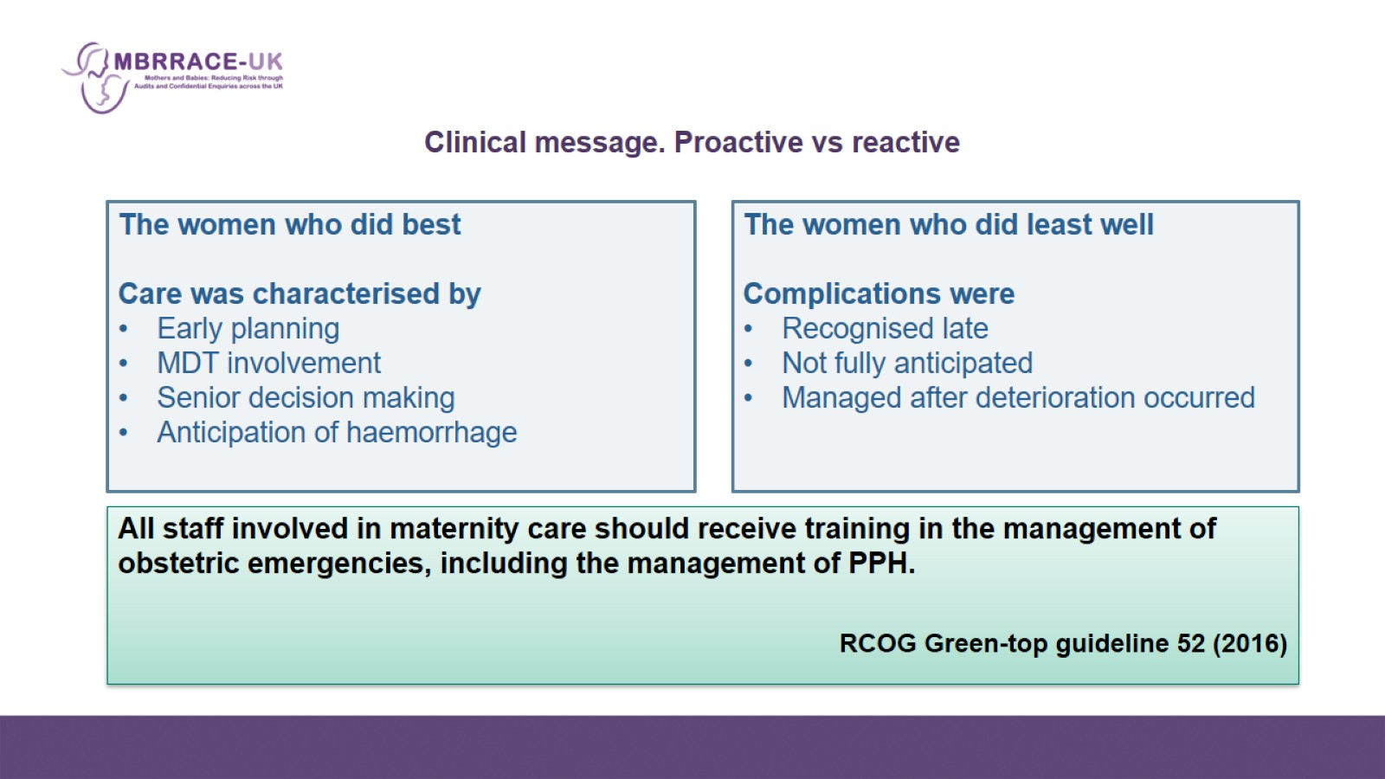
Clinical message. Proactive vs reactive

Slide 15
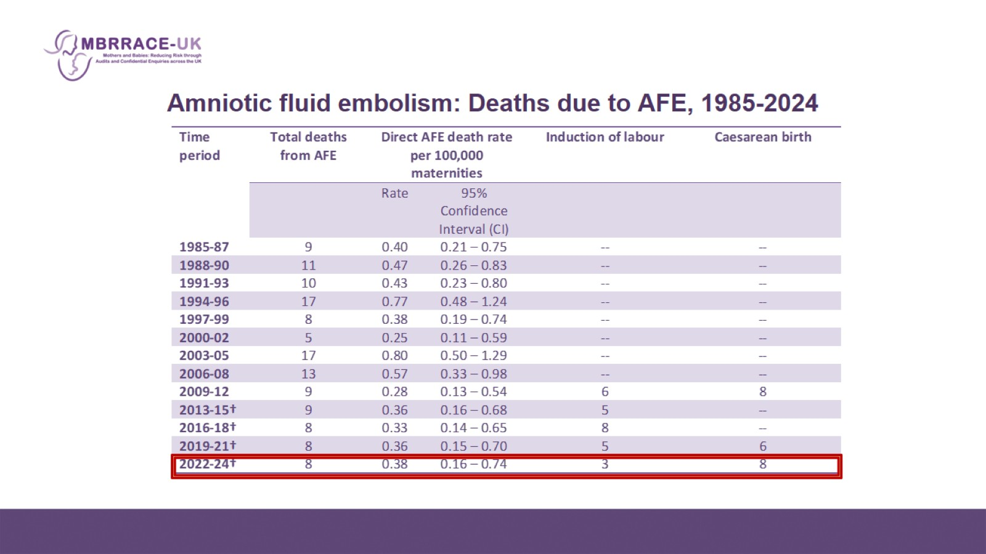
Amniotic fluid embolism: Deaths due to AFE, 1985-2024

Slide 16
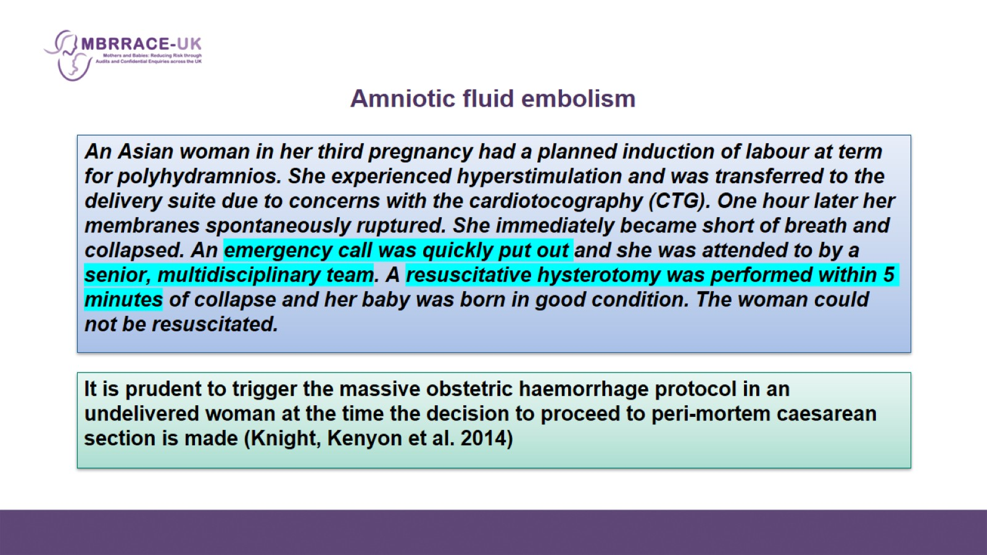
Amniotic fluid embolism

Slide 17
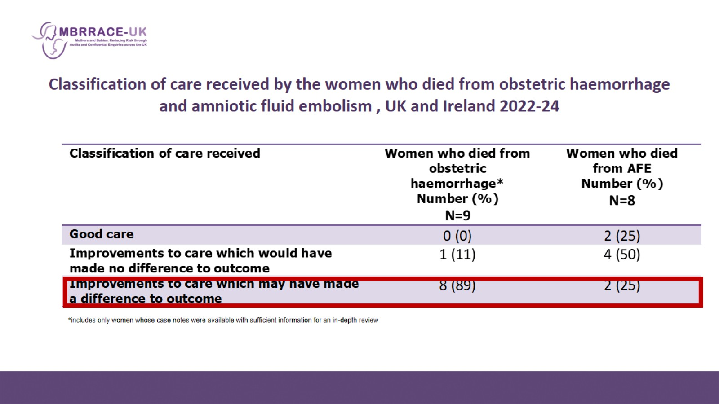
Classification of care received by the women who died from obstetric haemorrhage and amniotic fluid embolism , UK and Ireland 2022-24

Slide 18
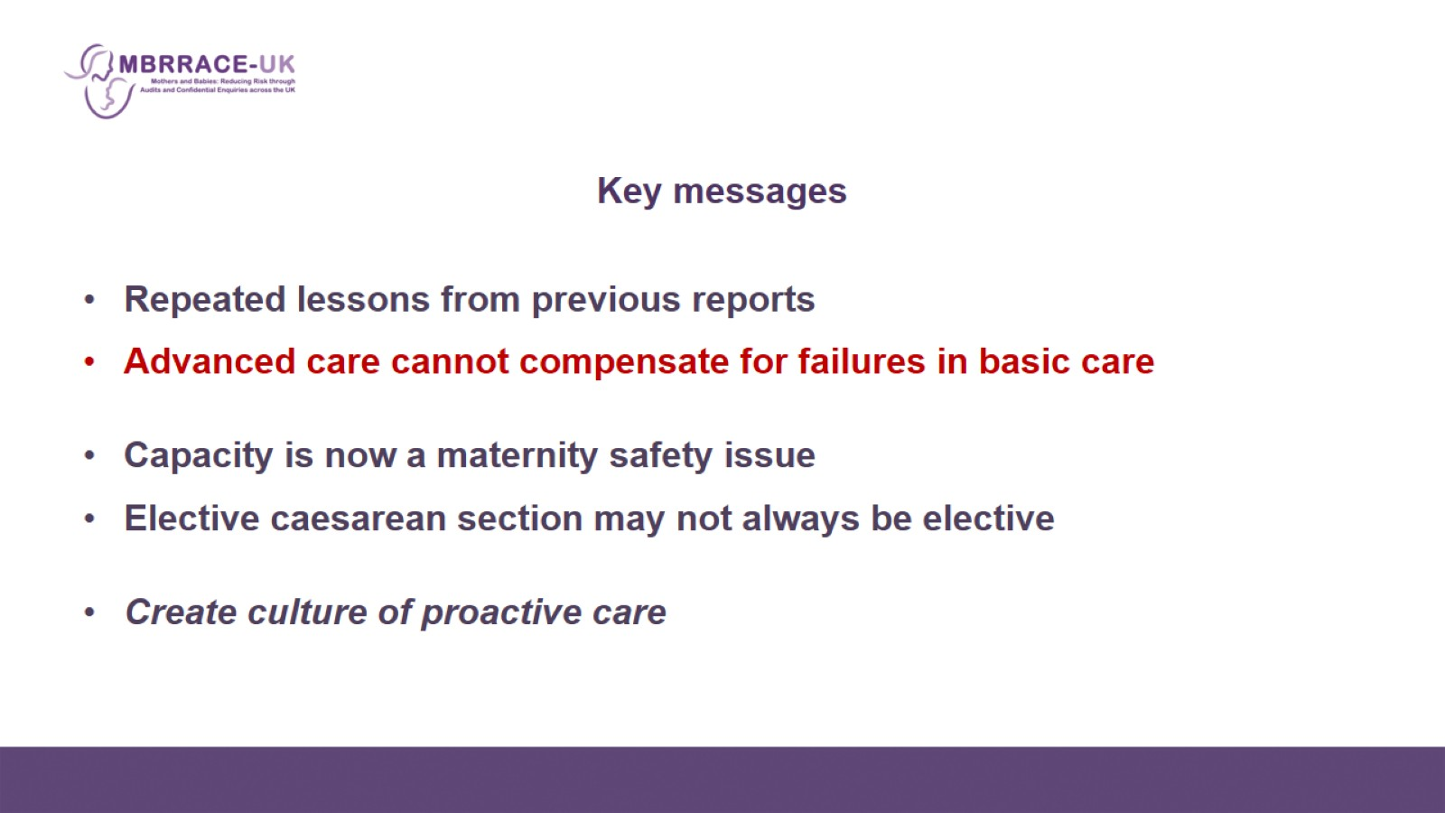
Key messages

