Slide 1
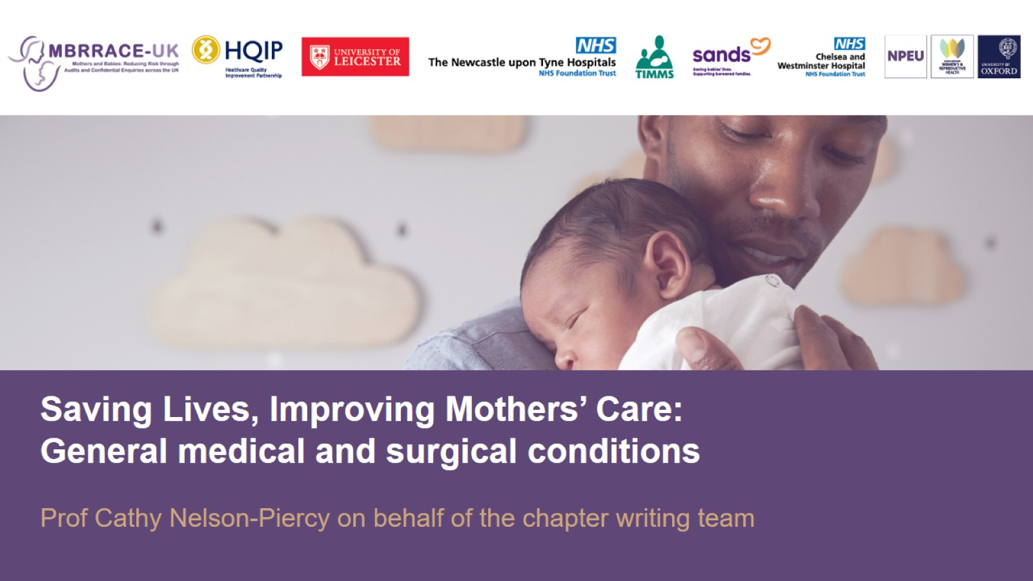

Slide 2
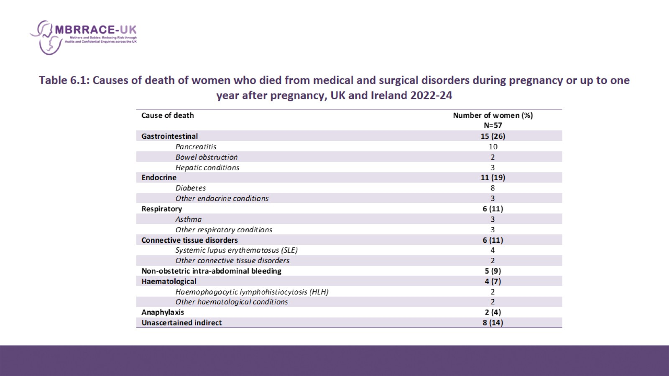
Table 6.1: Causes of death of women who died from medical and surgical disorders during pregnancy or up to one year after pregnancy, UK and Ireland 2022-24

Slide 3
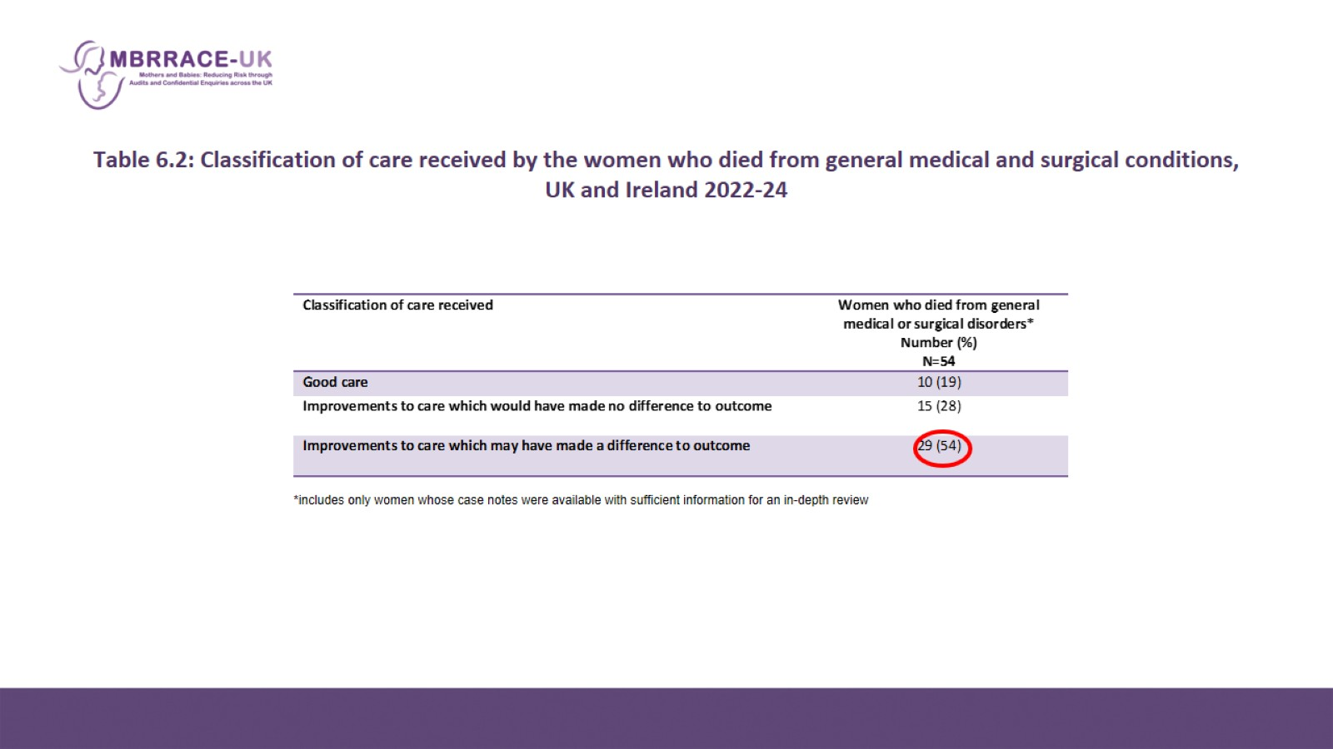
Table 6.2: Classification of care received by the women who died from general medical and surgical conditions, UK and Ireland 2022-24

Slide 4
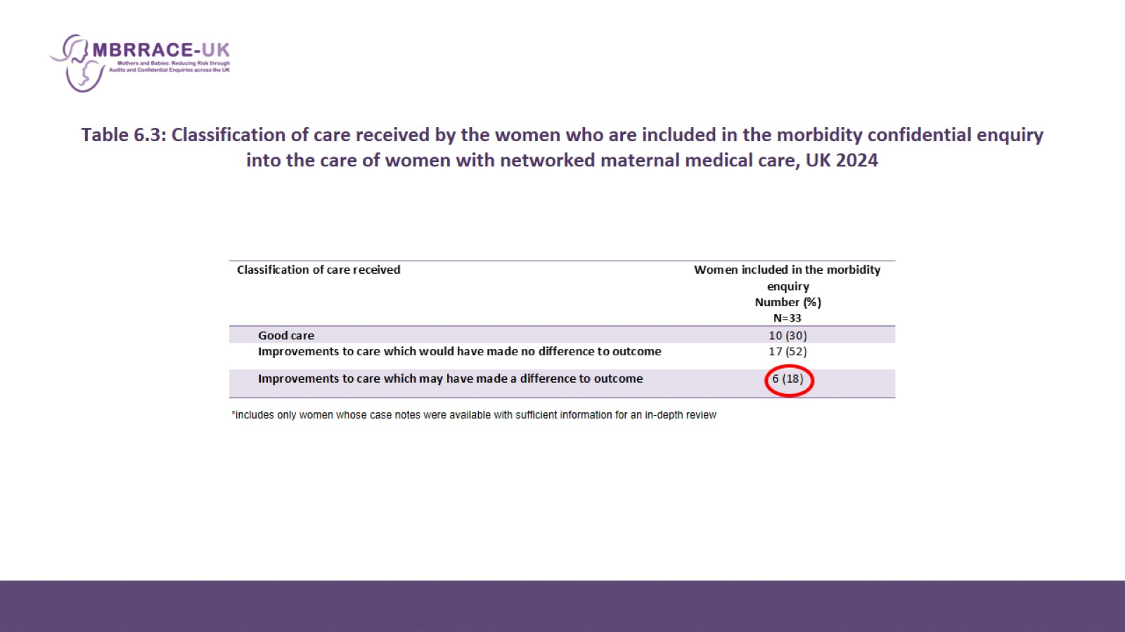
Table 6.3: Classification of care received by the women who are included in the morbidity confidential enquiry into the care of women with networked maternal medical care, UK 2024

Slide 5
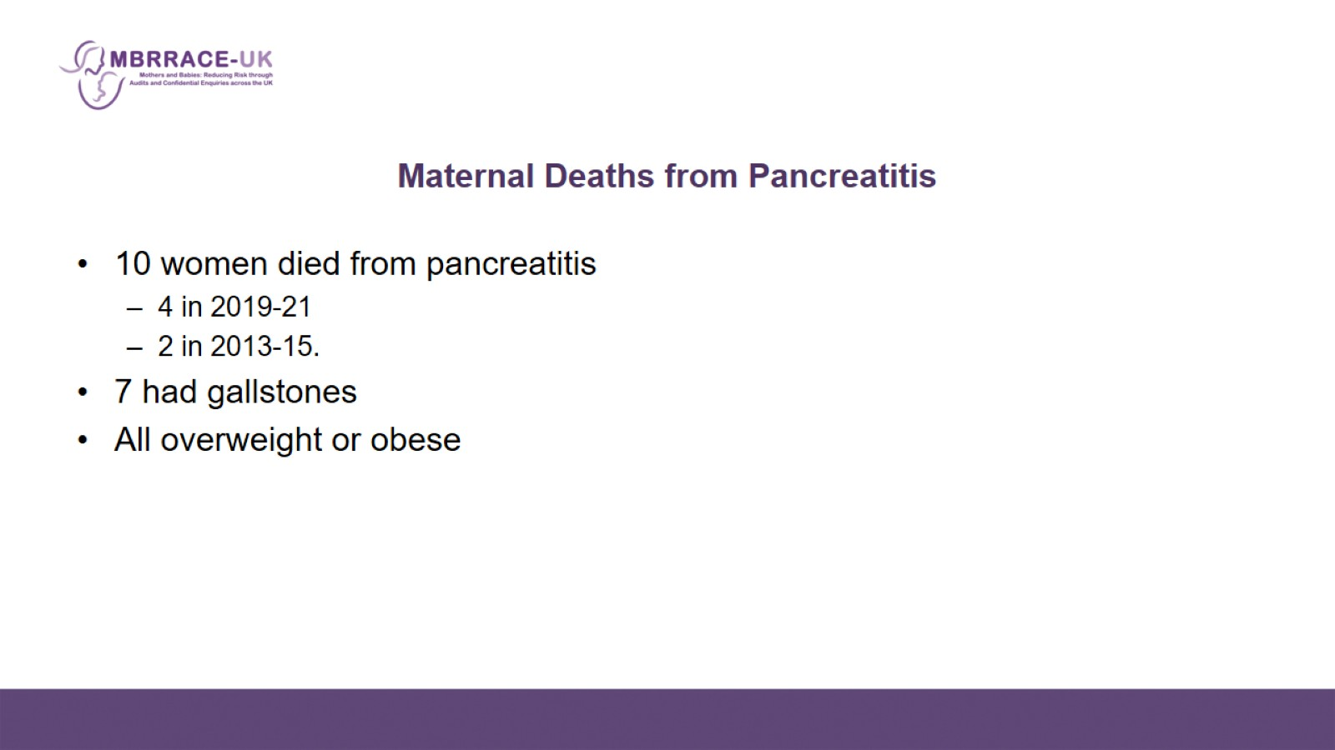
Maternal Deaths from Pancreatitis

Slide 6
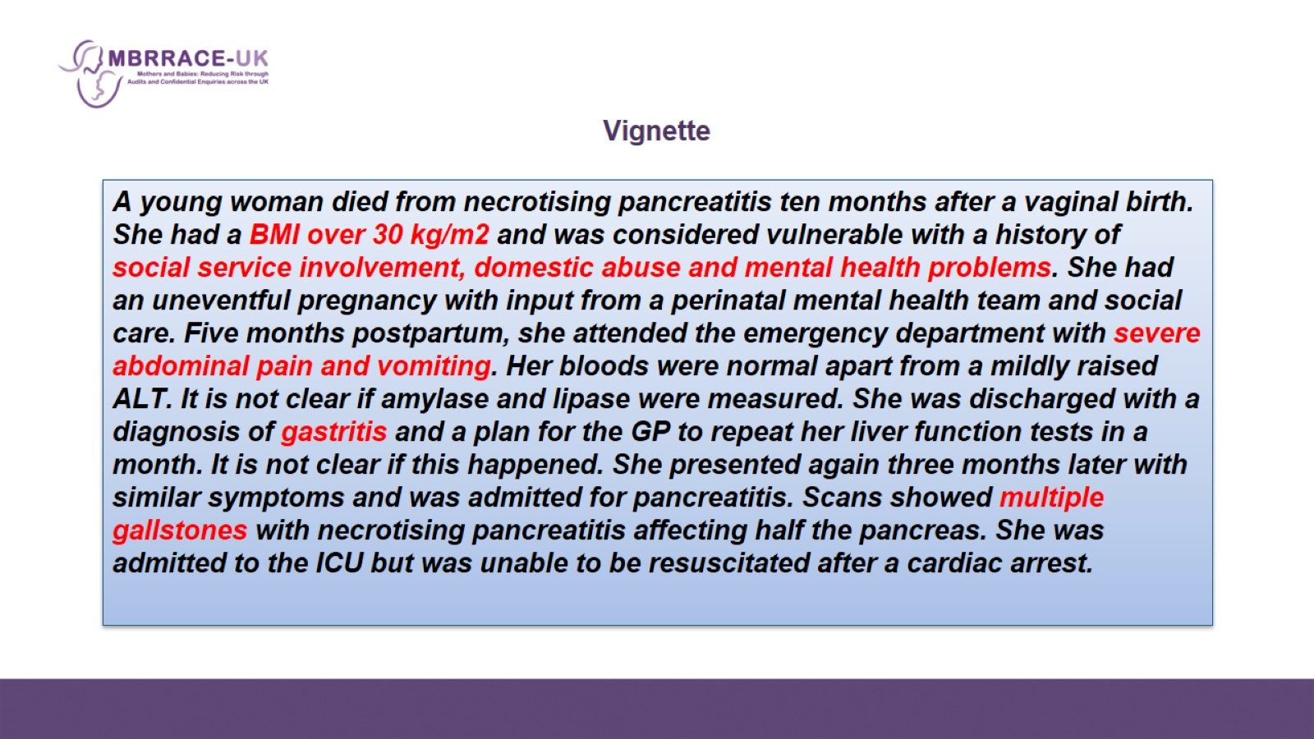
Vignette

Slide 7
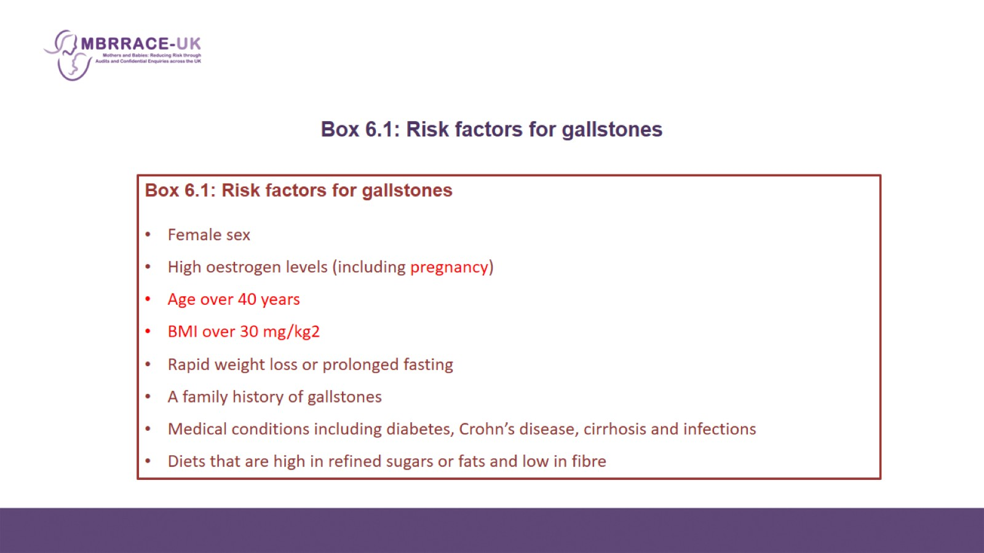
Box 6.1: Risk factors for gallstones

Slide 8
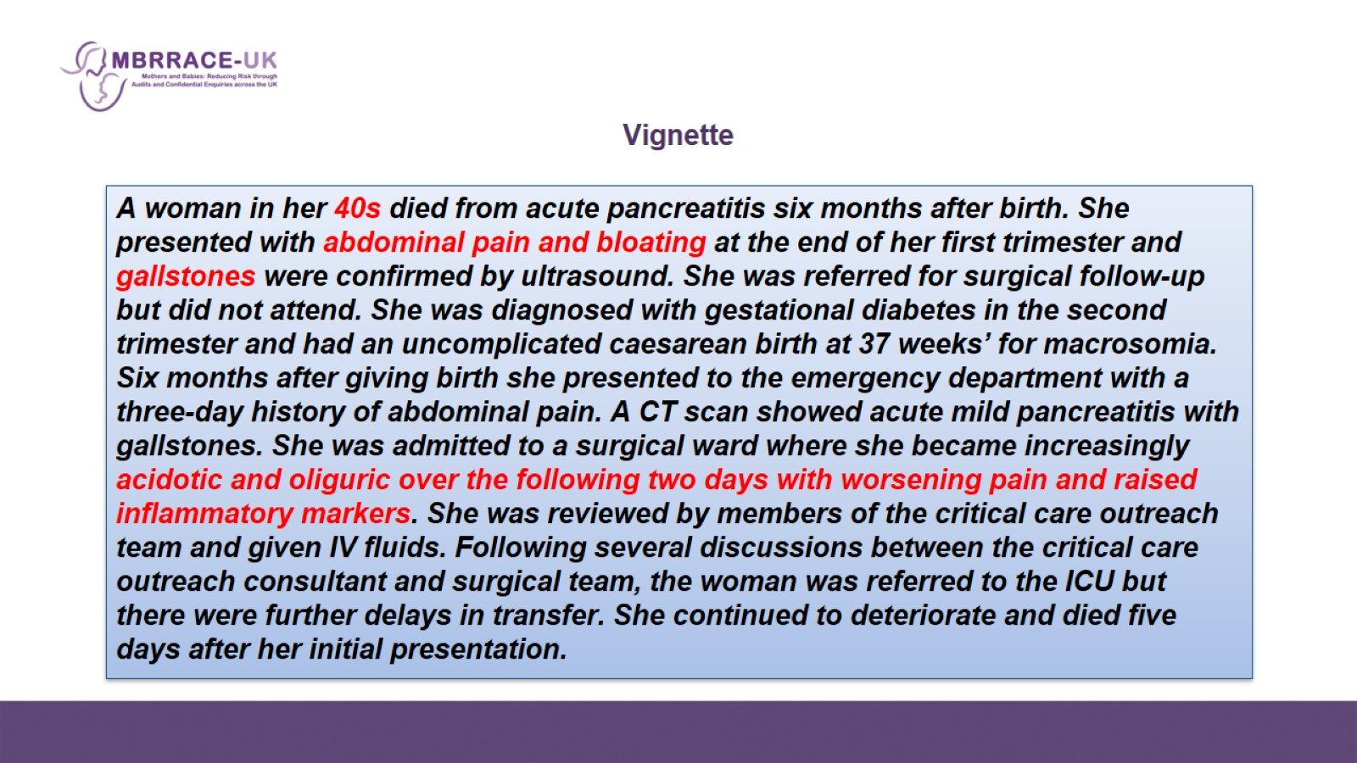
Vignette

Slide 9
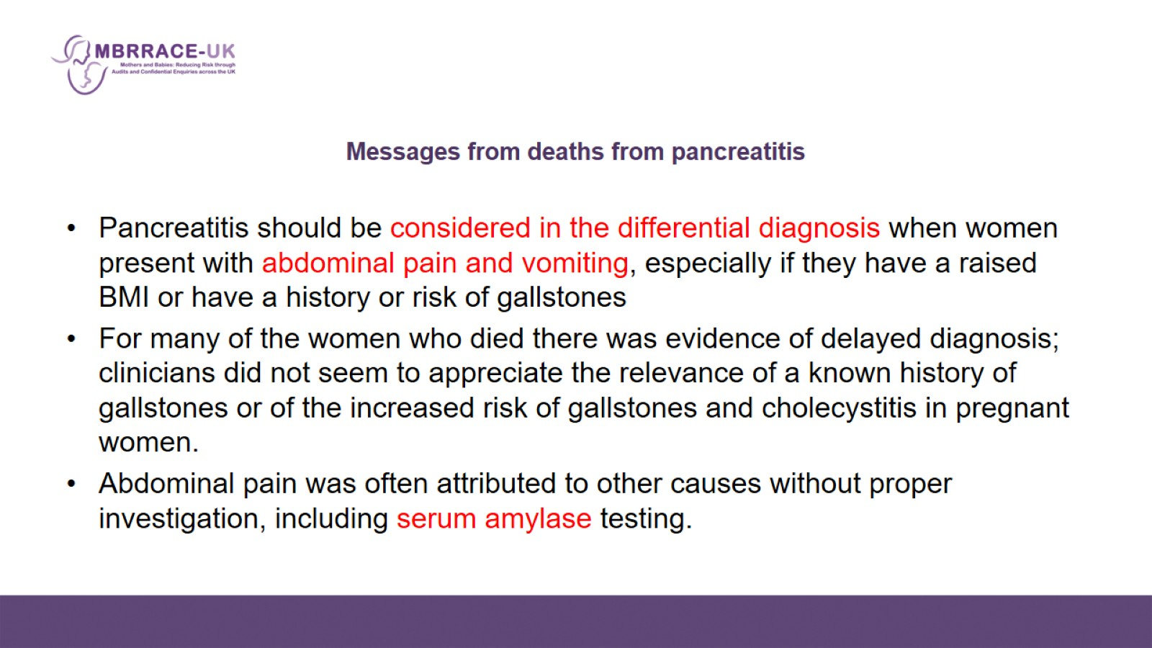
Messages from deaths from pancreatitis

Slide 10
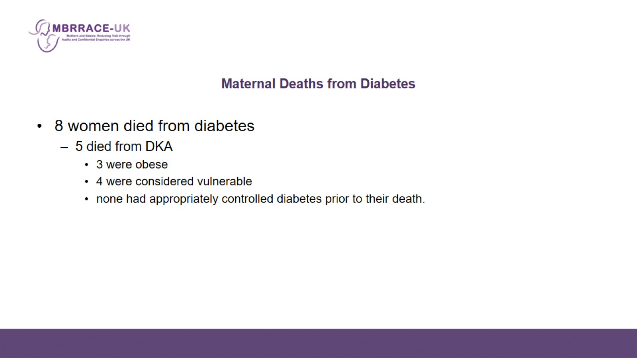
Maternal Deaths from Diabetes

Slide 11
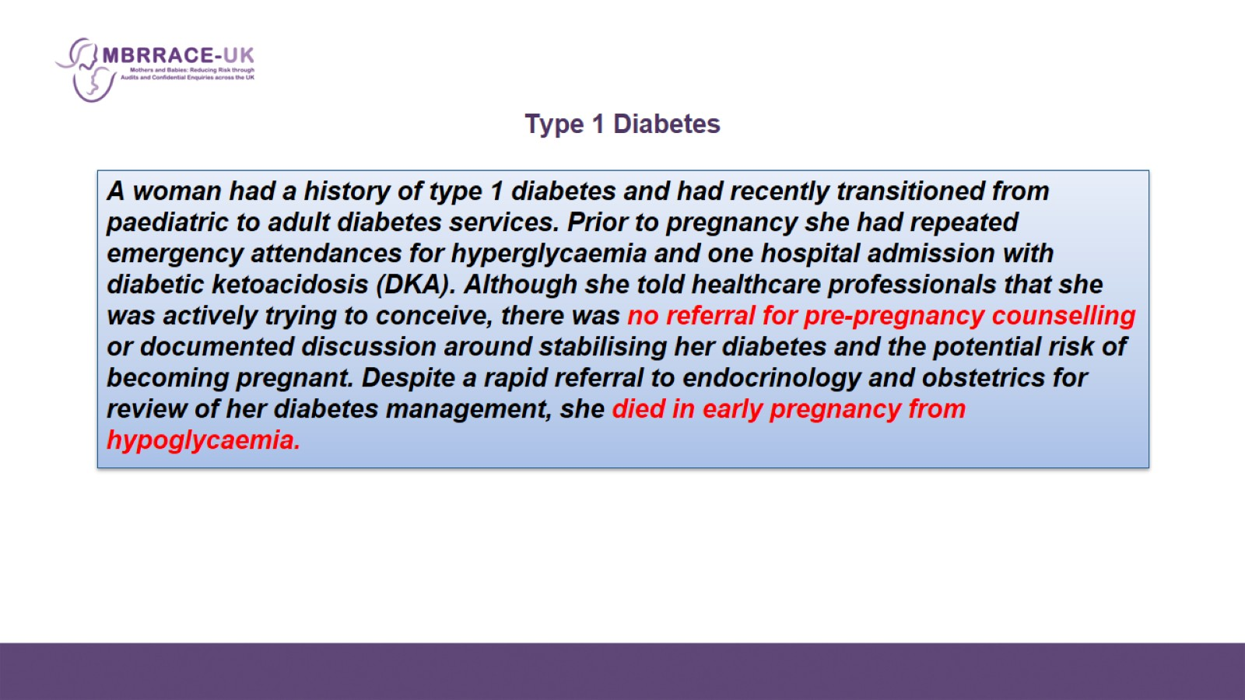
Type 1 Diabetes

Slide 12
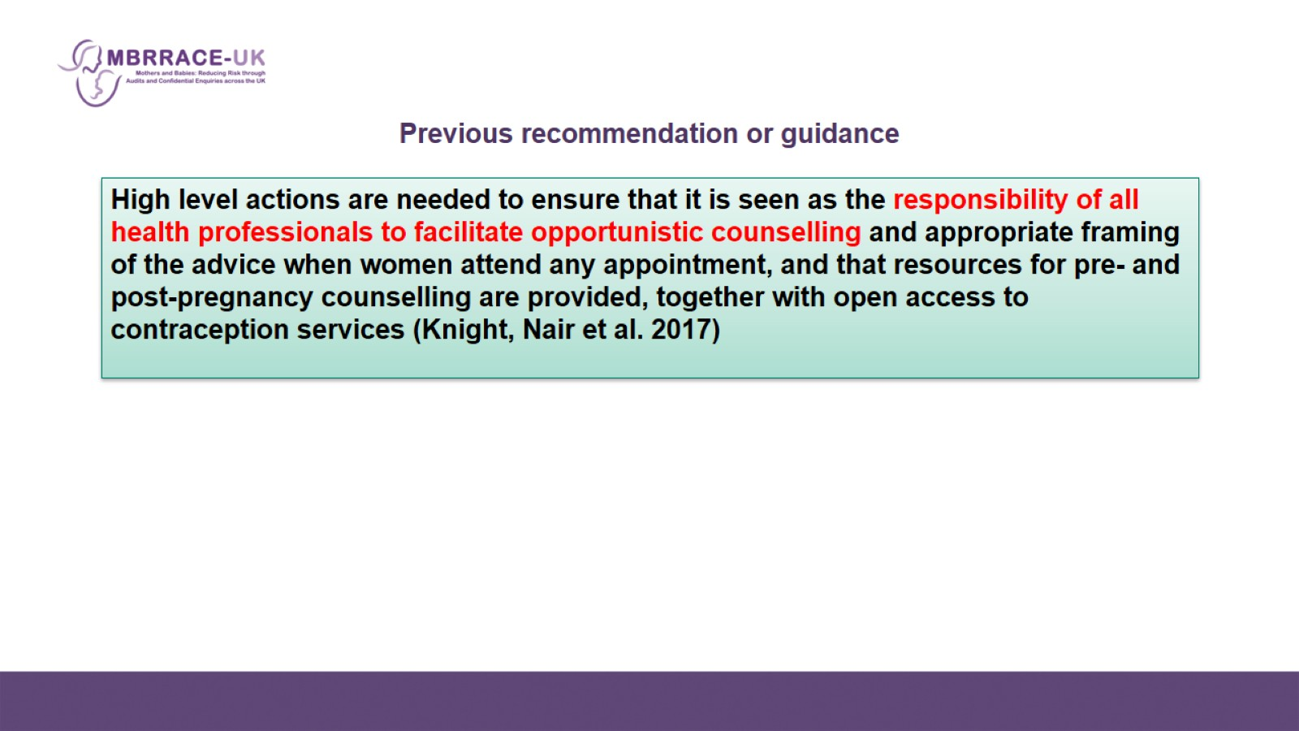
Previous recommendation or guidance

Slide 13
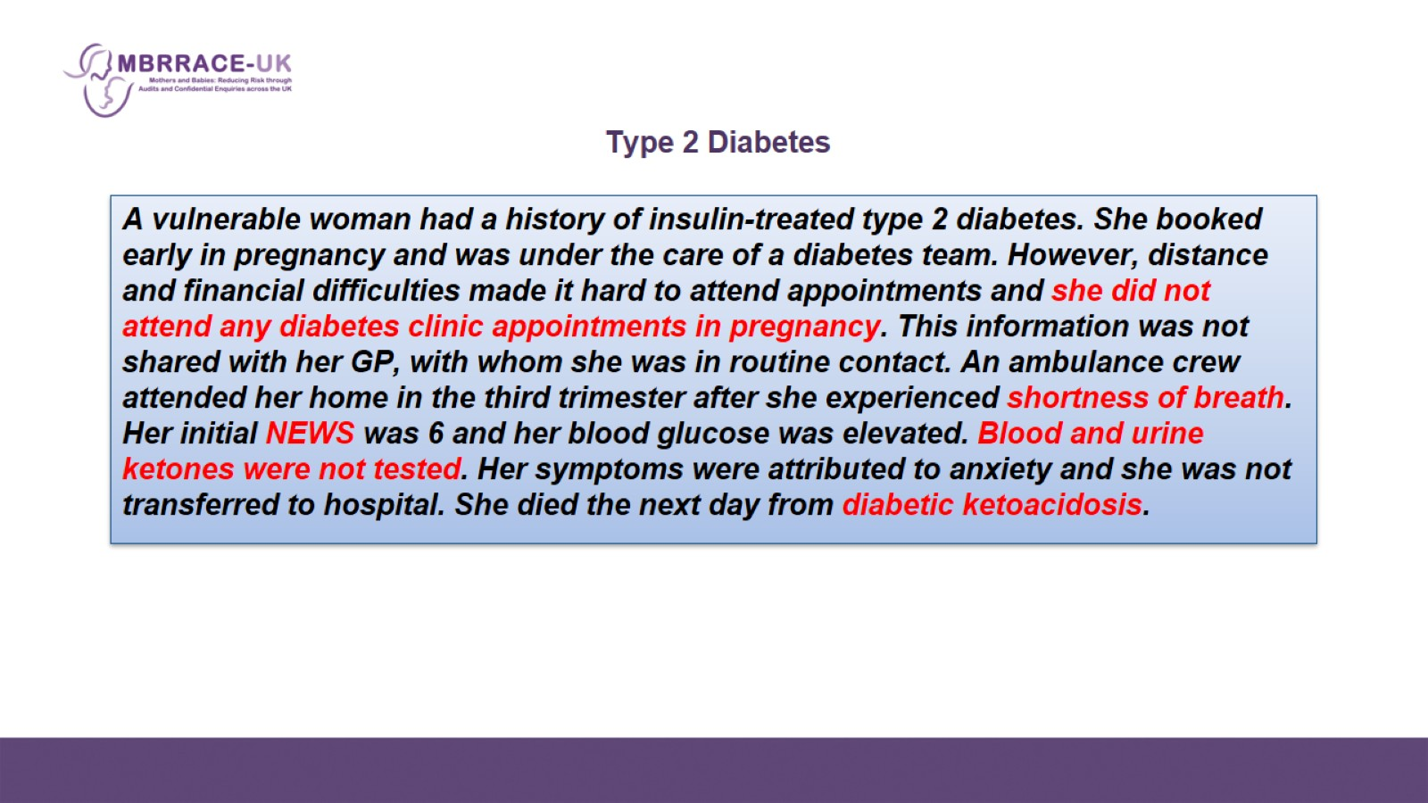
Type 2 Diabetes

Slide 14
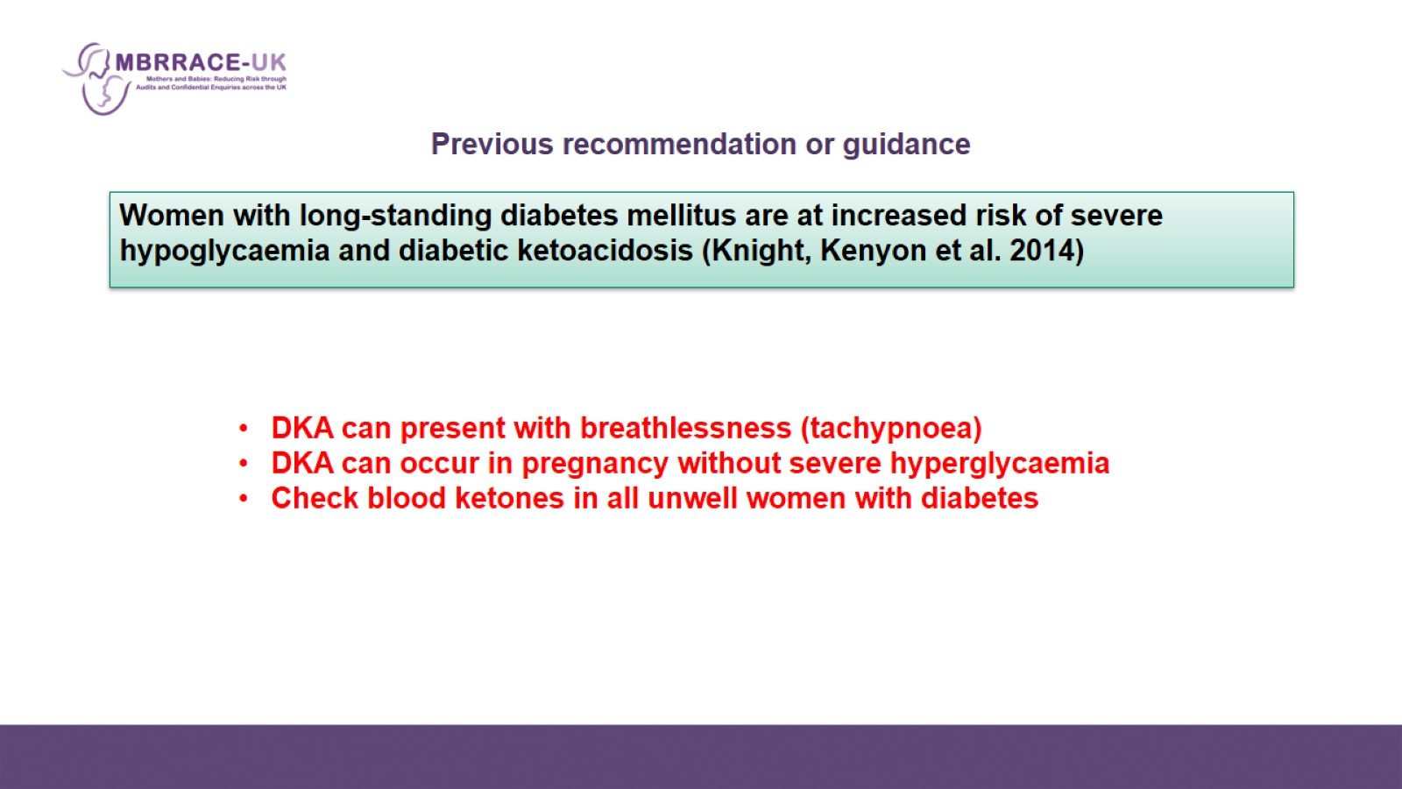
Previous recommendation or guidance

Slide 15
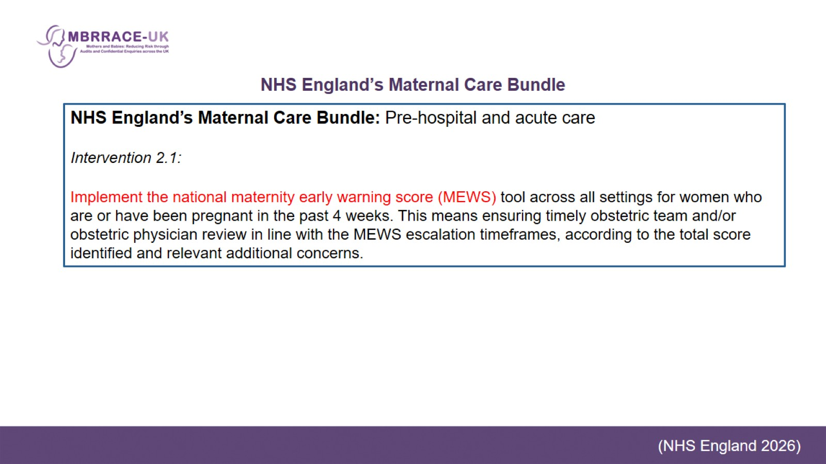
NHS England’s Maternal Care Bundle

Slide 16
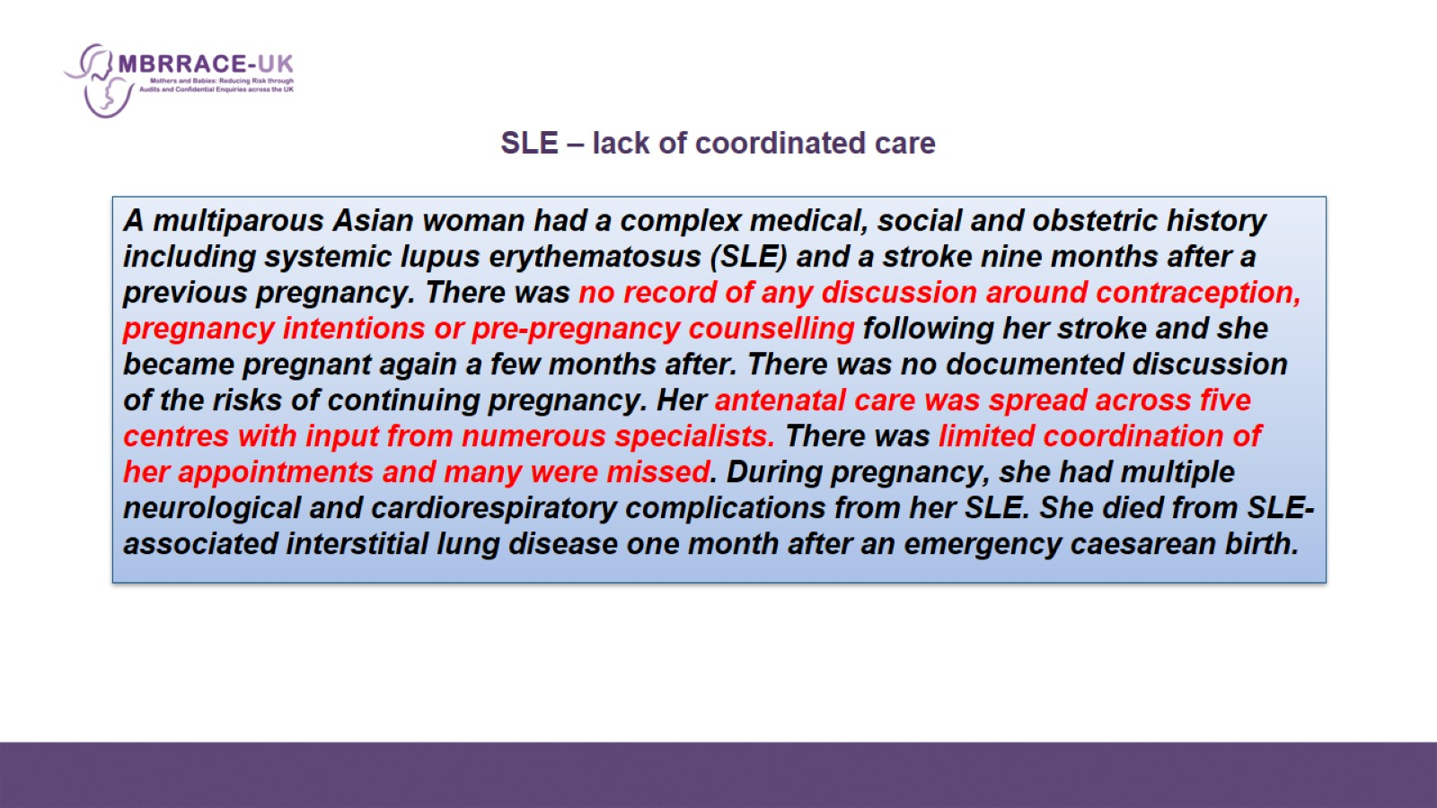
SLE – lack of coordinated care

Slide 17
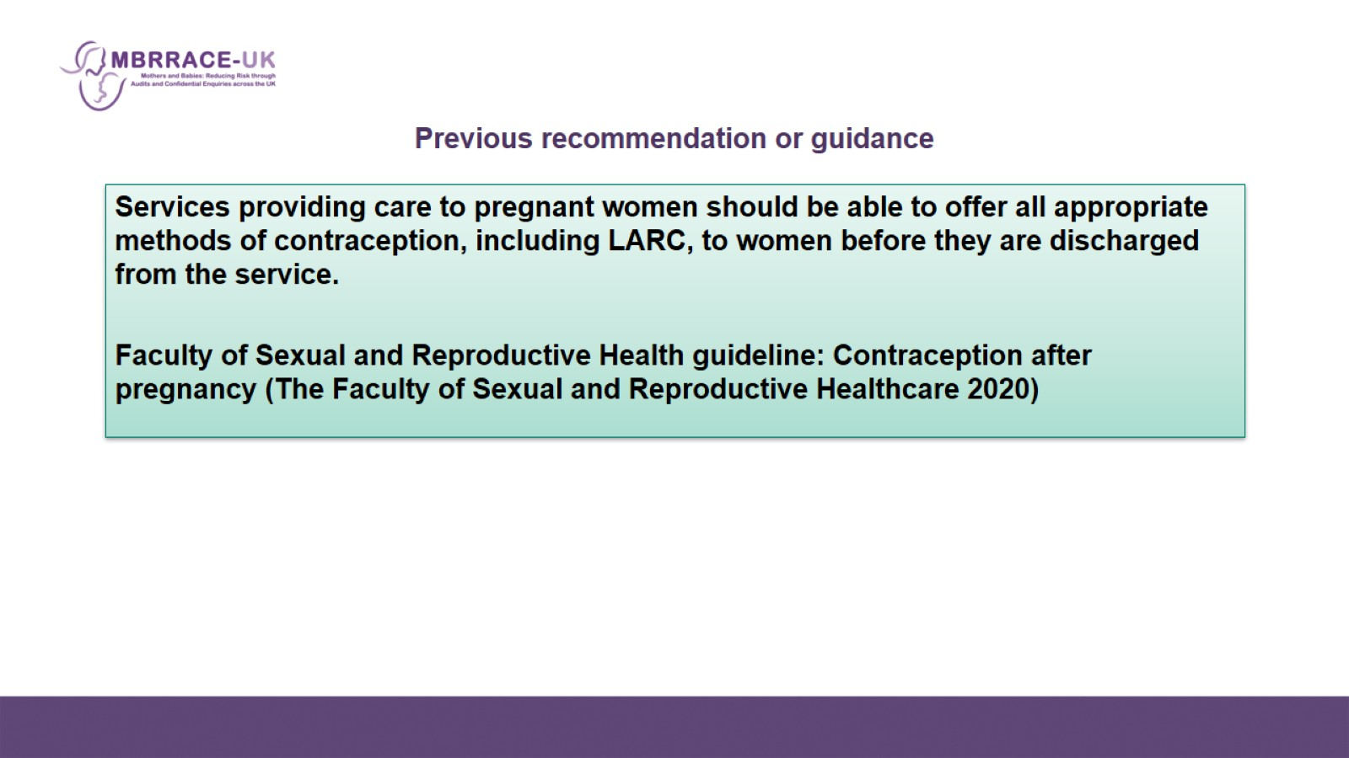
Previous recommendation or guidance

Slide 18
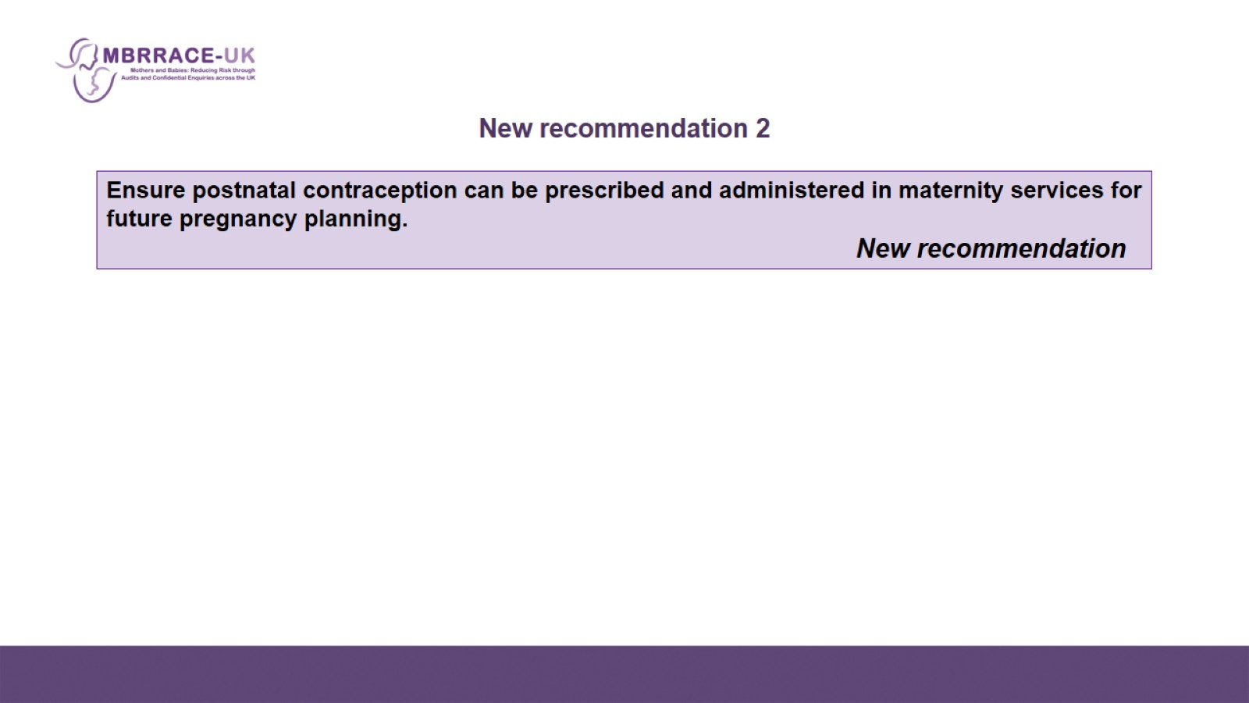
New recommendation 2

Slide 19
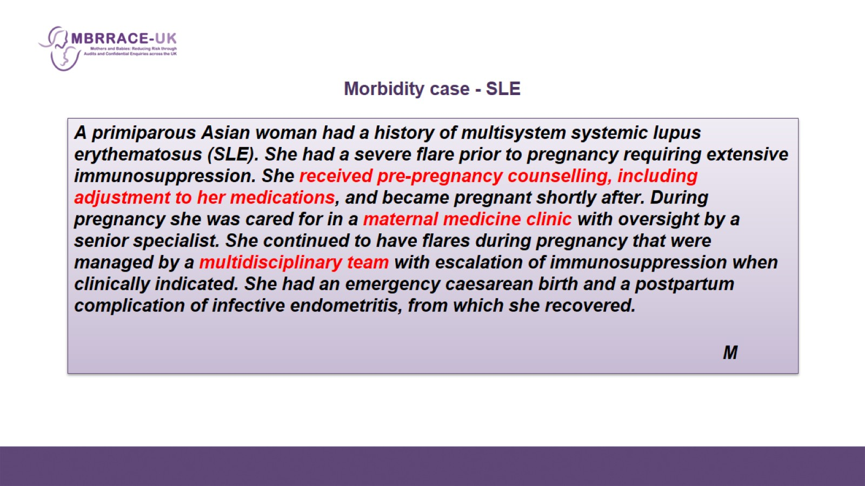
Morbidity case - SLE

Slide 20
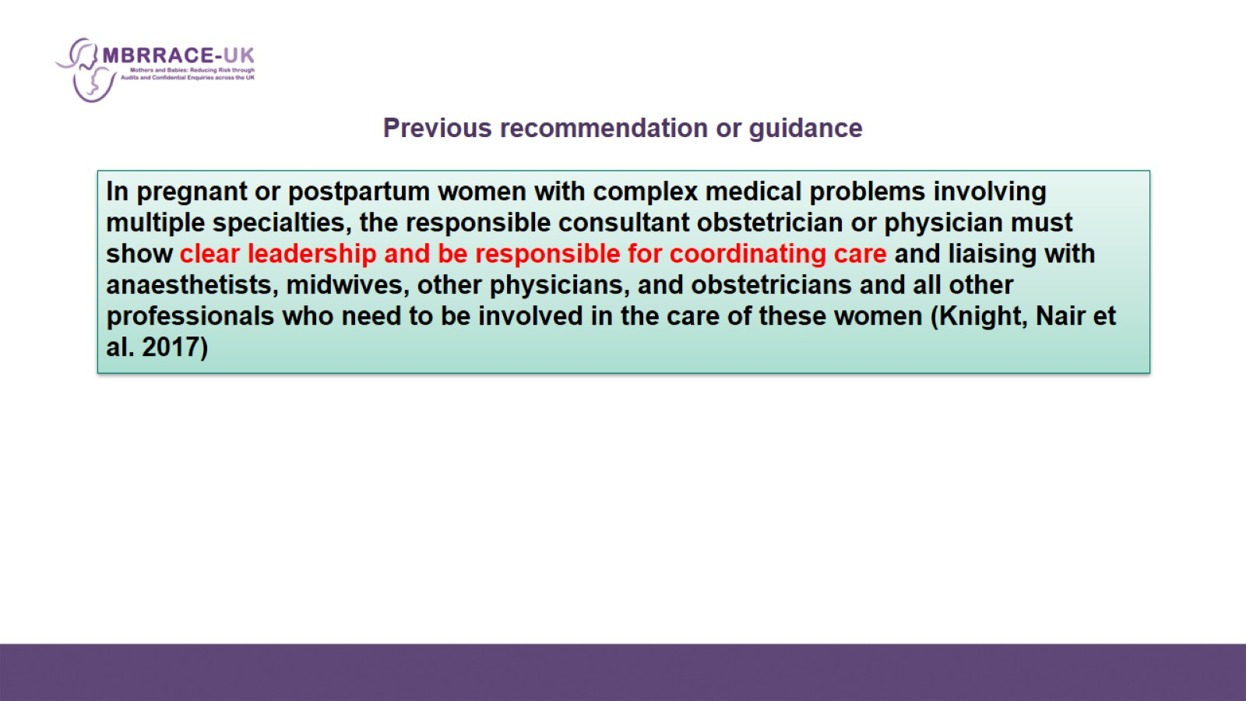
Previous recommendation or guidance

Slide 21
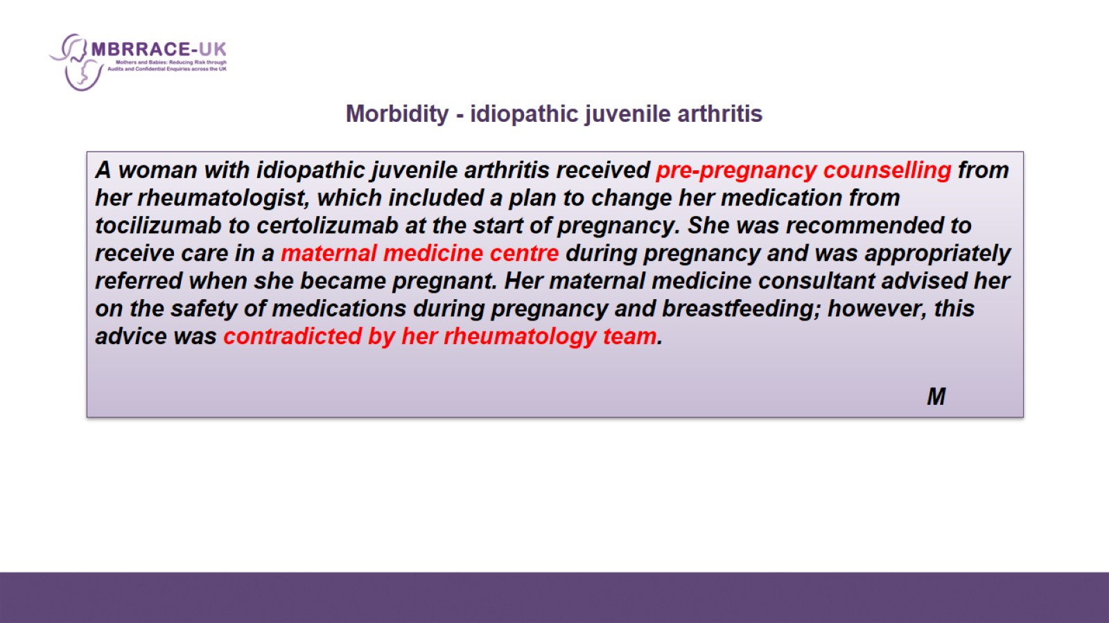
Morbidity - idiopathic juvenile arthritis

Slide 22
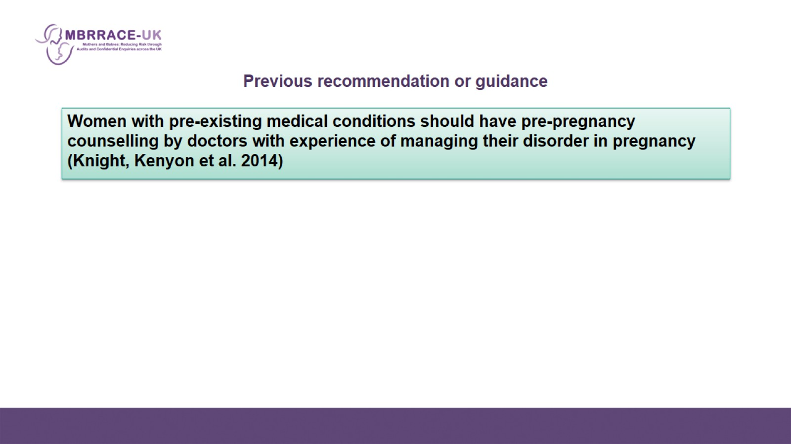
Previous recommendation or guidance

Slide 23
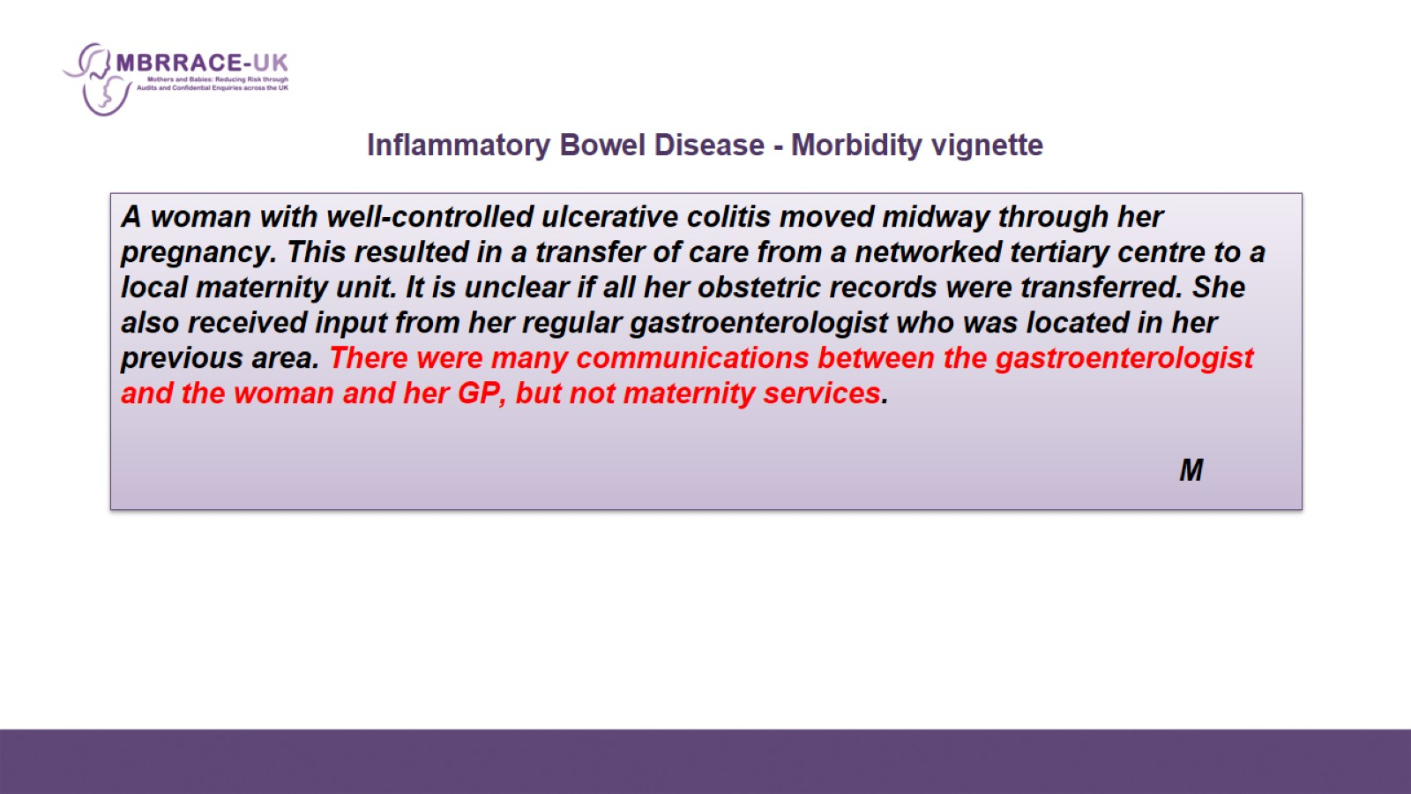
Inflammatory Bowel Disease - Morbidity vignette

Slide 24
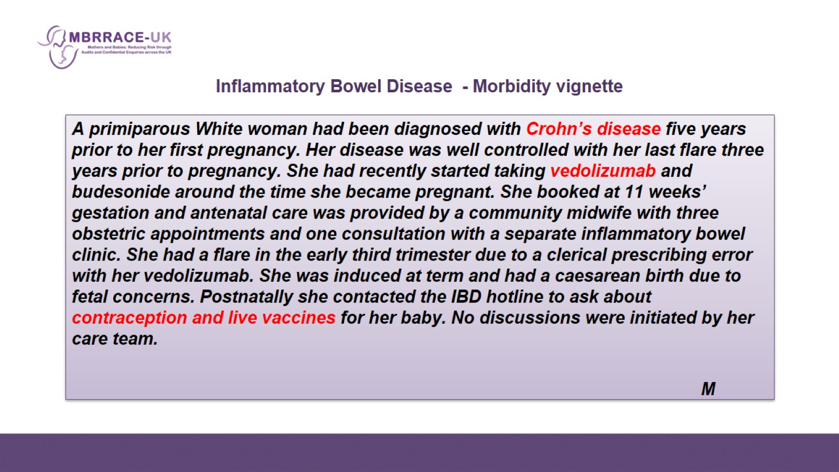
Inflammatory Bowel Disease - Morbidity vignette

Slide 25
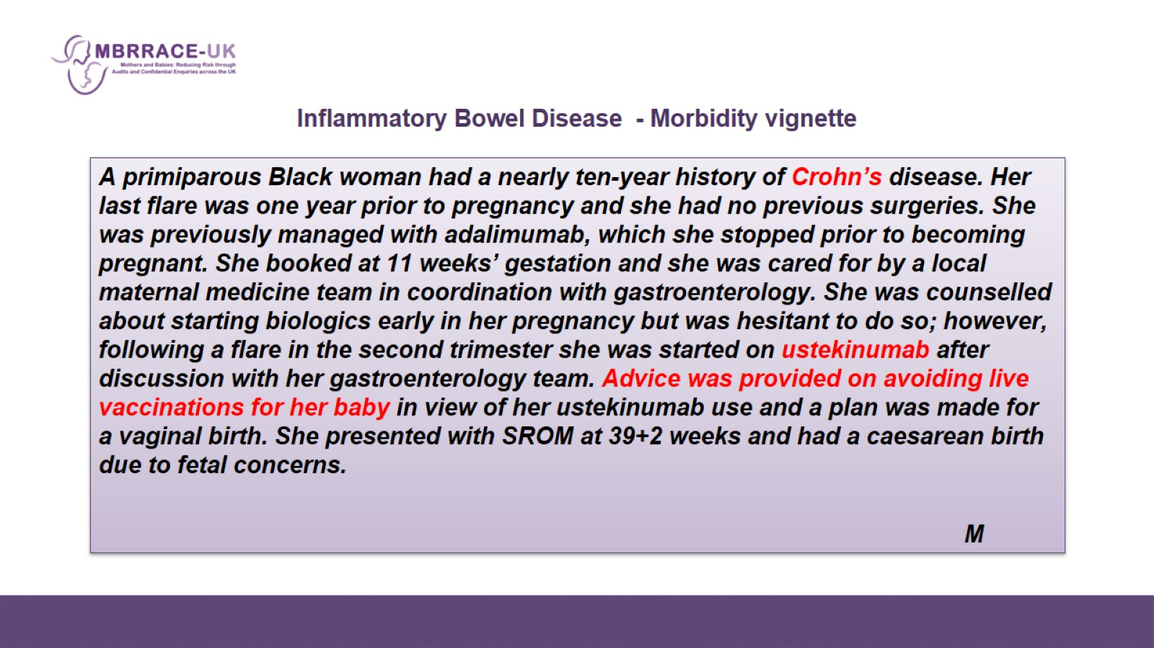
Inflammatory Bowel Disease - Morbidity vignette

Slide 26
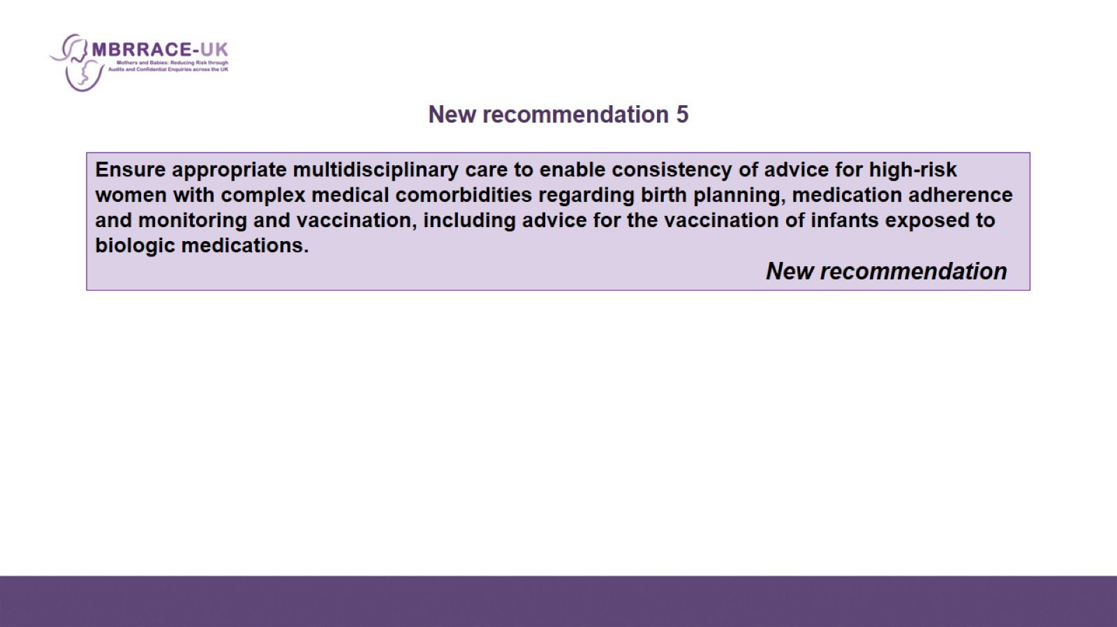
New recommendation 5

Slide 27

Thank you for listening

