Slide 1


Slide 2

EPILEPSY

Slide 3
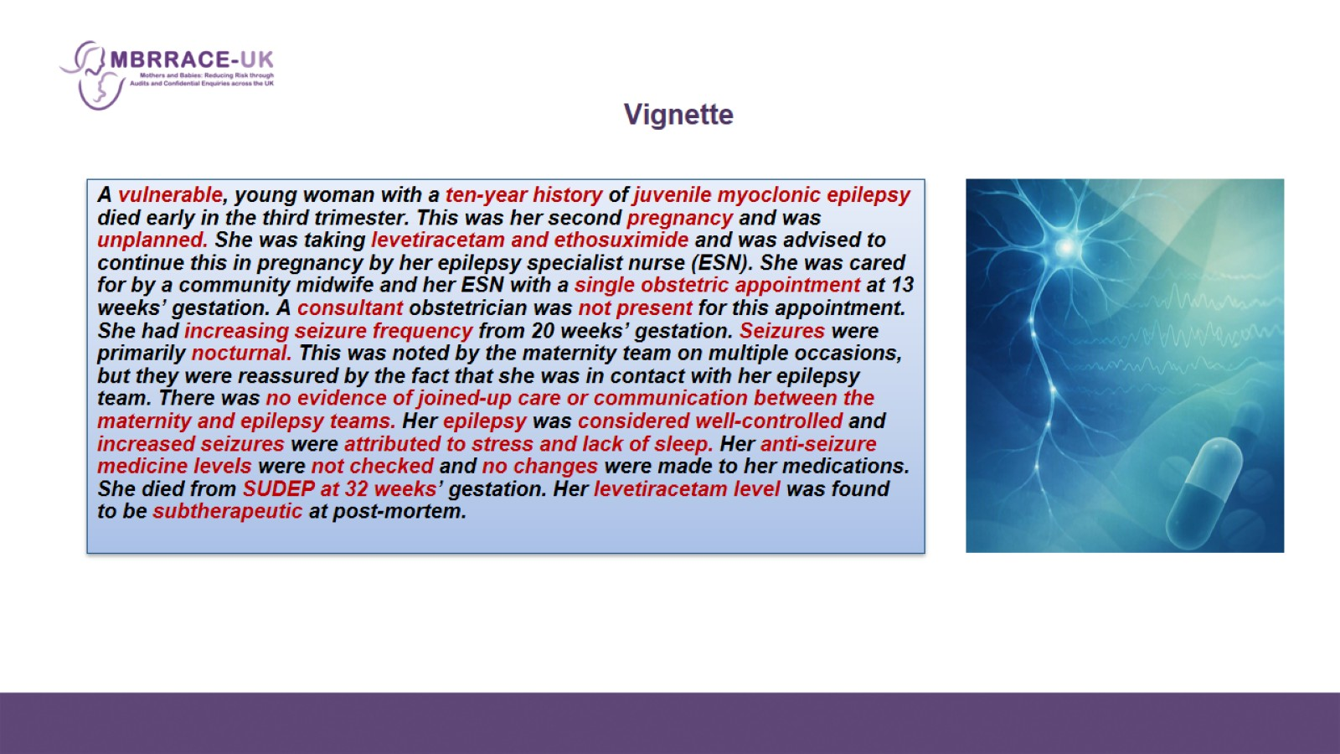
Vignette

Slide 4
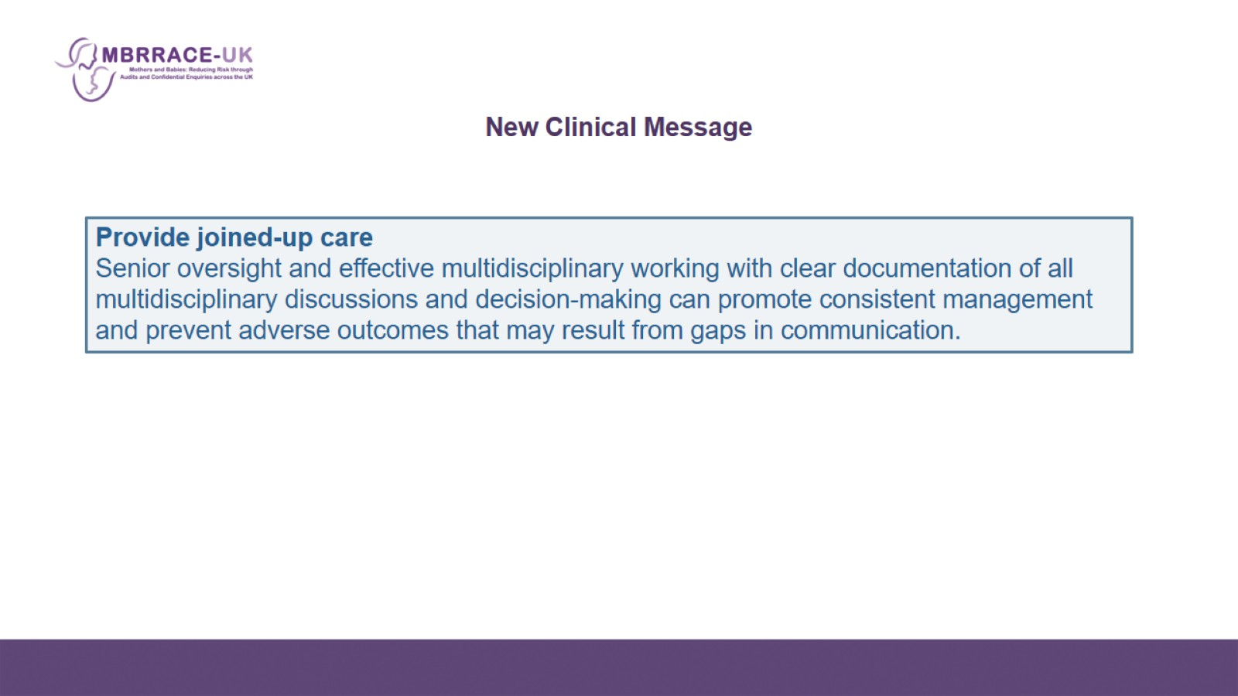
New Clinical Message

Slide 5
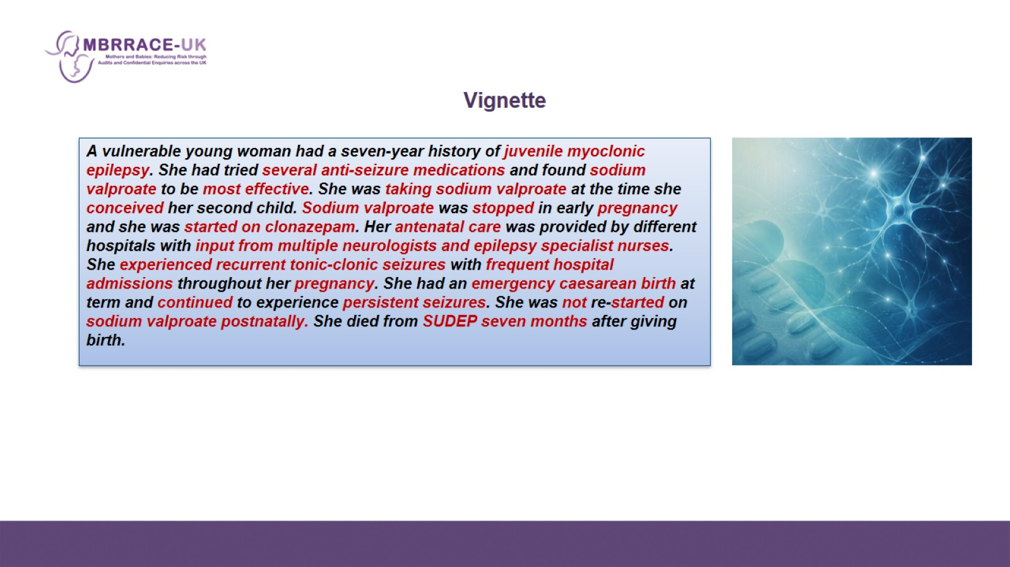
Vignette

Slide 6
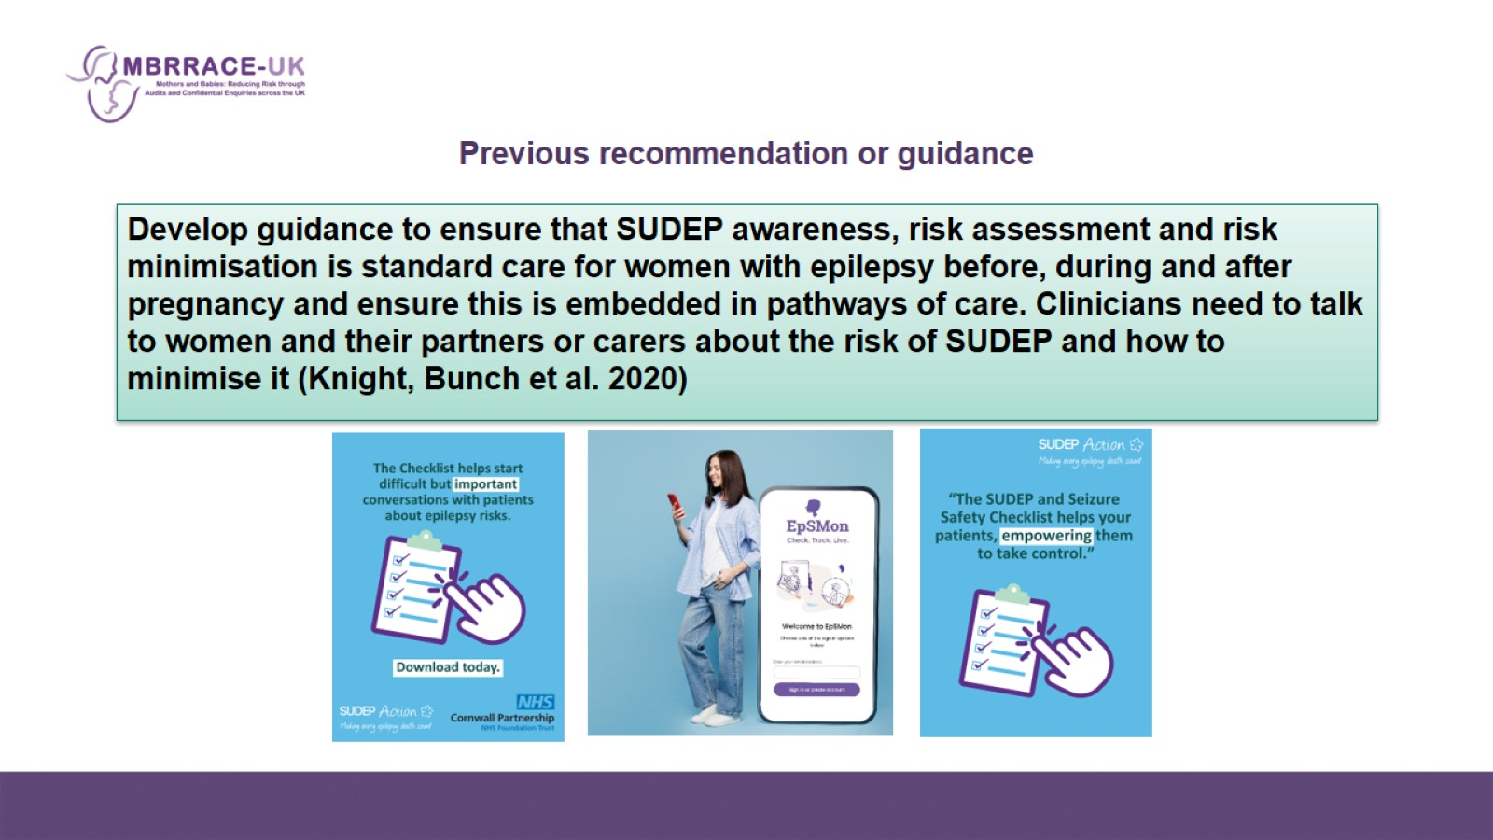
Previous recommendation or guidance

Slide 7
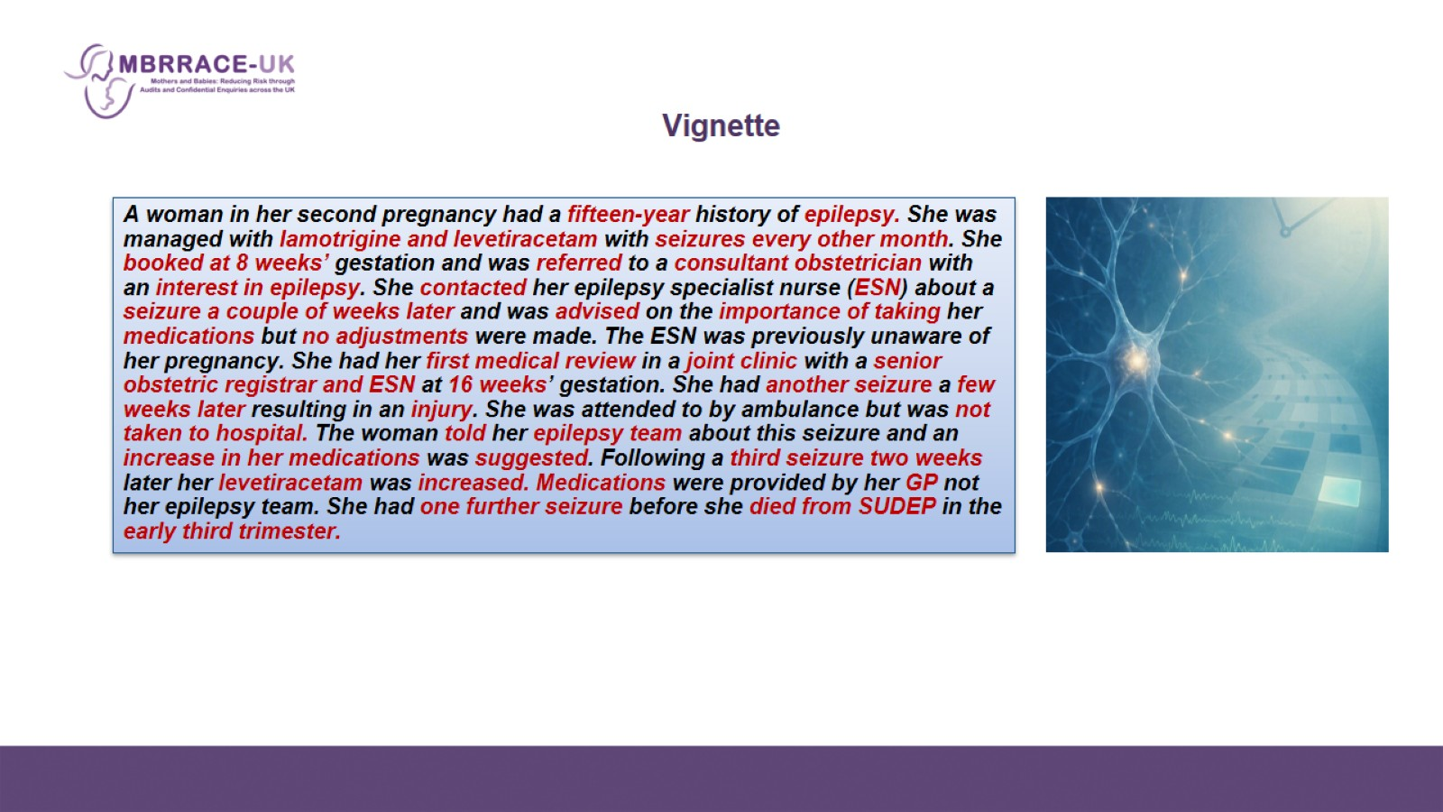
Vignette

Slide 8
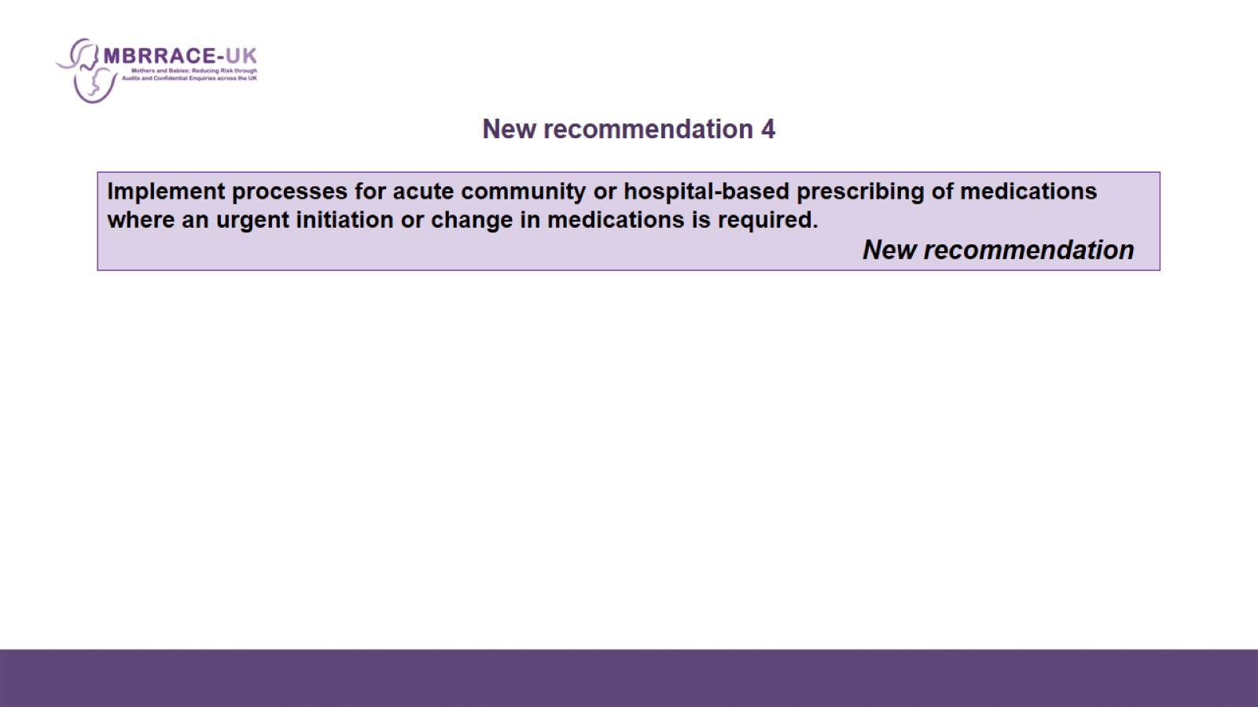
New recommendation 4

Slide 9
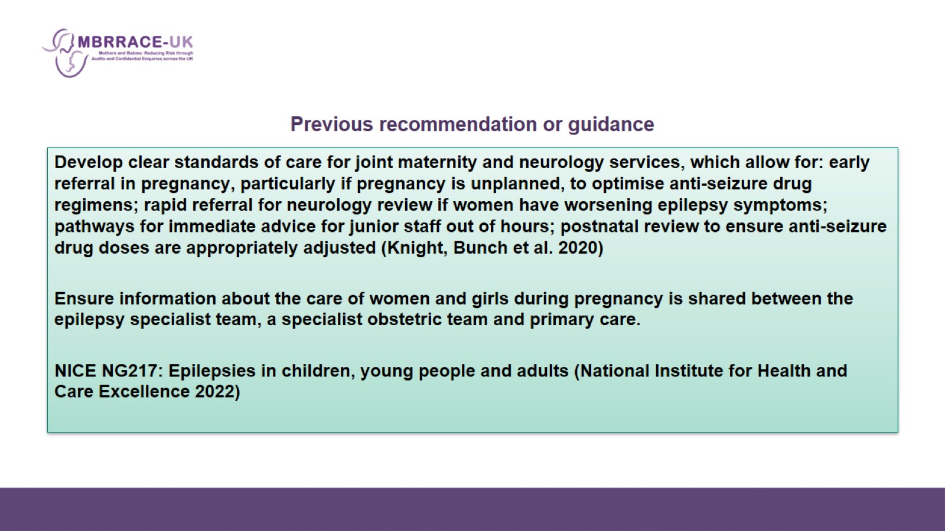
Previous recommendation or guidance

Slide 10
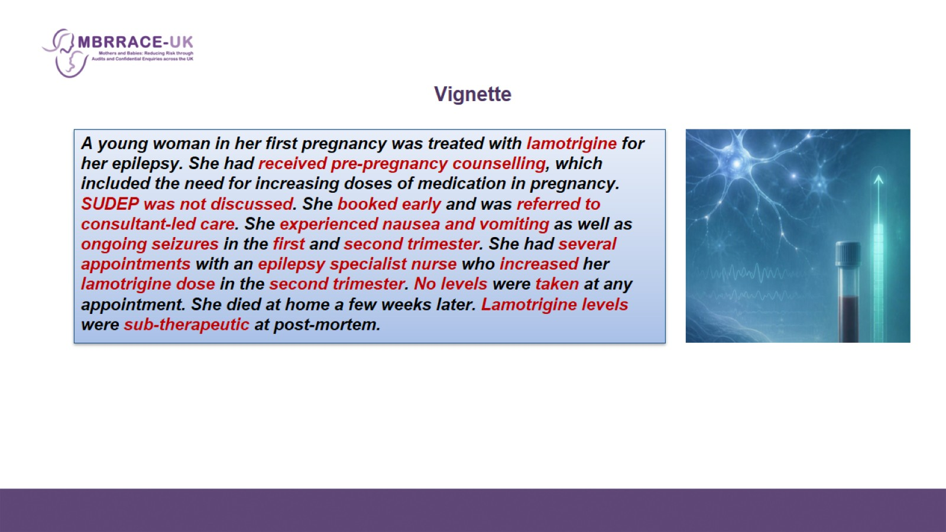
Vignette

Slide 11
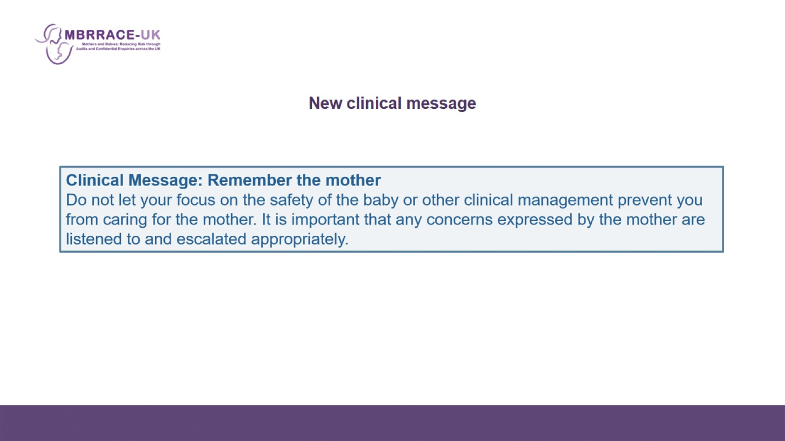
New clinical message

Slide 12
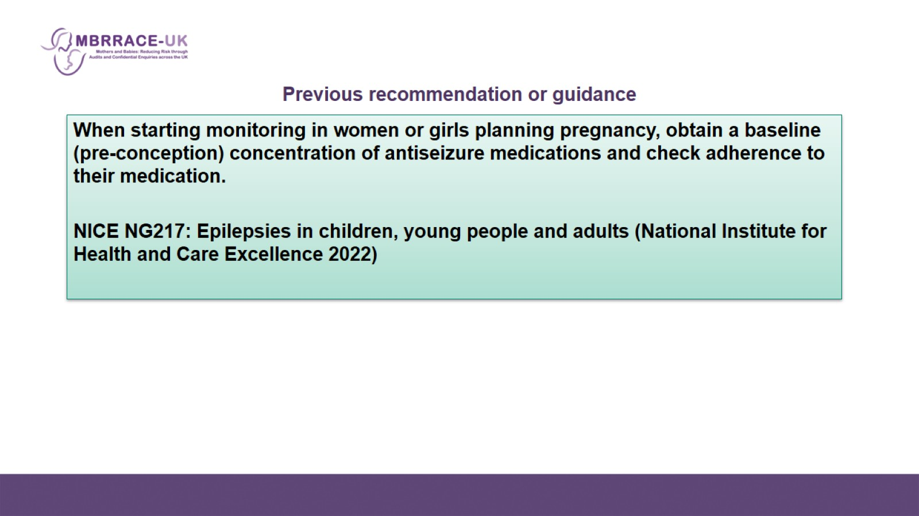
Previous recommendation or guidance

Slide 13
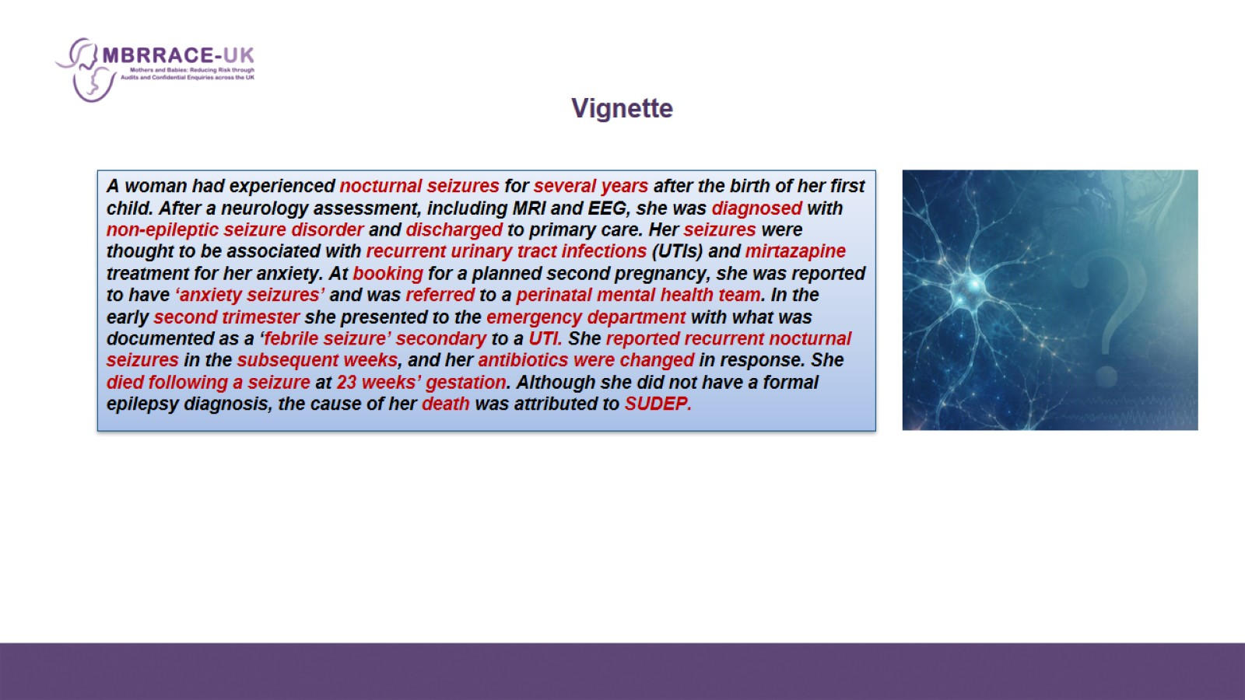
Vignette

Slide 14
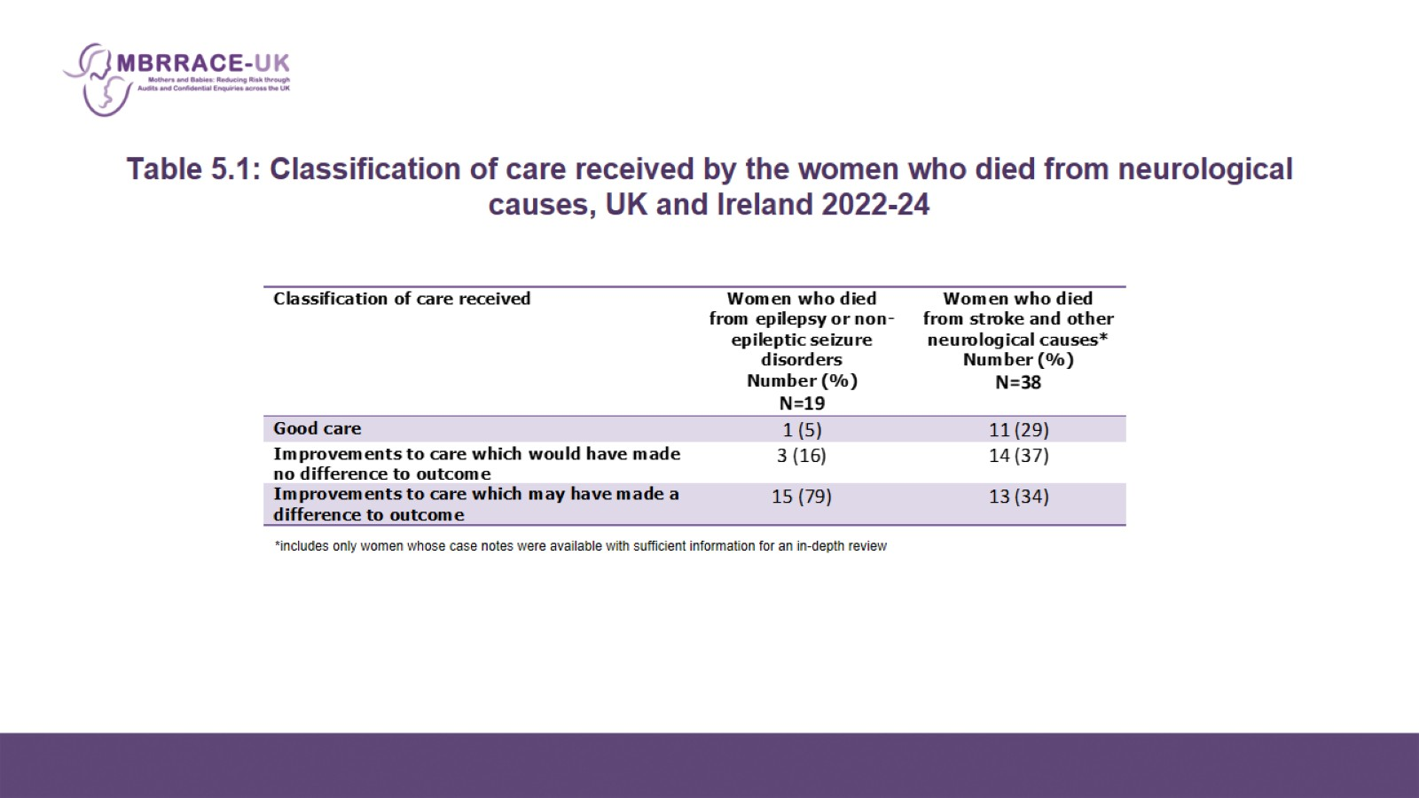
Table 5.1: Classification of care received by the women who died from neurological causes, UK and Ireland 2022-24

