Slide 1


Slide 2
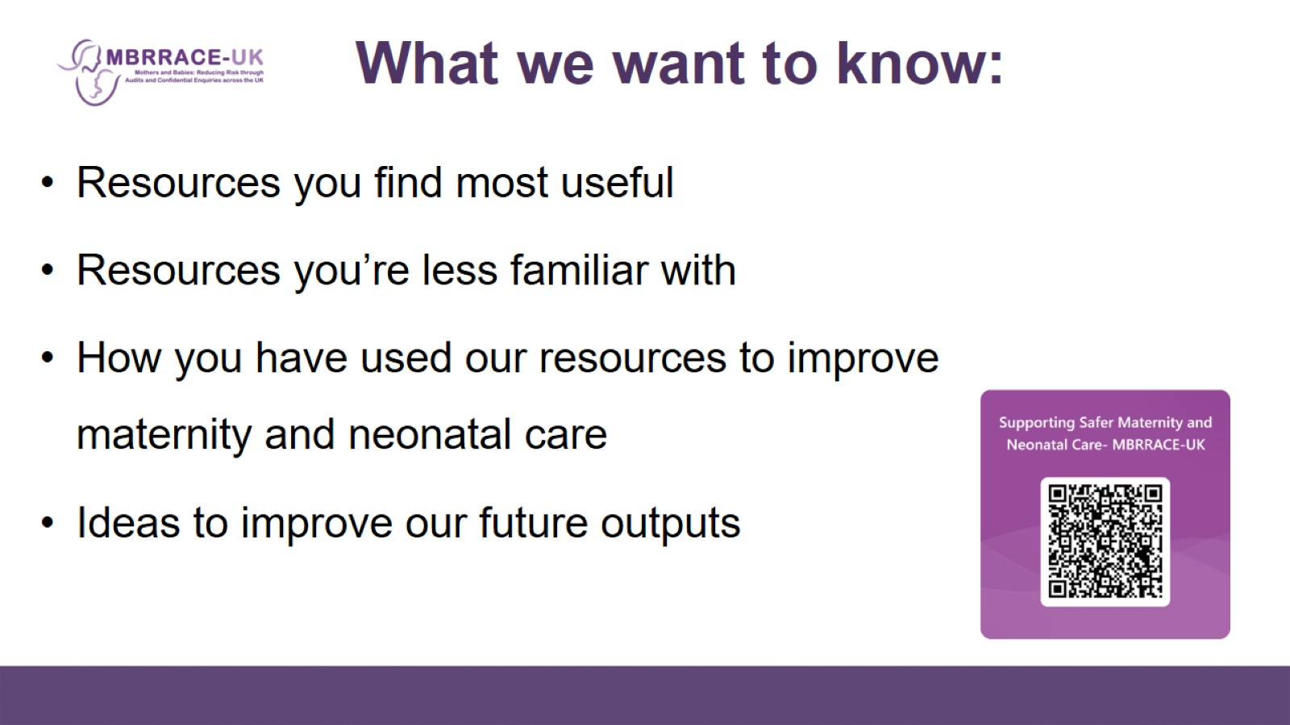
What we want to know:

Slide 3
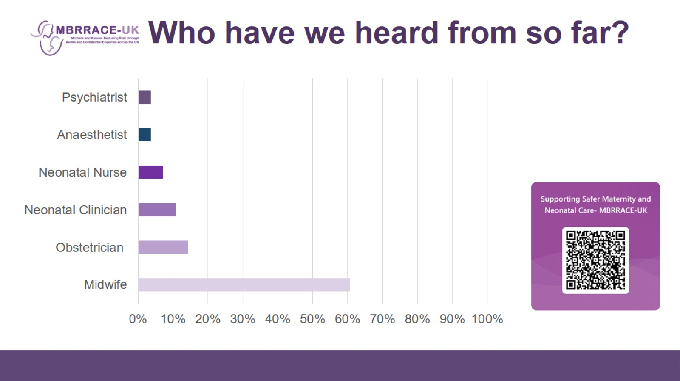

Slide 4
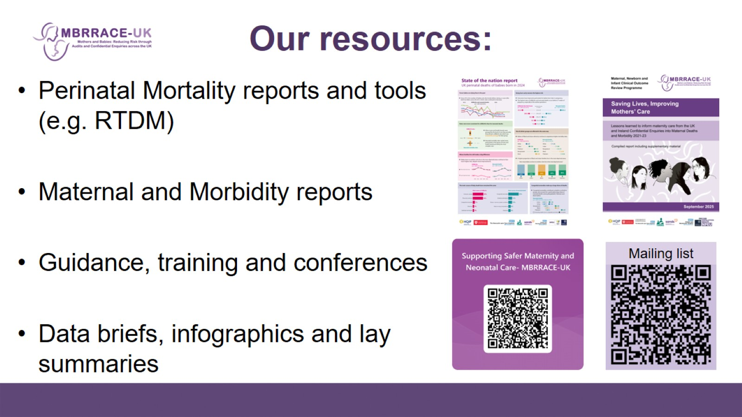
Our resources:

Slide 5

"We'd like you to describe the specific improvements your organisation has made and how MBRRACE-UK resources supported your work."

Slide 6
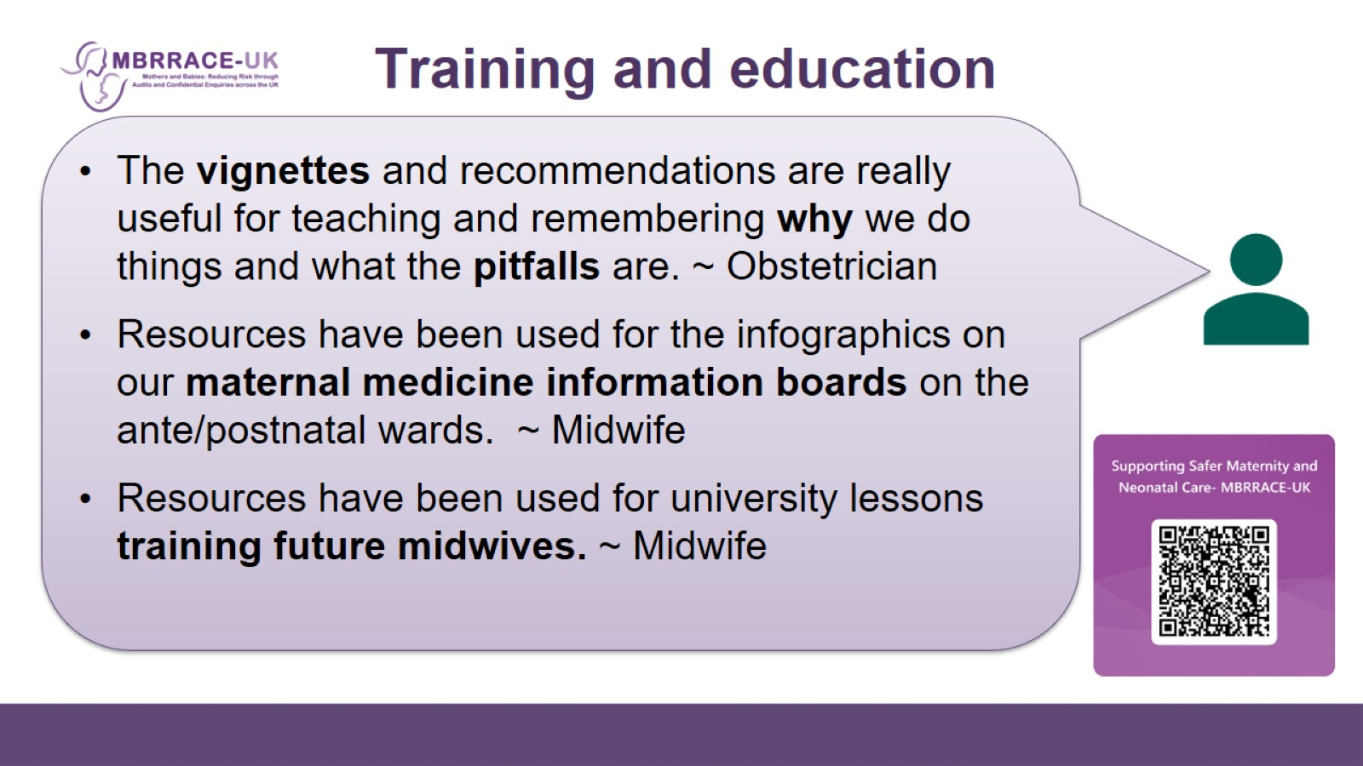
Training and education

Slide 7
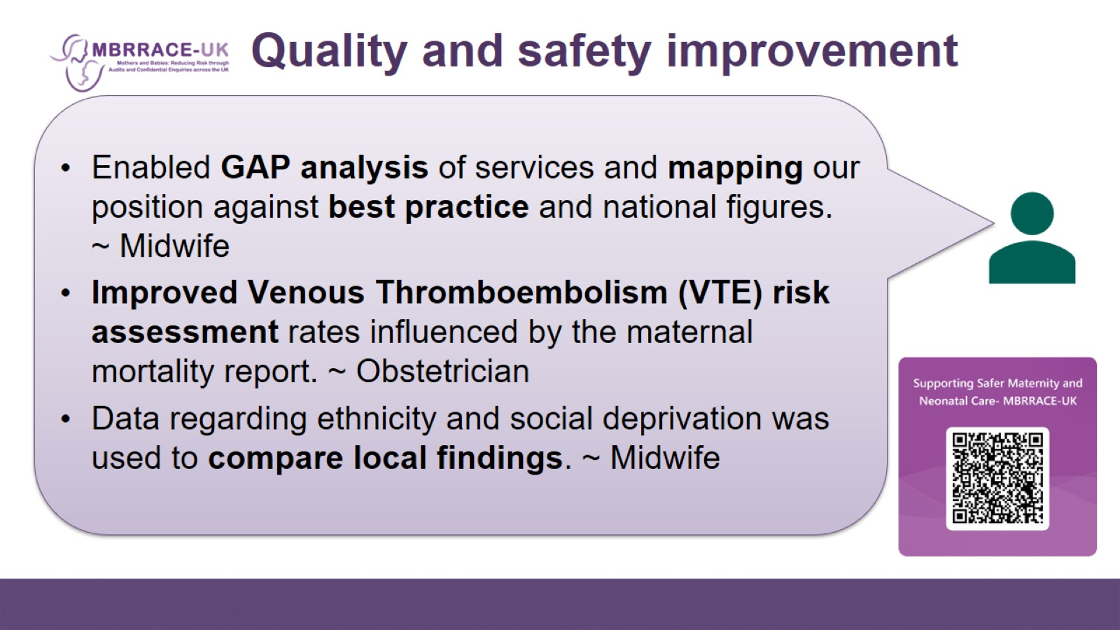
Quality and safety improvement

Slide 8
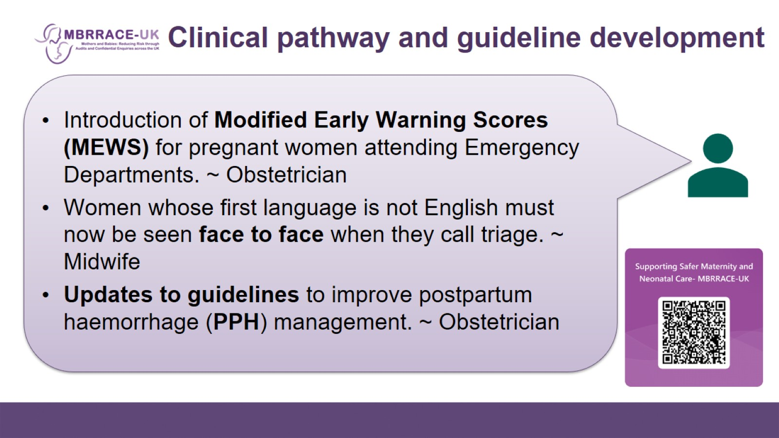
Clinical pathway and guideline development

Slide 9
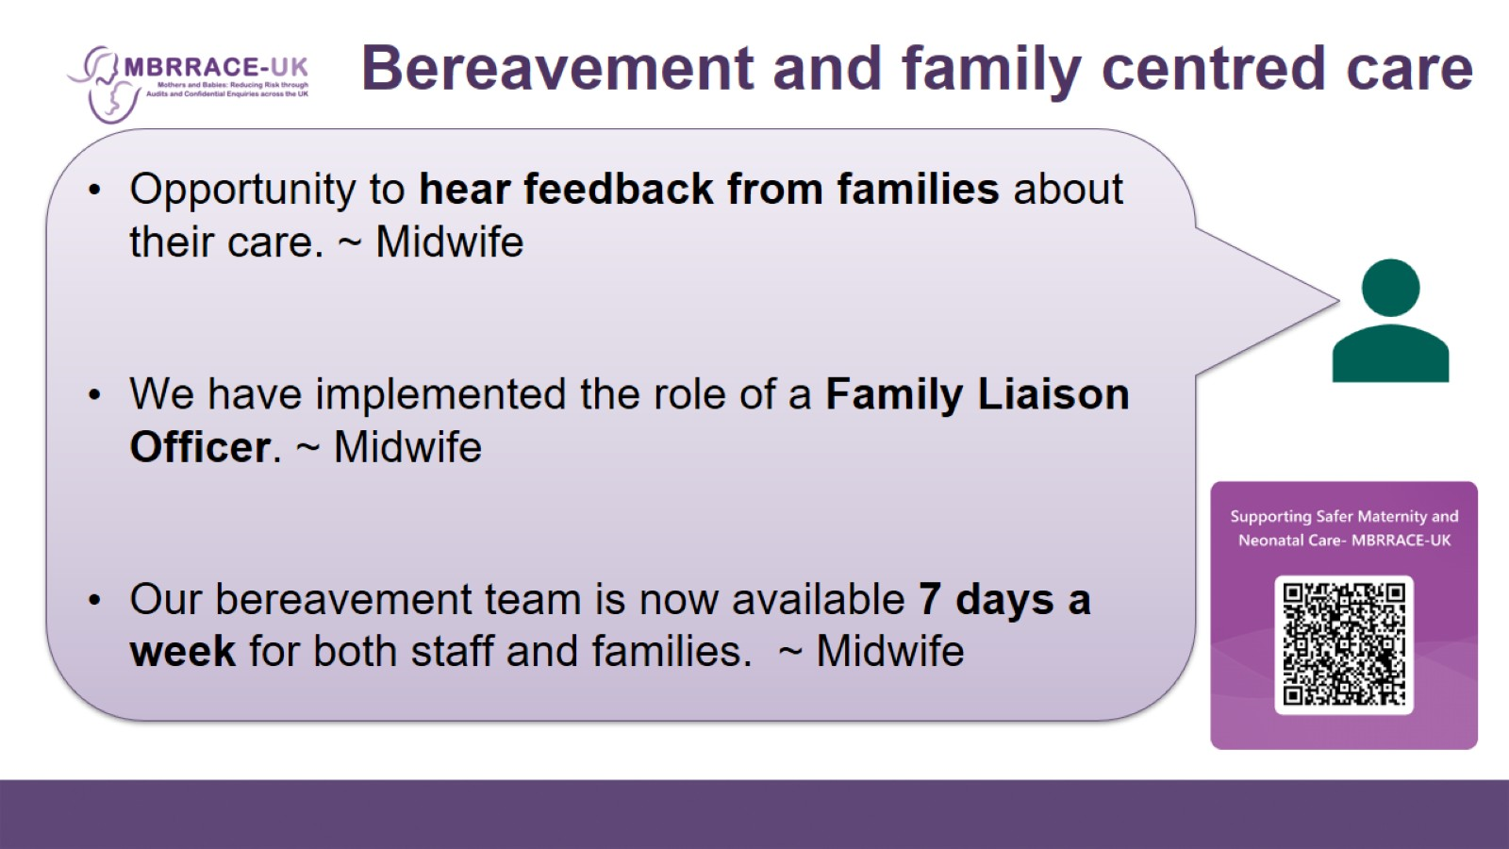
Bereavement and family centred care

Slide 10
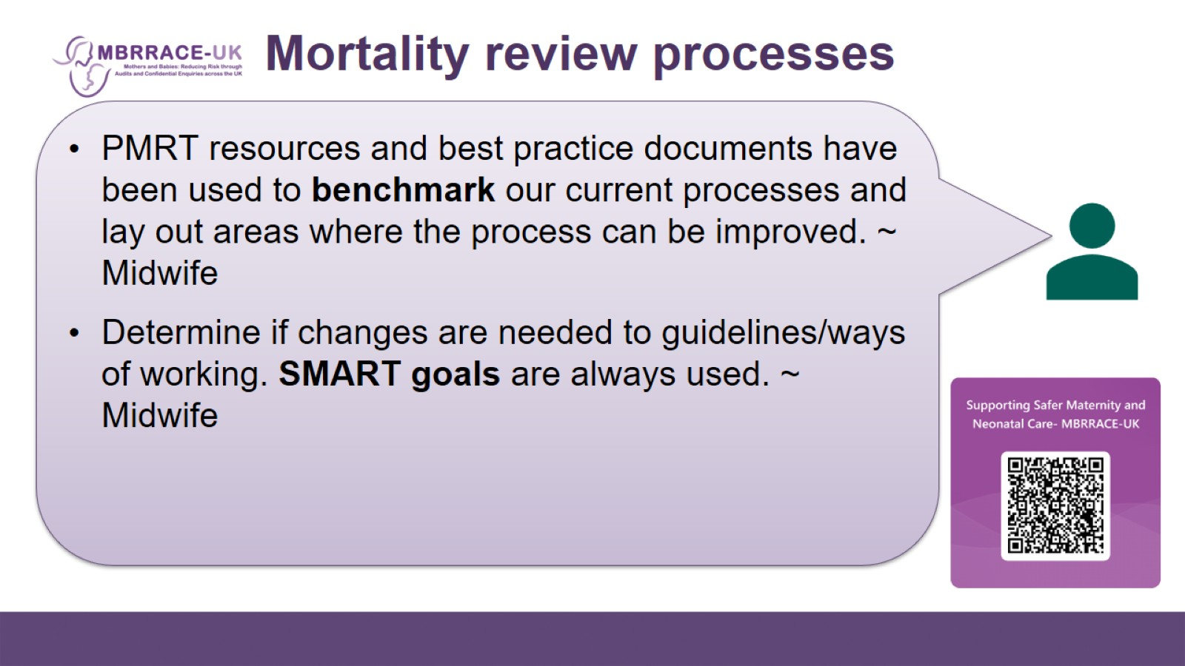
Mortality review processes

Slide 11
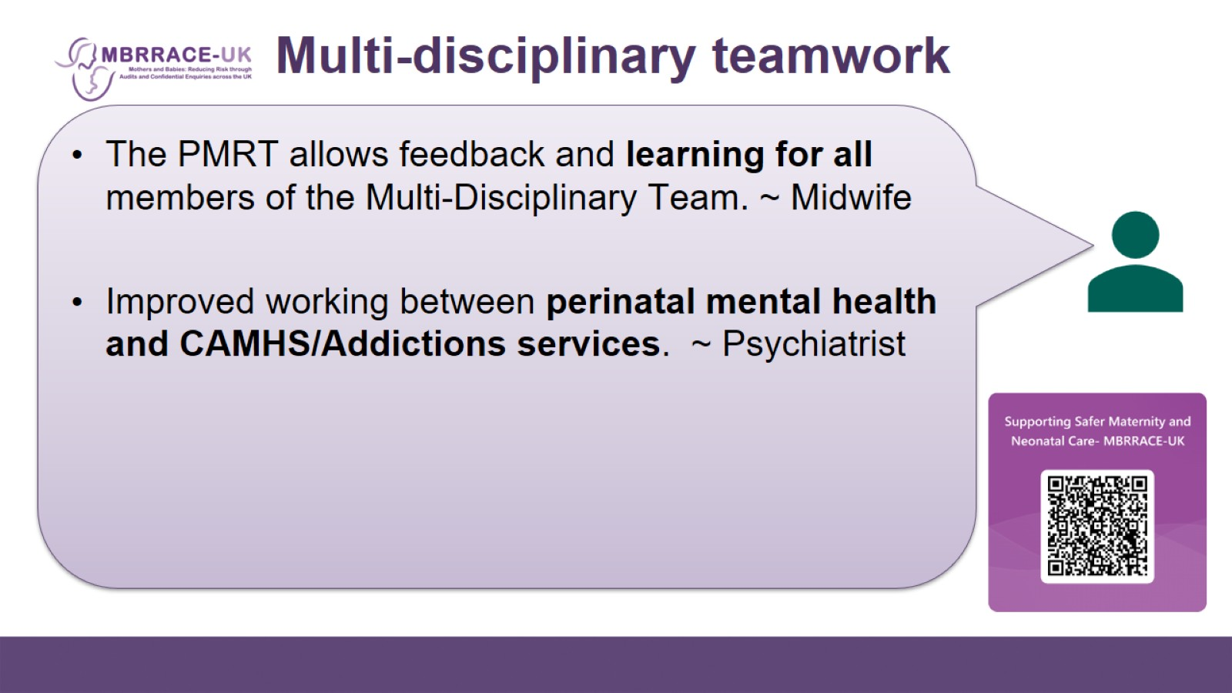
Multi-disciplinary teamwork

Slide 12
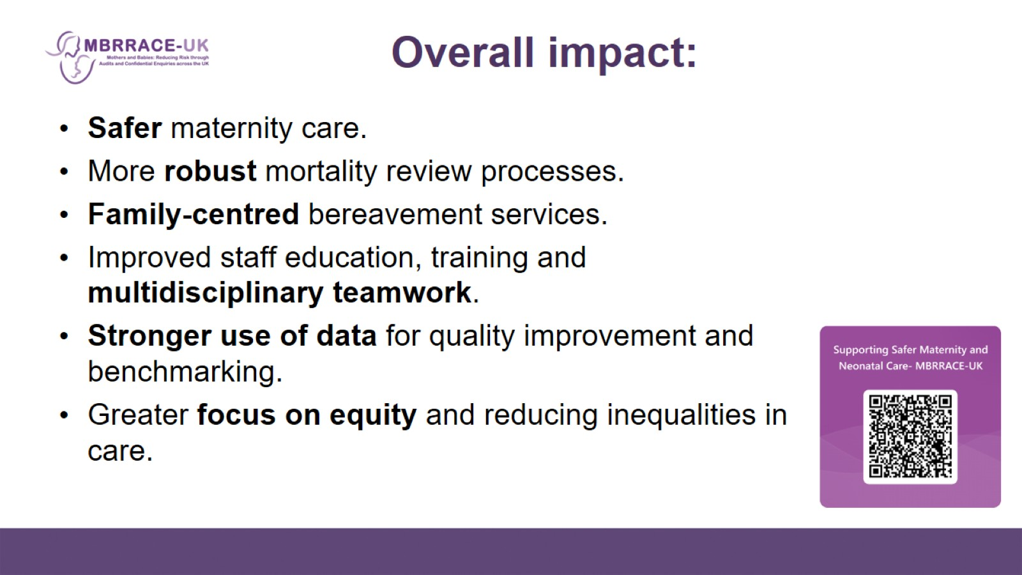
Overall impact:

Slide 13
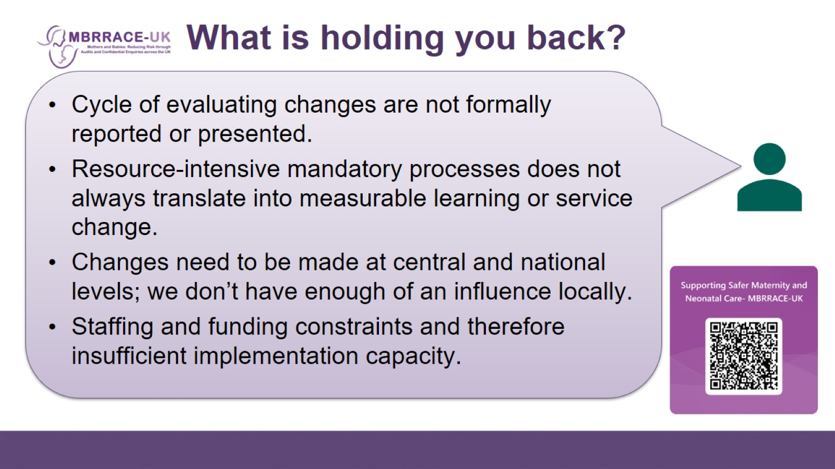
What is holding you back?

Slide 14
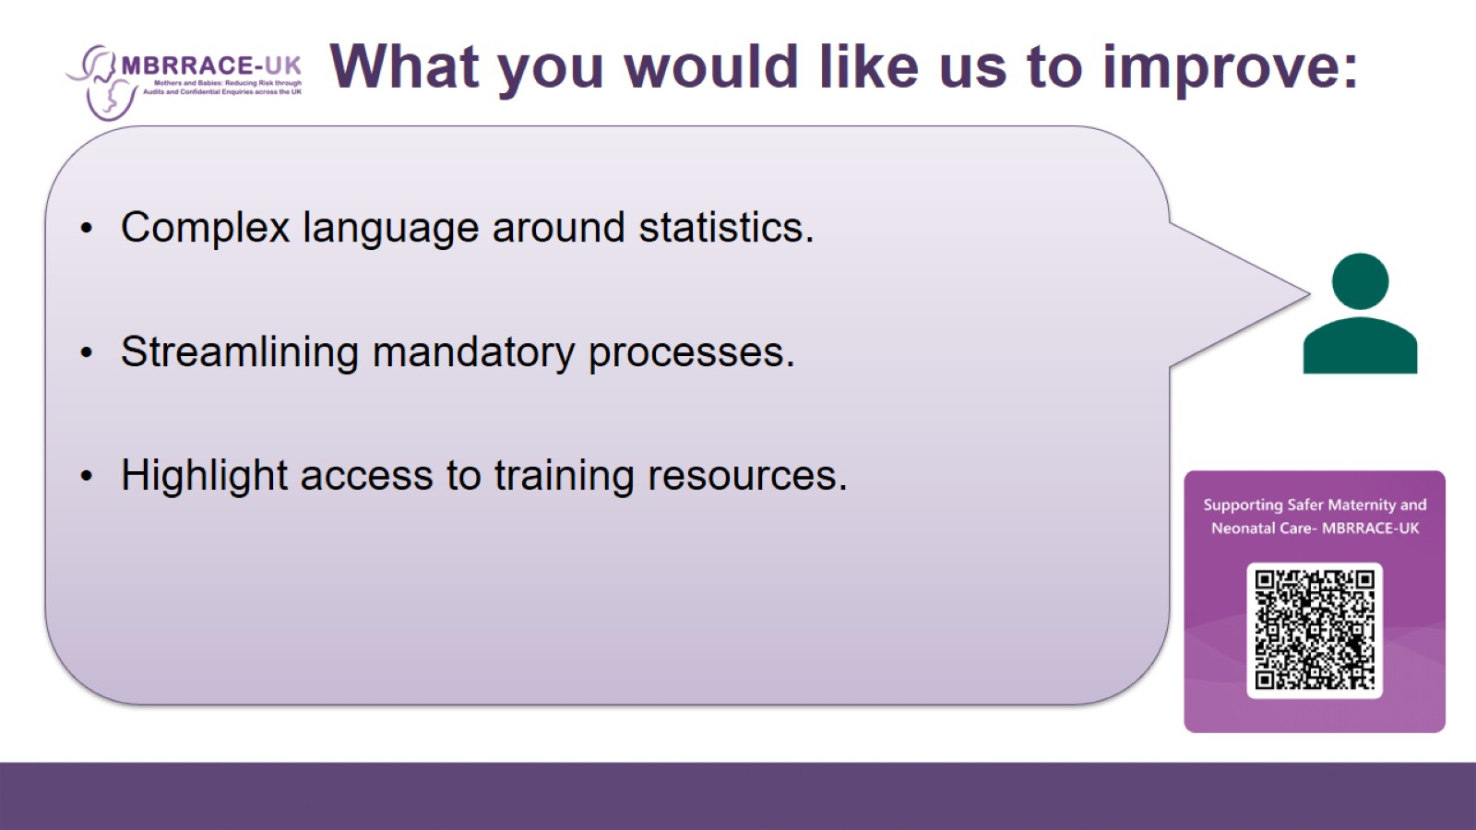
What you would like us to improve:

Slide 15
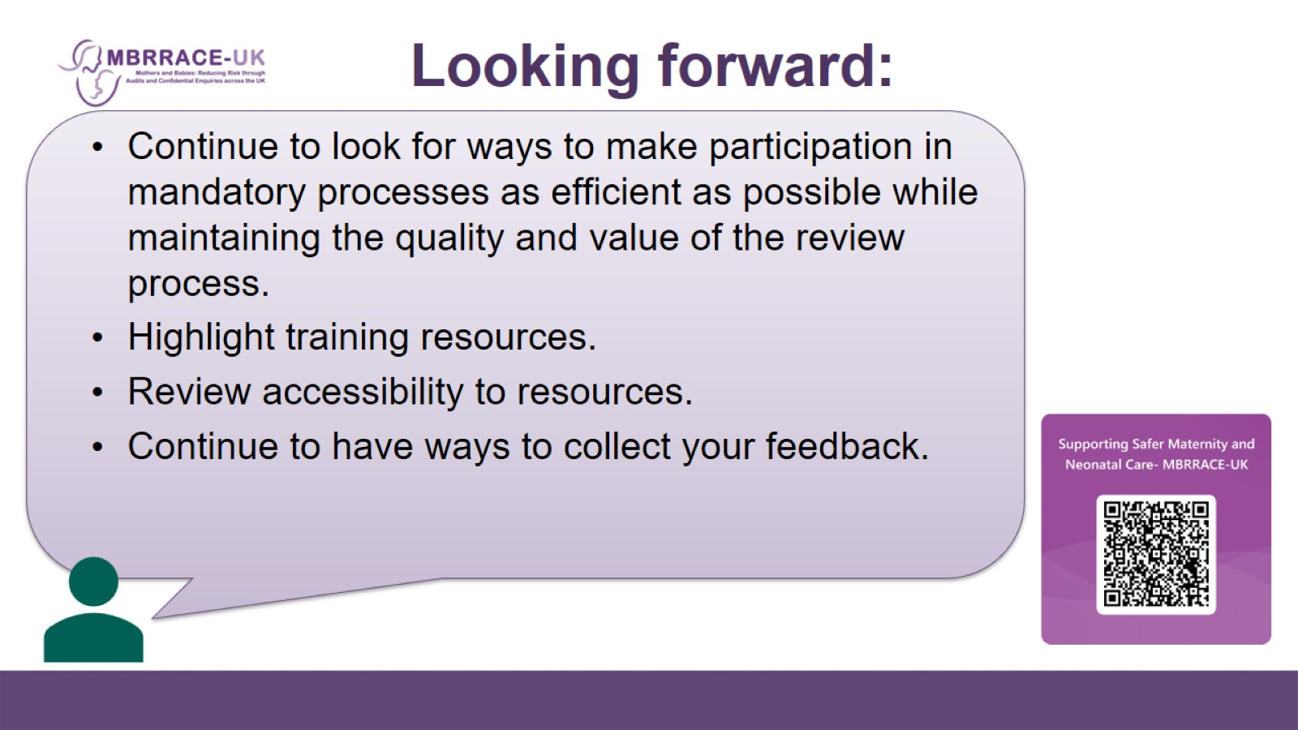
Looking forward:

Slide 16
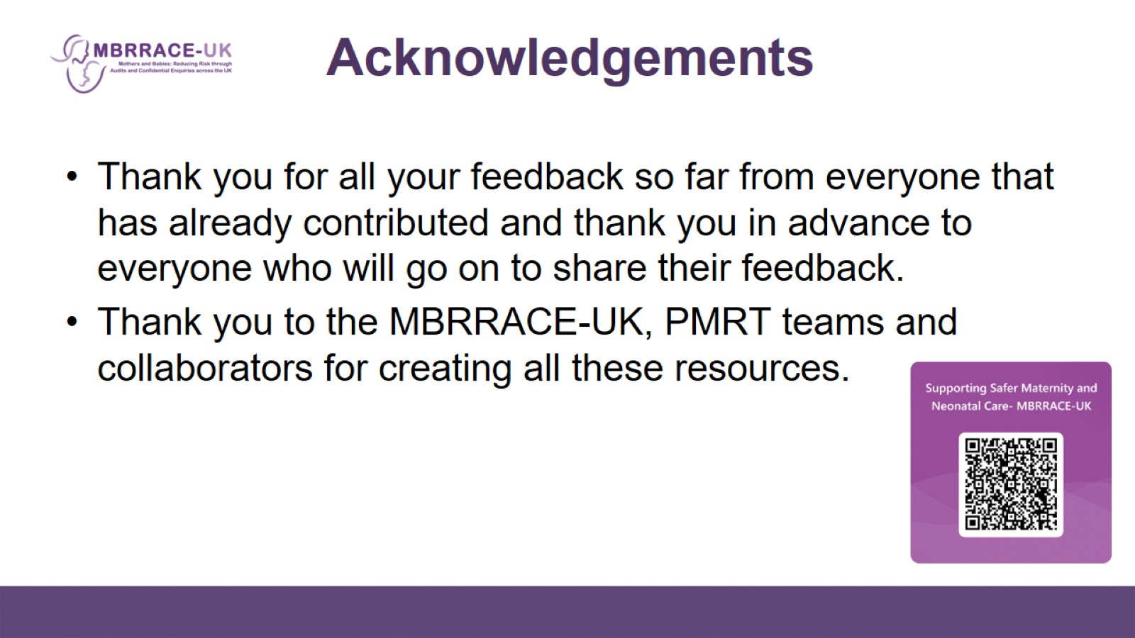
Acknowledgements

