Slide 1
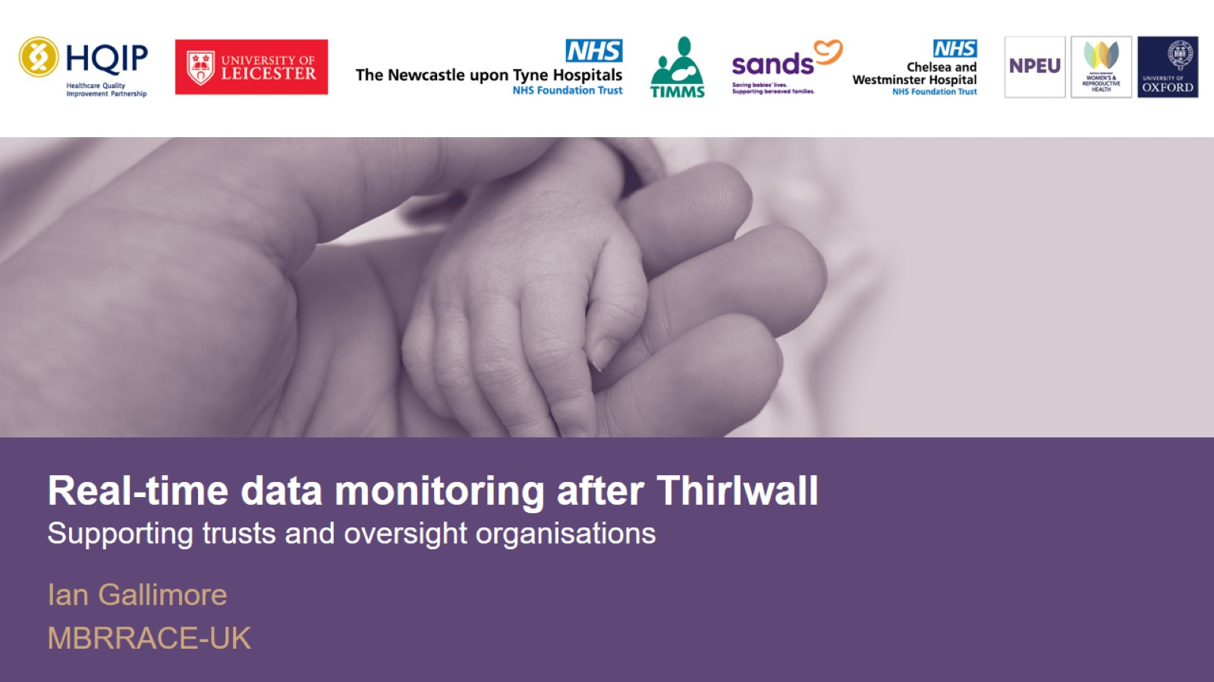

Slide 2
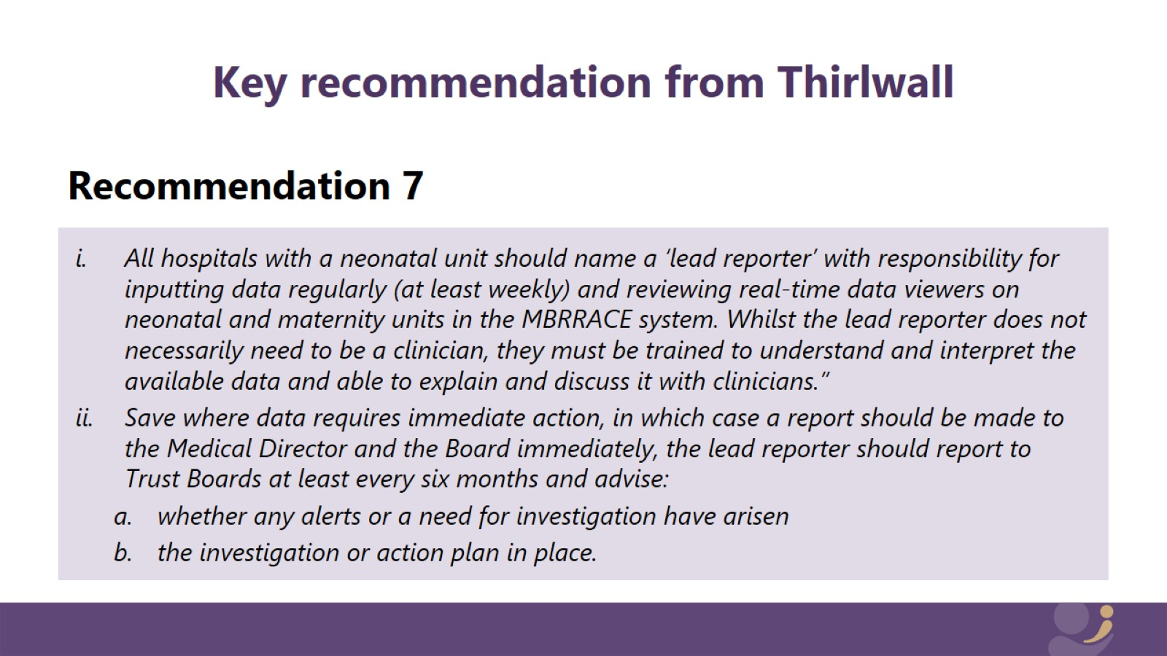
Key recommendation from Thirlwall

Slide 3
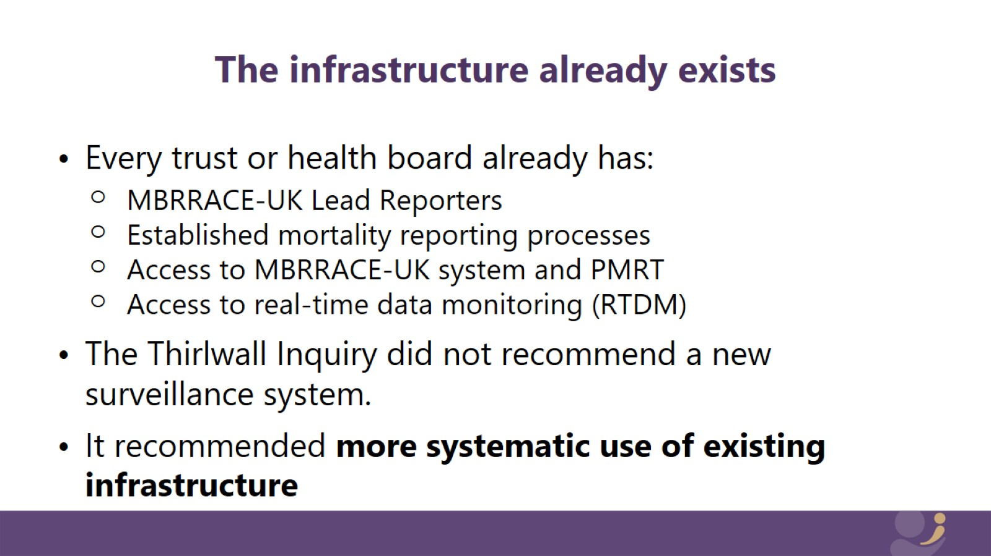
The infrastructure already exists

Slide 4
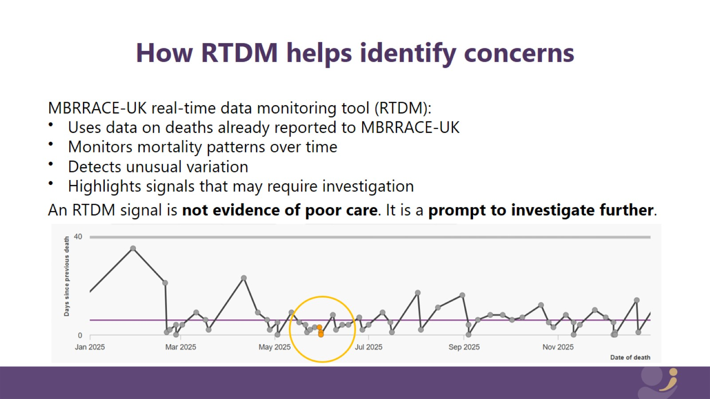
How RTDM helps identify concerns

Slide 5
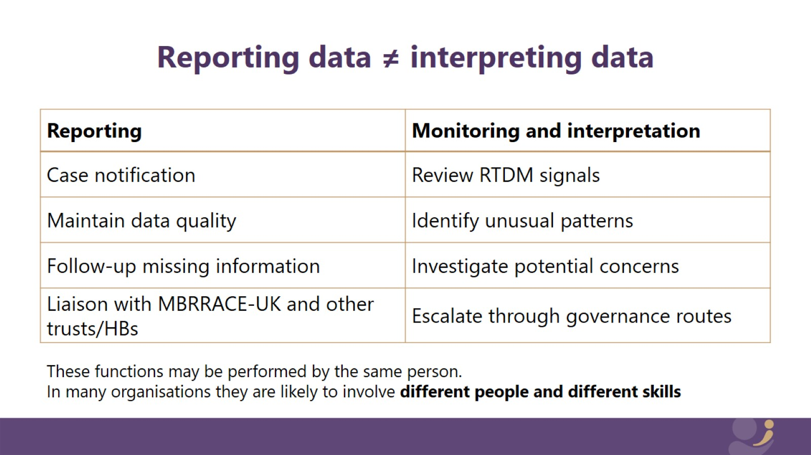
Reporting data ≠ interpreting data

Slide 6
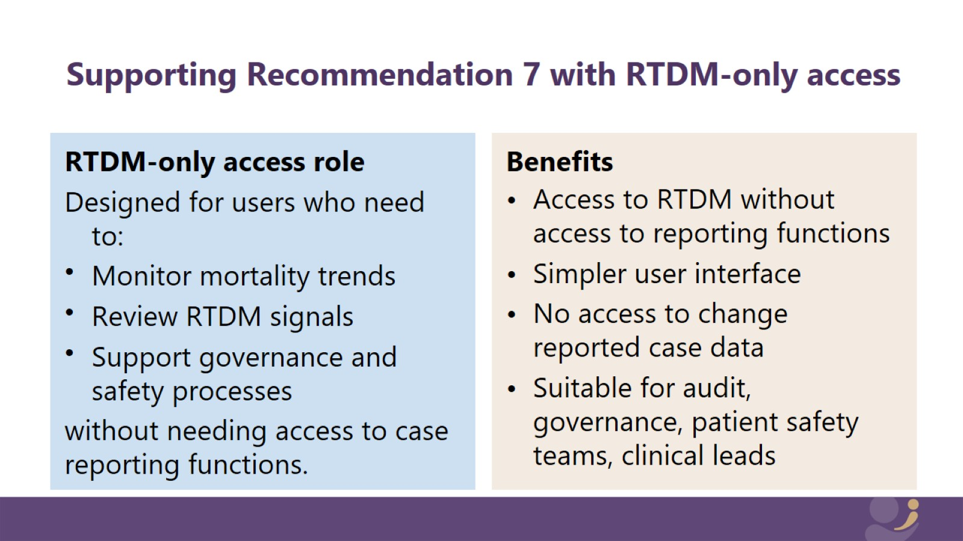

Slide 7
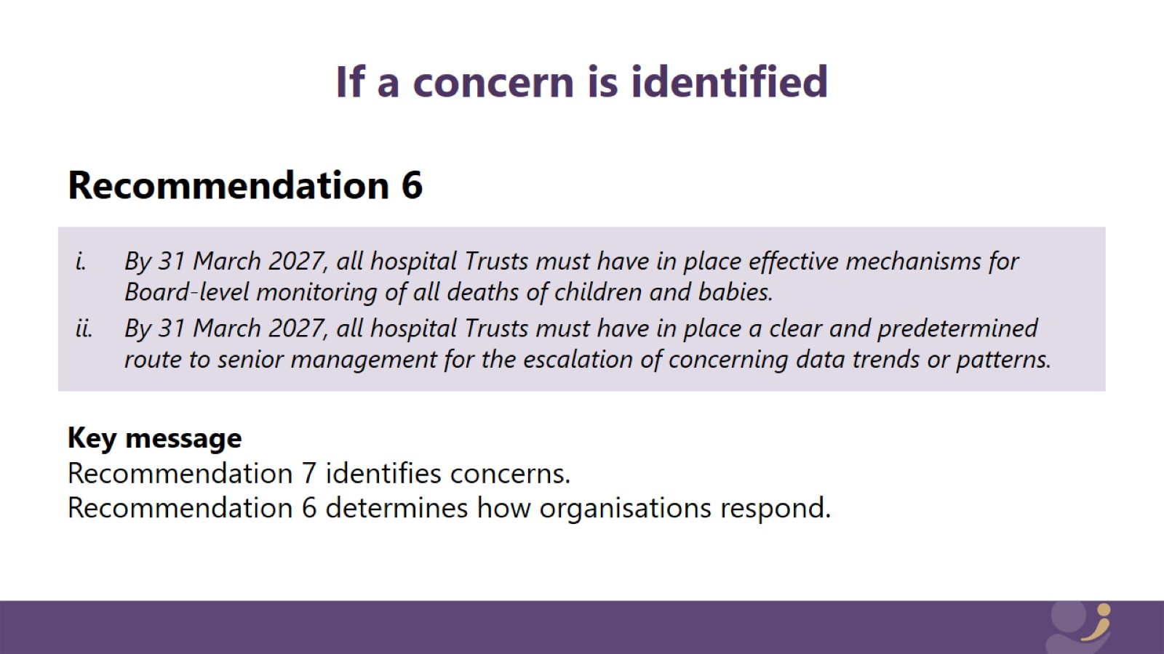
If a concern is identified

Slide 8
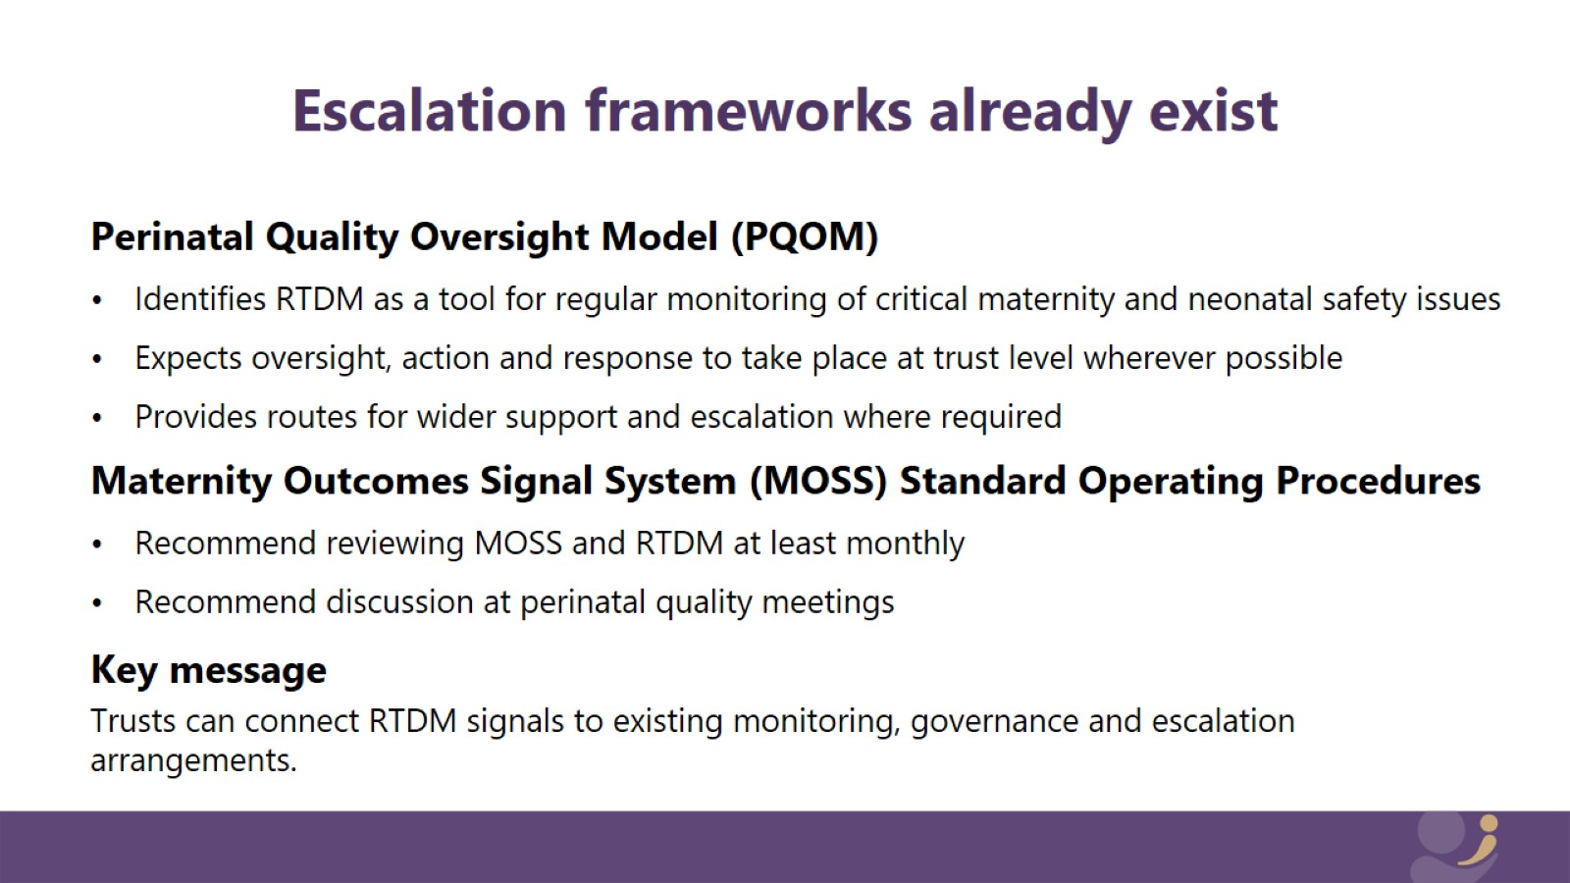
Escalation frameworks already exist

Slide 9
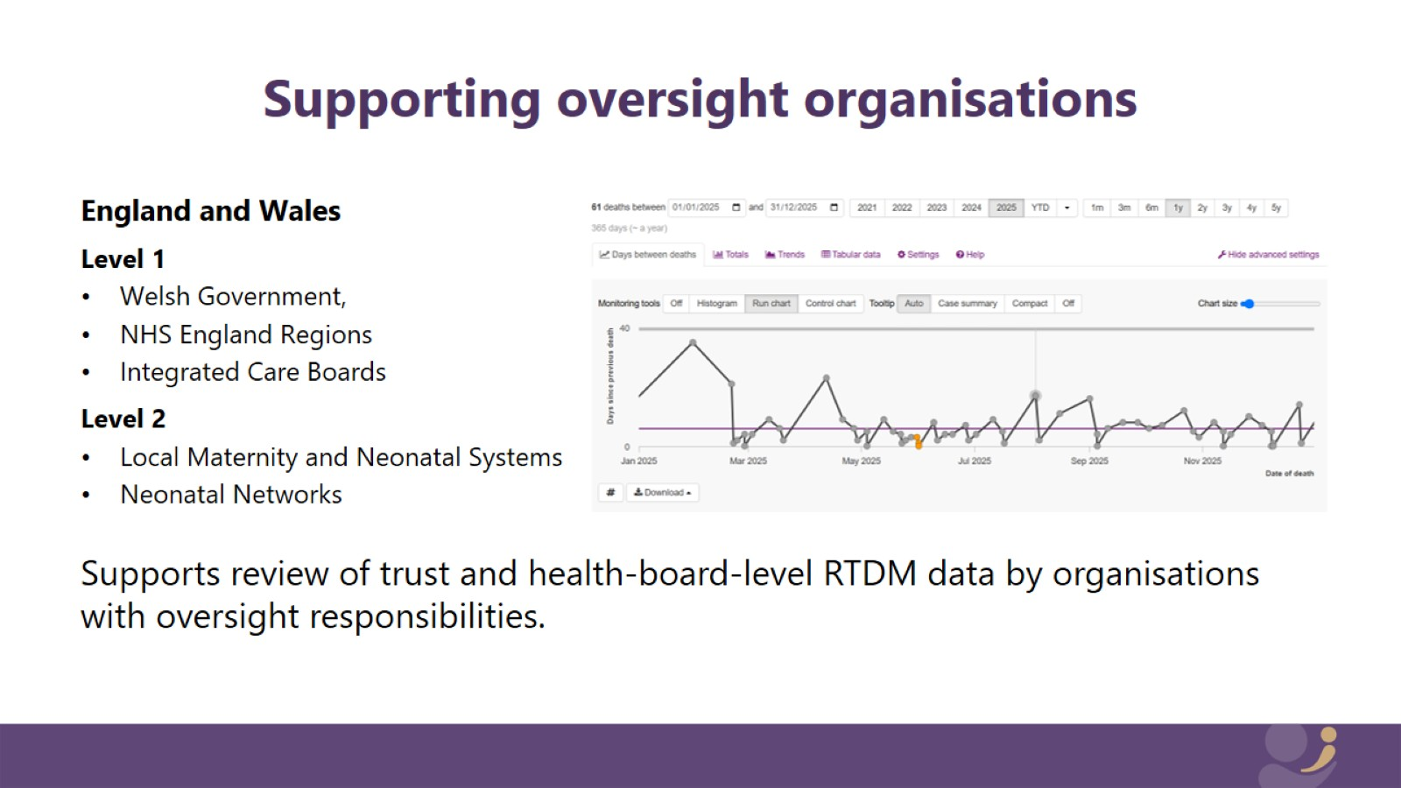
Supporting oversight organisations

Slide 10
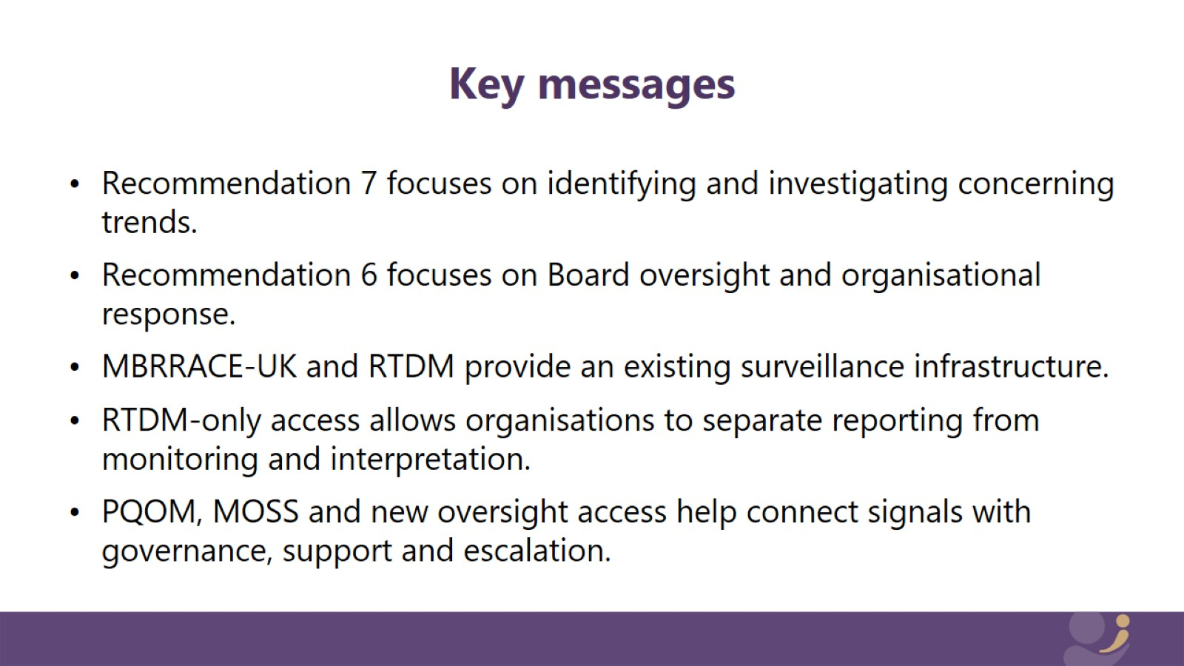
Key messages

Slide 11


