Slide 1


Slide 2
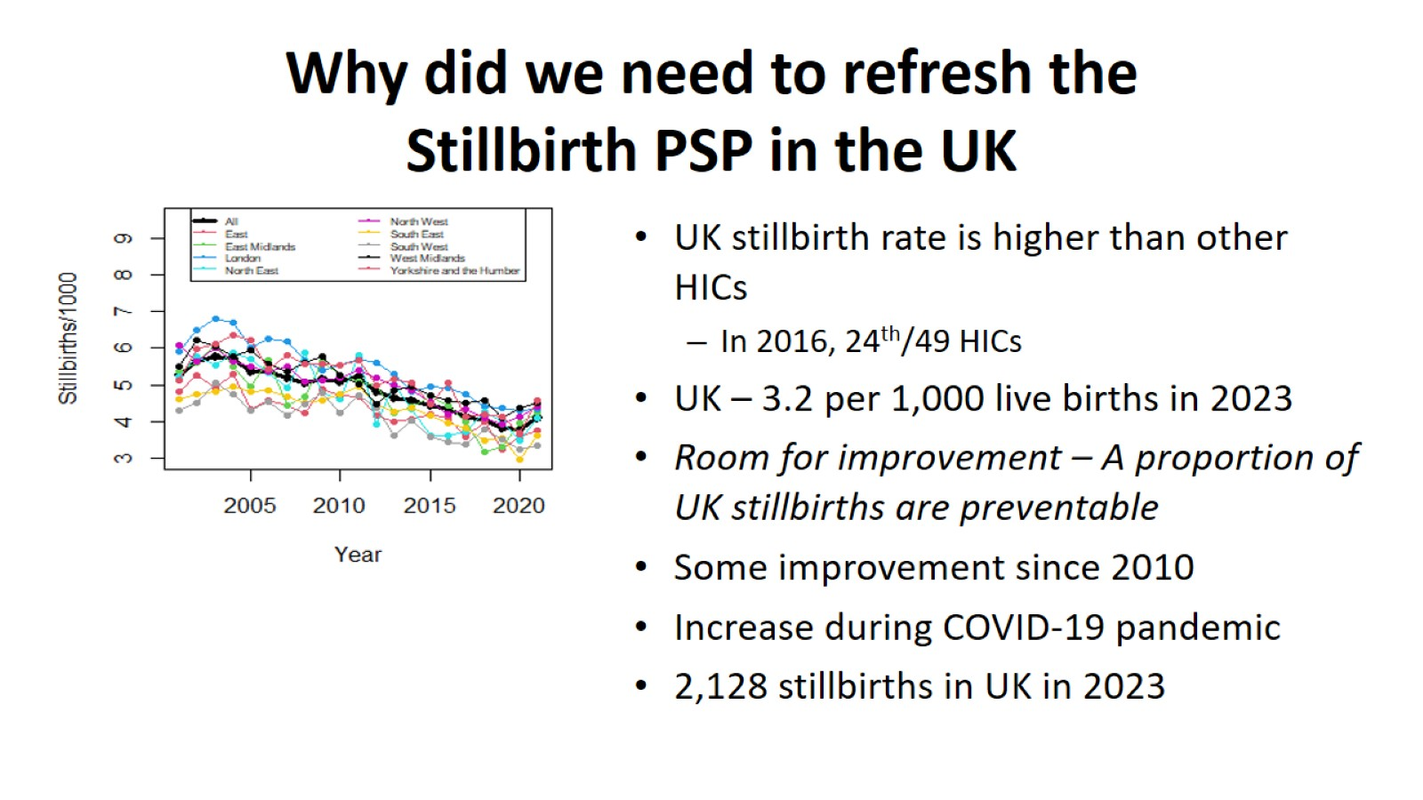
Why did we need to refresh the Stillbirth PSP in the UK

Slide 3
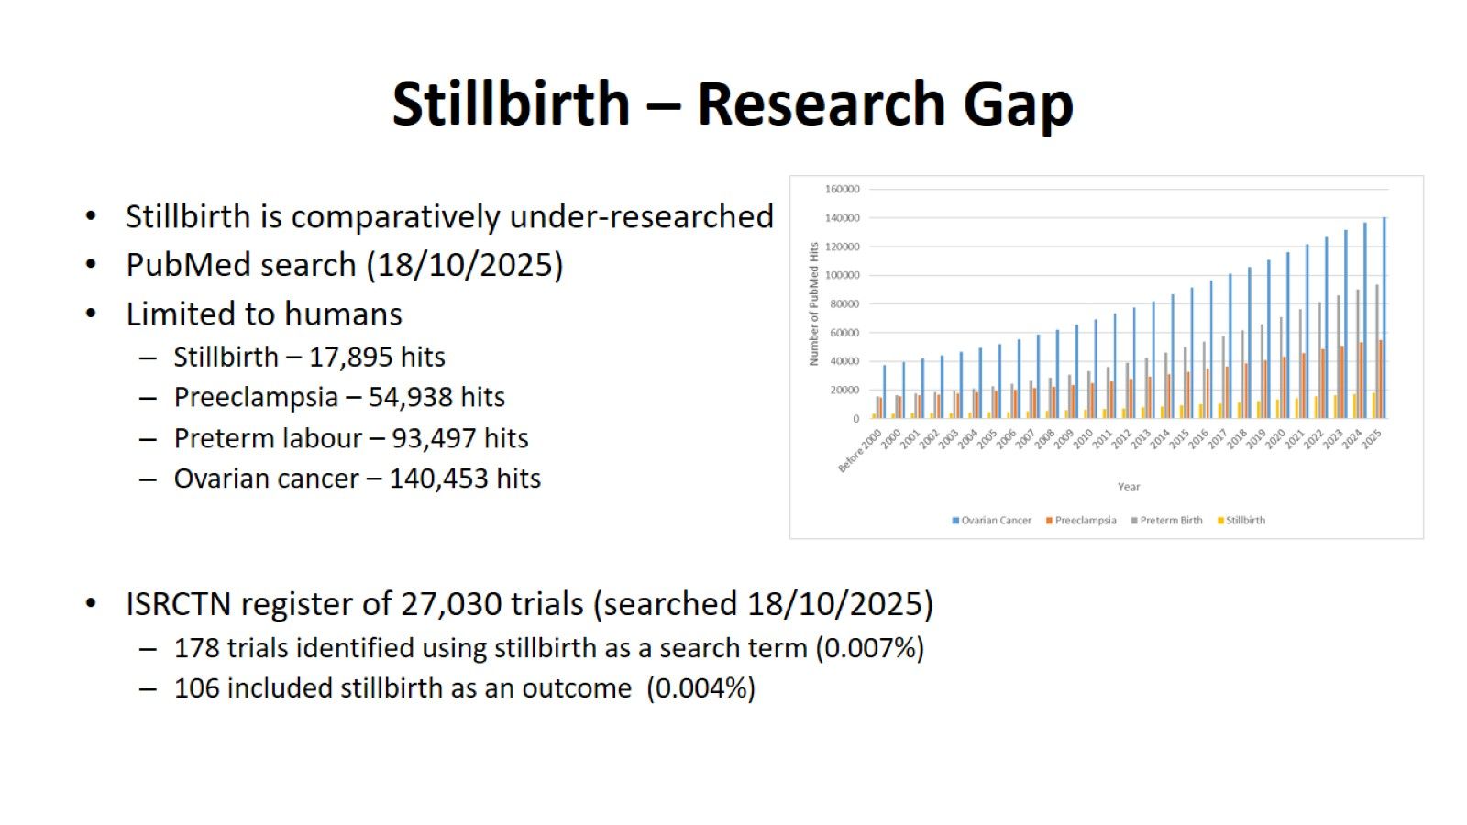
Stillbirth – Research Gap

Slide 4
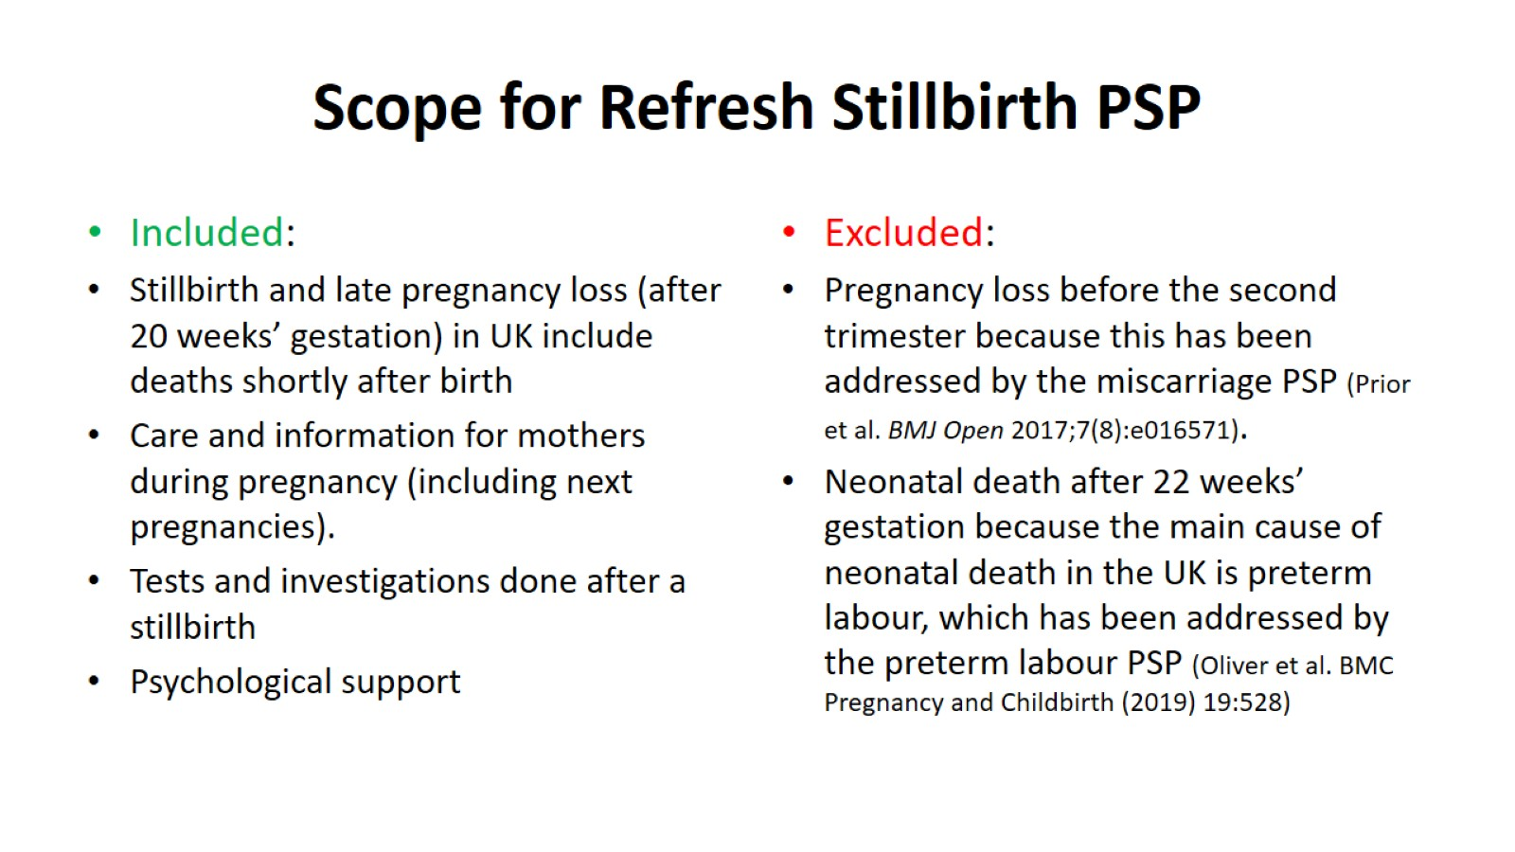
Scope for Refresh Stillbirth PSP

Slide 5
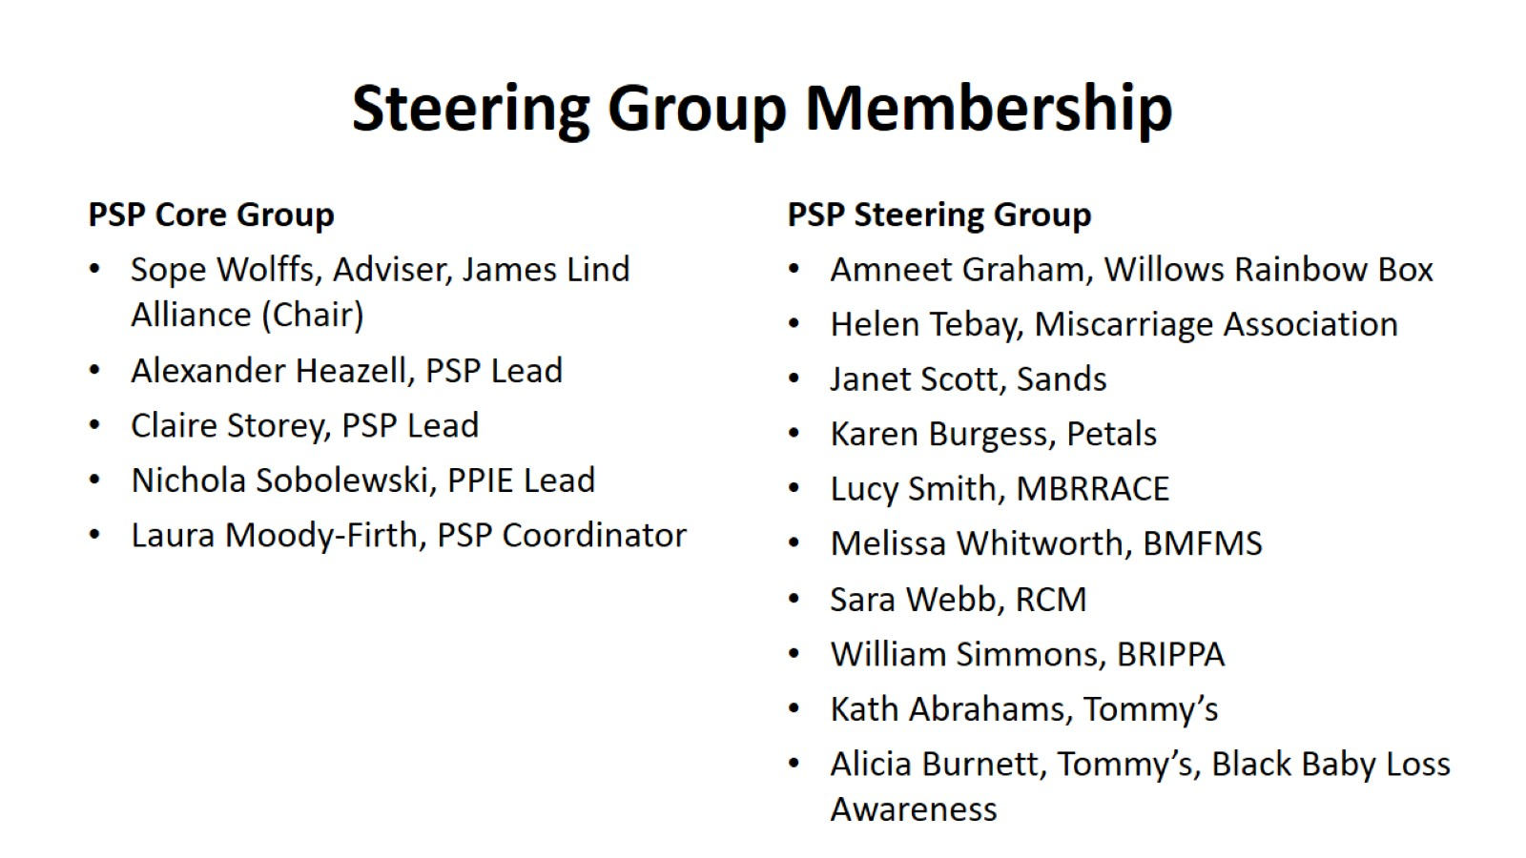
Steering Group Membership

Slide 6
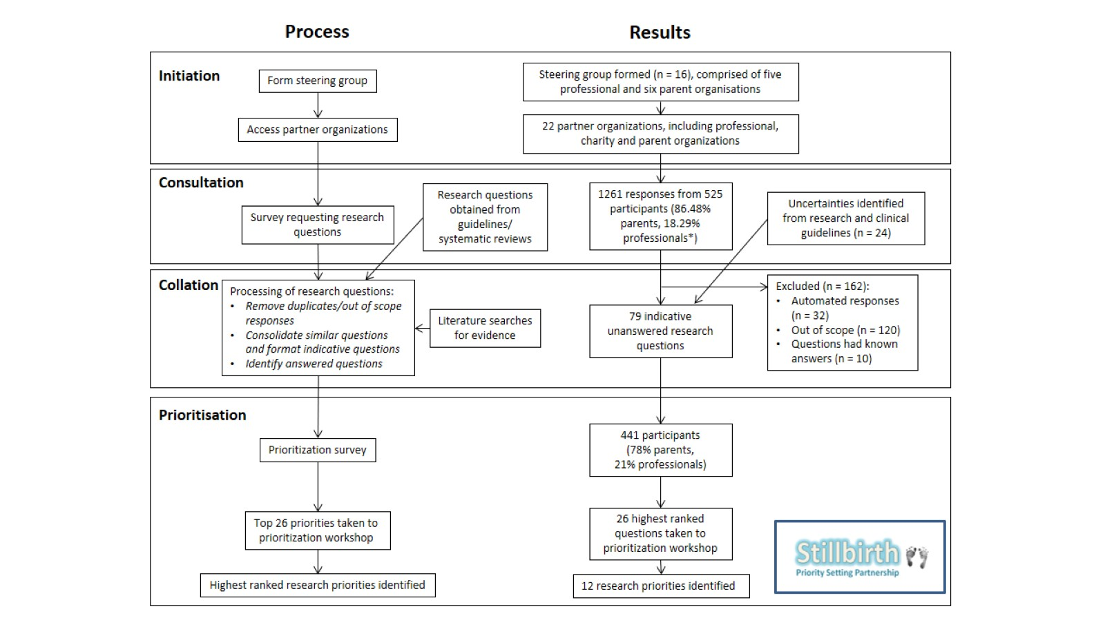

Slide 7
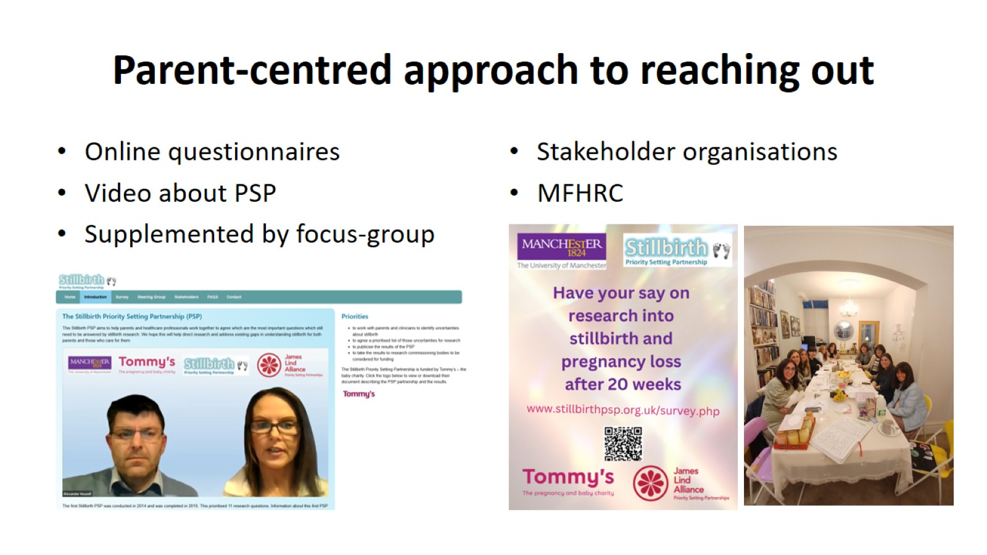
Parent-centred approach to reaching out

Slide 8
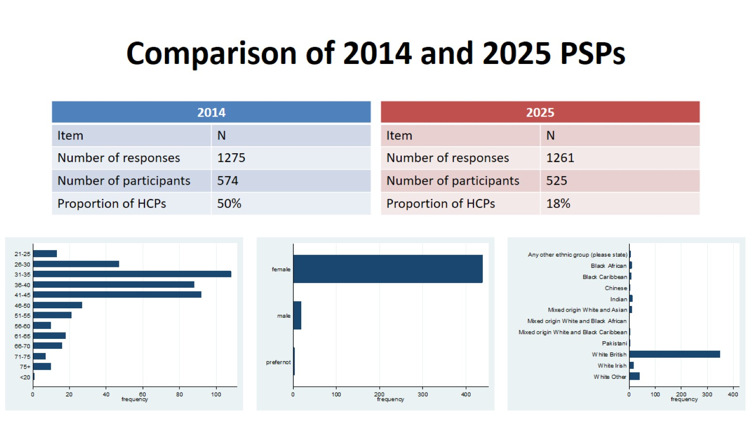
Comparison of 2014 and 2025 PSPs

Slide 9
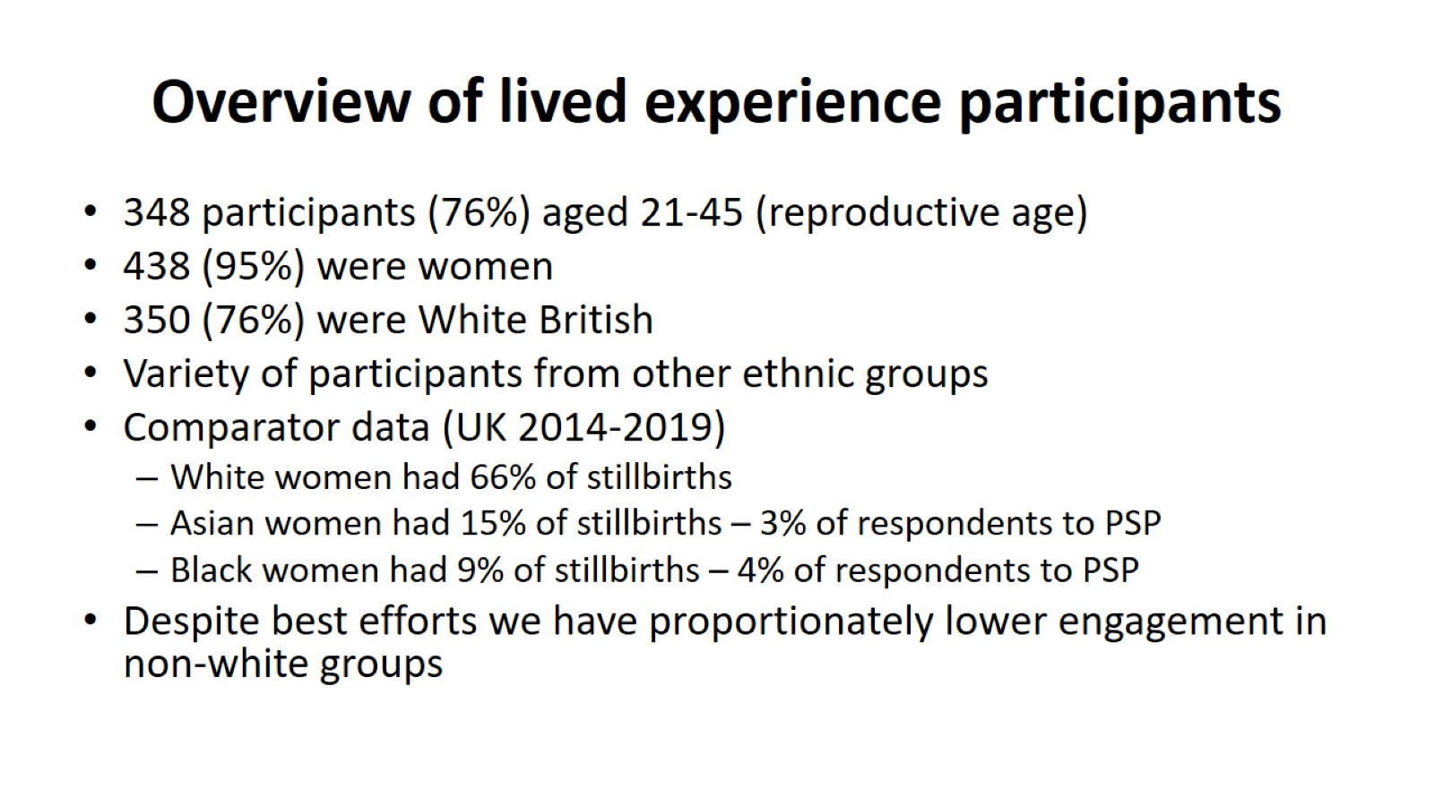
Overview of lived experience participants

Slide 10
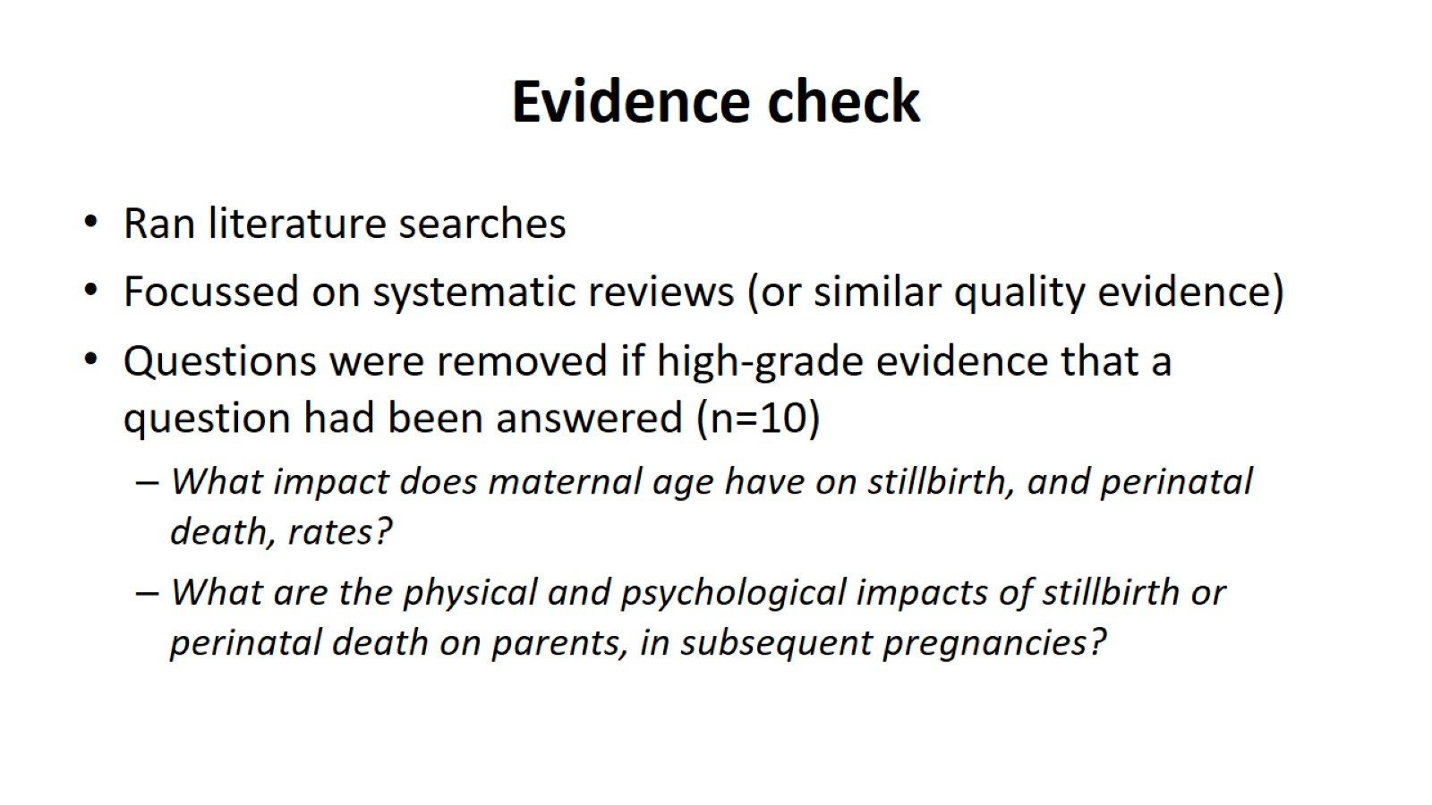
Evidence check

Slide 11
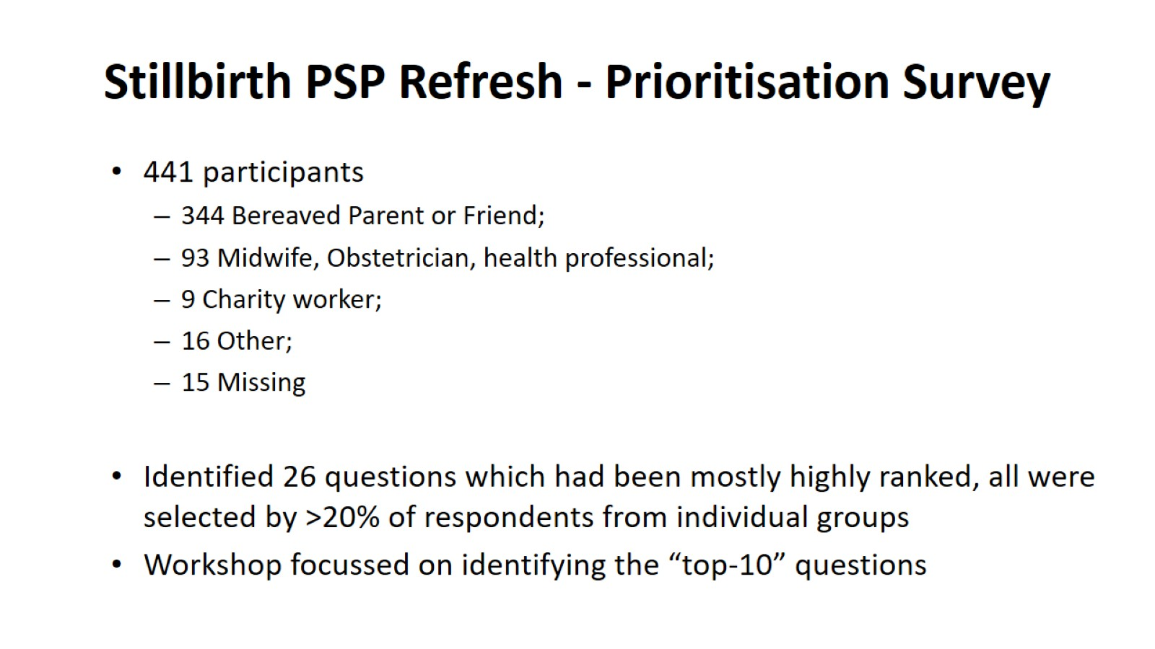
Stillbirth PSP Refresh - Prioritisation Survey

Slide 12
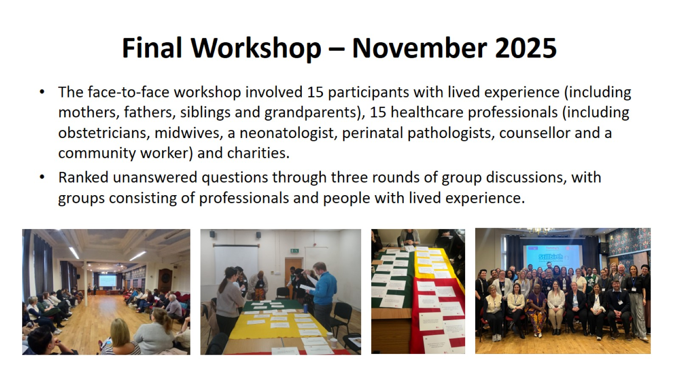
Final Workshop – November 2025

Slide 13
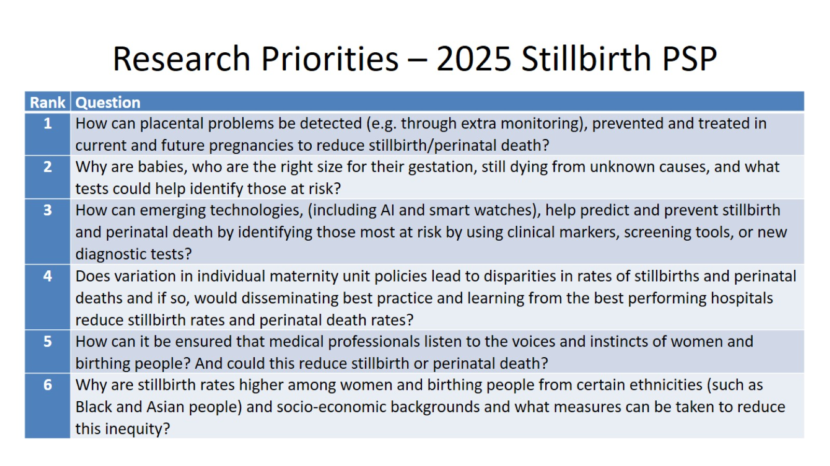
Research Priorities – 2025 Stillbirth PSP

Slide 14
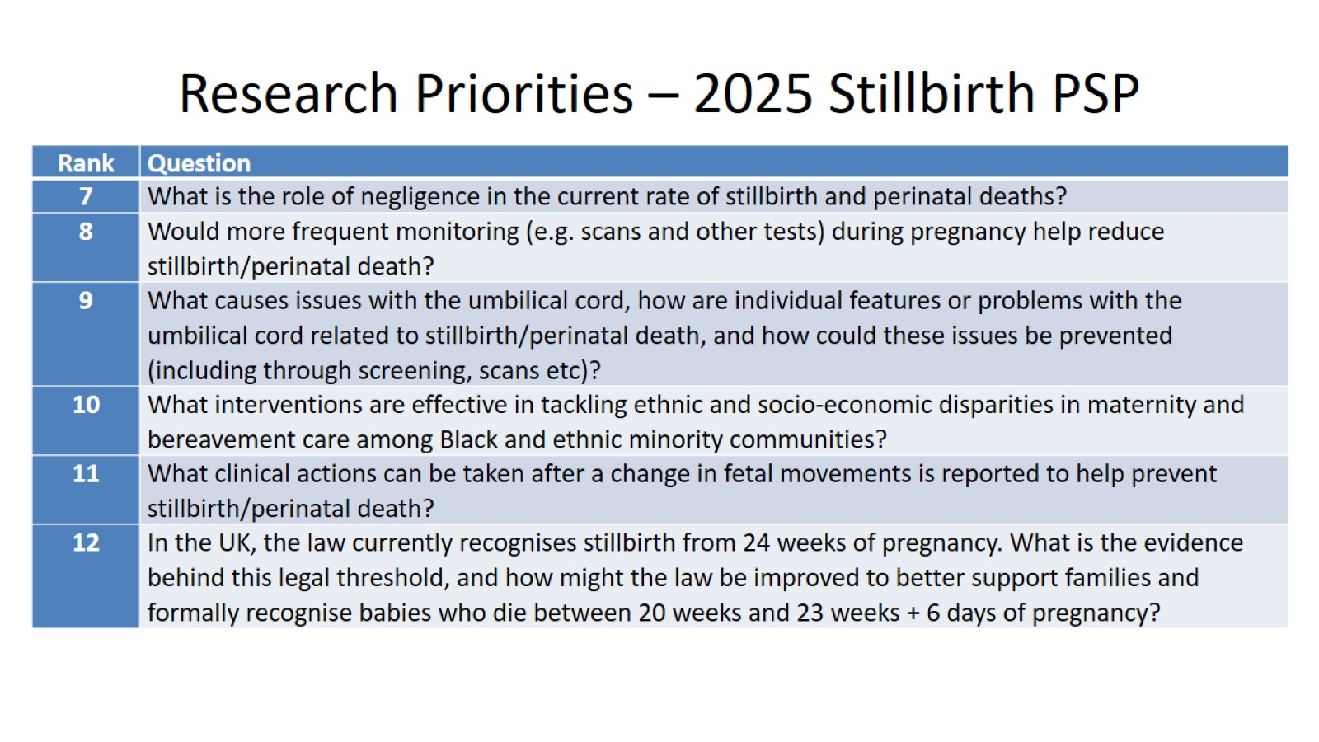
Research Priorities – 2025 Stillbirth PSP

Slide 15
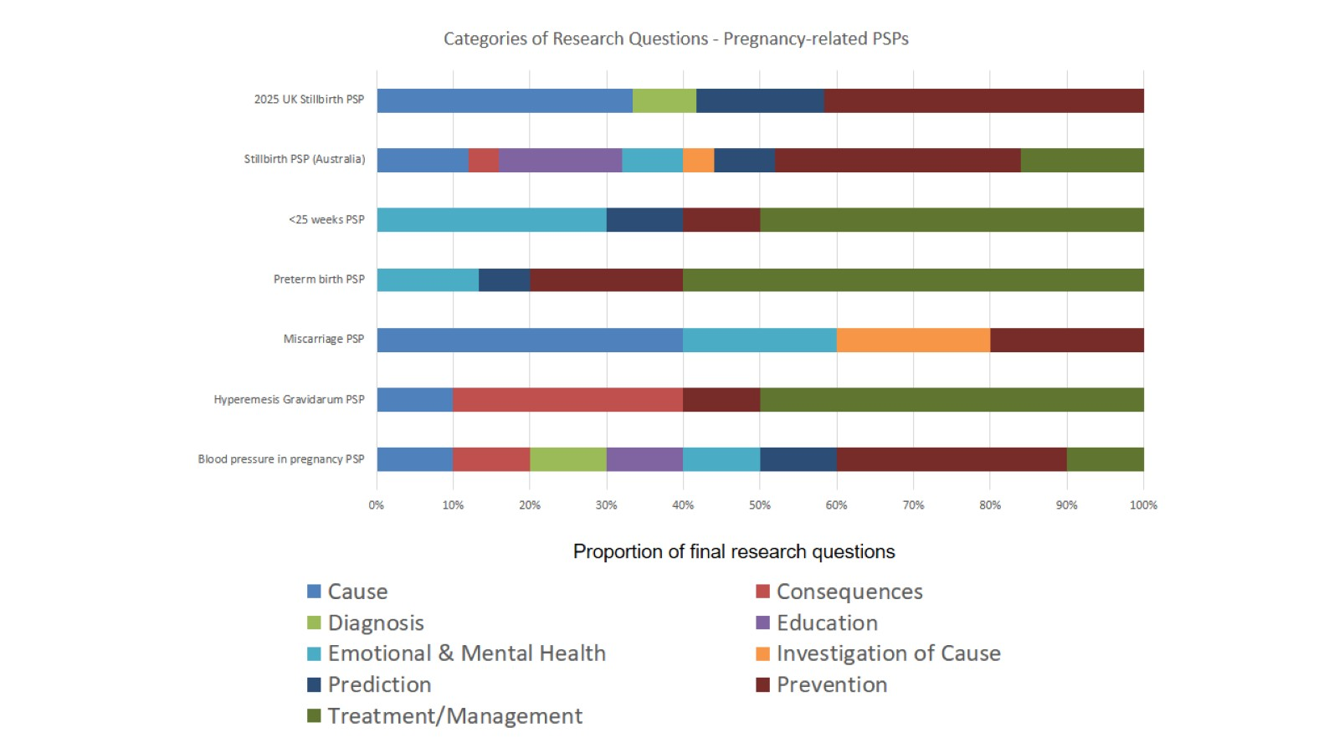

Slide 16

After the PSP – Public Engagement Events

Slide 17
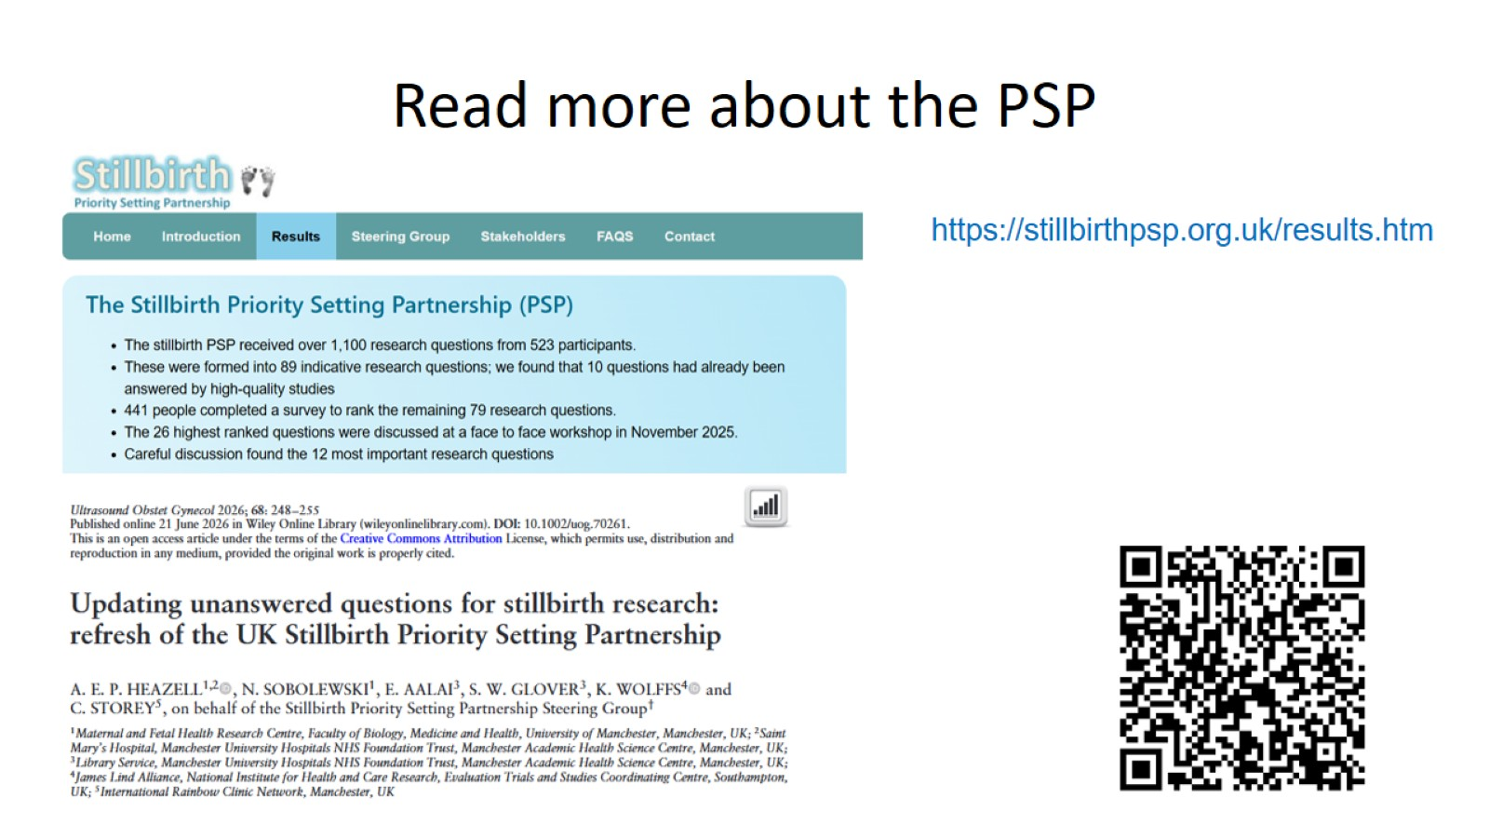
Read more about the PSP

