Slide 1


Slide 2


Slide 3
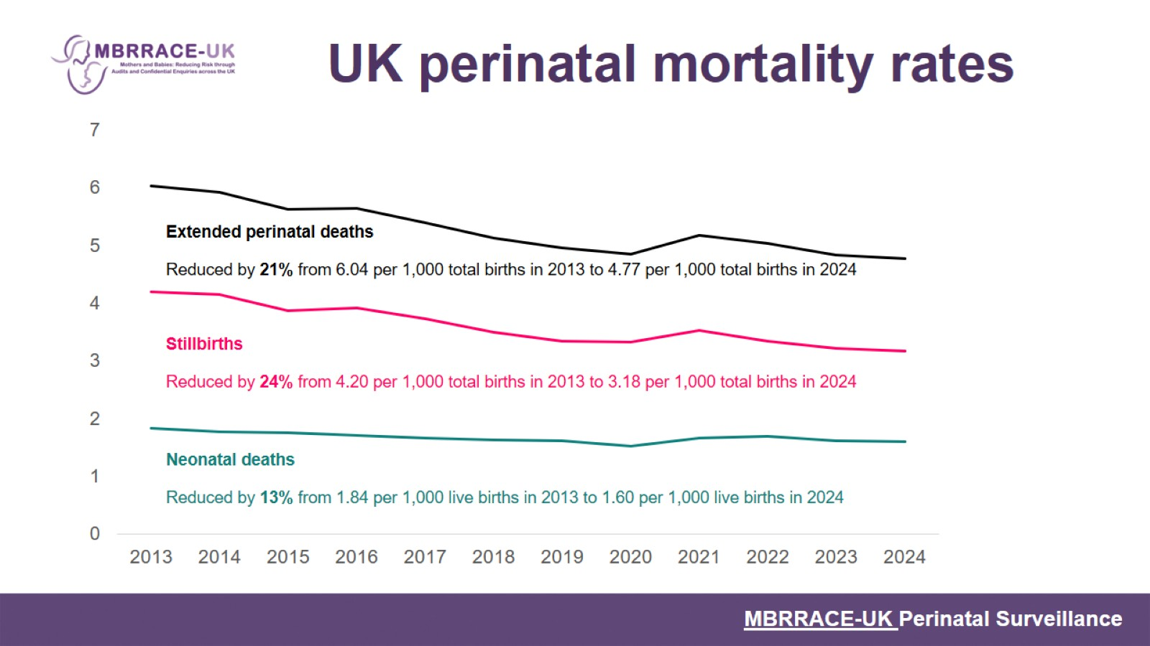
UK perinatal mortality rates

Slide 4
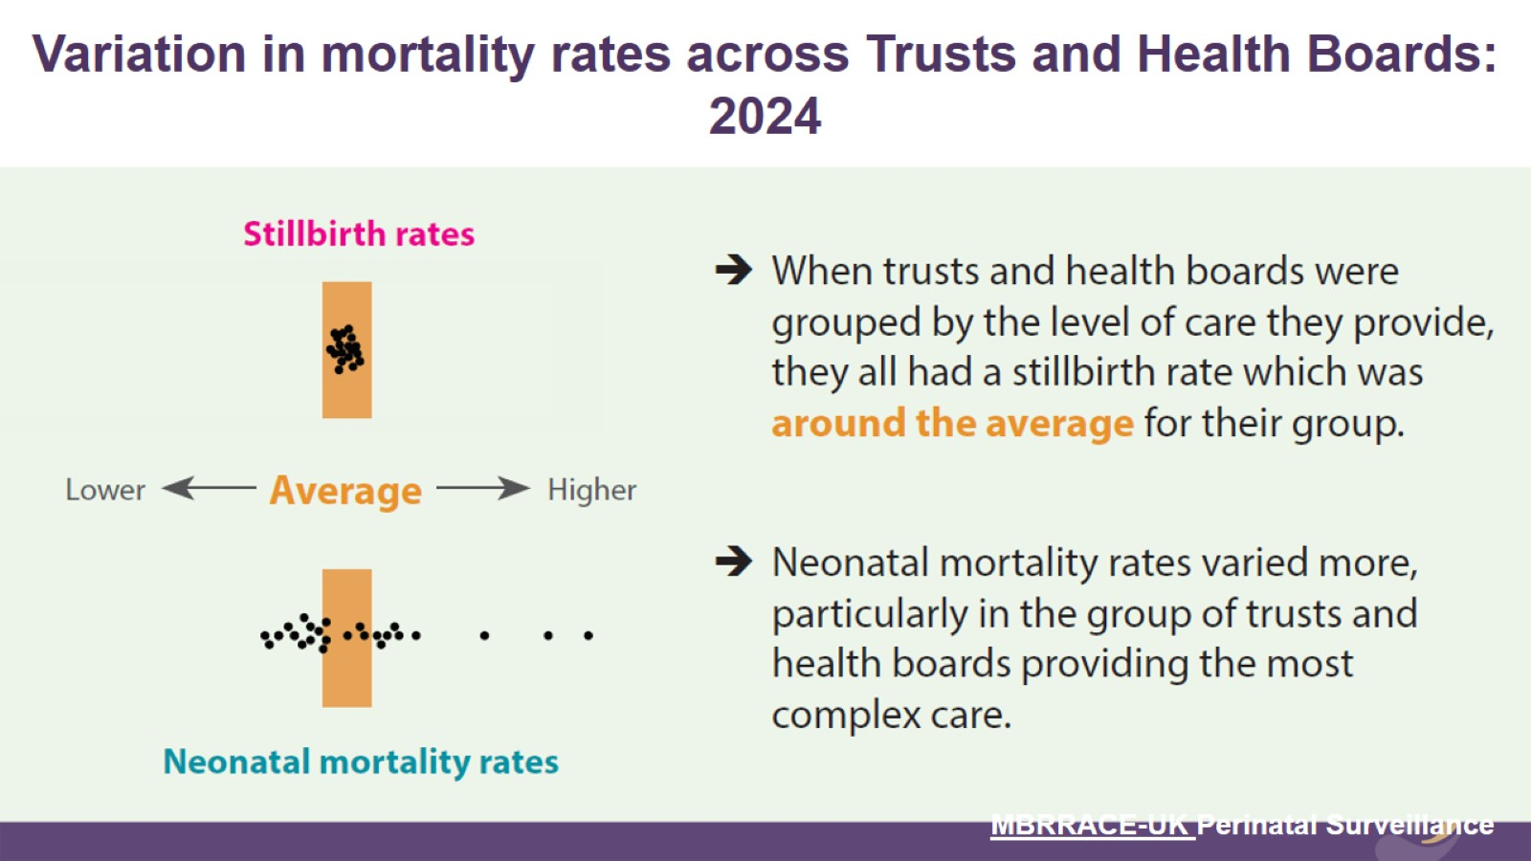

Slide 5
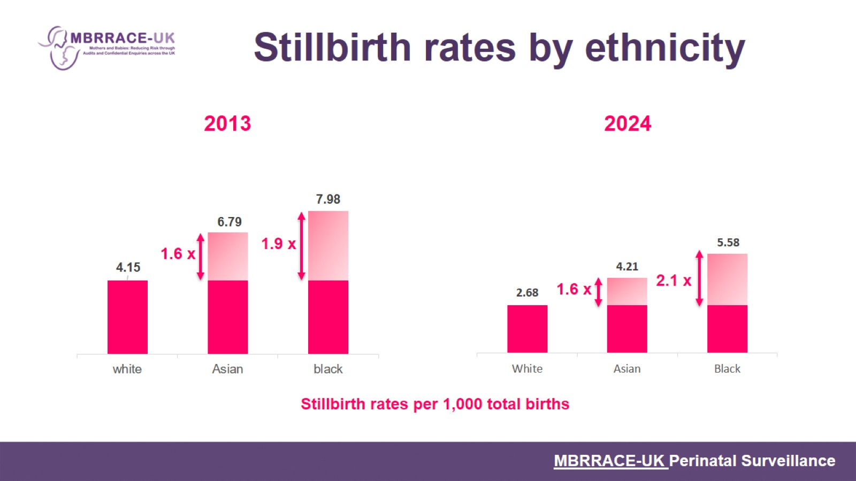
Stillbirth rates by ethnicity

Slide 6
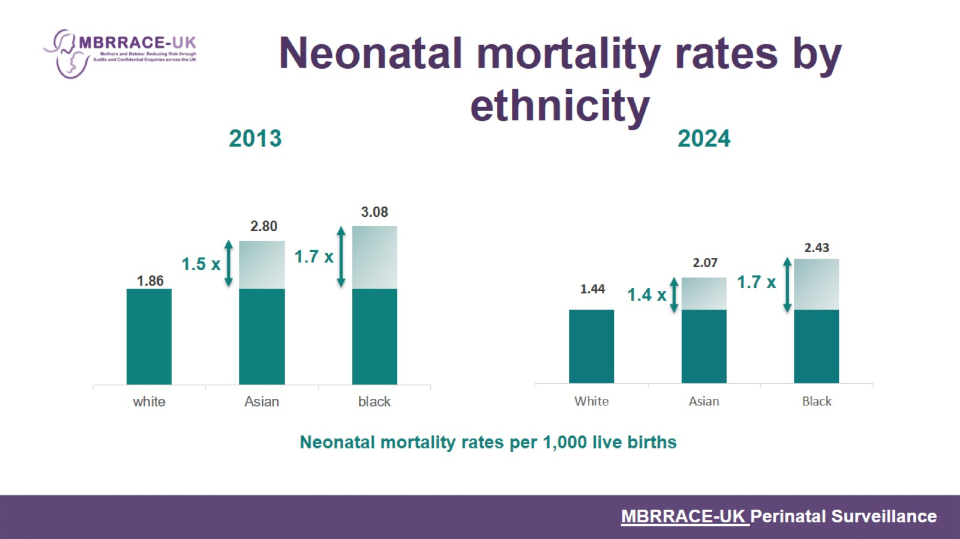
Neonatal mortality rates by ethnicity

Slide 7
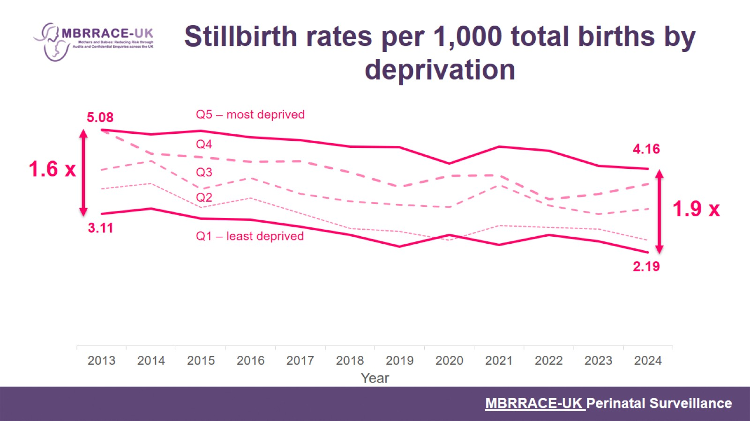
Stillbirth rates per 1,000 total births by deprivation

Slide 8
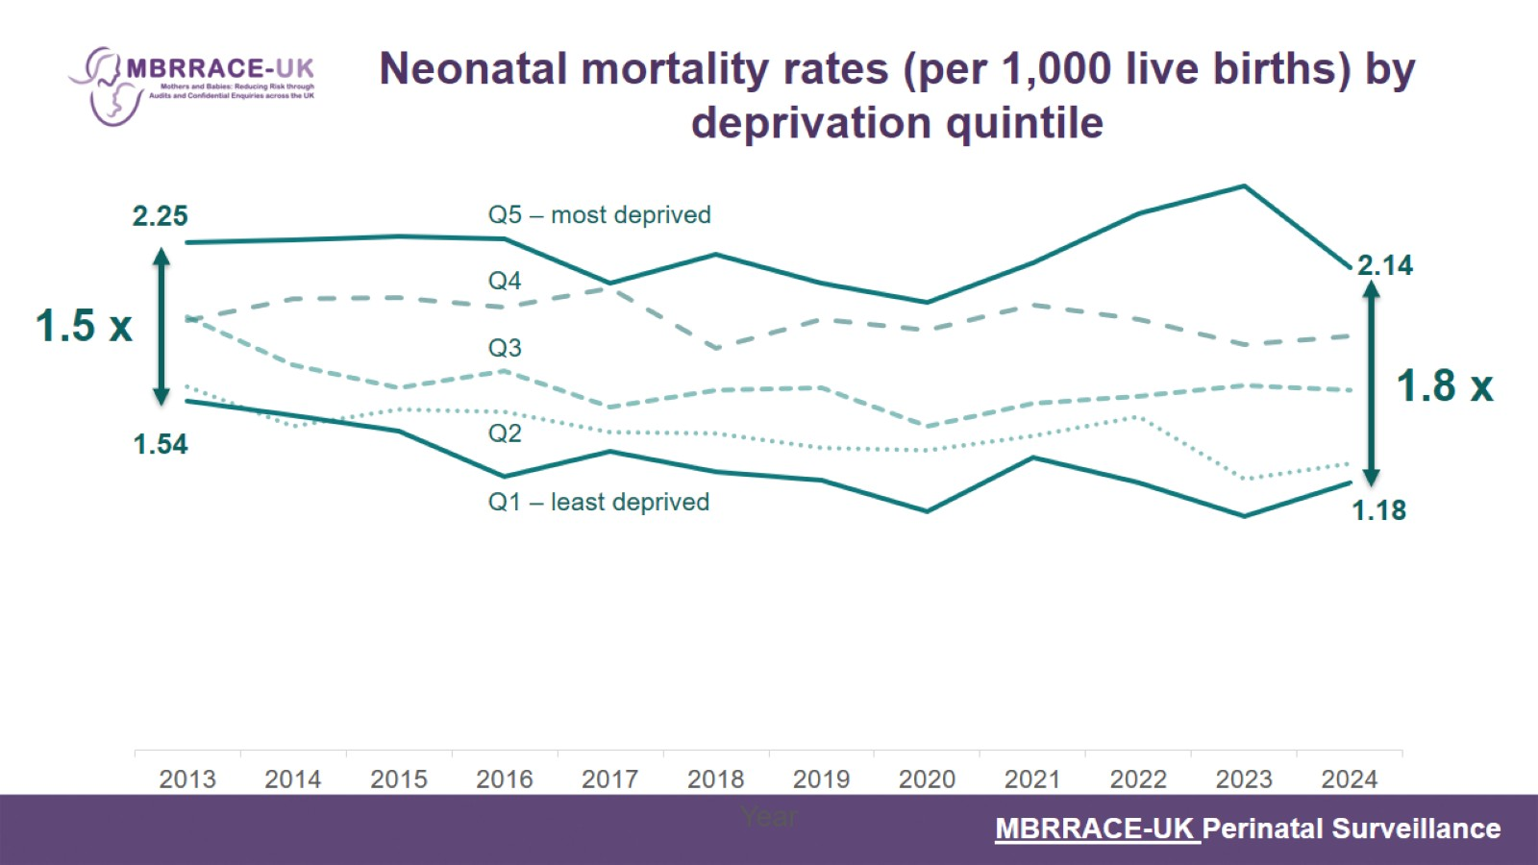
Neonatal mortality rates (per 1,000 live births) by deprivation quintile

Slide 9
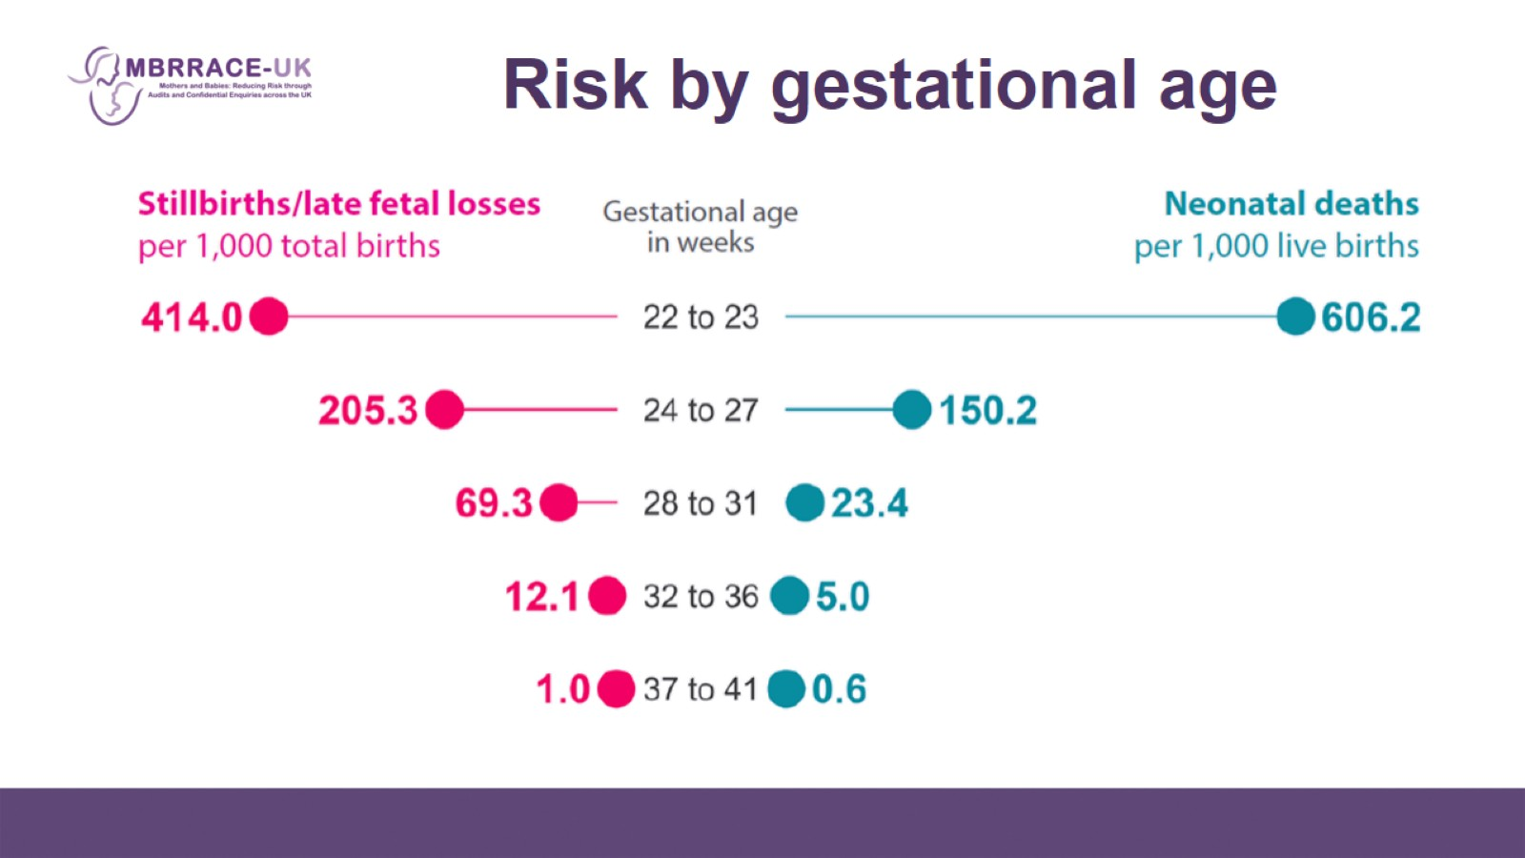
Risk by gestational age

Slide 10
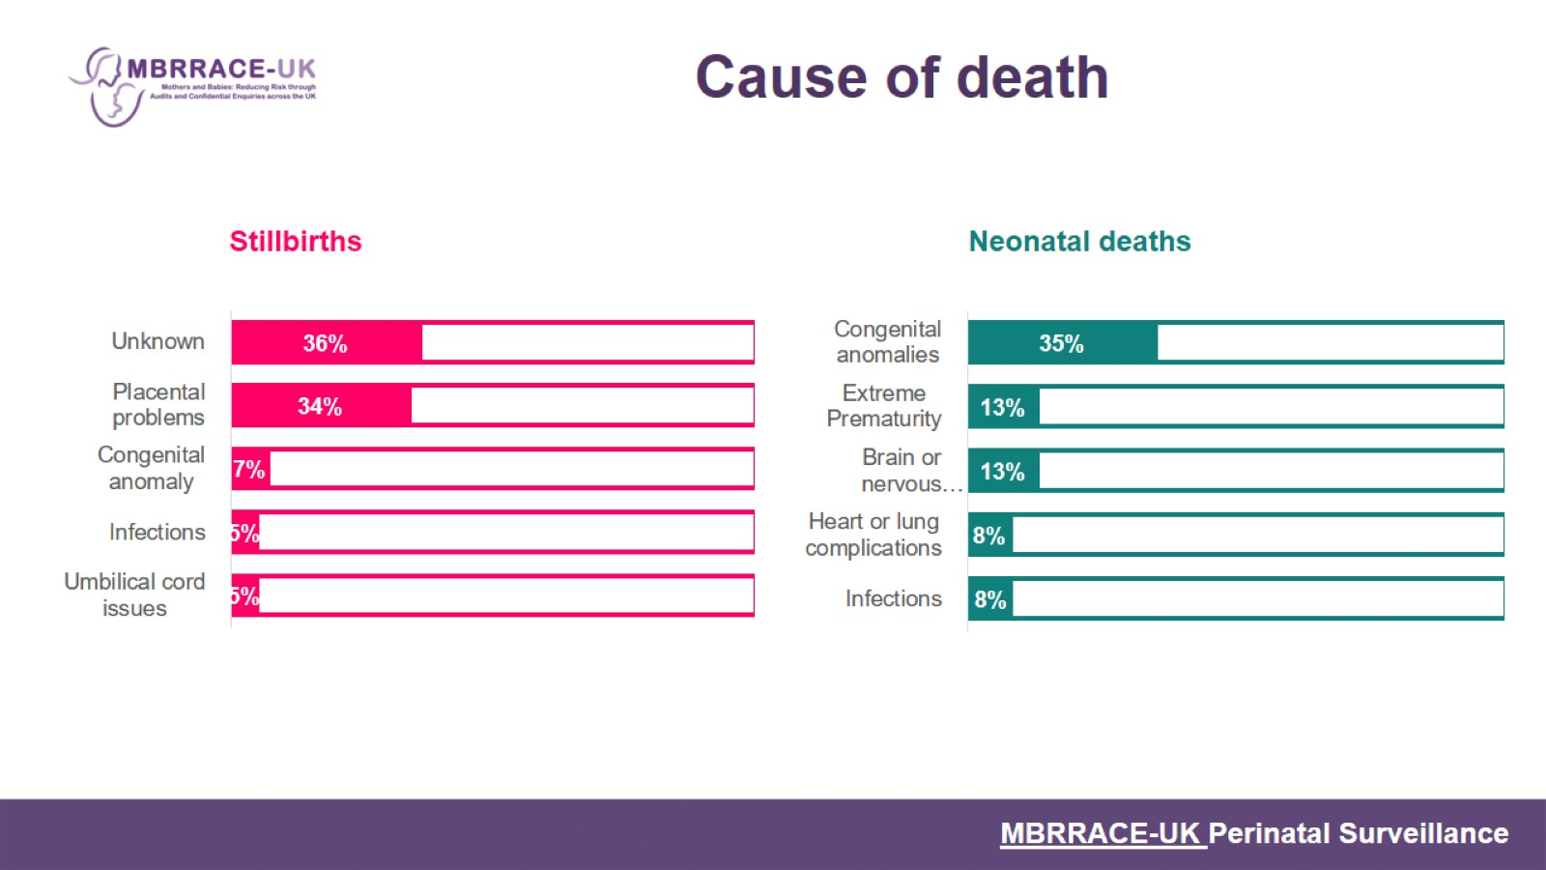
Cause of death

Slide 11

From surveillance data to information for action

Slide 12
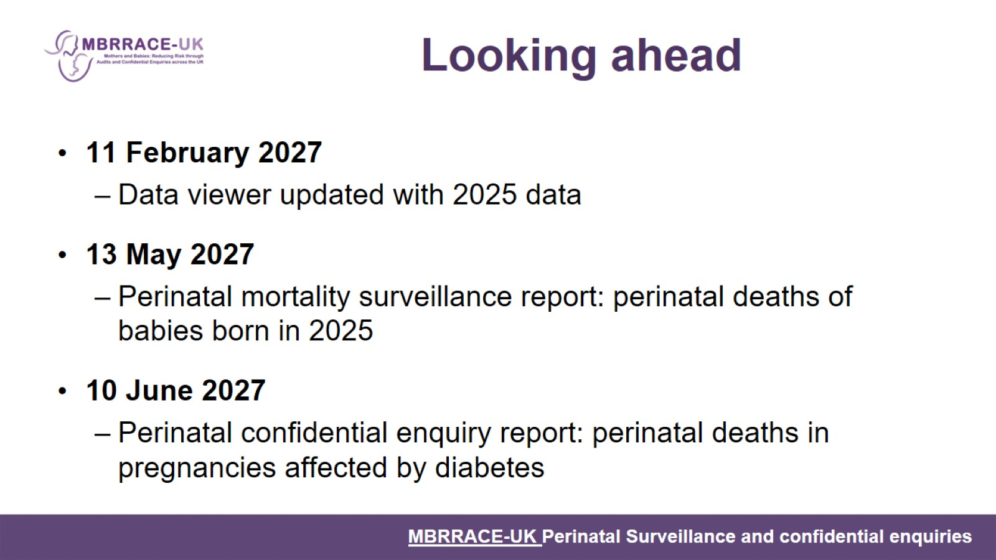
Looking ahead

