Slide 2
Overview

Slide 3
1. How quickly are deaths notified?

Slide 4
Who should notify the death?

Slide 6
What are the benchmarks?

Slide 8
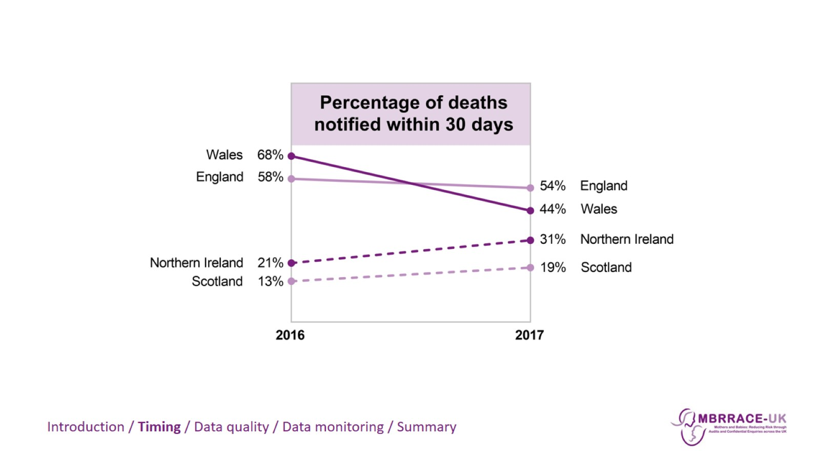

Slide 9
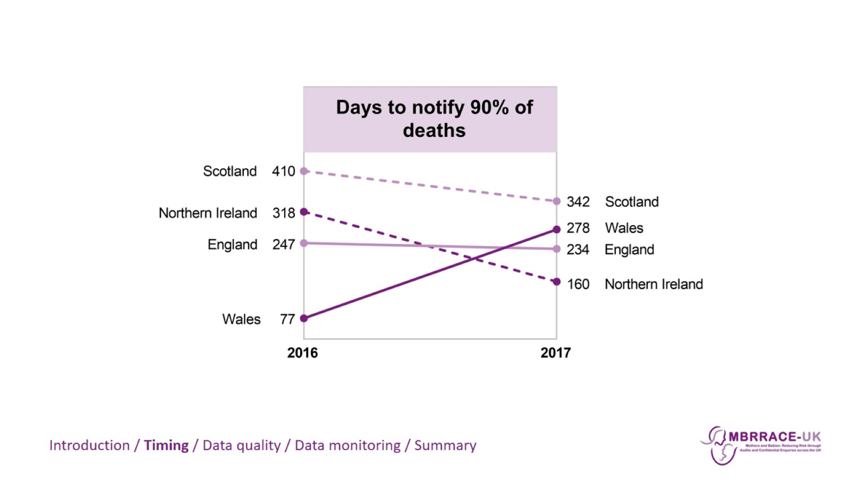

Slide 10
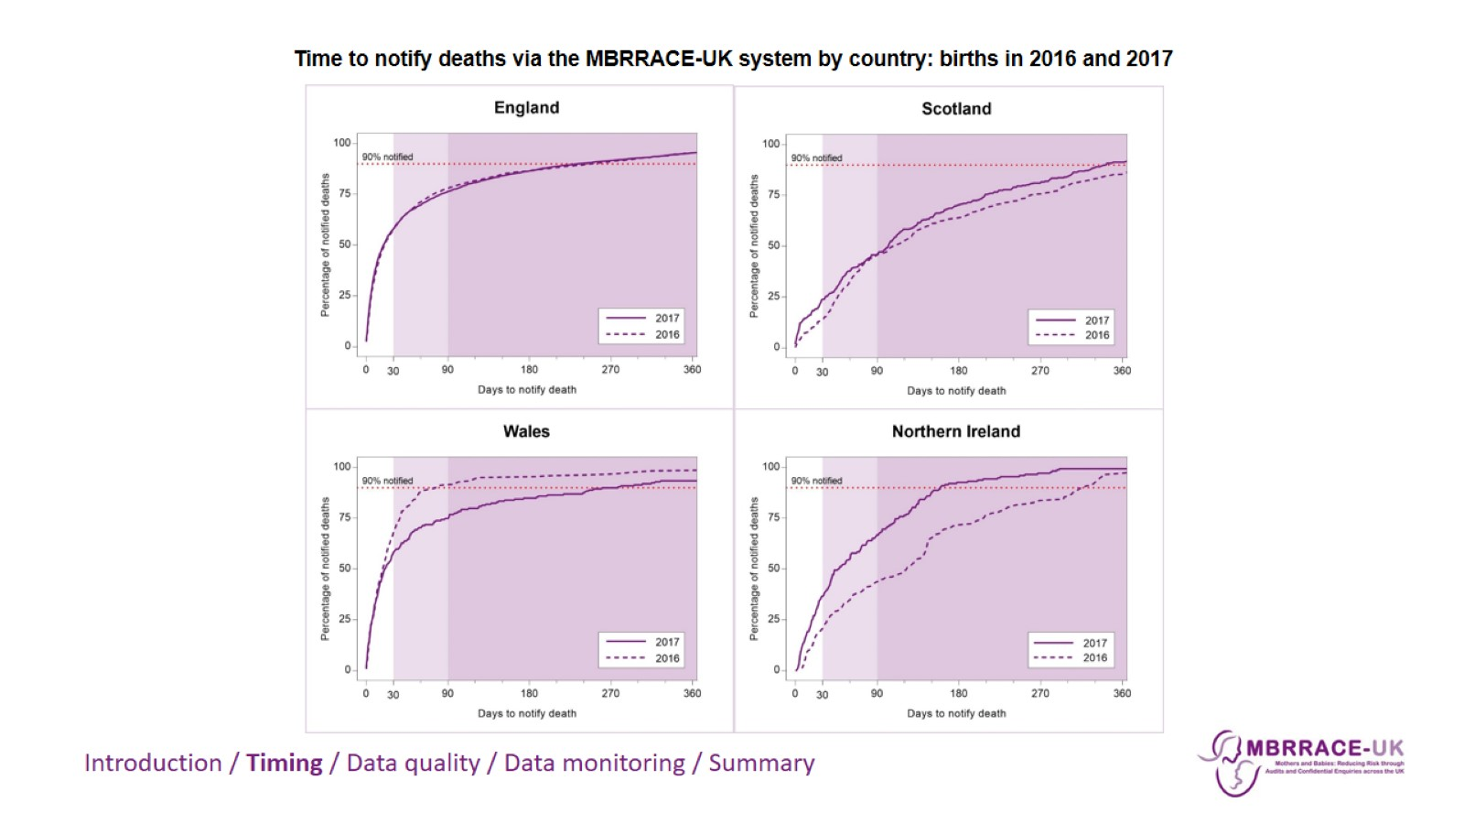

Slide 12
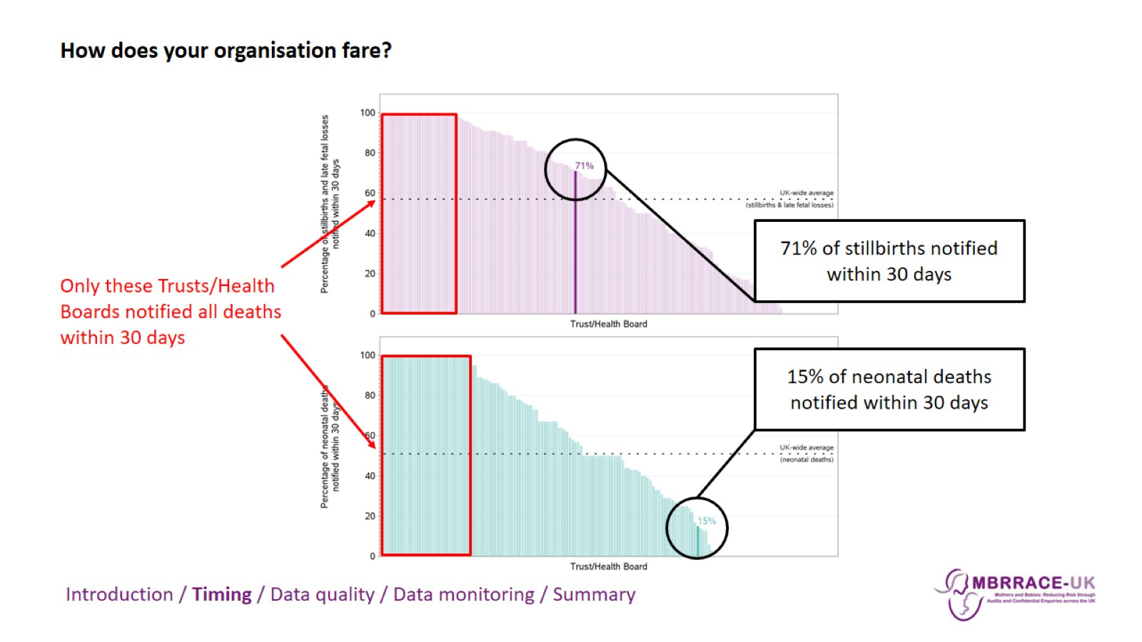

Slide 13
Incentives for notifying early

Slide 14
Incentives for notifying early

Slide 15
Incentives for notifying early

Slide 16
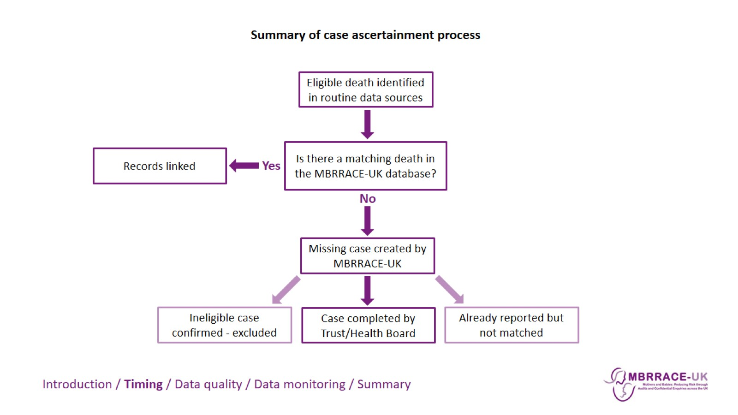

Slide 18
Incentives for notifying early

Slide 19
MBRRACE-UK recommendation:

Slide 21
2. What’s the quality of the data?

Slide 24
Completeness of key variables

Slide 26
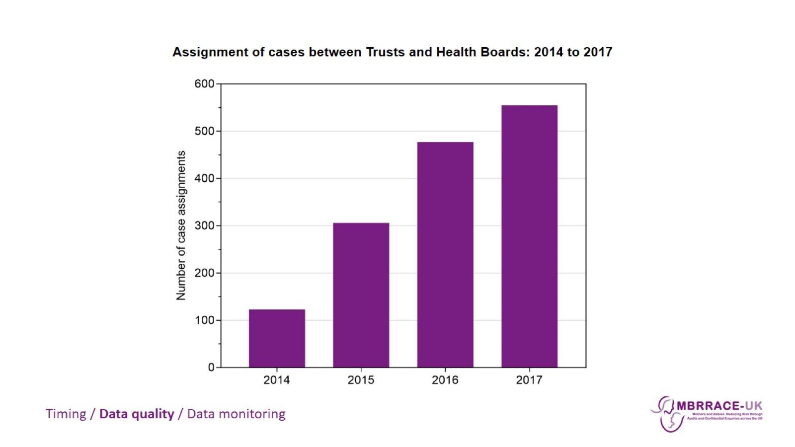

Slide 27
Why is data missing?

Slide 28
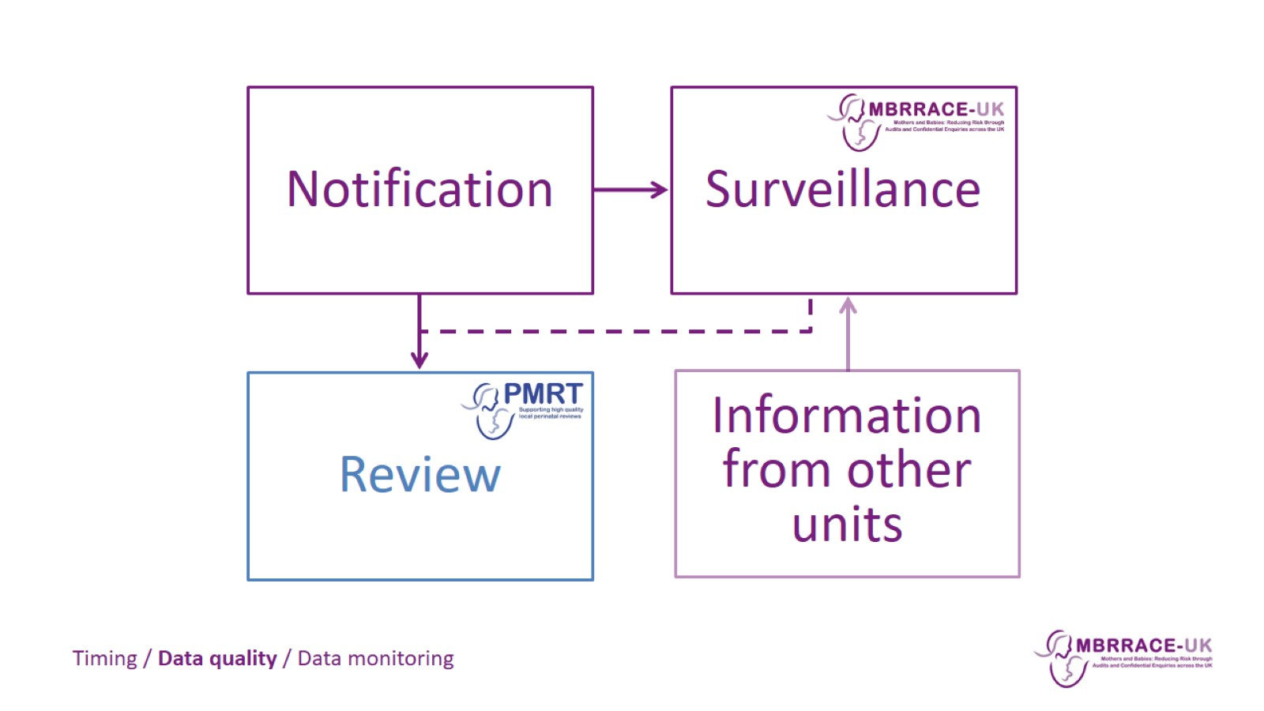

Slide 29
3. Why does it matter?

Slide 30
3. Why does it matter?

Slide 31
Real-time data monitoring

Slide 35
MBRRACE-UK recommendation

Slide 37
In summary…

Slide 38
We want to help!

Slide 40
MBRRACE-UK birthweight centiles calculator

Slide 42
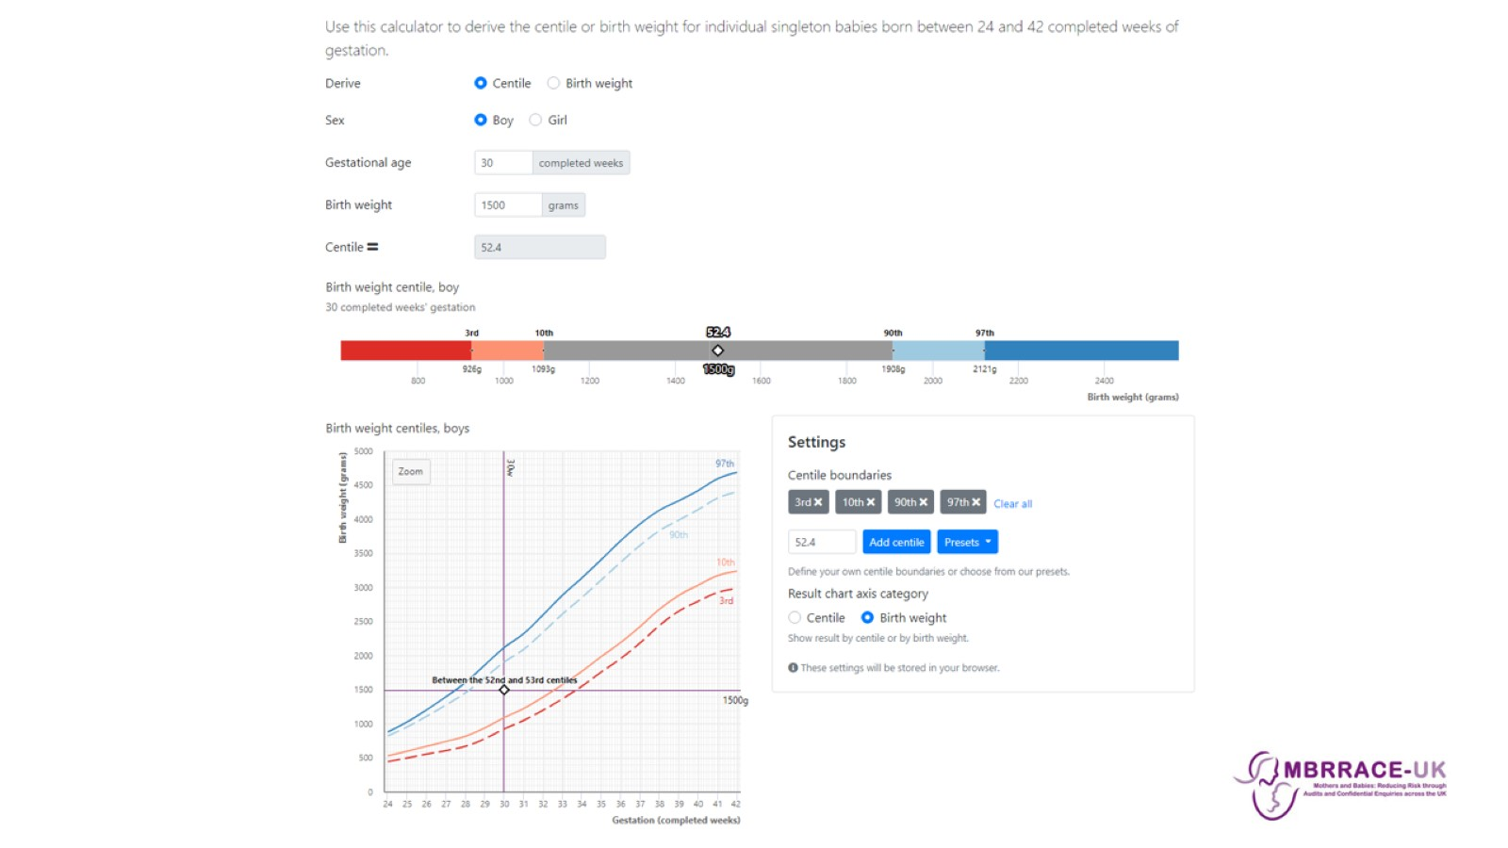

Slide 44
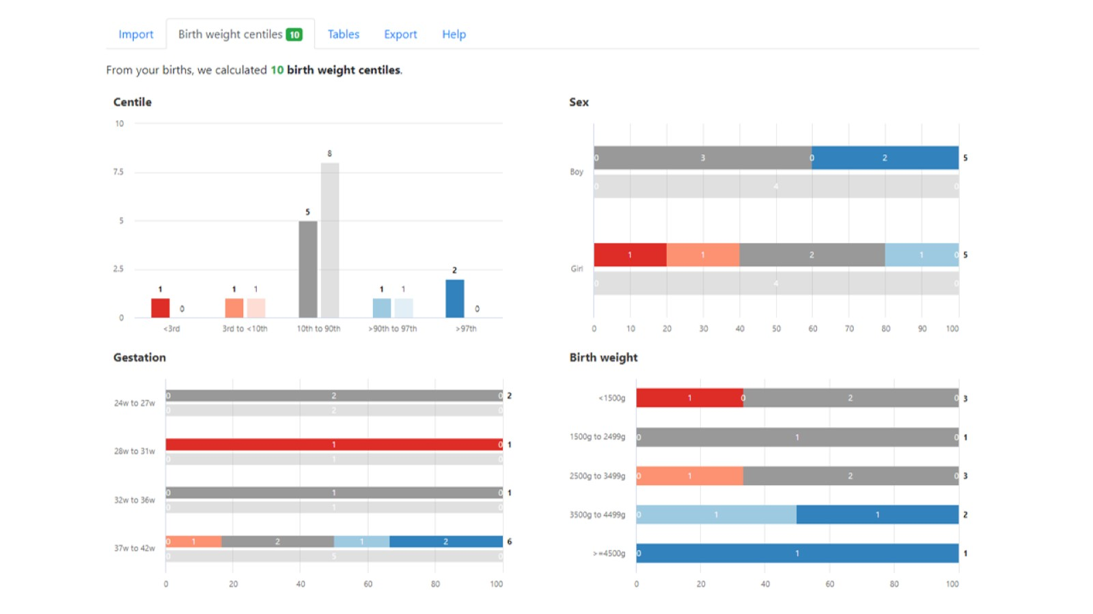

Slide 45
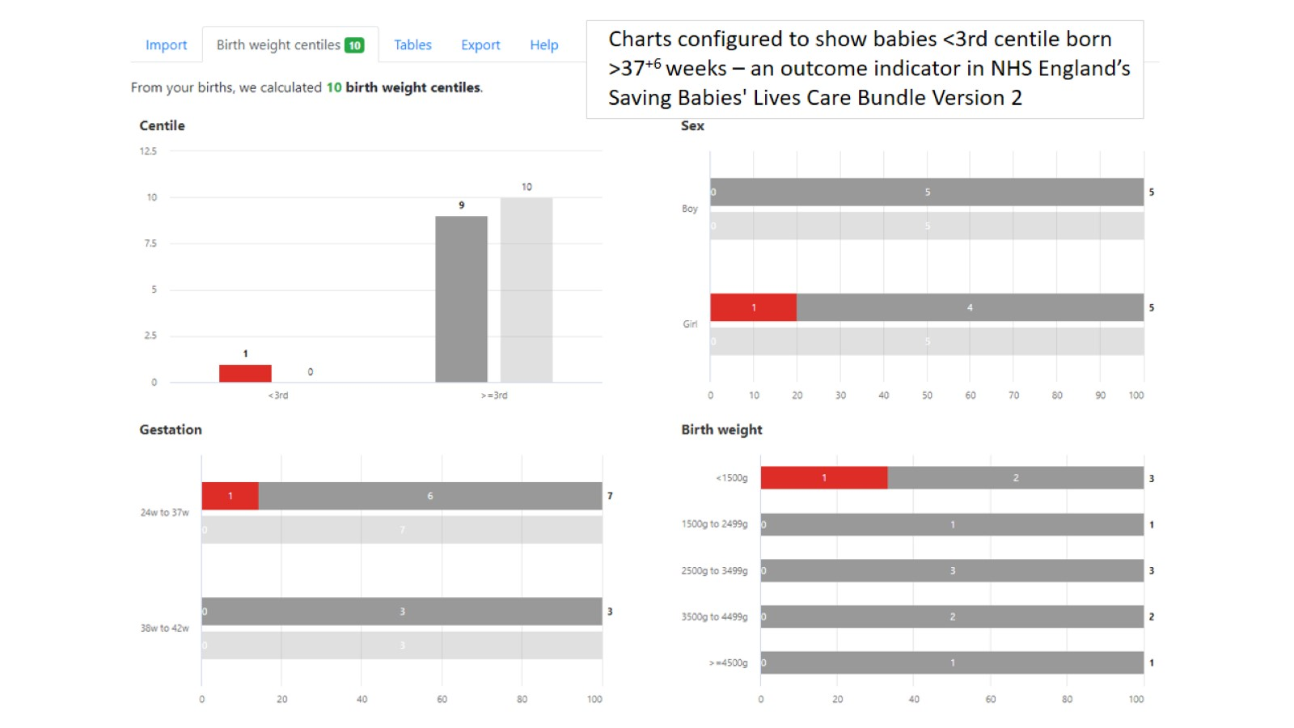

Slide 46
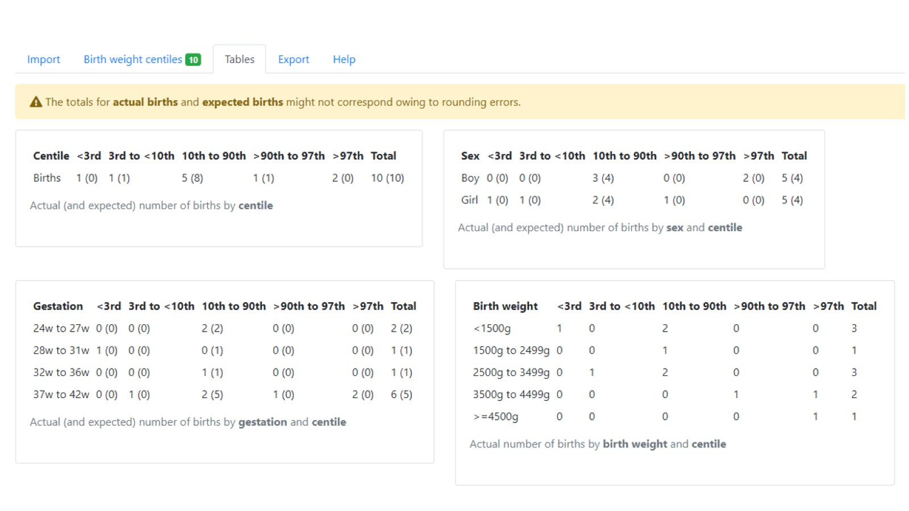

Slide 47
Call for confidential enquiry topics

