Slide 2
The PMRT – a tool designed to facilitate…

Slide 3
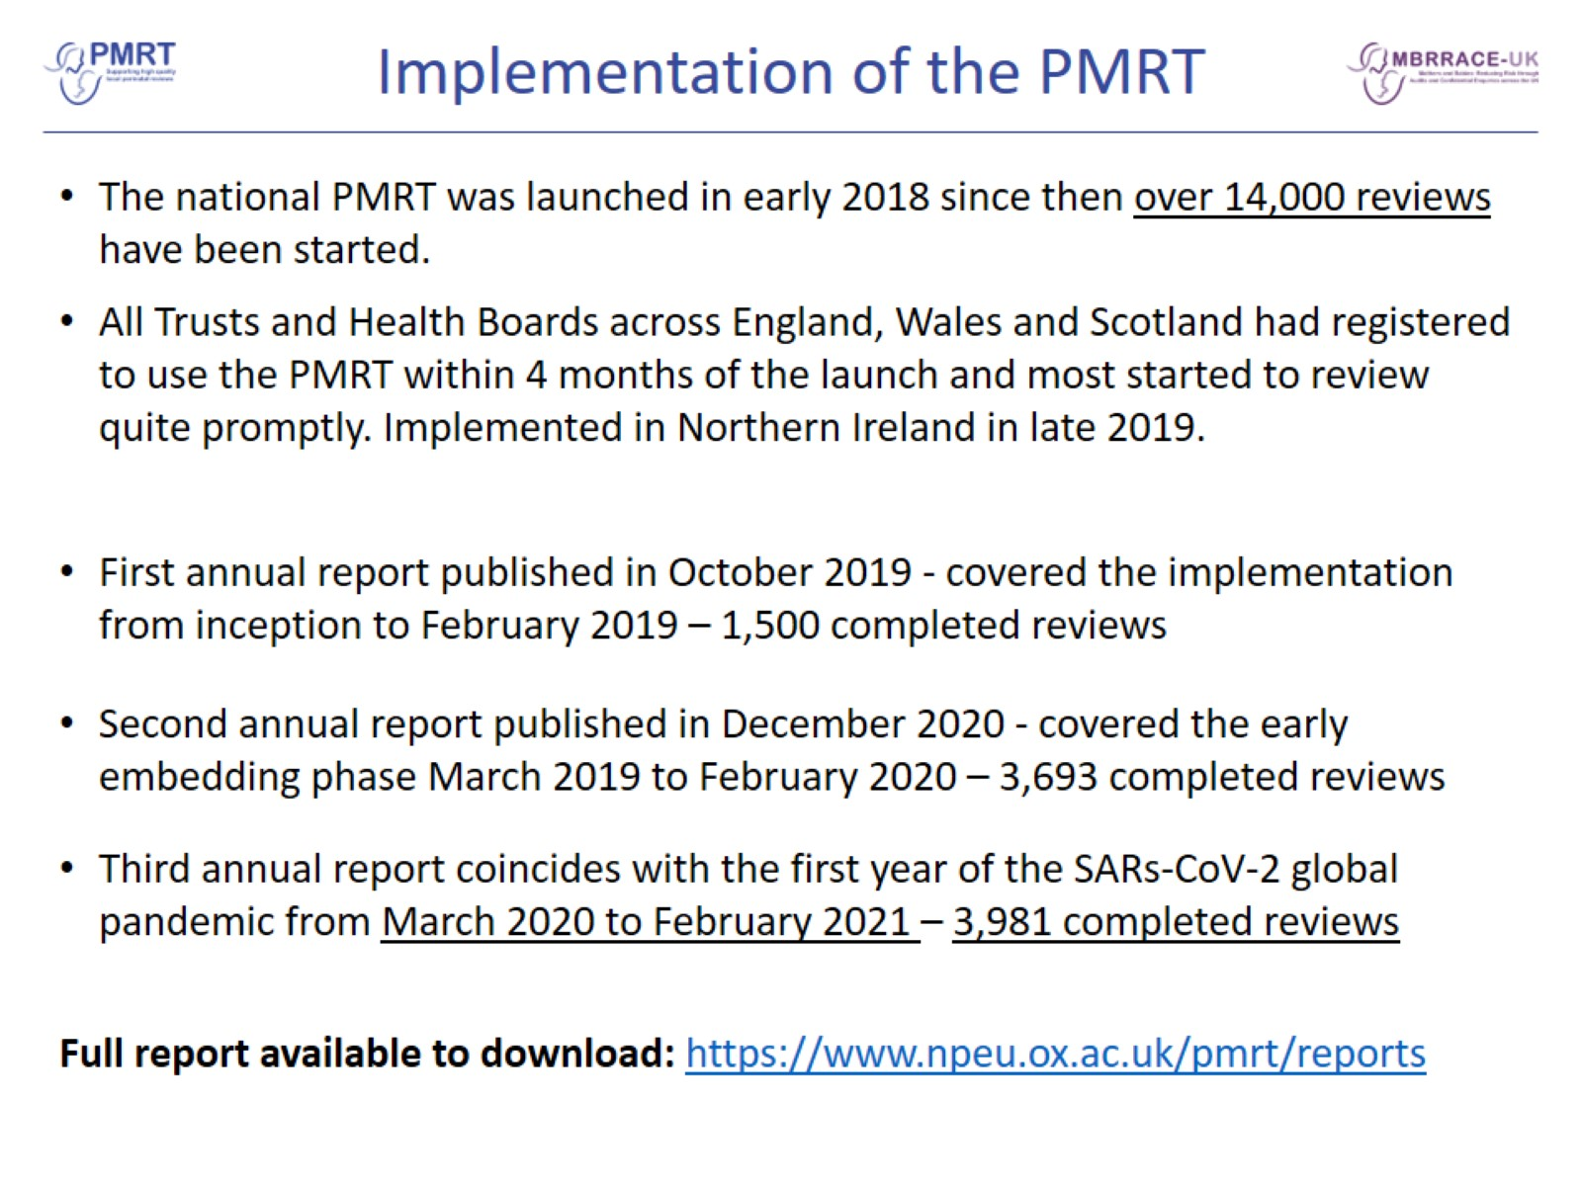
Implementation of the PMRT

Slide 4
Multi-disciplinary Review

Slide 5
Multi-disciplinary Review

Slide 6
Multi-disciplinary Review

Slide 7
Parent Engagement

Slide 8
Parent Engagement Improves the Quality of Review

Slide 10
Engaging Parents in Reviews

Slide 11
Issues with Care Identified

Slide 12
Issues with Care Identified

Slide 13
Antenatal Care Issues – relevant to the death

Slide 14
Intrapartum Care Issues – relevant to the death

Slide 15
Neonatal Care Issues with Documentation - relevant to the death

Slide 16
Neonatal Care Issues with Temperature Control - relevant to the death

Slide 17
Bereavement Care Issues

Slide 18
Impact of the SARS-CoV-2 global pandemic on care

Slide 19
Grading of Care

Slide 20
Grading of Care

Slide 21
Grading of Care

Slide 22
Grading of Care

Slide 23
Action plans in response to issues….

Slide 24
Action plans in response to issues….

Slide 25
Examples of action strength

Slide 26
Summary

Slide 27
Summary

Slide 28
Recommendations

Slide 29
Recommendations contd.

Slide 30
Acknowledgements

Slide 31
MBRRACE-UK/PMRT collaboration

Slide 32
PMRT tool development group members

